Slide 1
Project Excellence
Equipping colleagues with confidence
Zachery Jones | July 2026
©2026 CVS Health and/or one of its affiliates. Confidential and proprietary.
Notes:
TIME: 0:25
SCRIPT: Good afternoon. My capstone is Project Excellence, a working demonstration of point-of-need Photo training for colleagues. The idea is simple: when a colleague reaches a basic task they do not know, the instruction should already be available at that workstation. This presentation focuses on the system I built, the local need behind it, and the research that supports its design.
POSITIONING: This presentation focuses on the Photo training solution.
TRANSITION: To understand the solution, first consider where the training gap actually appears.

Slide 2
The knowledge gap appears during the task
Colleagues may understand their role but, still freeze when a specific Photo task appears.
RESEARCH EVIDENCE
Structured onboarding strengthens role clarity and self-efficacy.
Procedures are scattered or too dense to scan quickly.
Basic tasks become interruptions for experienced colleagues.
Those are two of the strongest drivers of successful new-hire adjustment.
Confidence depends on who is available to help.
Bauer et al., 2007 | Meta-analysis of 70 newcomer studies
Notes:
TIME: 0:50
SCRIPT: The problem is not that procedures do not exist. The problem is that they can be scattered, dense, or separated from the equipment. A new hire may understand the role overall and still freeze when a specific Photo task appears. Then a basic task becomes an interruption for an experienced colleague. Research helps explain why this matters. Bauer and colleagues combined 70 newcomer studies and found that role clarity and self-efficacy are two of the strongest drivers of successful new-hire adjustment. In practical terms, people adjust better when they understand what to do and believe they can do it. Project Excellence is designed to support both at the moment of need.
SOURCE: Bauer et al. (2007), https://pubmed.ncbi.nlm.nih.gov/17484552/
TRANSITION: I then checked whether this type of need was visible among colleagues at my own store.

Slide 3
Colleagues described a local training need
all respondents had 1–6 months of tenure
Some survey results based on my current store.
50%
75%
mostly figured procedures out themselves
ask for help daily or weekly
Average Photo confidence: 3.75 / 5
Average expected QR usefulness: 3.5 / 5
Design implication: support should be visual, fast to scan, and available without waiting for another person.
Source: Associate Confidence & Knowledge Survey, CVS Store 02876 (descriptive results only).
Notes:
TIME: 0:55
SCRIPT: I used a short pulse survey with four Front Store colleagues at CVS Store 02876, where I work. Every respondent had between one and six months of tenure. This is not a company-wide conclusion; it is a description of my store. Two of four said they mostly figured procedures out themselves. Three of four still ask for help daily or weekly. All four preferred visual or mixed-format support. Their average Photo confidence was 3.75 out of 5, while expected QR usefulness averaged 3.5. With only four responses, I am not claiming measured impact. I am using the results to define a local design need: support should be visual, quick to scan, and available without waiting for another person.
DATA: Photo confidence values 3, 3, 4, 5. QR usefulness values 3, 4, 4, 3.
TRANSITION: Those responses led to four specific design choices.

Slide 4
The solution was built around four design choices
1
2
3
4
At the workstation
One task per guide
One image per step
Basic scope
A QR code opens the exact training hub where the task happens.
The new hire chooses a basic task instead of searching a long module/Job-aid.
The visual matches the instruction currently being completed.
Guides focus on routine tasks and required materials.
WHAT RESEARCH ADDS
Arthur et al., 2003 2008
Training improves job knowledge, skills, and on-the-job performance.
Notes:
TIME: 1:00
SCRIPT: I built the solution around four choices. First, access begins at the workstation, so a QR code opens the exact training hub where the task happens. Second, each guide handles one basic task instead of making the colleague search a long manual. Third, each step shows one instruction and one matching image. Fourth, the scope stays focused on routine execution and required materials rather than troubleshooting. The research supports these choices. Arthur and colleagues found that training improves workplace behavior, not just knowledge test scores. Nguyen and Klein found that point-of-need electronic support improves procedural performance. Together, that evidence supports training that is both usable and physically close to the task. The design goal is to reduce reading, searching, remembering, and waiting.
SOURCES: Arthur et al. (2003), https://doi.org/10.1037/0021-9010.88.2.234 | Nguyen & Klein (2008), https://eric.ed.gov/?id=EJ822121
TRANSITION: The clearest way to see that design is to compare the original procedure with the finished guide.

Slide 5
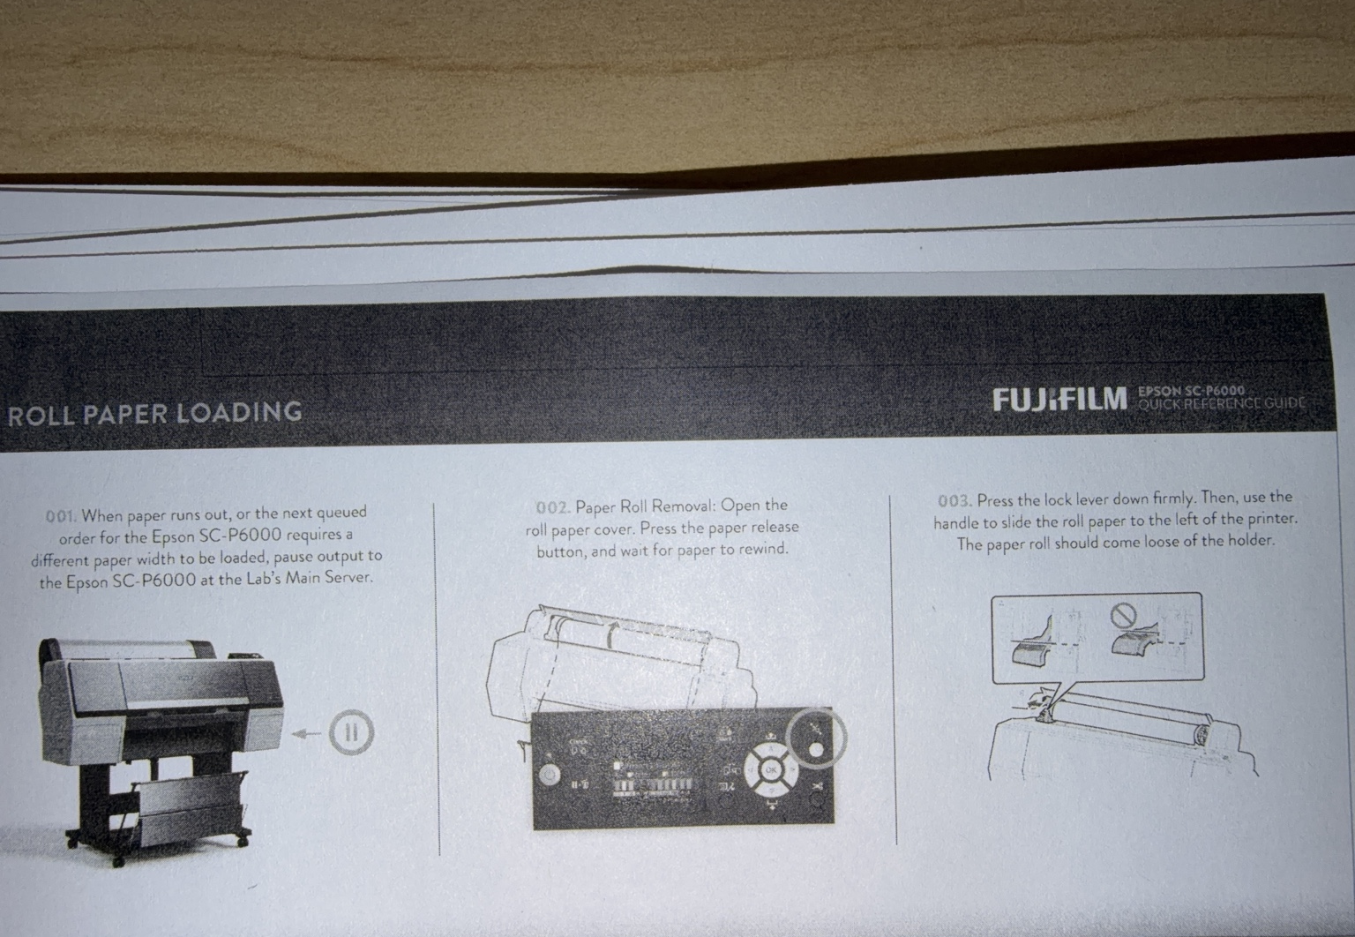
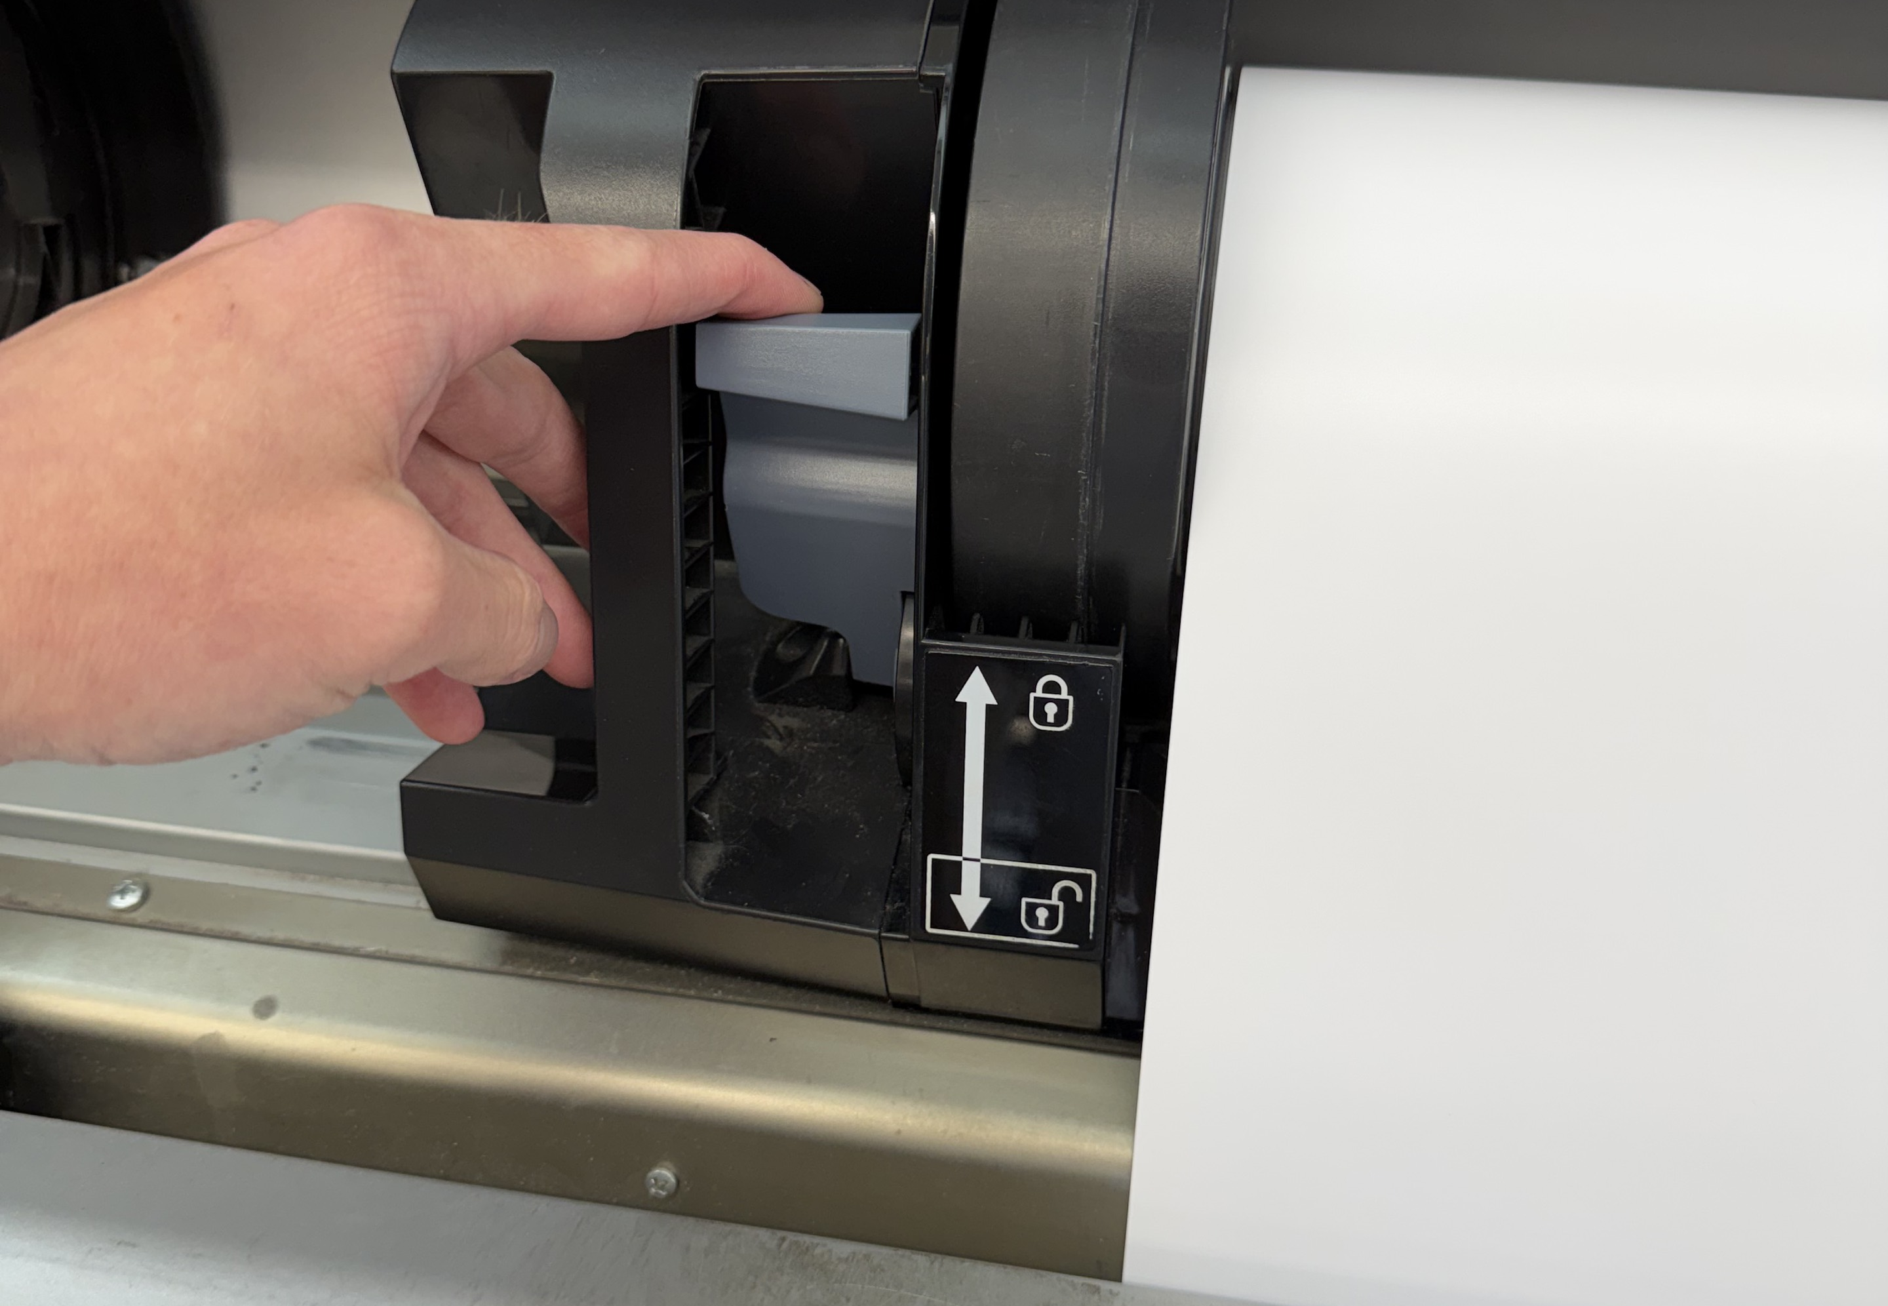
Raw procedures became usable, step-by-step guides
BEFORE
AFTER
STEP 1 Press the blue lock lever
Dense reference
One action + one visual
Notes:
TIME: 0:55
SCRIPT: This is a true before-and-after for the same Epson P6000 roll-paper task. On the left is the original procedure: useful source information, but dense and difficult to scan quickly while working. On the right is the first website step. The colleague sees one action—press the blue lock lever—and one approved in-store image showing exactly where that lever is. I did not discard the source procedure or invent a different sequence. I translated the existing instructions into smaller decisions. The website follows the original order while revealing only the step the colleague needs right now. That reduces cognitive load without removing the operational detail.
TRANSITION: The same principle also changes how quickly a colleague can reach the instruction.

Slide 6
QR guides shorten the path from question to action
The advantage is immediate access, not the QR code by itself
Traditional learning-module path
Project Excellence path
1
Log in
1
Scan at the workstation
2
Open the learning portal
3
Search for the module or video
2
Choose the task
4
Watch and remember
3
Follow the current step
5
Return to the workstation
RESEARCH EVIDENCE
Nguyen & Klein, 2008
Electronic point-of-need support improved procedural performance and completion time compared with training alone.
Notes:
TIME: 0:55
SCRIPT: The advantage is not the QR code by itself. The advantage is immediate access. In a traditional learning-module path, a colleague may need to log in, open the portal, search for the correct module or video, watch it, remember the steps, and return to the workstation. Project Excellence reduces that path to three actions: scan at the workstation, choose the task, and follow the current step. Nguyen and Klein compared training with electronic performance support and found better procedural performance and completion time when support was available during the task. That directly supports this access model. The guide does not replace formal learning. It closes the gap between learning something and successfully doing it in the moment.
SOURCE: Nguyen & Klein (2008), https://eric.ed.gov/?id=EJ822121
TRANSITION: Here is what that experience looks like in the working demonstration.

Slide 7
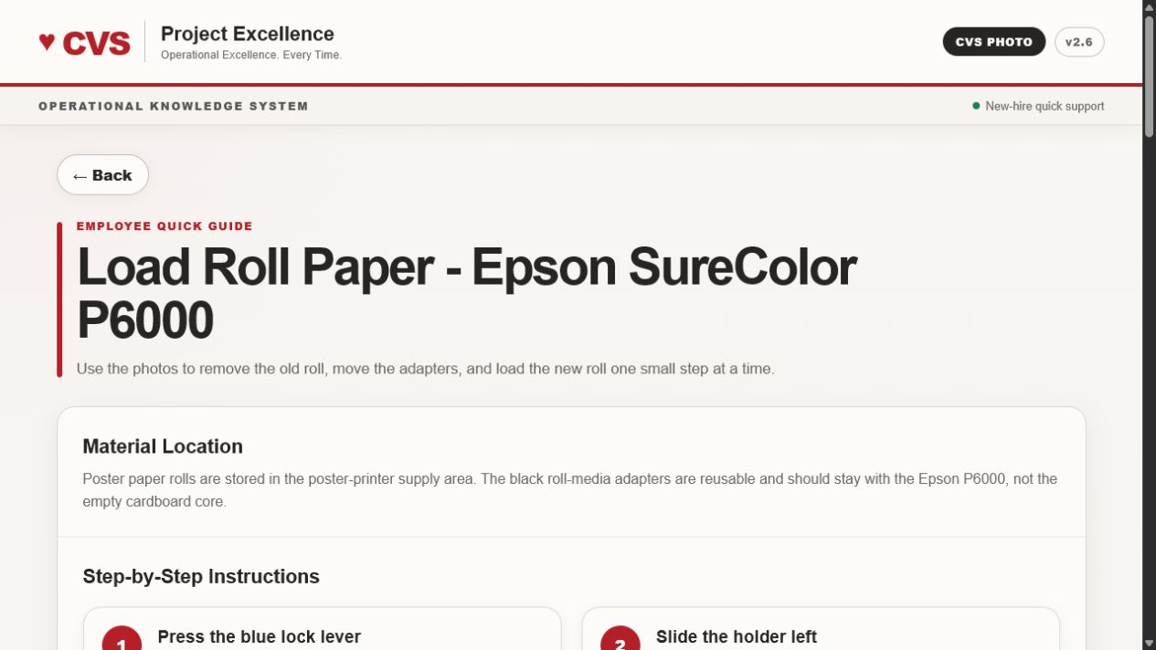
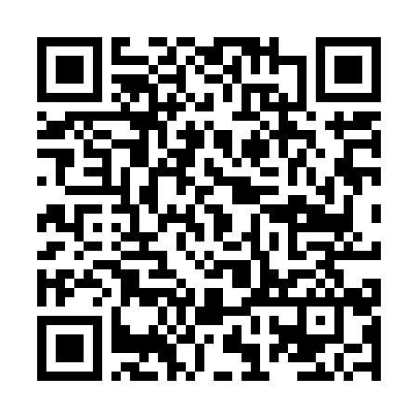
Working demonstration: scan, choose, follow
1
Scan the QR at the workstation
2
Choose the basic task
3
Complete one step at a time
zachjones04.github.io/project-excellence
Notes:
TIME: 2:20
SCRIPT: This is the working demonstration. The experience is intentionally simple: scan, choose, and follow. First, the colleague scans the QR code located at the workstation. That opens Project Excellence directly—there is no login screen and no need to search for the correct learning module. Second, the colleague chooses the workstation and the basic task. The site is organized around Main Photo, the Poster Printer, and the iPOS register, so the labels match the physical work area. Third, the colleague completes one step at a time. For this example, the Load Roll Paper guide identifies the material location and then presents the approved in-store image for each action. The first step shows the blue lock lever. The next step shows the holder moving left. The sequence continues through removing the old roll, preparing the new roll, feeding the paper, and verifying that the printer is ready. Every guide is designed for a phone, includes Back navigation, and keeps the current action visible. The system deliberately avoids troubleshooting and complicated exceptions. Its job is to help a new hire complete the routine task correctly and confidently without immediately stopping another colleague. That is the full value proposition: the instructions already existed, but Project Excellence makes them reachable and usable at the exact moment they are needed.
LIVE DEMO: If scanning is practical, scan the QR and briefly open Poster Printer > Load Roll Paper. Show the material location, Step 1 image, and Back navigation. Do not scroll through every step.
FALLBACK: If connectivity or projection prevents a live scan, point to the screenshot and narrate the same three actions. The presentation remains complete without live navigation.
TRANSITION: This demonstration represents the finished capstone deliverable; the next step would be measuring it in a limited pilot.
LIVE URL: https://zachjones04.github.io/project-excellence/#guide-load-paper

Slide 8
Training through inclusion
Clear instructions.
Visual support.
Confidence at the moment of need.
Questions?
Notes:
TIME: 0:50, then 2:00 Q&A
SCRIPT: Project Excellence is training through inclusion in a practical sense: essential knowledge is easier to reach and easier to use. It combines clear instructions, visual support, and confidence at the moment of need. The website is a working demonstration, not a completed impact study. The next phase would be a limited pilot measuring task completion time, requests for help, confidence before and after use, and guide completion. Today, the result is a functional training system built around a local need and supported by research. Thank you. I am ready for questions.
Q&A — WHY ONLY FOUR SURVEY RESPONSES? Answer: The survey is a local pulse from Store 02876, not proof of impact. Research supports the broader design, and a future pilot would collect stronger pre/post data.
Q&A — DOES THIS REPLACE CVS TRAINING? Answer: No. It supplements formal training with point-of-need support during routine work.
Q&A — WHY QR CODES? Answer: QR codes remove access steps and place the exact guide beside the workstation. The value is immediate access, not the code itself.
Q&A — HOW WOULD SUCCESS BE MEASURED? Answer: Compare completion time, help requests, confidence, guide completion, and basic-task accuracy before and after a limited pilot.
Q&A — HOW IS CONTENT KEPT ACCURATE? Answer: Guides are built from source procedures and approved in-store images; a designated owner would review them when procedures or equipment change.

