Slide 1
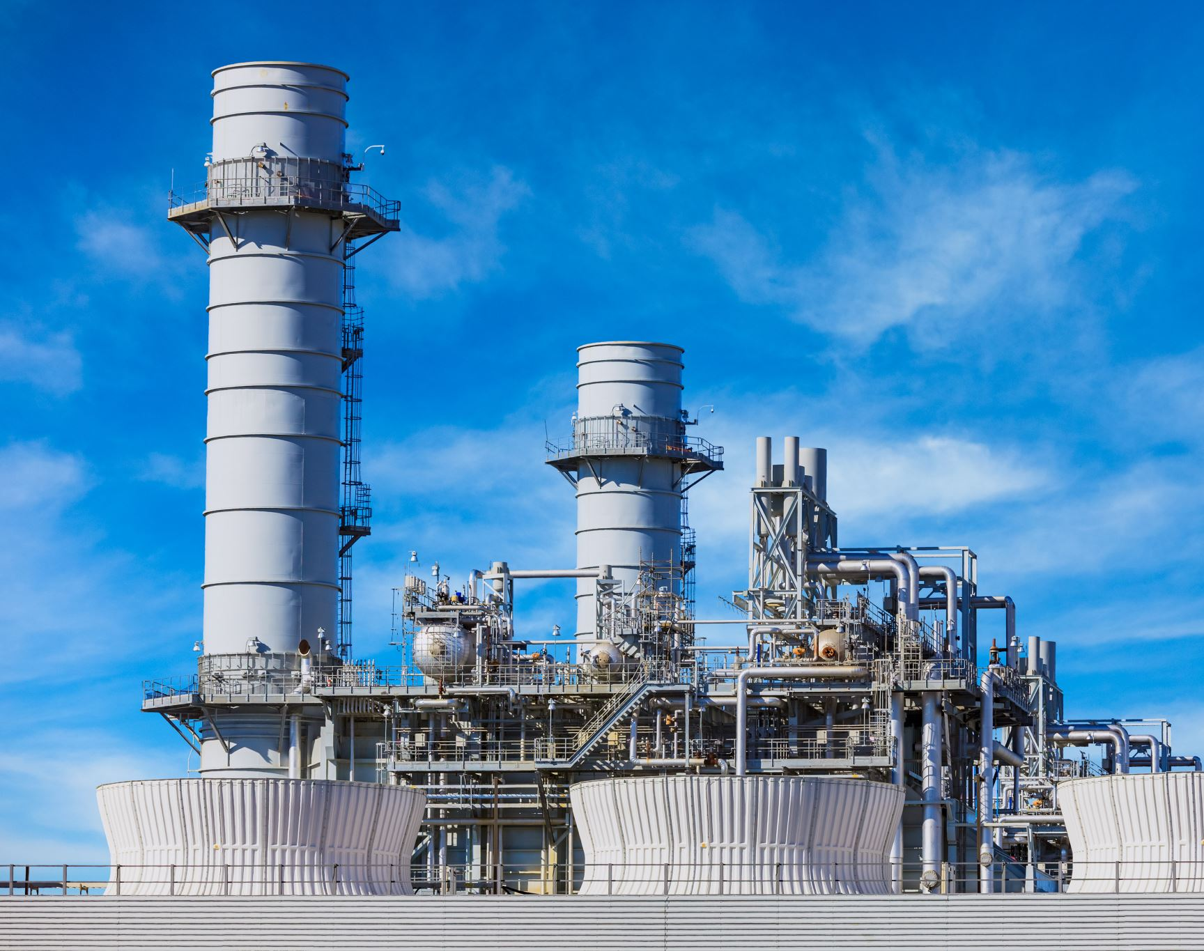
Power Plants affect on local fish size
Zachary Muller

Slide 2
Contents
Introduction
Theory Needed to carry out SLR
Validity with Math
Analysis of data
Conclusion

Slide 3
Introduction
Power plants effect on water
Waters effect on fish
Any relationship?

Slide 4

Introduction
Collected to determine if there is a causation
Passionate about nature and the environment

Slide 5

Theory needed for SLR

Slide 6
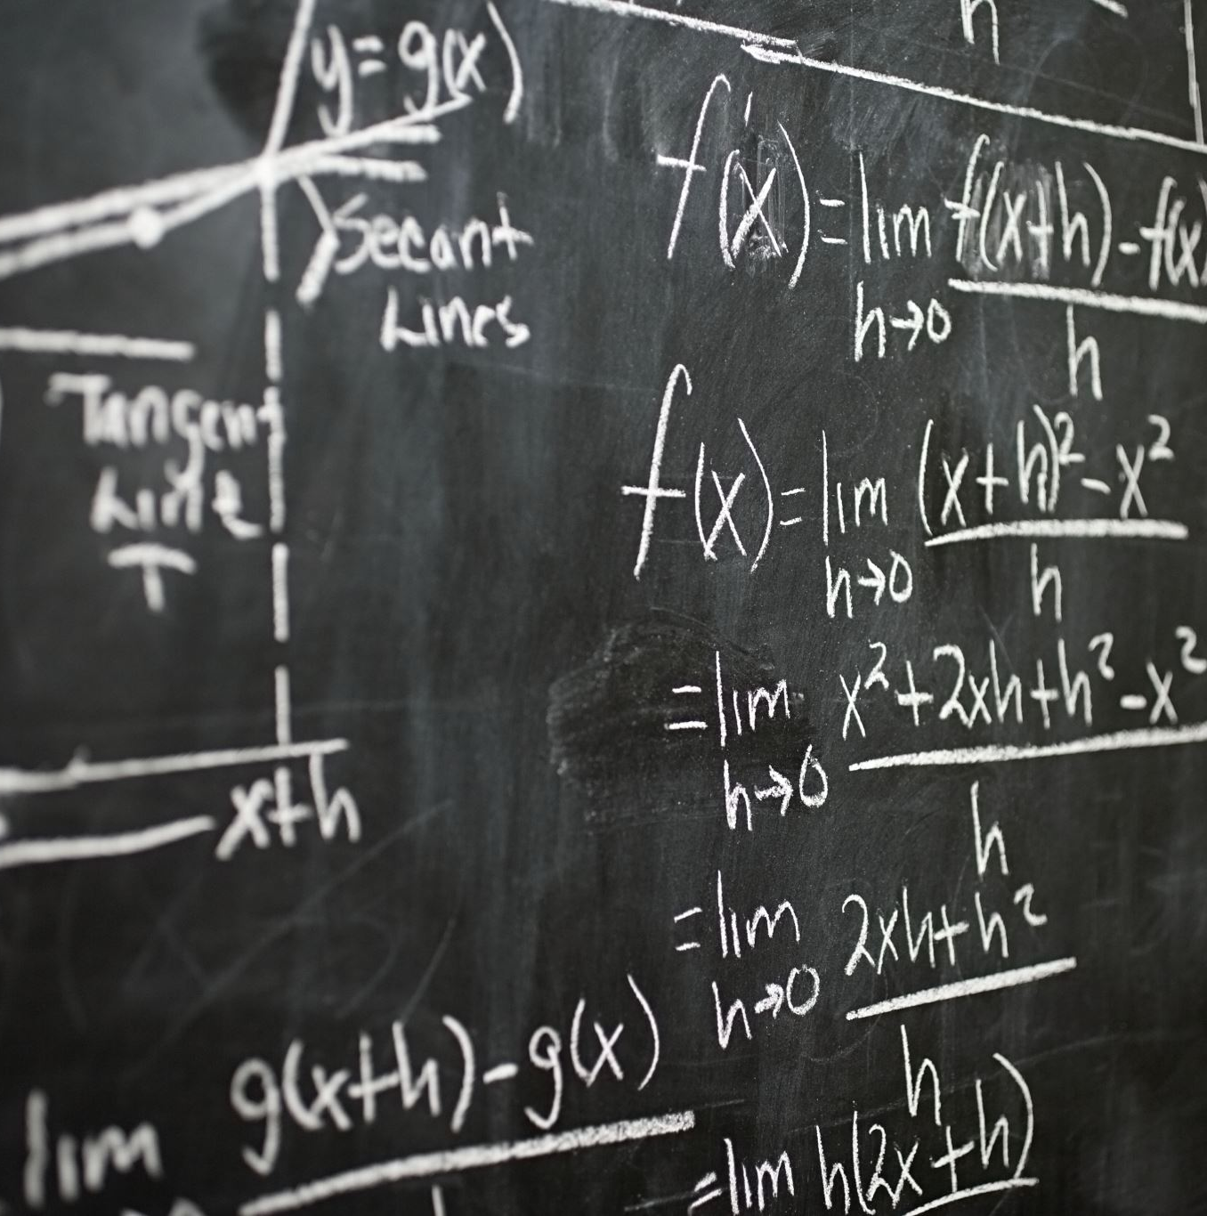
Theory: 3 assumptions
Linearity
Normality of errors
Mean of 0

Slide 7
Validity with Math
Using plots and graphs to validate our data
Notes:
Consider talking about:
Development of modern statistics

Slide 8
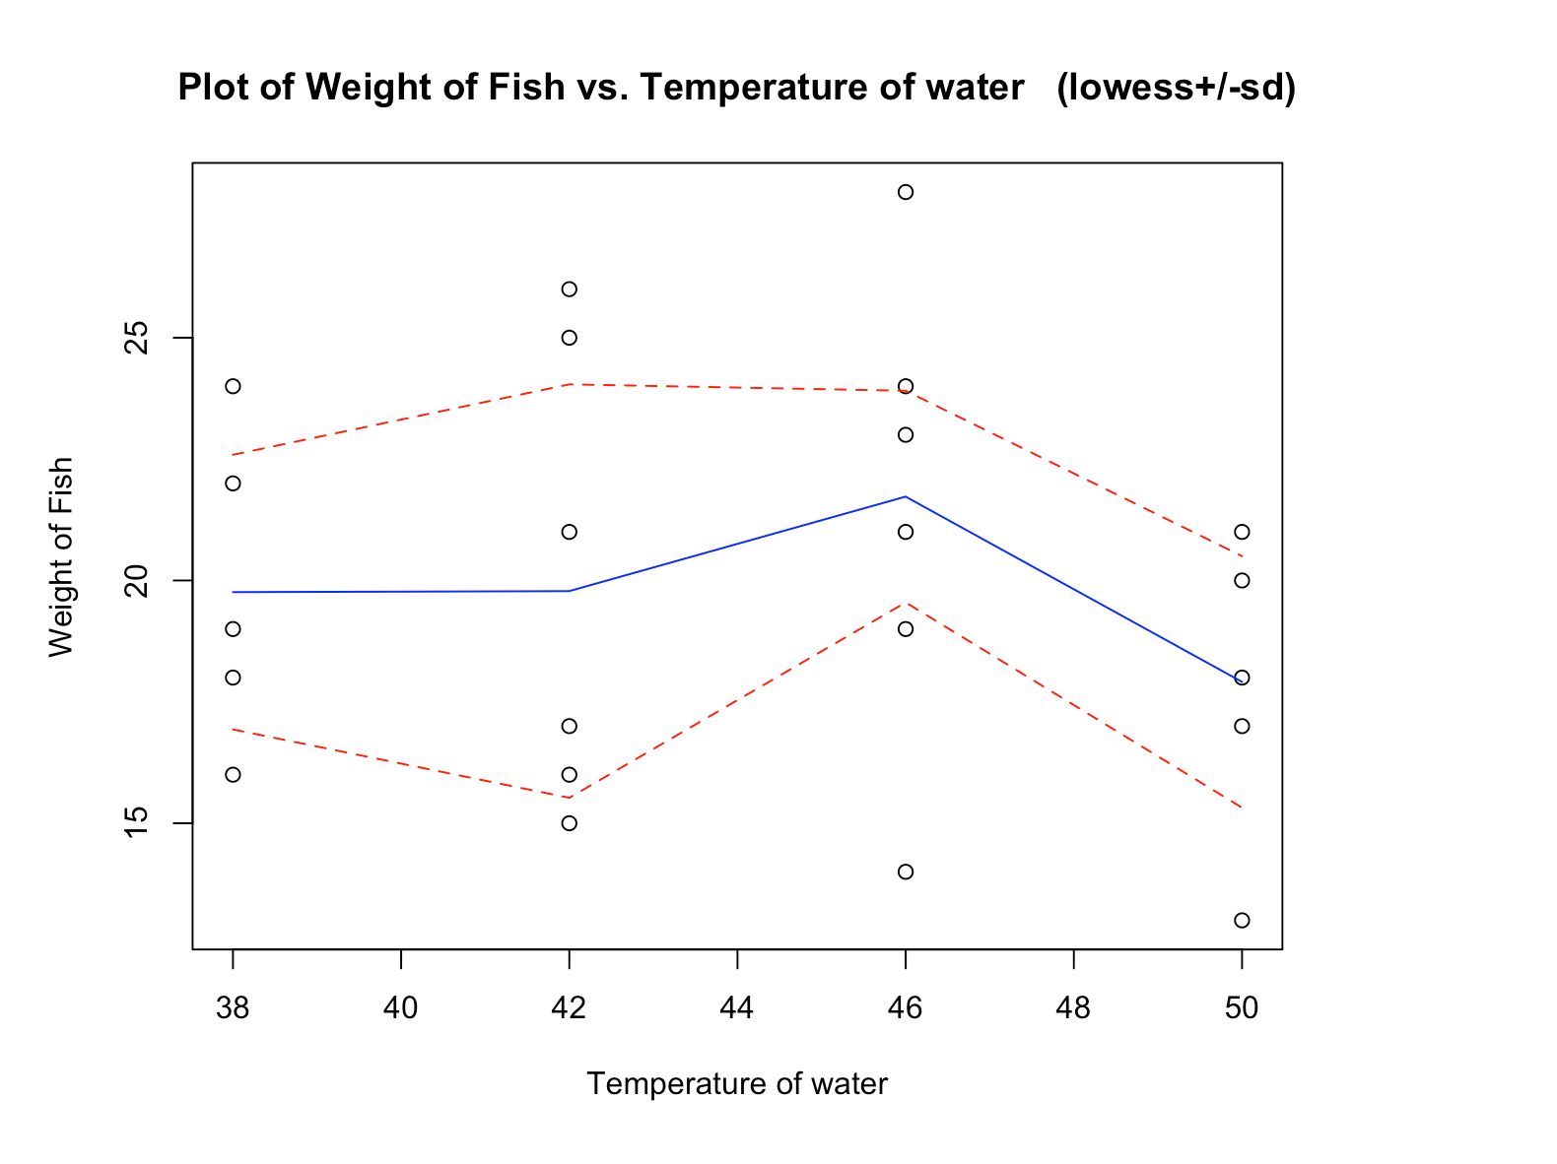

Slide 9
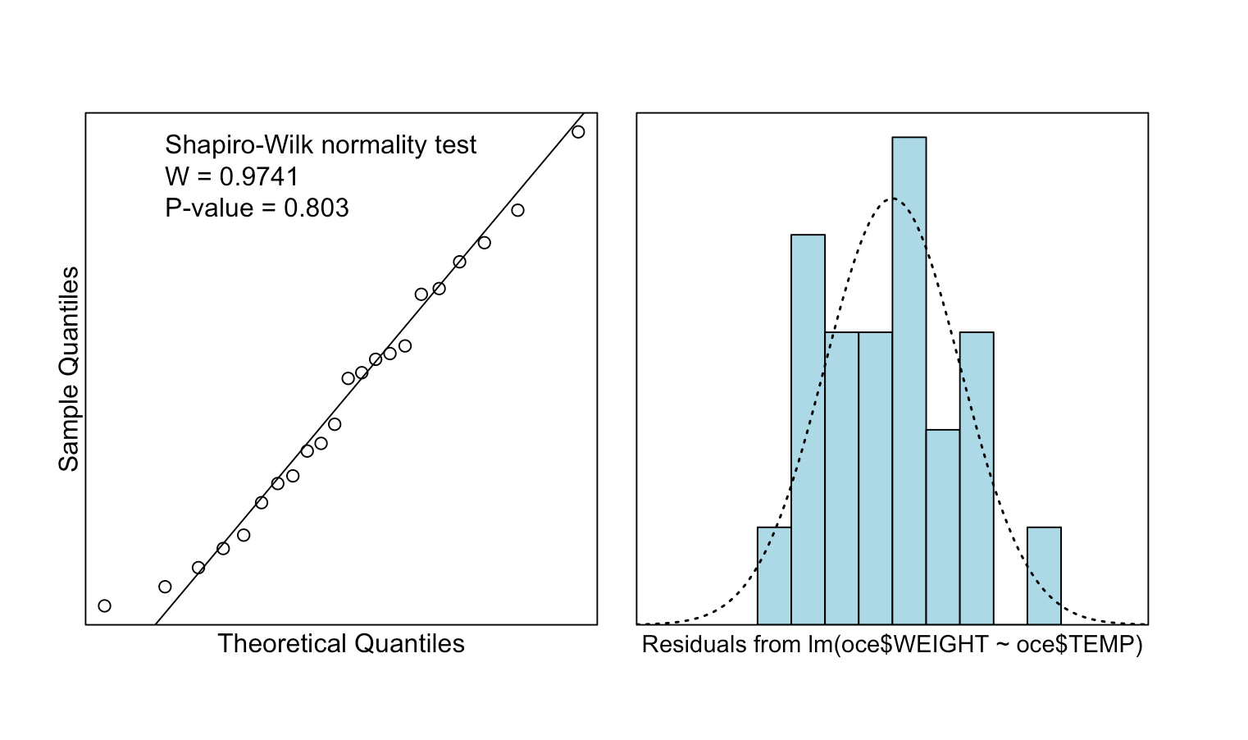
Normal Errors

Slide 10
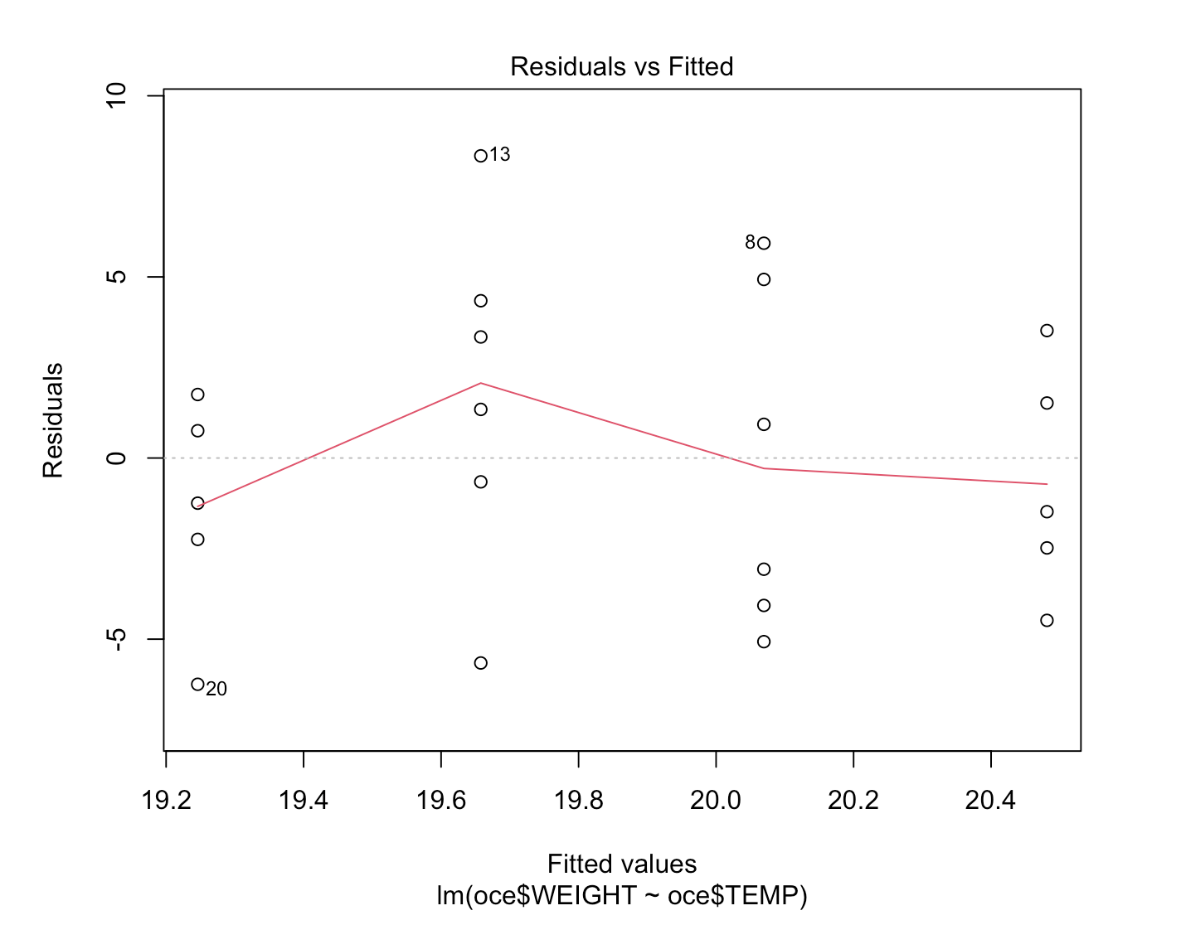

Slide 11
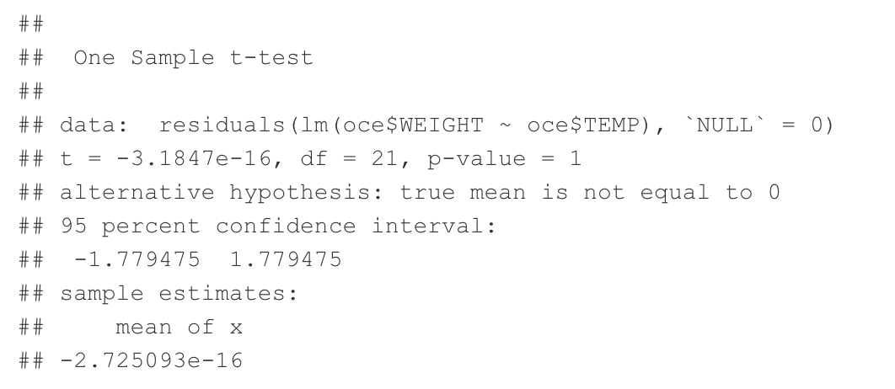

Slide 12
Analysis of Data

Slide 13
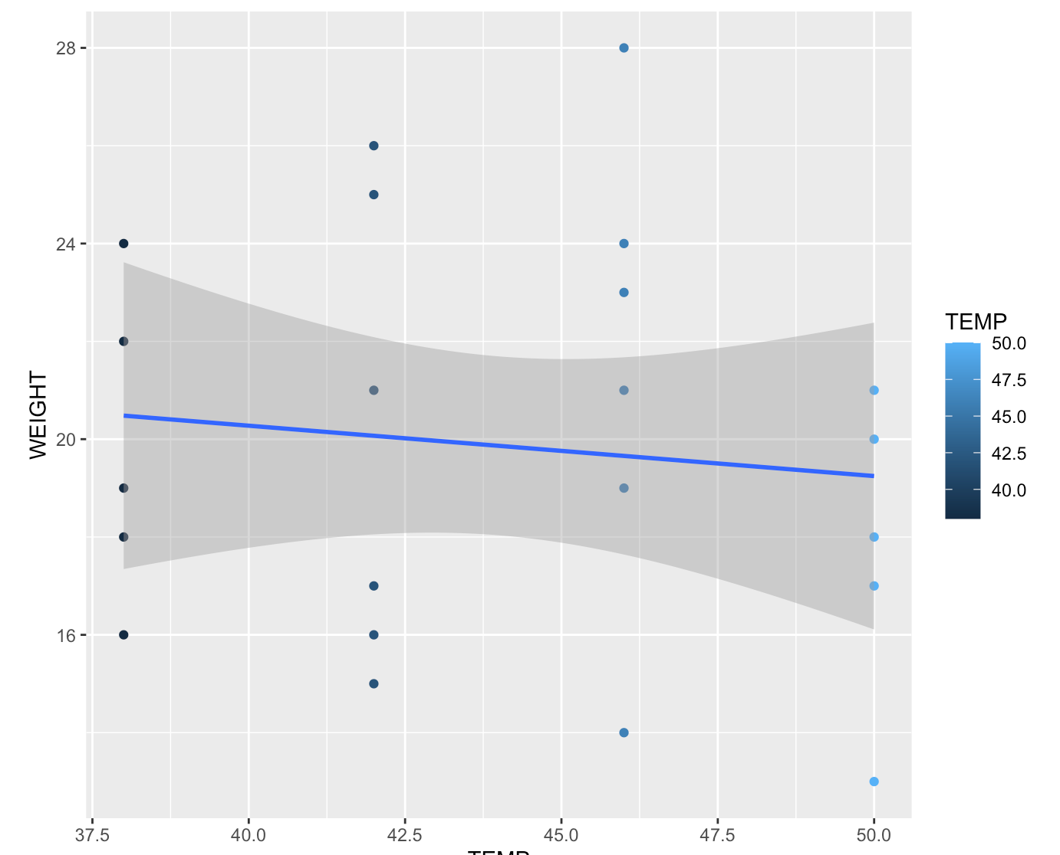

Slide 14
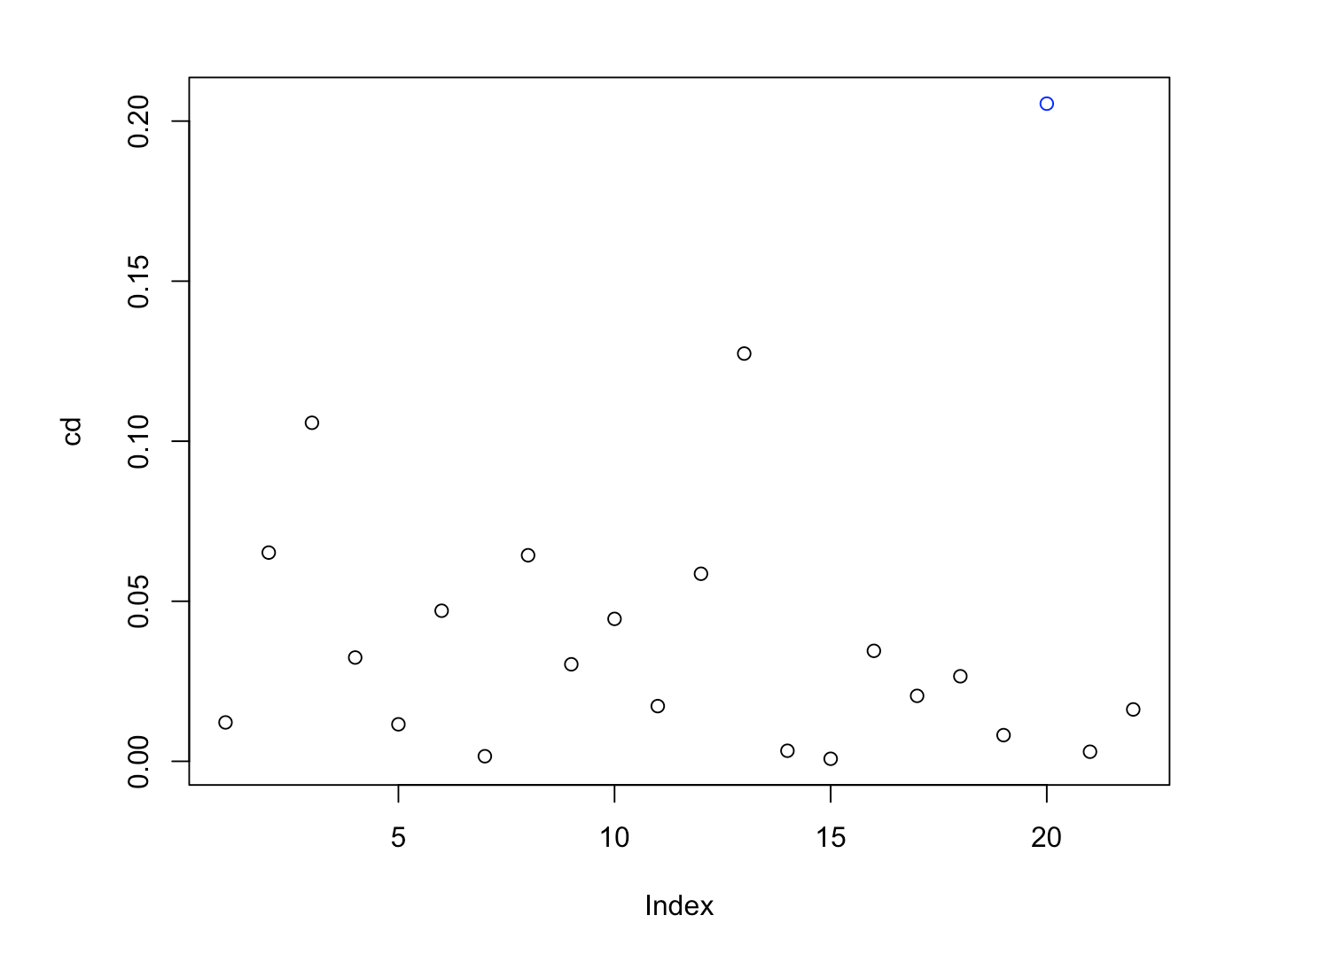

Slide 15
Conclude
Not enough data
Negative trend

