Slide 1



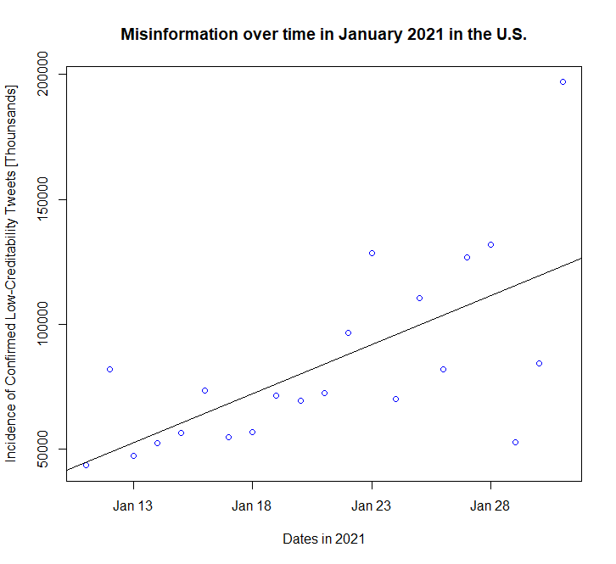
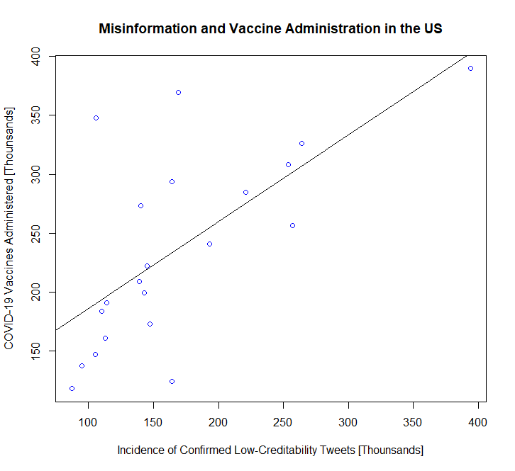

Impacts of Misinformation on
COVID-19 Vaccine Administration in the U.S.
Zachary Montoya, BS Department of Chemical and Biological Engineer, University of New Mexico
Andisheh Dadashi, M.S. Stat, Ph.D. Department of Computer Science, University of New Mexico
Introduction
SARS-COV-2 won’t be our last pandemic, but we can learn from it. What were the impacts of misinformation on this pandemic, specifically vaccine administration?
Results
Discussion
Administered vaccines increase over time and with increase in Tweet Misinformation.
VIF Values < 5 and close to 1, indicate non-multicollinearity between independent variables in multiple regression².
Tweet Misinformation Model coefficient has a p-value>0.05 and Dates has a p-value<0.05, indicating Date has a statistically significant effect in this model and Tweet Misinformation does not.
Methodology
11MM Tweets IDs were downloaded and hydrated from a database, CoVaxxy¹, designed to isolate vaccine related content using substrings and #Hastags.
The CDC aggregated data on daily vaccine distribution and administration per state.
Python algorithms were used to clean and assembly the data. R statistical programming language then was used to regression model and variable inflation test (VIF) the aggregated dataset.
Figure 1 - Low-Creditability Tweets in the US vs Administered Vaccines in the US.
Figure 2 - Low-Creditability Tweets in the US for January 2021.
Conclusion
In January of 2021, the US published tweets containing substrings related to COVID-19 sharing domains to unreliable sources did not have a statistically significant impact to vaccines administration in the US.
This could be due to early popularity of the vaccine, a small temporal sample duration, gaps in the dataset due to filtering, not accounting for other sources of misinformation, and fraction of the population without social media accounts.
Table 1 – Multiple Regression Model for Tweet Misinformation and Dates effects on Administered Vaccines in the US.
$$Y_{i}= β_{0}+β_{1}X_{i1}+{β_{2}X_{i2}+ε}_{i}$$
Multiple Regression Model
Term | Estimate Std. | Estimate Std. |  | Error | Error | t-value | VIF | P-value | P-value
Intercept | -1.746e+10 | -1.746e+10 |  | 6.754e+08 | 6.754e+08 | -25.854 | - | 1.10e-15 | 1.10e-15 ***
Confirmed Low-Credibility Tweets | 4.064e+00 | 4.064e+00 |  | 6.028e+00 | 6.028e+00 | 0.674 | 1.745916 | 5.09e-01 | 0.509
Dates | 1.085e+01 | 1.085e+01 |  | 4.194e-01 | 4.194e-01 | 25.866 | 1.745916 | 1.09e-15 | 1.09e-15 ***
α = 0.05 | Adjusted R-square: |  |  | 0.9837 |  | Multiple R-squared: |  |  | 0.9853
References
M. R. Deverna et al., “CoVaxxy: A Collection of English-Language Twitter Posts about COVID-19 Vaccines,” 2021
A. Alin, “Multicollinearity,” Wiley Interdiscip. Rev. Comput. Stat., vol. 2, no. 3, pp. 370–374, May 2010.
Acknowledgements
National Security Studies Program and Critical Technology Studies Program mentors for providing a plethora of opportunities and education.
University of New Mexico’s Chemical and Biological Engineering Department and Computer Science Department for providing unparallel counsel.
Further Information
Please feel free to email me
at zacharymontoya@unm.edu
or my mentor
at andisheh@unm.edu
for inquiries or discussions.

