Slide 1
TaskEngine
Zach Panter CS3210 Final Project

Slide 2
Personal Task-Management System
MySQL database
Git source control
TravisCI build tests
Ncurses GUI

Slide 3
MySQL Database
Hosted on DigitalOcean server in San Francisco
taskengine.io (138.68.40.47/phpmyadmin)
Three tables
Actionable
Reminder
Taskrepo
Clients can use guest credentials
user: teguest,
passw: guest

Slide 4
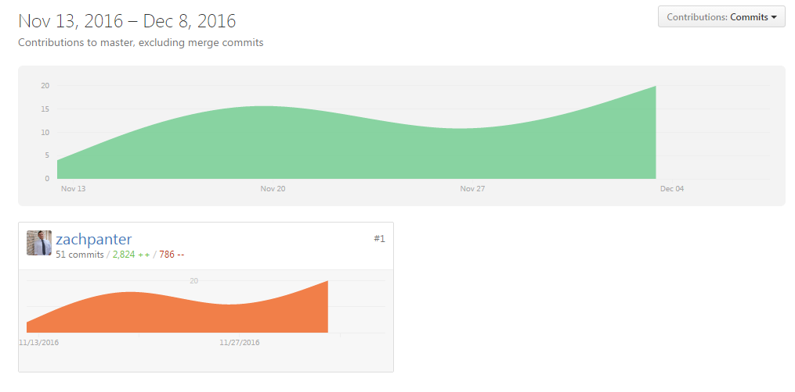
Git Source Control
https://github.com/zachpanter/taskengine_c

Slide 5
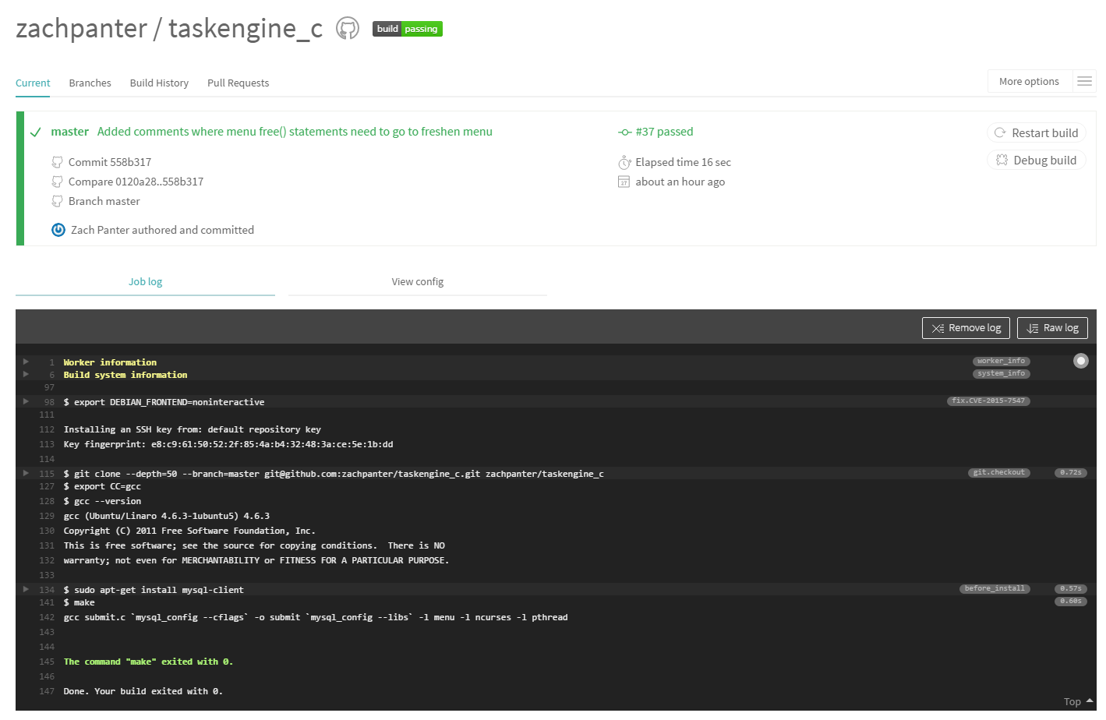
Travis CI (Continuous Integration)

Slide 6
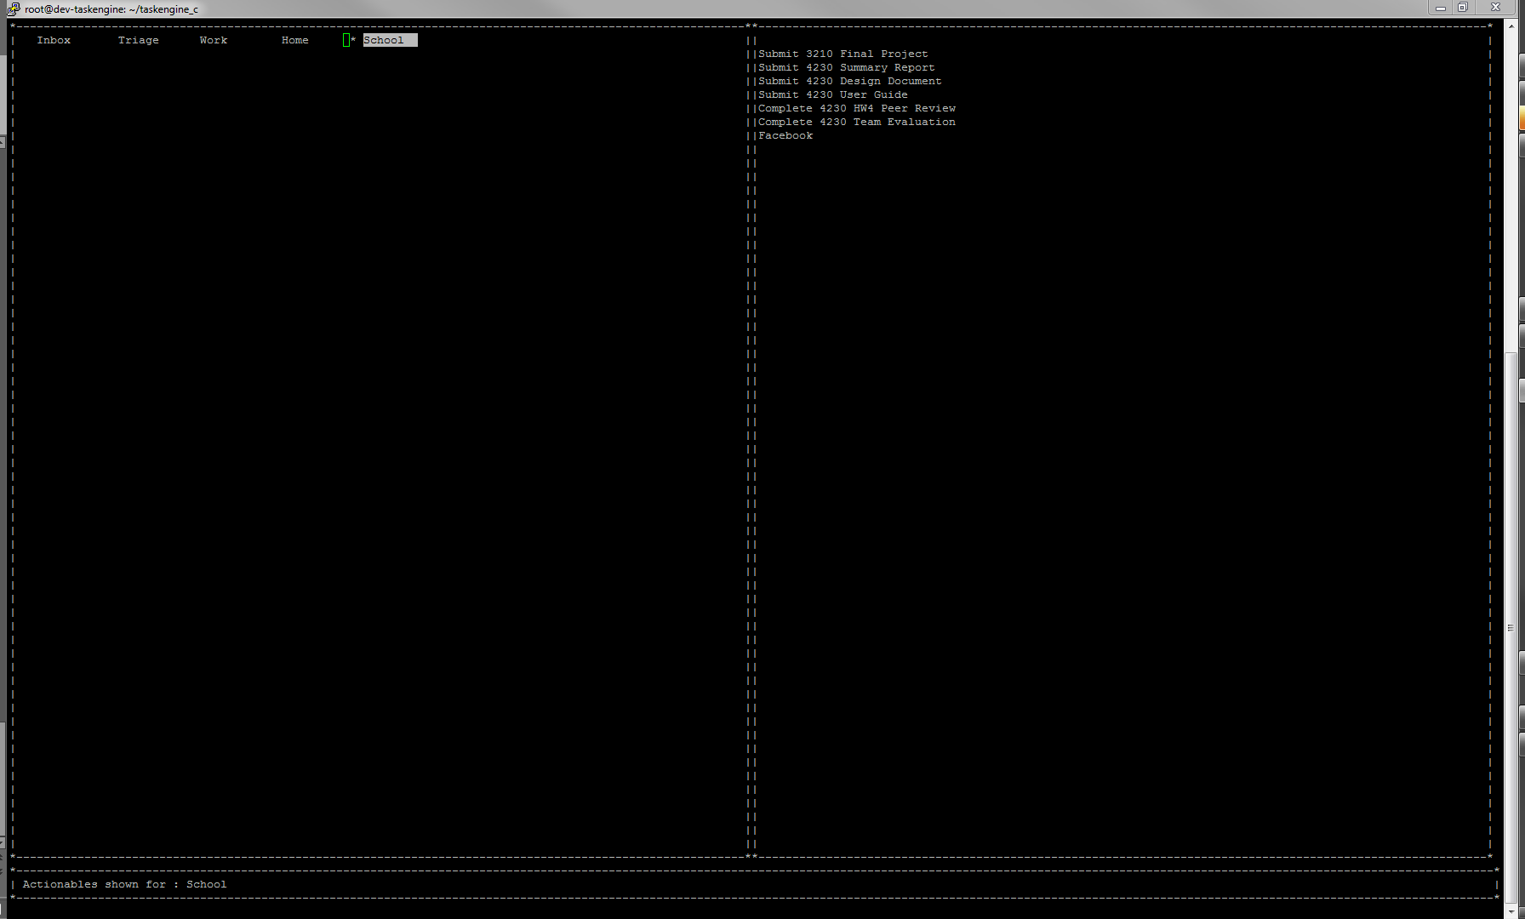
Ncurses GUI

Slide 7
Demo

Slide 8
Future Goals
Delete actionable functionality
Add taskrepo functionality
View, sort by due date
CRON jobs for reminders

Slide 9
References
http://tldp.org/HOWTO/NCURSES-Programming-HOWTO/menus.html
http://www.kitebird.com/mysql-book/chapters-5ed/ch07.pdf
Beginning Linux Programming (Matthew, Stones)
StackOverflow.com

