Slide 1
게임엔진2 제4주
블럭쌓기용 상자 생성하기
드론IoT시뮬레이션학부
담당교수 : 이형원
E304호, hwlee@inje.ac.kr

Slide 2
XR Grab Interactable
Version 2.2.0

Slide 3
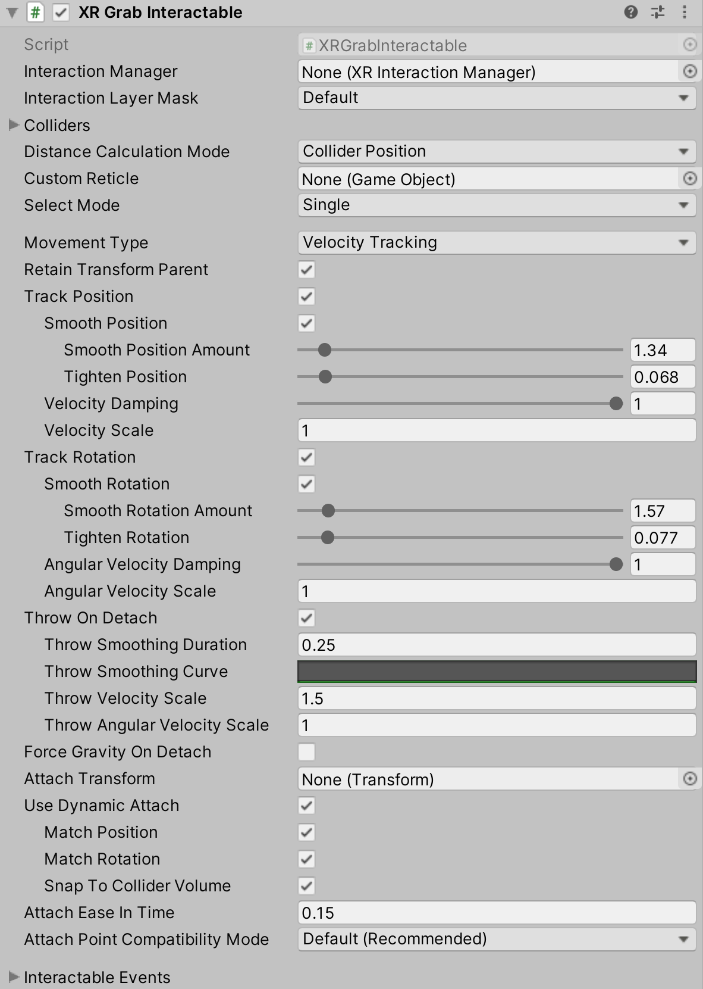
XR Grab Interactable | XR Interaction Toolkit | 2.2.0 (unity3d.com)

Slide 4
XR Grab Interactable | XR Interaction Toolkit | 2.2.0 (unity3d.com)
Property | Description
Interaction Manager | The XRInteractionManager that this Interactable will communicate with (will find one if None).
Interaction Layer Mask | Allows interaction with Interactors whose Interaction Layer Mask overlaps with any Layer in this Interaction Layer Mask.
Colliders | Colliders to use for interaction with this Interactable (if empty, will use any child Colliders).
Distance Calculation Mode | Specifies how distance is calculated to Interactors, from fastest to most accurate. If using Mesh Colliders, Collider Volume only works if the mesh is convex.
Transform Position | Calculates the distance using the Interactable's transform position. This option has low performance cost, but it may have low distance calculation accuracy for some objects.
Collider Position | Calculates the distance using the Interactable's Colliders list using the shortest distance to each. This option has moderate performance cost and should have moderate distance calculation accuracy for most objects.
Collider Volume | Calculates the distance using the Interactable's Colliders list using the shortest distance to the closest point of each (either on the surface or inside the Collider). This option has high performance cost but high distance calculation accuracy.
Custom Reticle | The reticle that appears at the end of the line when valid.
Select Mode | Indicates the selection policy of an Interactable. This controls how many Interactors can select this Interactable. The value is only read by the Interaction Manager when a selection attempt is made, so changing this value from Multiple to Single will not cause selections to be exited.
Single | Set Select Mode to Single to prevent additional simultaneous selections from more than one Interactor at a time.
Multiple | Set Select Mode to Multiple to allow simultaneous selections on the Interactable from multiple Interactors.

Slide 5
Movement Type | Specifies how this object moves when selected, either through setting the velocity of the Rigidbody, moving the kinematic Rigidbody during Fixed Update, or by directly updating the Transform each frame.
Velocity Tracking | Set Movement Type to Velocity Tracking to move the Interactable object by setting the velocity and angular velocity of the Rigidbody. Use this if you don't want the object to be able to move through other Colliders without a Rigidbody as it follows the Interactor, however with the tradeoff that it can appear to lag behind and not move as smoothly as Instantaneous.
Kinematic | Set Movement Type to Kinematic to move the Interactable object by moving the kinematic Rigidbody towards the target position and orientation. Use this if you want to keep the visual representation synchronized to match its Physics state, and if you want to allow the object to be able to move through other Colliders without a Rigidbody as it follows the Interactor.
Instantaneous | Set Movement Type to Instantaneous to move the Interactable object by setting the position and rotation of the Transform every frame. Use this if you want the visual representation to be updated each frame, minimizing latency, however with the tradeoff that it will be able to move through other Colliders without a Rigidbody as it follows the Interactor.
Retain Transform Parent | Enable to have Unity set the parent of this object back to its original parent this object was a child of after this object is dropped.
Track Position | Enable to have this object follow the position of the Interactor when selected.
Smooth Position | Enable to have Unity apply smoothing while following the position of the Interactor when selected.
Smooth Position Amount | Scale factor for how much smoothing is applied while following the position of the Interactor when selected. The larger the value, the closer this object will remain to the position of the Interactor.
Tighten Position | Reduces the maximum follow position difference when using smoothing. Fractional amount of how close the smoothed position should remain to the position of the Interactor when using smoothing. The value ranges from 0 meaning no bias in the smoothed follow distance, to 1 meaning effectively no smoothing at all.
Velocity Damping | Scale factor of how much to dampen the existing velocity when tracking the position of the Interactor. The smaller the value, the longer it takes for the velocity to decay. Only applies when Movement Type is in Velocity Tracking mode.
Velocity Scale | Scale factor Unity applies to the tracked velocity while updating the Rigidbody when tracking the position of the Interactor. Only applies when Movement Type is in Velocity Tracking mode.
Track Rotation | Enable to have this object follow the rotation of the Interactor when selected.
Smooth Rotation | Apply smoothing while following the rotation of the Interactor when selected.

Slide 6
Smooth Rotation Amount | Scale factor for how much smoothing is applied while following the rotation of the Interactor when selected. The larger the value, the closer this object will remain to the rotation of the Interactor.
Tighten Rotation | Reduces the maximum follow rotation difference when using smoothing. Fractional amount of how close the smoothed rotation should remain to the rotation of the Interactor when using smoothing. The value ranges from 0 meaning no bias in the smoothed follow rotation, to 1 meaning effectively no smoothing at all.
Angular Velocity Damping | Scale factor of how much Unity dampens the existing angular velocity when tracking the rotation of the Interactor. The smaller the value, the longer it takes for the angular velocity to decay. Only applies when Movement Type is in VelocityTracking mode.
Angular Velocity Scale | Scale factor Unity applies to the tracked angular velocity while updating the Rigidbody when tracking the rotation of the Interactor. Only applies when Movement Type is in Velocity Tracking mode.
Throw On Detach | Enable to have this object inherit the velocity of the Interactor when released. This is not supported for a kinematic Rigidbody.
Throw Smoothing Duration | Time period to average thrown velocity over.
Throw Smoothing Curve | The curve to use to weight thrown velocity smoothing (most recent frames to the right).
Throw Velocity Scale | Scale factor Unity applies to this object's velocity inherited from the Interactor when released.
Throw Angular Velocity Scale | Scale factor Unity applies to this object's angular velocity inherited from the Interactor when released.
Force Gravity On Detach | Forces this object to have gravity when released (will still use pre-grab value if this is false / unchecked).
Attach Transform | The attachment point Unity uses on this Interactable (will use this object's position if none set).
Use Dynamic Attach | Enable to make the effective attachment point based on the pose of the Interactor when the selection is made.
Match Position | Match the position of the Interactor's attachment point when initializing the grab. This will override the position of Attach Transform.
Match Rotation | Match the rotation of the Interactor's attachment point when initializing the grab. This will override the rotation of Attach Transform.

Slide 7
Snap To Collider Volume | Adjust the dynamic attachment point to keep it on or inside the Colliders that make up this object.
Attach Ease In Time | Time in seconds Unity eases in the attach when selected (a value of 0 indicates no easing).
Attach Point Compatibility Mode | Controls the method used when calculating the target position of the object. Use AttachPointCompatibilityMode.Default for consistent attach points between all XRBaseInteractable.MovementType values. Marked for deprecation, this property will be removed in a future version. This is a backwards compatibility option in order to keep the old, incorrect method of calculating the attach point. Projects that already accounted for the difference can use the Legacy option to maintain the same attach positioning from older versions without needing to modify the Attach Transform position.
Add Default Grab Transformers | Whether Unity will add the default set of grab transformers if either the Single or Multiple Grab Transformers lists are empty.
Starting Multiple Grab Transformers | The grab transformers that this Interactable automatically links at startup (optional, may be empty). Used for multi-interactor selection. After startup, this property is not used. Useful when there is more than one Grab Transformer that should be processed and you need to specify the order.
Starting Single Grab Transformers | The grab transformers that this Interactable automatically links at startup (optional, may be empty). Used for single-interactor selection. After startup, this property is not used. Useful when there is more than one Grab Transformer that should be processed and you need to specify the order.
Multiple Grab Transformers | (Play mode only) The grab transformers used when there are multiple interactors selecting this object.
Single Grab Transformers | (Play mode only) The grab transformers used when there is a single interactor selecting this object.
Interactable Events | See the Interactable Events page.

Slide 8
Interactable Events | XR Interaction Toolkit | 2.2.0 (unity3d.com)
Property | Description
First Hover Entered | The event that is called only when the first Interactor begins hovering over this Interactable as the sole hovering Interactor. Subsequent Interactors that begin hovering over this Interactable will not cause this event to be invoked as long as any others are still hovering. The HoverEnterEventArgs passed to each listener is only valid while the event is invoked, do not hold a reference to it.
Last Hover Exited | The event that is called only when the last remaining hovering Interactor ends hovering over this Interactable. The HoverExitEventArgs passed to each listener is only valid while the event is invoked, do not hold a reference to it.
Hover Entered | The event that is called when an Interactor begins hovering over this Interactable. The HoverEnterEventArgs passed to each listener is only valid while the event is invoked, do not hold a reference to it.
Hover Exited | The event that is called when an Interactor ends hovering over this Interactable. The HoverExitEventArgs passed to each listener is only valid while the event is invoked, do not hold a reference to it.
First Select Entered | The event that is called only when the first Interactor begins selecting this Interactable as the sole selecting Interactor. Subsequent Interactors that begin selecting this Interactable will not cause this event to be invoked as long as any others are still selecting. The SelectEnterEventArgs passed to each listener is only valid while the event is invoked, do not hold a reference to it.
Last Select Exited | The event that is called only when the last remaining selecting Interactor ends selecting this Interactable. The SelectExitEventArgs passed to each listener is only valid while the event is invoked, do not hold a reference to it.
Select Entered | The event that is called when an Interactor begins selecting this Interactable. The SelectEnterEventArgs passed to each listener is only valid while the event is invoked, do not hold a reference to it.
Select Exited | The event that is called when an Interactor ends selecting this Interactable. The SelectExitEventArgs passed to each listener is only valid while the event is invoked, do not hold a reference to it.
Activated | The event that is called when the selecting Interactor activates this Interactable. Not to be confused with activating or deactivating a GameObject with GameObject.SetActive. This is a generic event when an Interactor wants to activate an Interactable, such as from a trigger pull on a controller. The ActivateEventArgs passed to each listener is only valid while the event is invoked, do not hold a reference to it.
Deactivated | The event that is called when an Interactor deactivates this Interactable. Not to be confused with activating or deactivating a GameObject with GameObject.SetActive. This is a generic event when an Interactor wants to deactivate an Interactable, such as from a trigger release on a controller. The DeactivateEventArgs passed to each listener is only valid while the event is invoked, do not hold a reference to it.

Slide 9
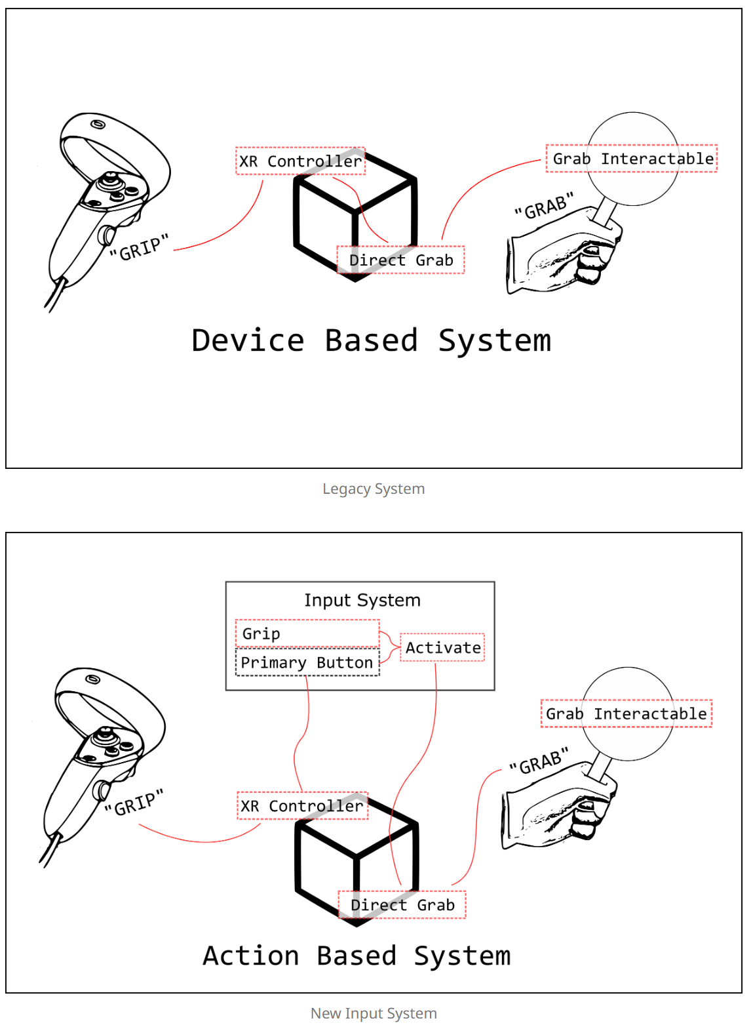

Slide 10
Block02 의 개요
테이블을 만들고 테이블을 선택하여 Activate하면 계속 상자를 생성하도록 한다.
상자는 위쪽의 랜덤 위치에서 떨어지도록 한다.(z는 변하지 않는다)
상자의 색은 랜덤으로 설정한다.

Slide 11
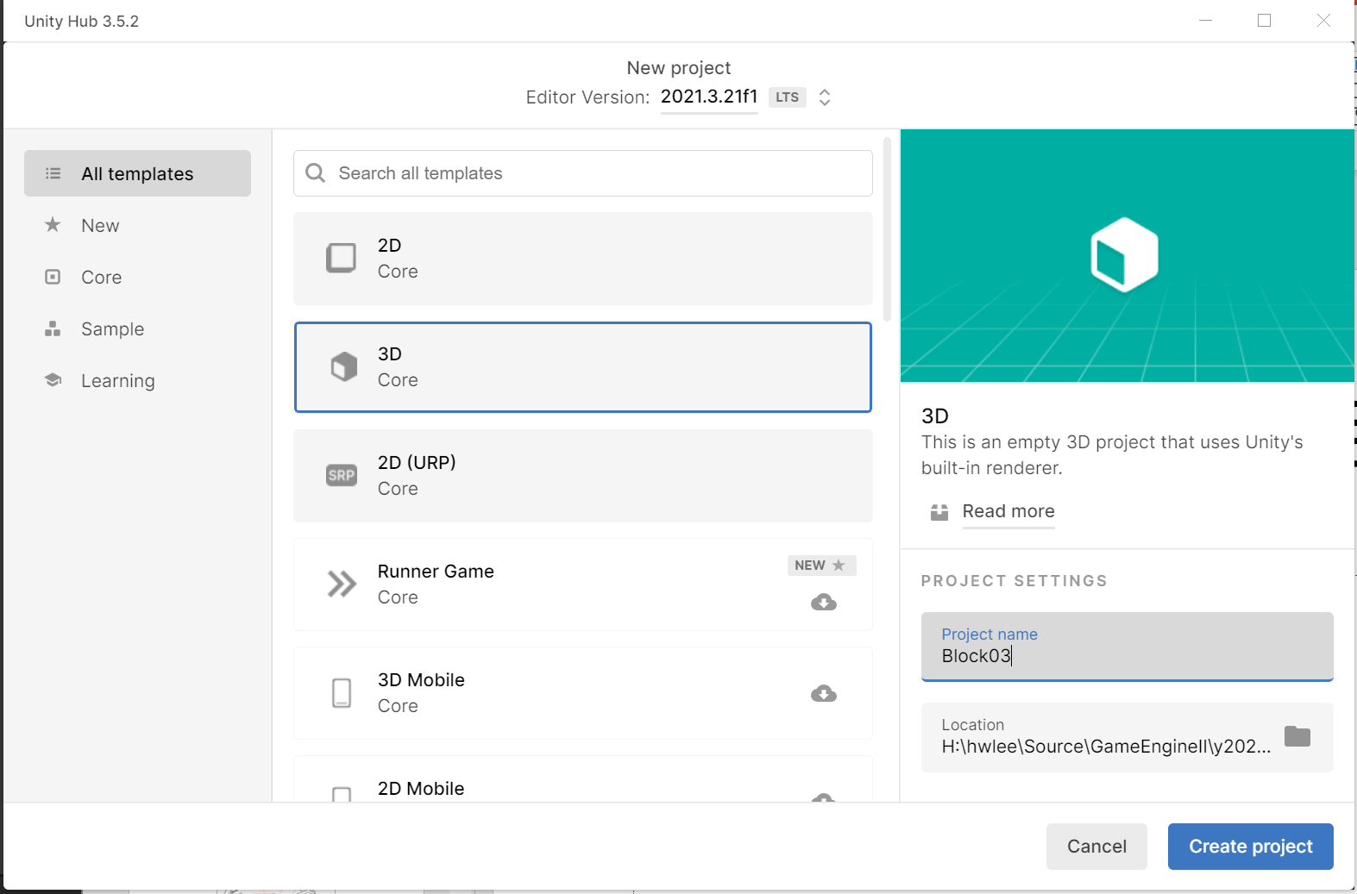
Block02 프로젝트 생성

Slide 12
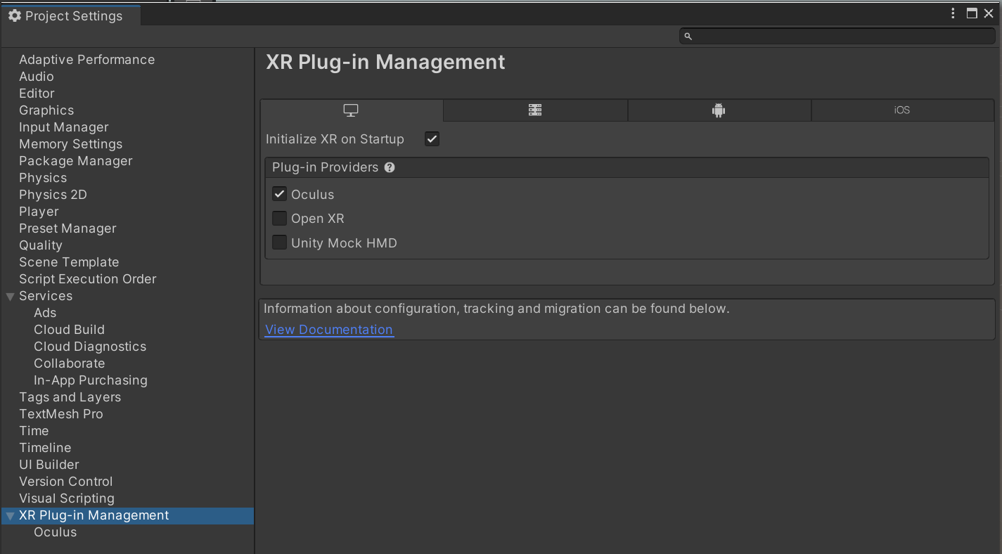
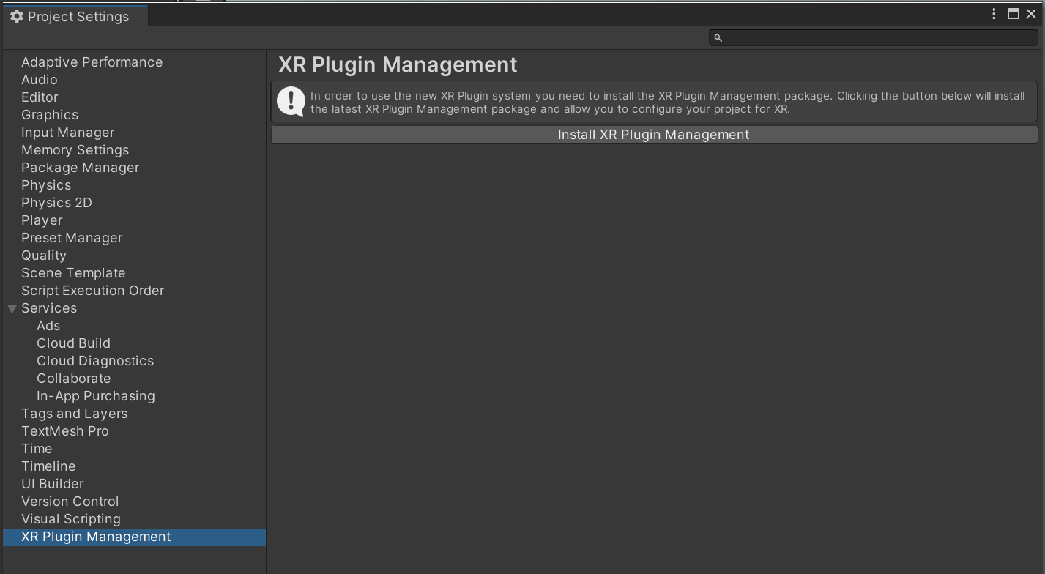
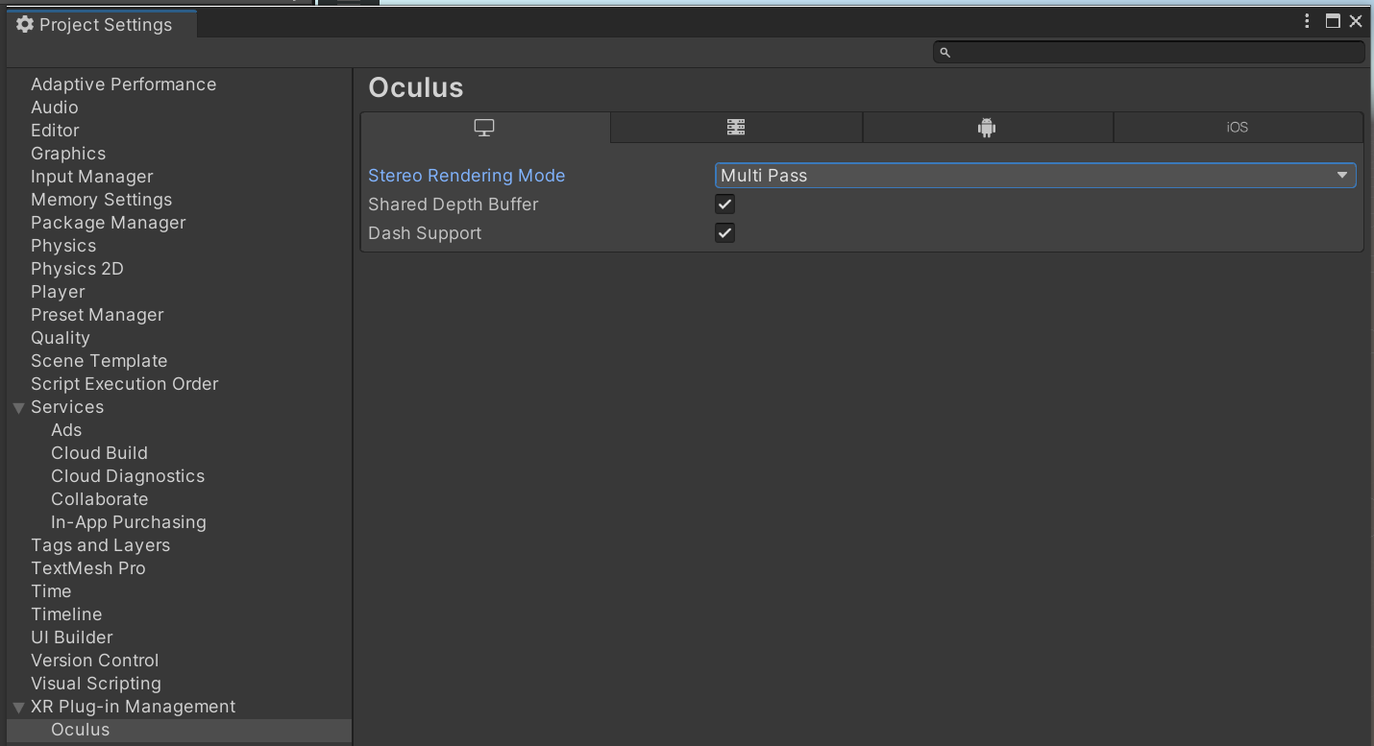
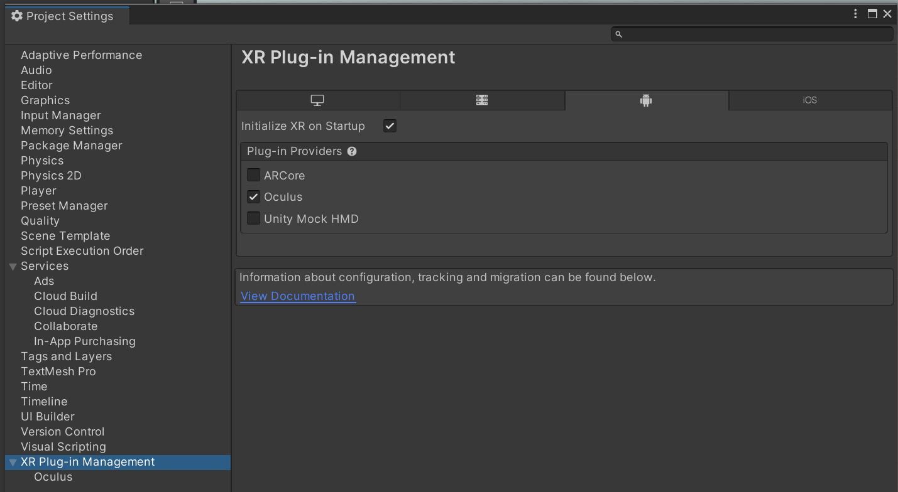
XR Plugin Manager 설치
Edit->Project Settings
2
1
3
Stereo Rendering Mode -> Multi Pass 로 설정
4
Android에 대해서도 동일하게 설정

Slide 13
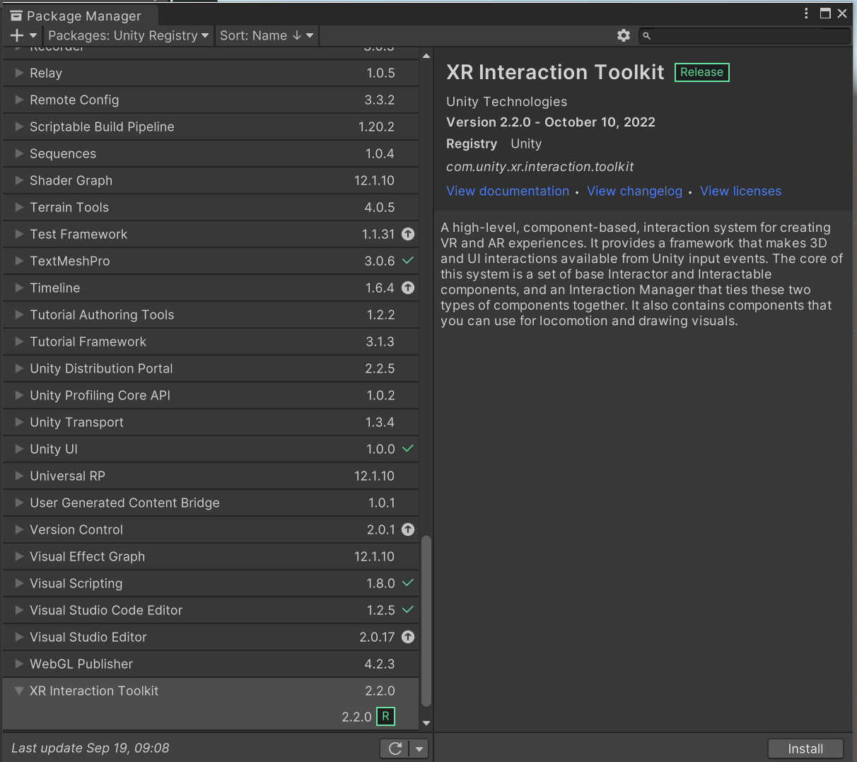
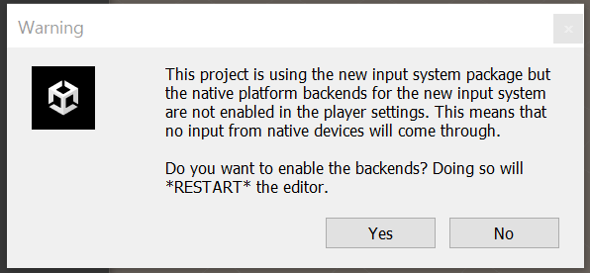
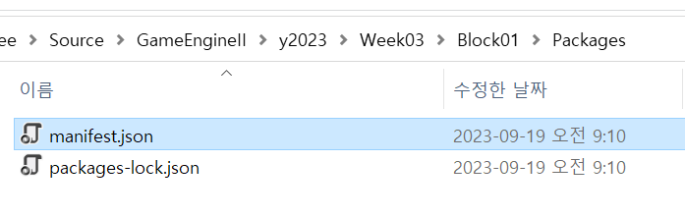
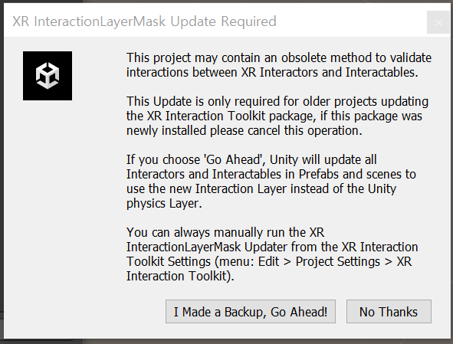
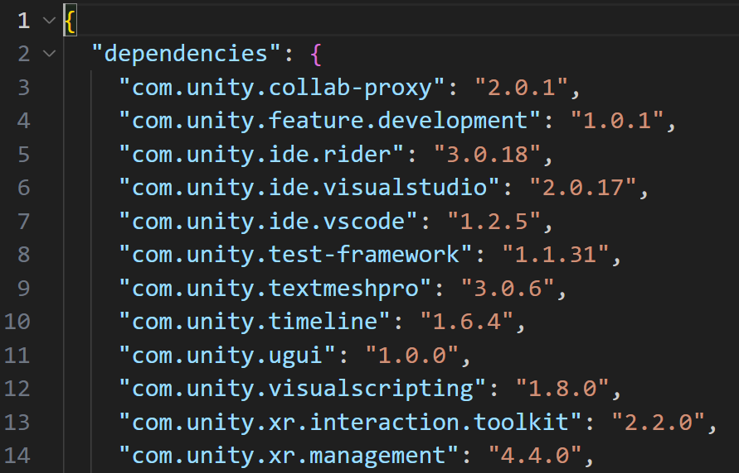
XR Interaction Toolkit 설치
Window -> Package Manager
2
Version 2.2.0 설치
3
1

Slide 14
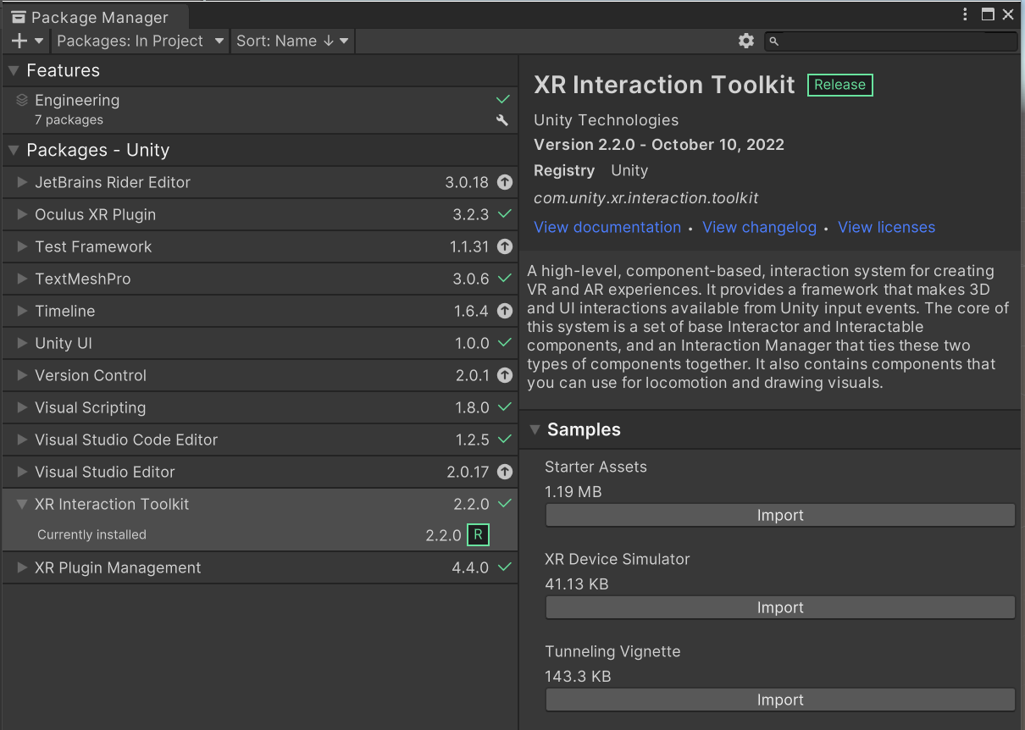
Starter Asset 설치
Package Manager -> XR Interaction Toolkit -> Samples
Ray 등이 제대로 보이지 않는 경우에는 Toolkit의 버전을 조정해 볼 것
1

Slide 15
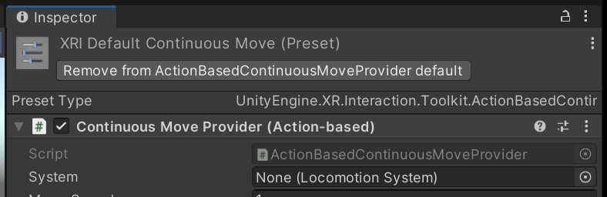
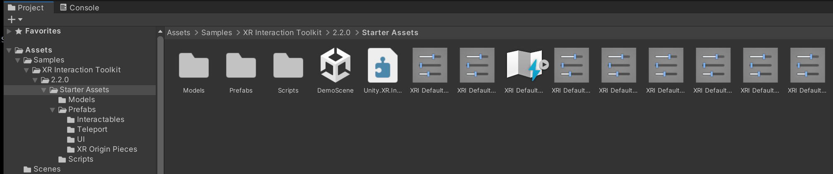
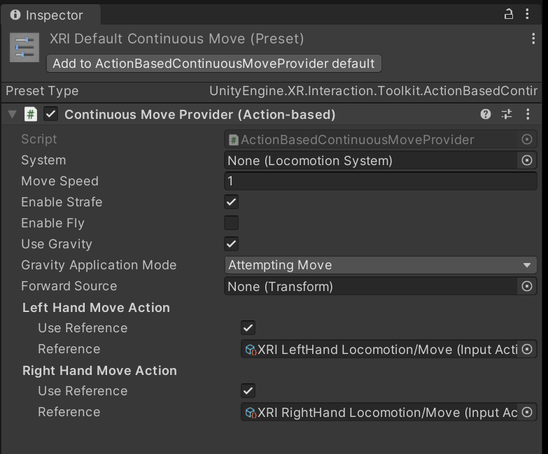
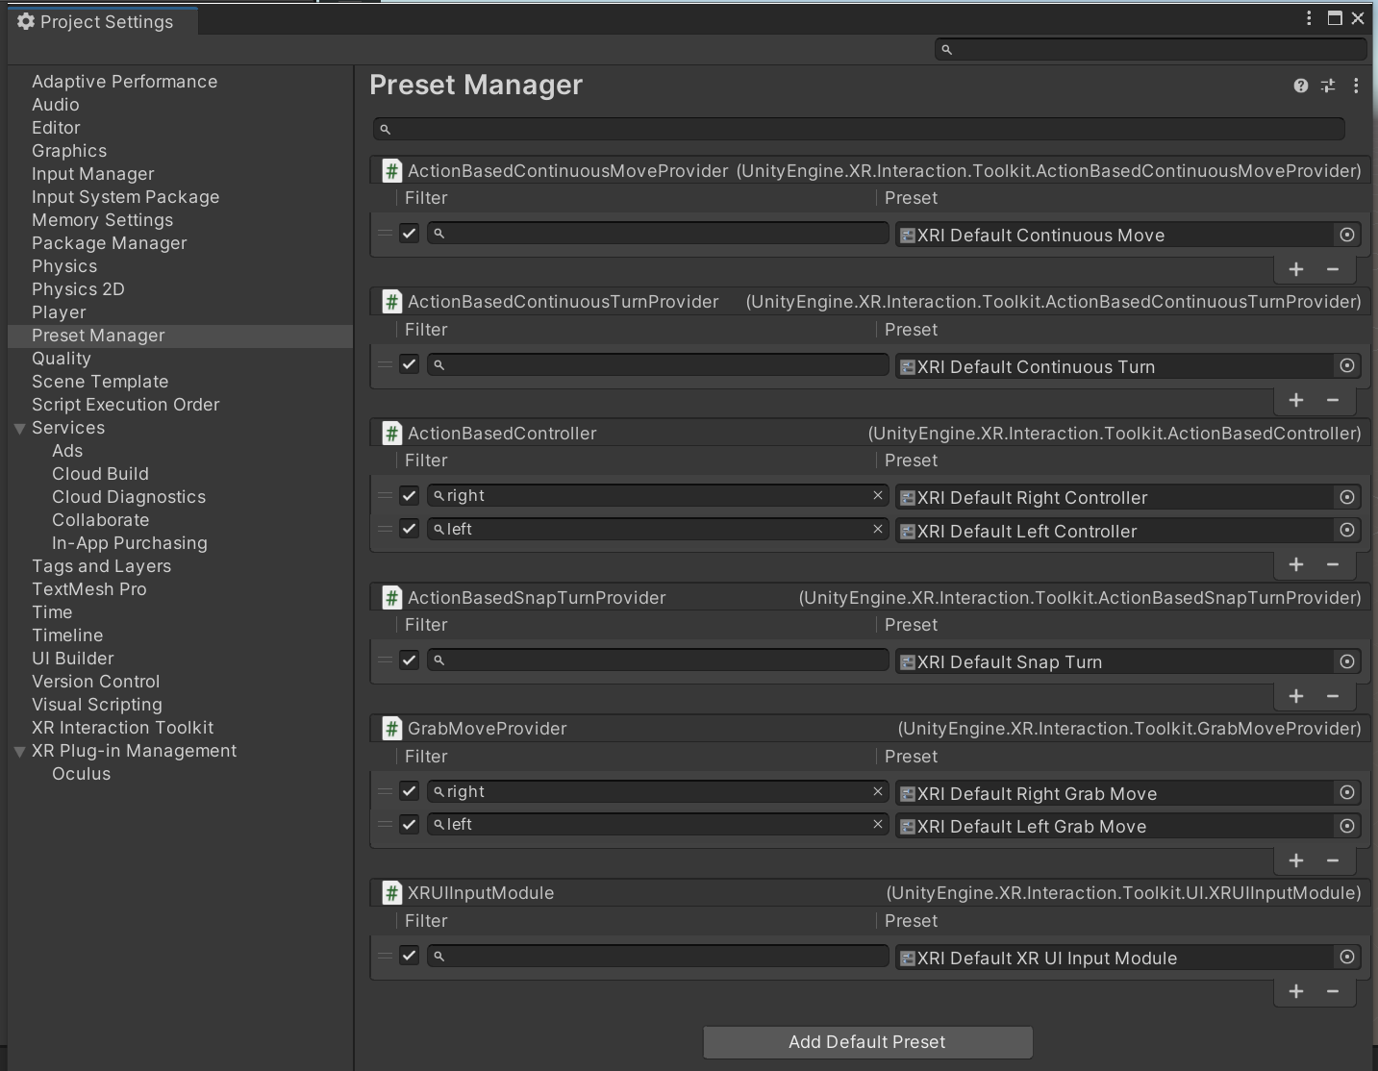
XRI Default Actions 추가
Project -> Assets -> Samples -> XR Interaction Toolkit -> 2.2.0 -> Starter Assets
1
XR Default Continuous Move
3
모든 XRI Default 에 대하여 추가
4
2
Preset Manager에서 필터 설정

Slide 16
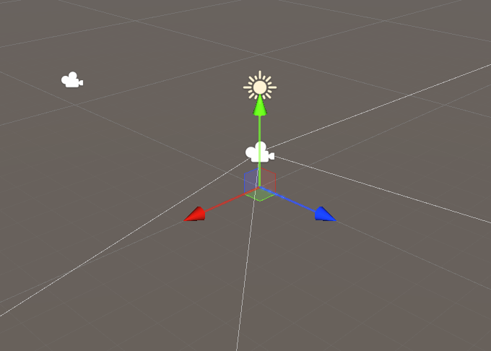
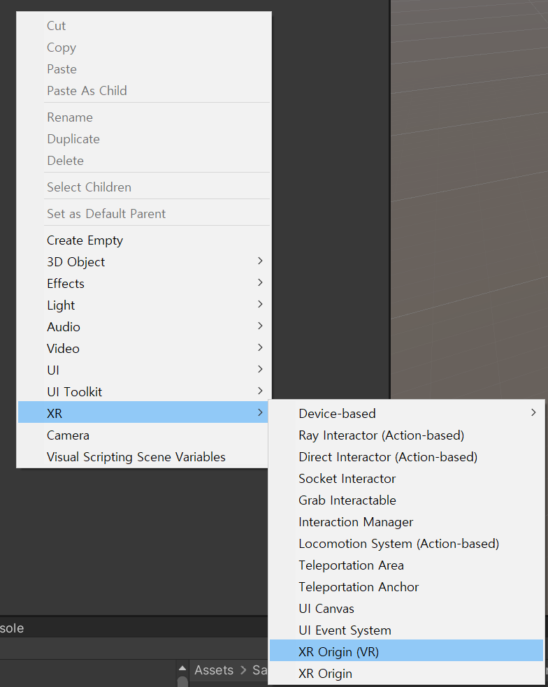
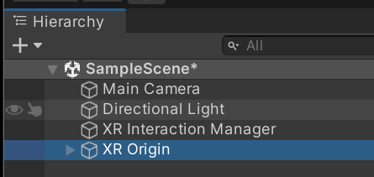
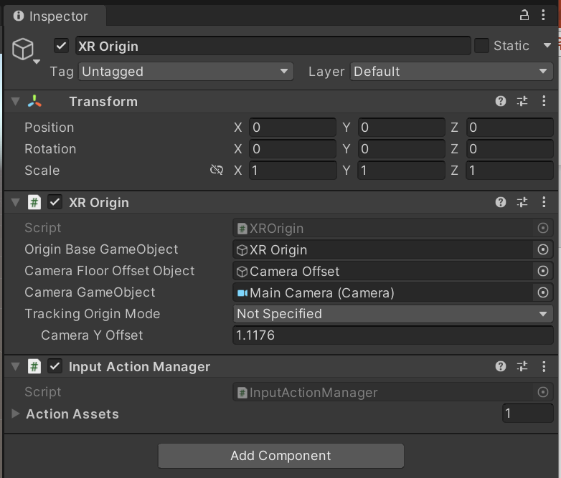
XR Origin 추가
Hierarchy -> Right Button
1
편집기 버전에 따라 명칭은 다를 수 있음

Slide 17
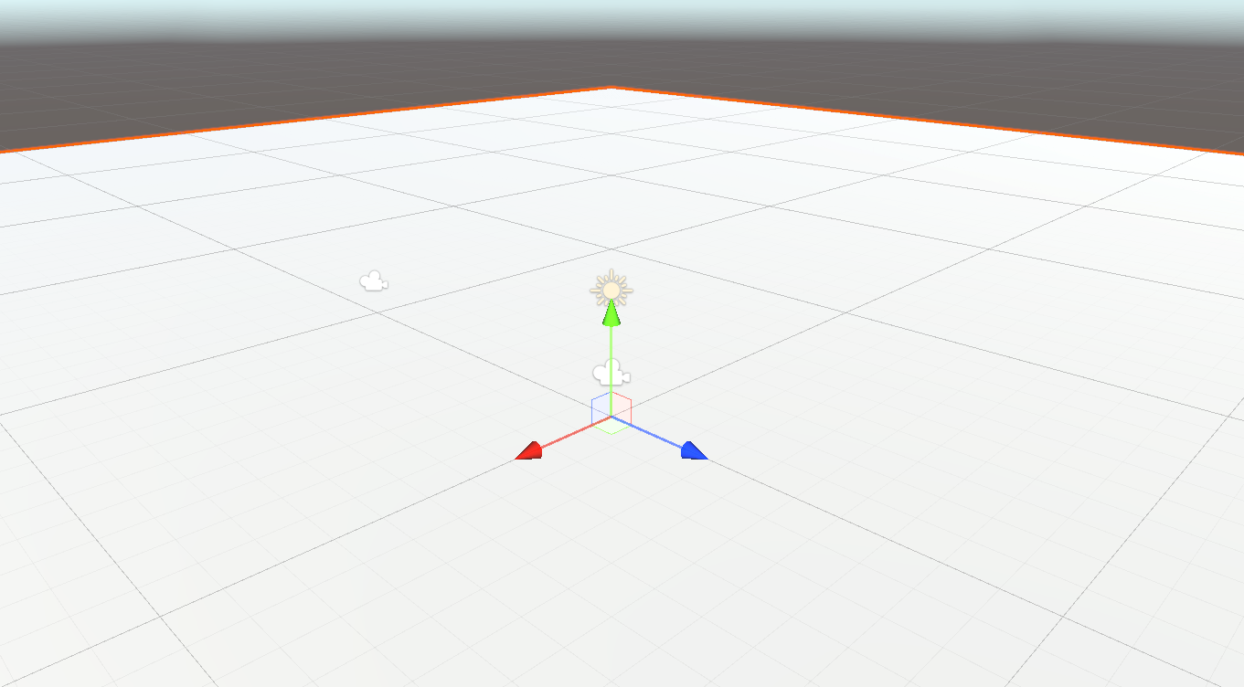
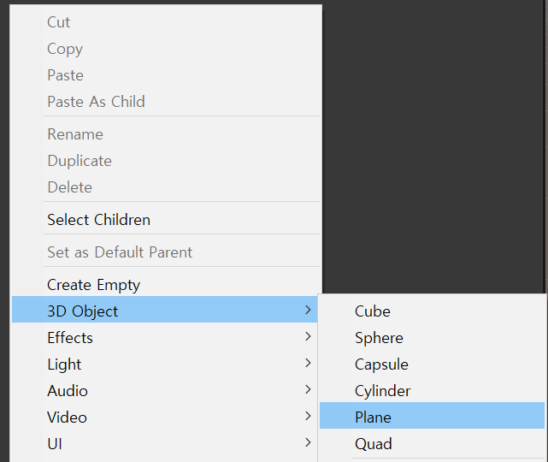
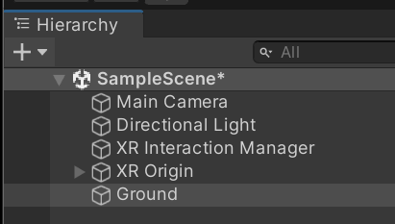
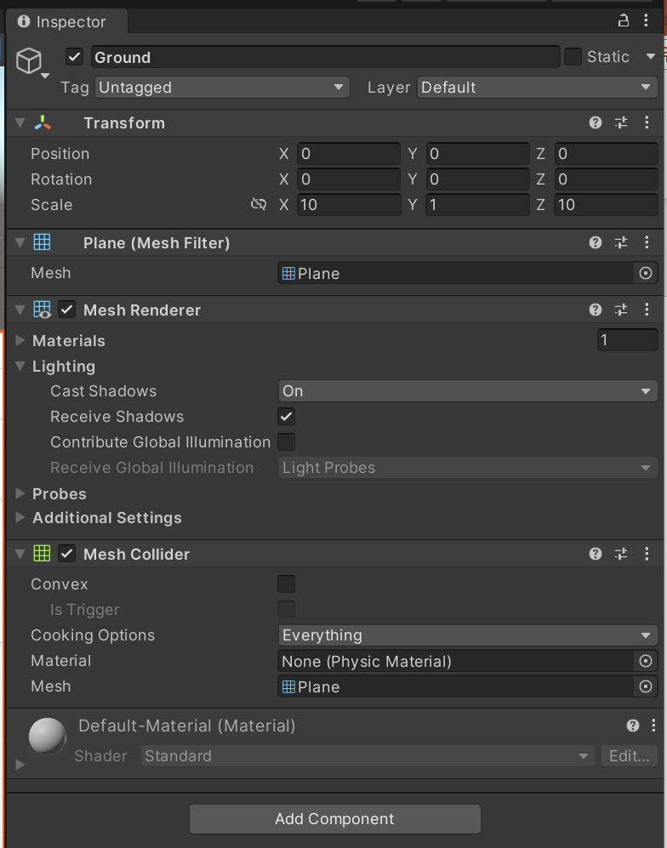
Plane 추가
Hierarchy -> Right Button
1
2
Plane을 Ground 로 수정
3
Scale을 10으로 수정 (또는 원하는 크기로 수정)

Slide 18
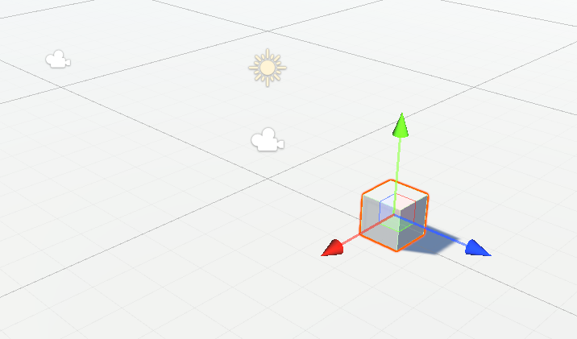
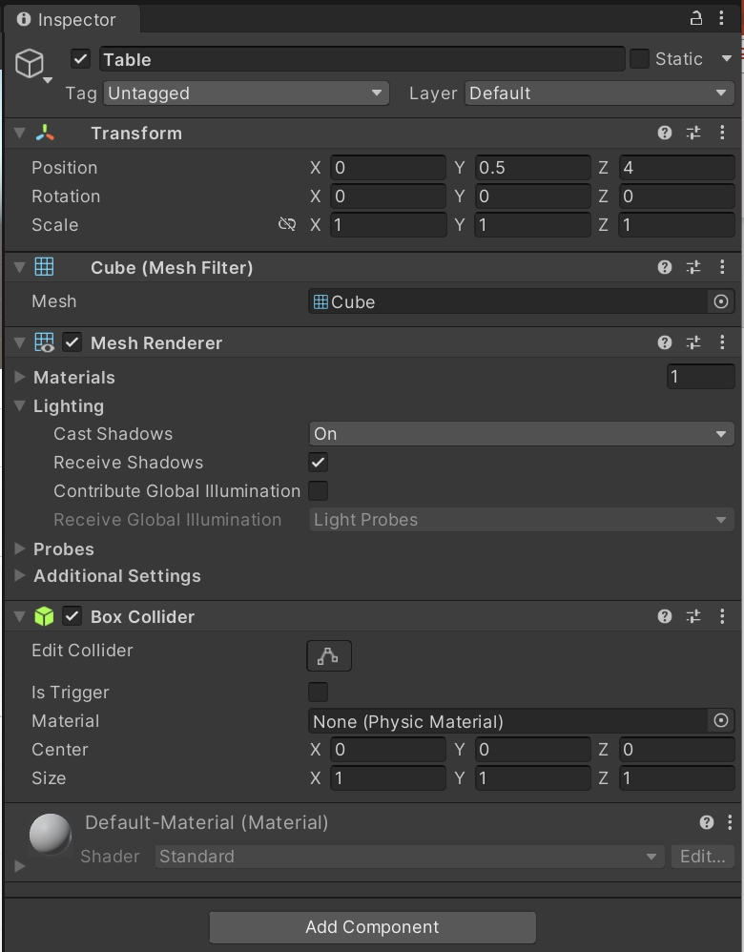
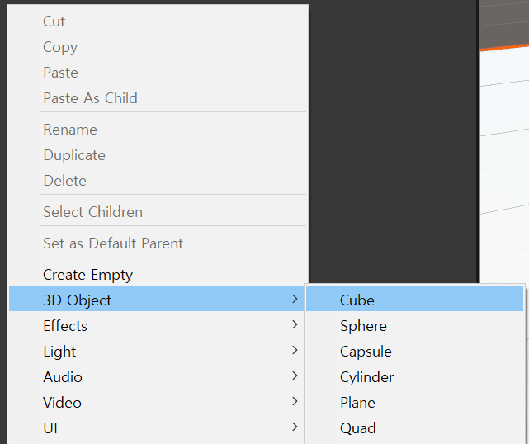
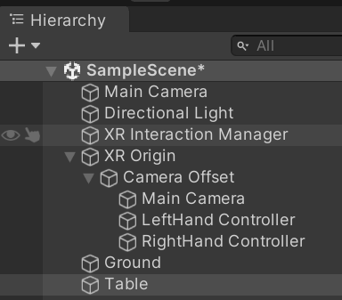
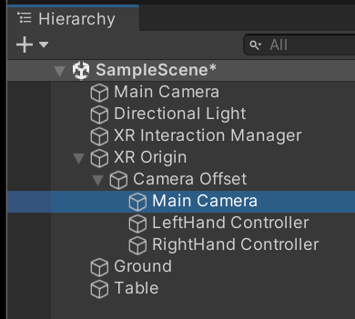
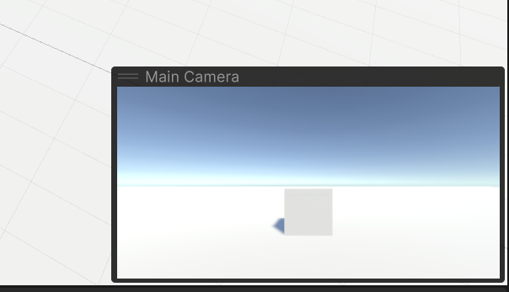
테이블로 사용할 Cube 추가
Hierarchy -> Right Button
1
2
Cube를 Table로 수정
3
원하는 크기와 위치 수정
4
XR Origin Camera를 선택하여
Table이 앞에 보이는지 확인

Slide 19
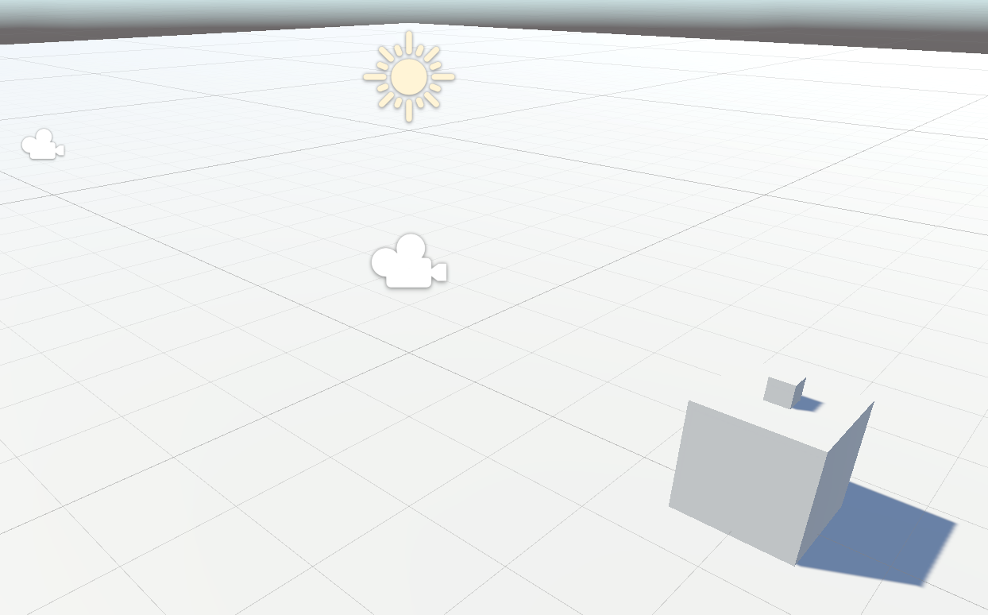
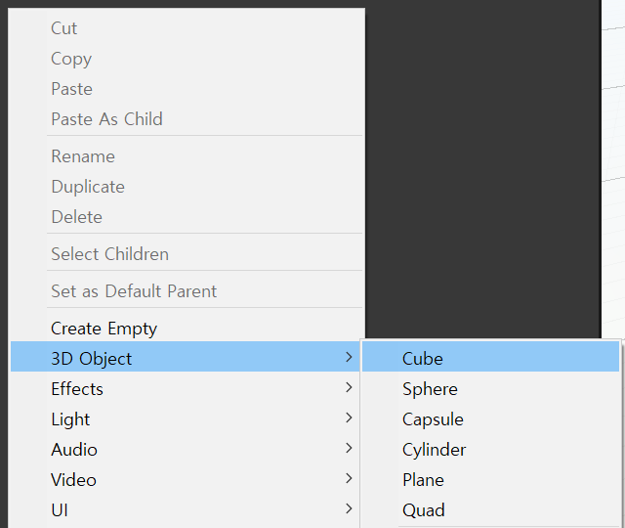
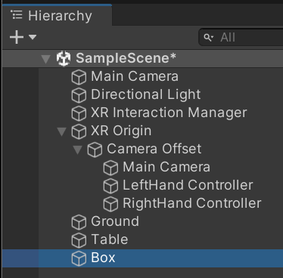
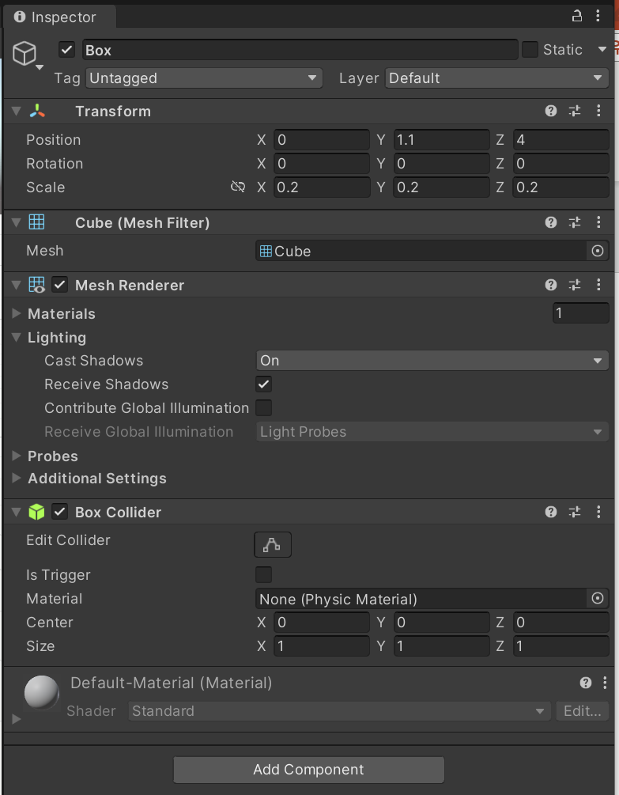
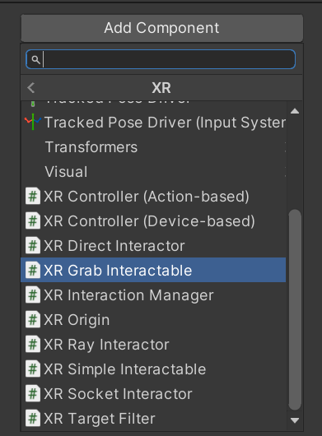
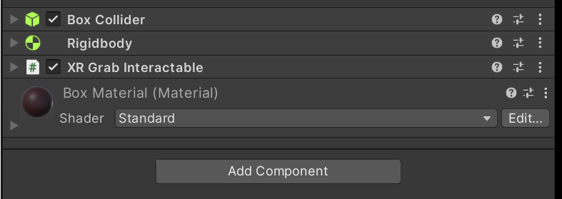
Grab할 Cube 추가
Hierarchy -> Right Button
3
1
2
4
Cube를 Box로 수정
크기와 위치 수정
XR Grab Interactable 추가
Material을 추가하여 색 변경

Slide 20
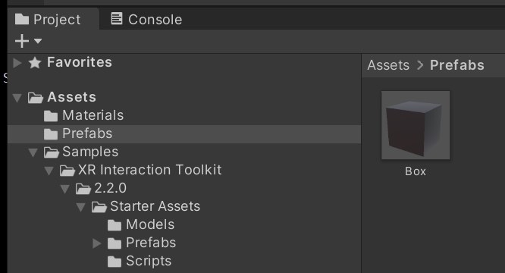
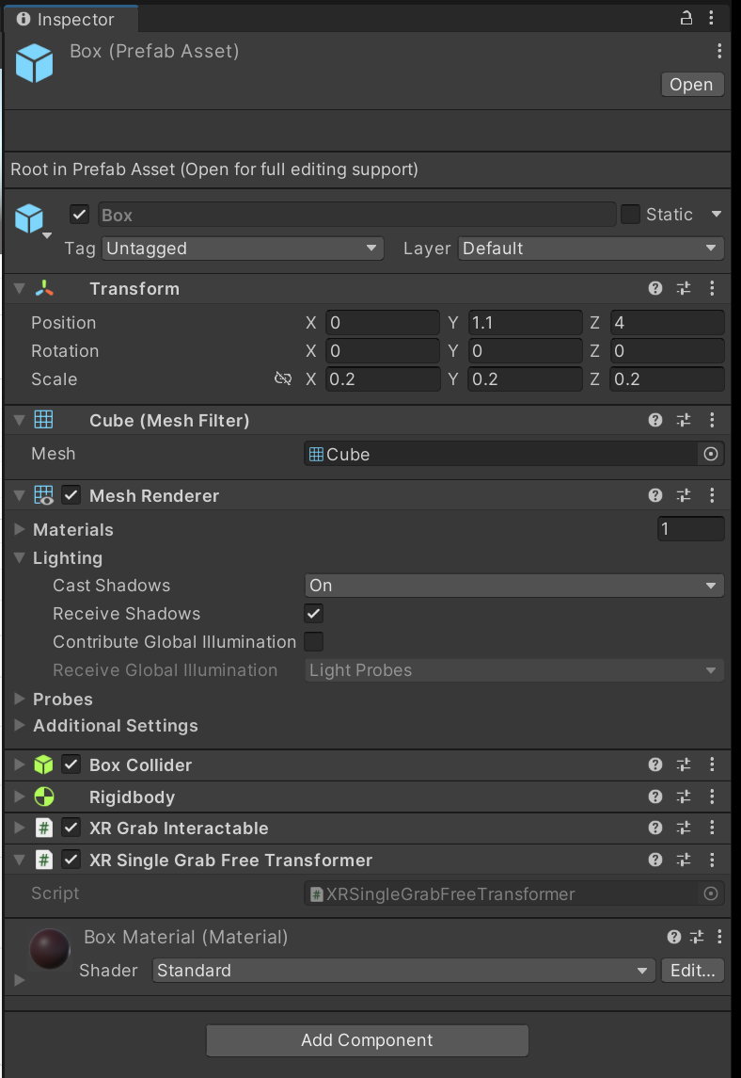
Box를 Prefab으로 만들기
Hierarchy 창의 Box를 Project->Assets->Prefabs로 이동

Slide 21
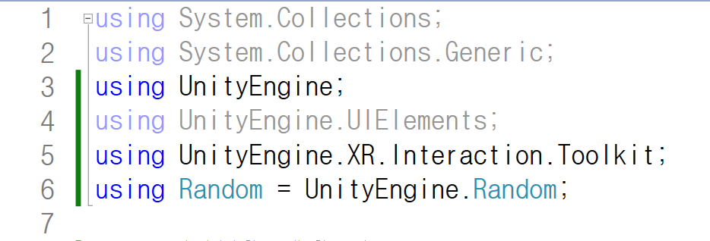
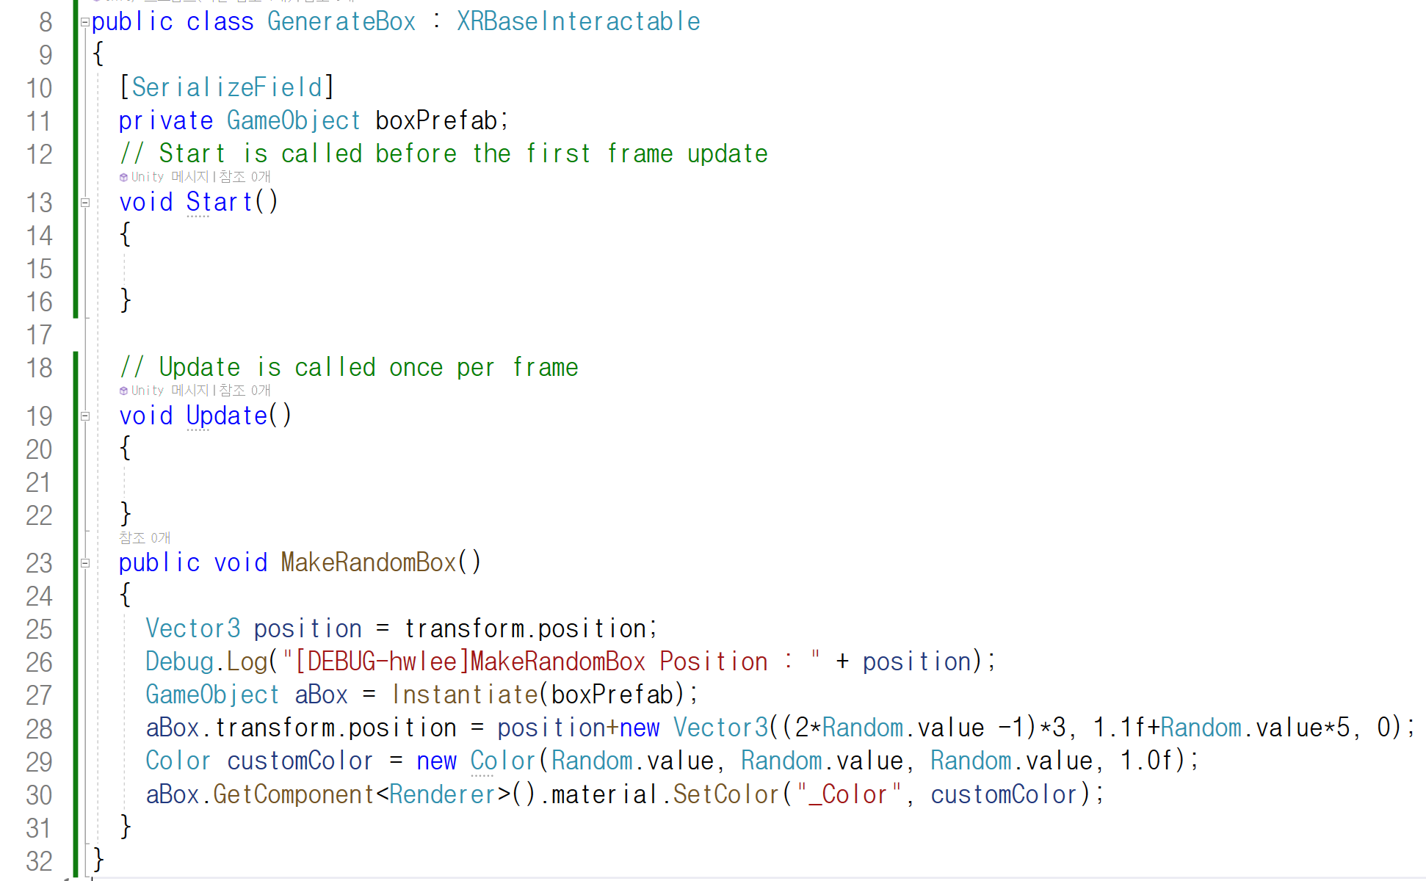
GenerateBox.cs
XRBaseInteractable
GenerateBox
MakeRandomBox

Slide 22
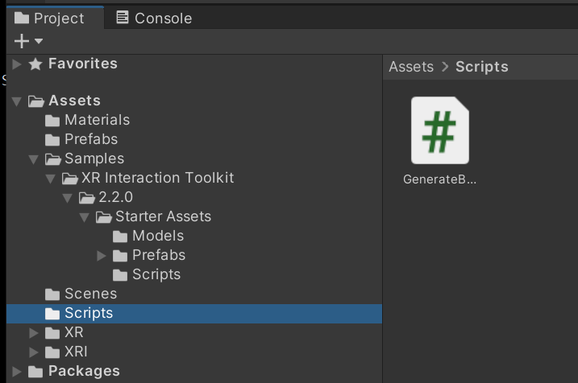
Table에 추가할 스크립트 작성
Project -> Assets -> Scripts 에 작성

Slide 23
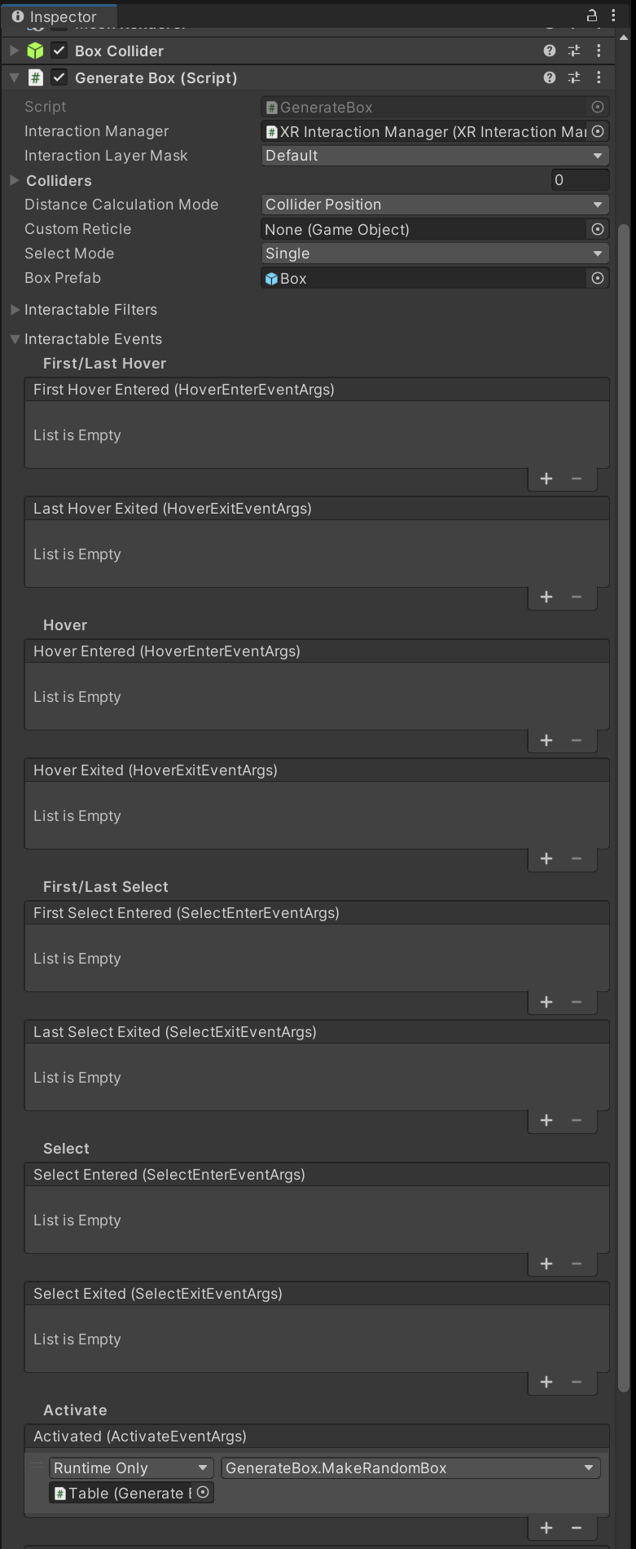
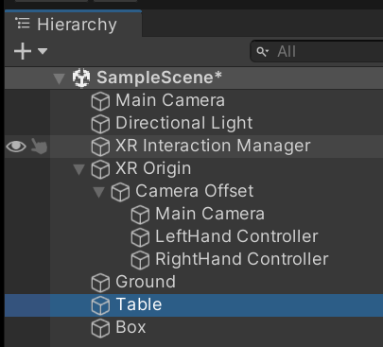
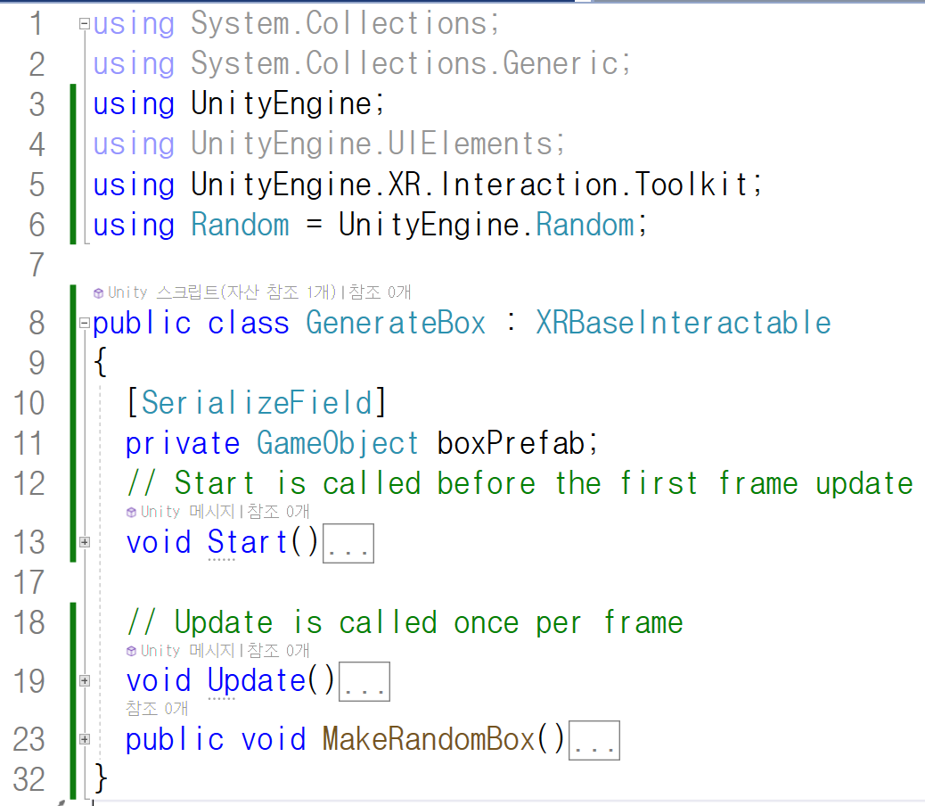
Event Handler 추가

Slide 24
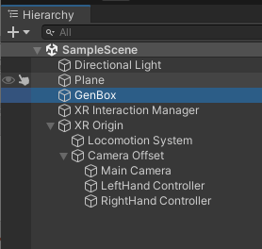
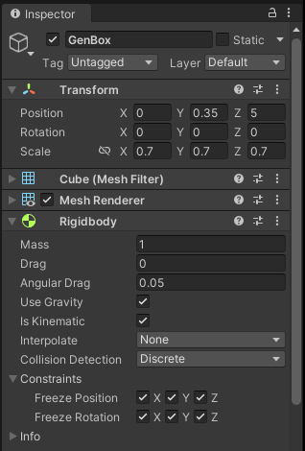
상자생성기 고정
상자를 생성하는 큰 상자를 움직이지 않도록 한다.

Slide 25
할일
상자 생성 완성
위치를 Table위에 고정하고 AddForce를 이용하여 발사하도록 수정

