Slide 1
게임엔진2 제5주
Locomotion 구현
드론IoT시뮬레이션학부
담당교수 : 이형원
E304호, hwlee@inje.ac.kr

Slide 2
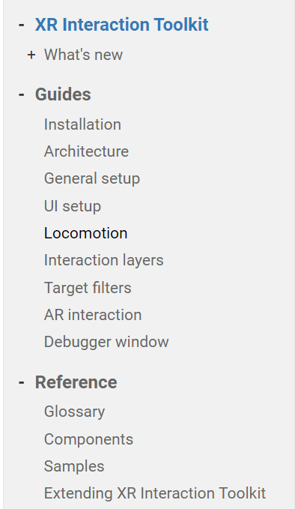
XR Interaction Toolkit Guide
XR Interaction Toolkit | XR Interaction Toolkit | 2.2.0 (unity3d.com)

Slide 3
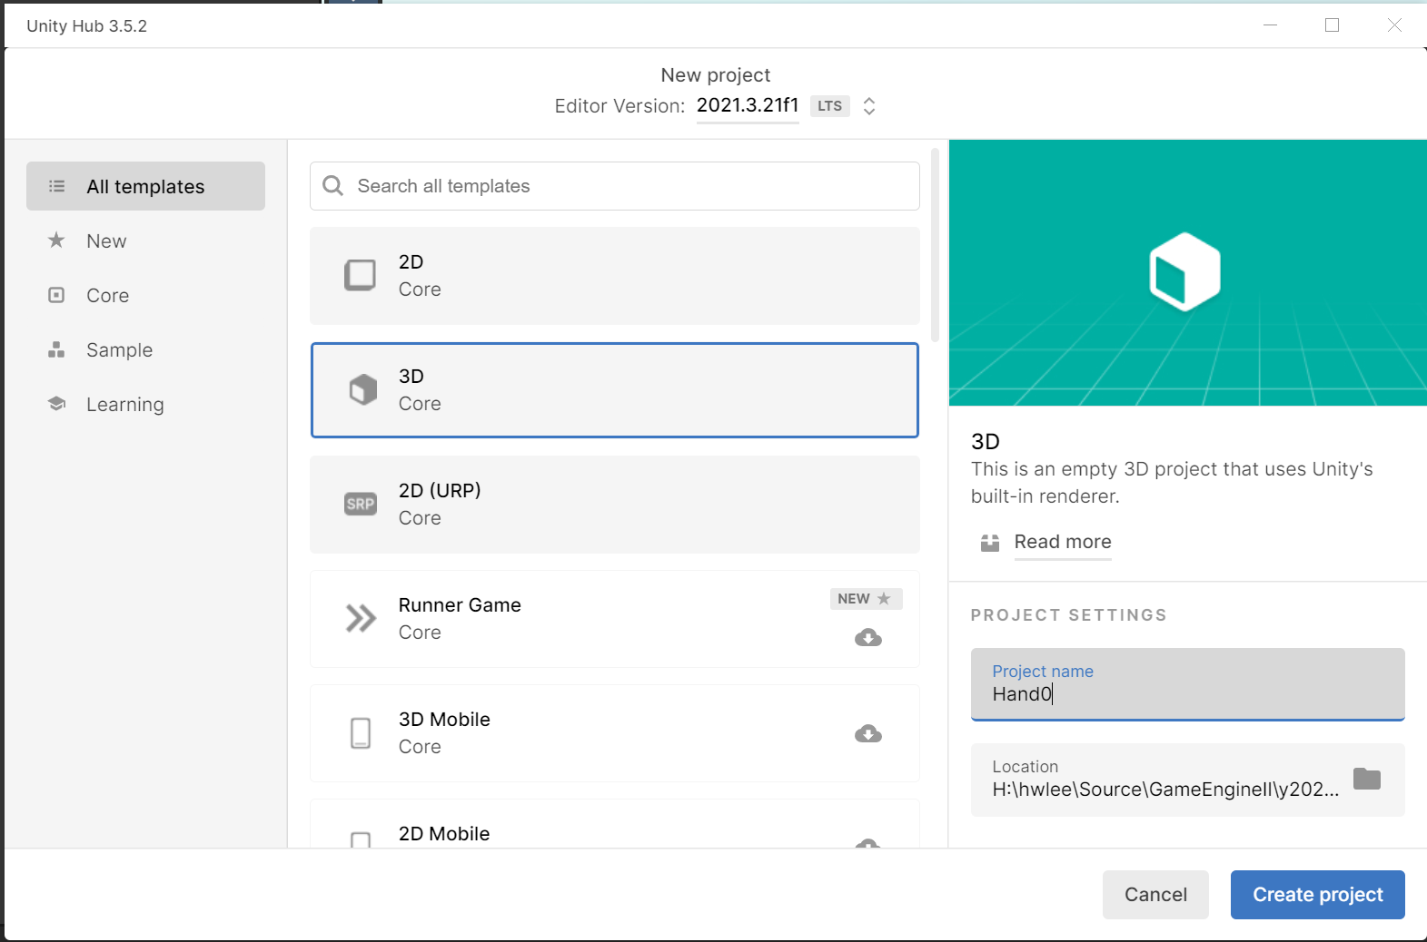
Project 생성(Hand01)

Slide 4
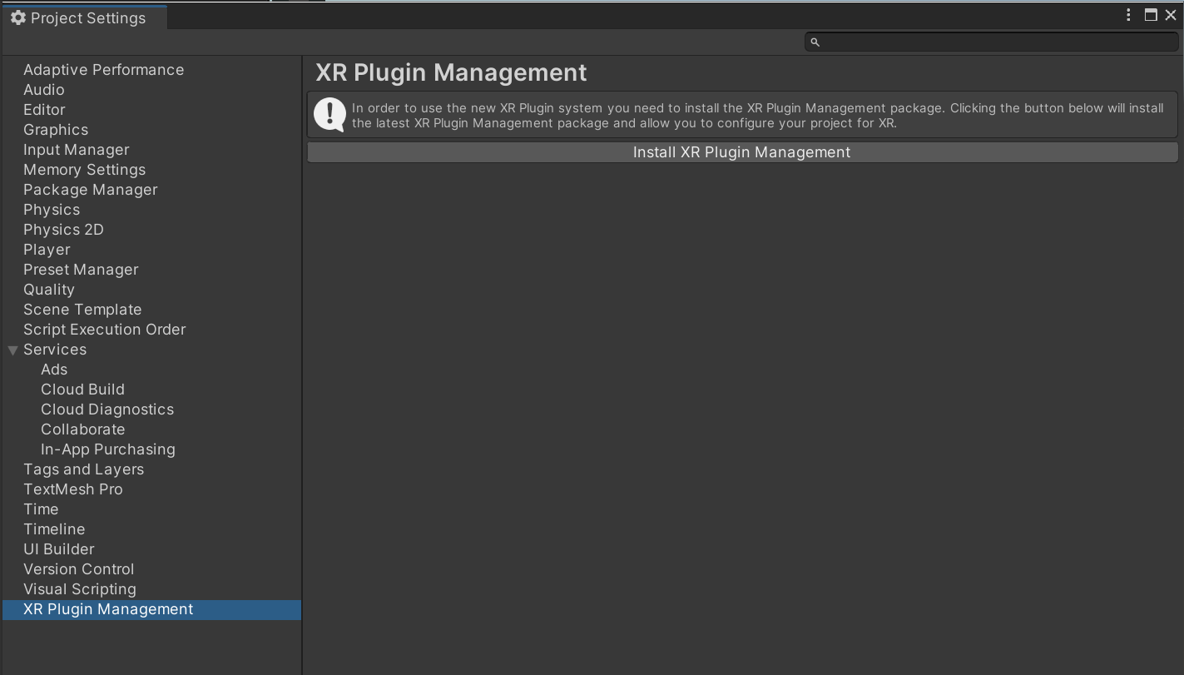
XR Plugin Management 설치

Slide 5
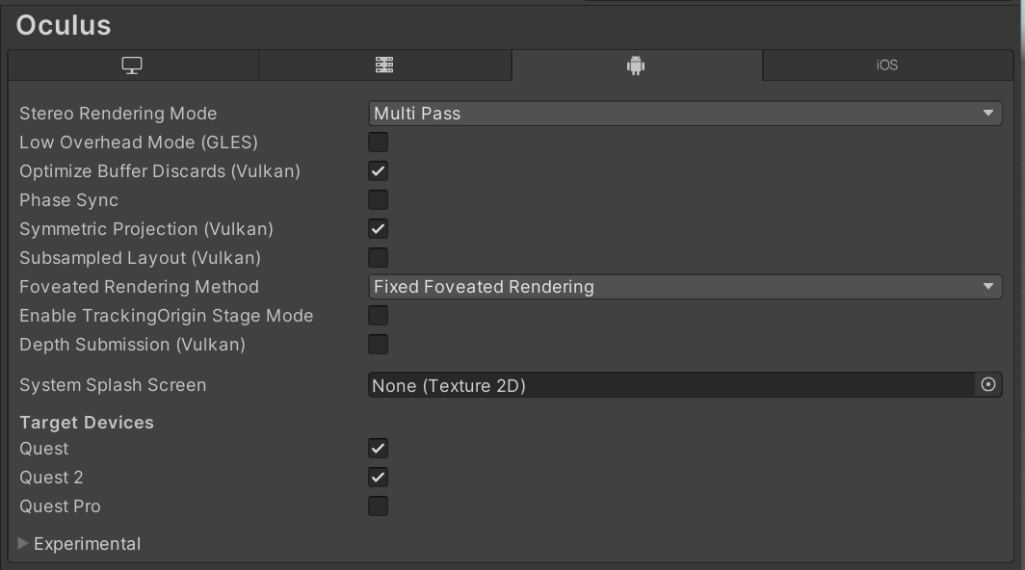
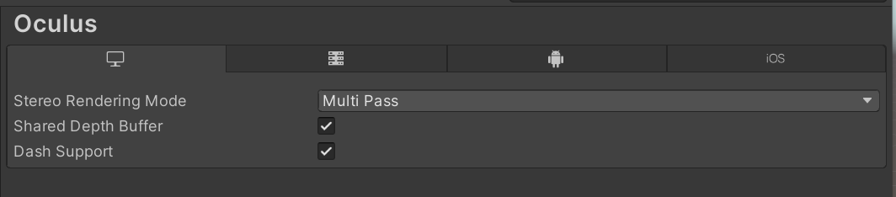
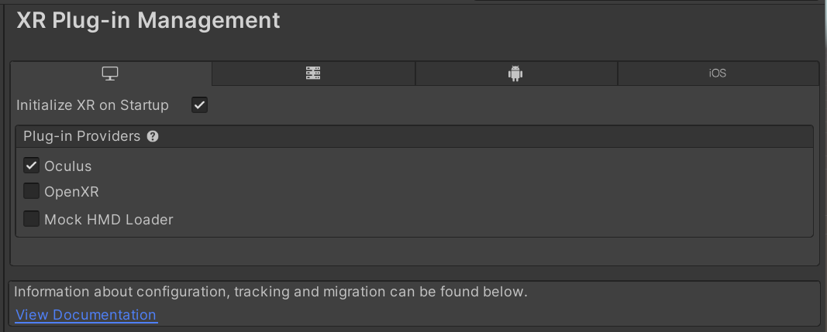
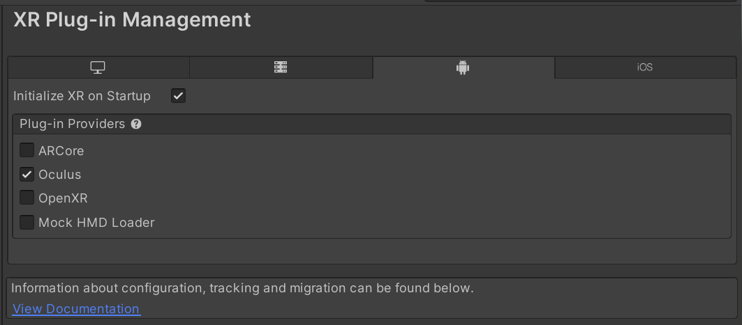
장치 설정

Slide 6
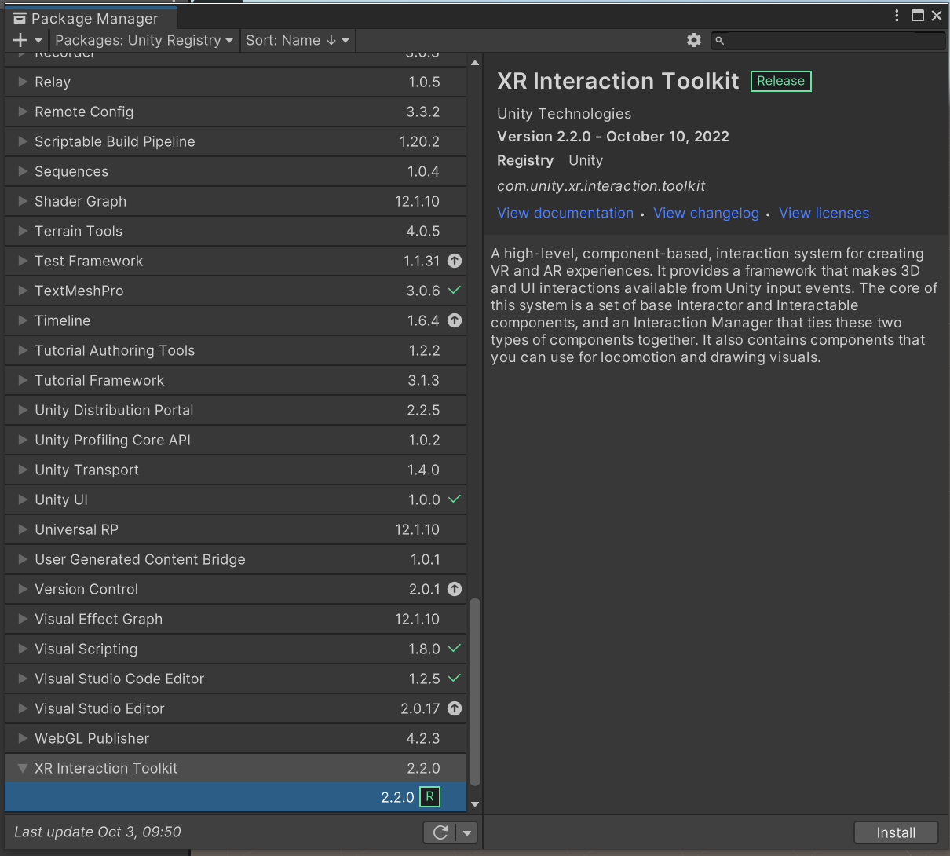
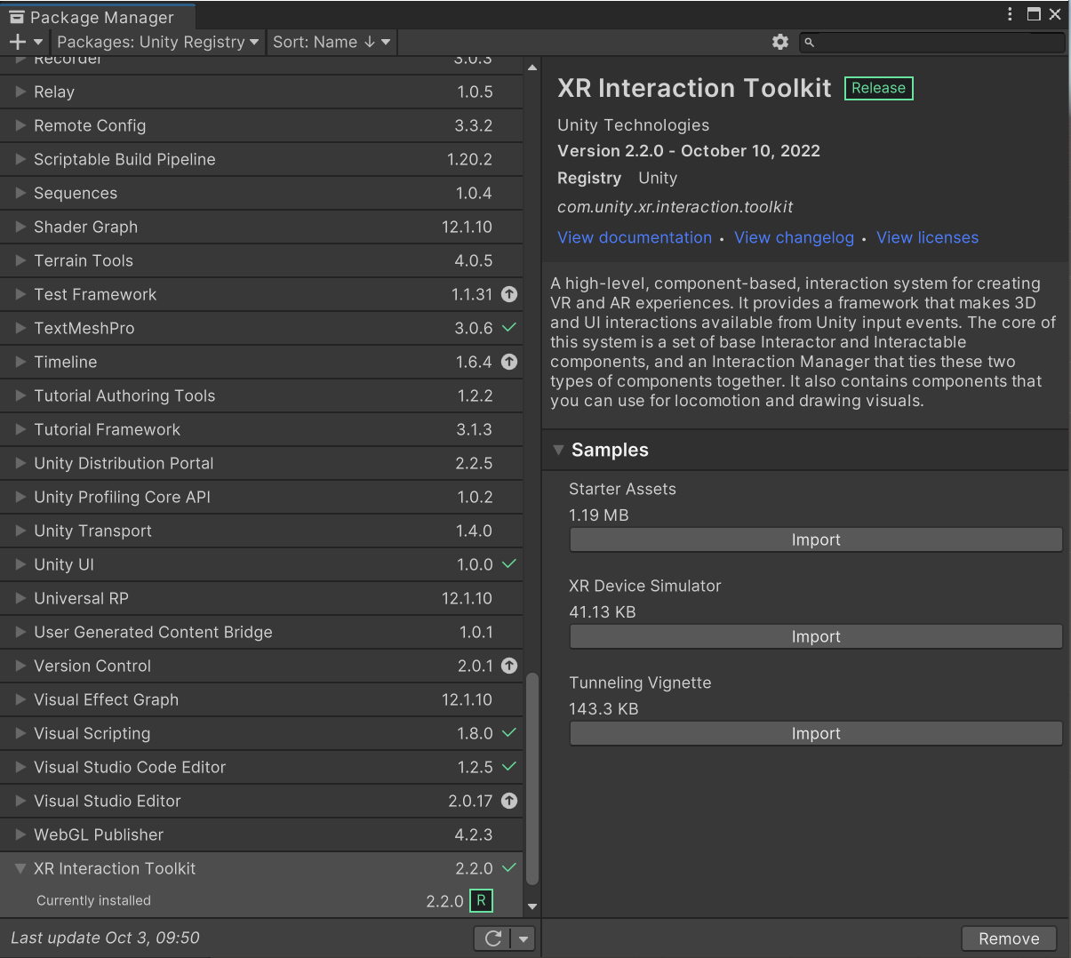
XR Interaction Toolkit 설치(버전 2.2.0)

Slide 7
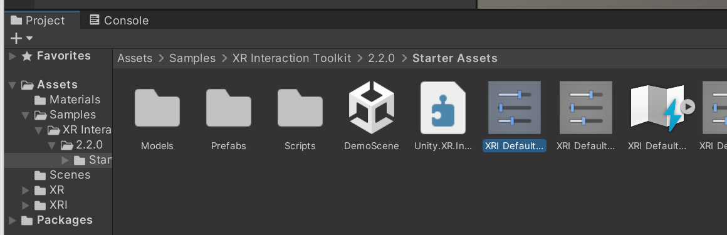
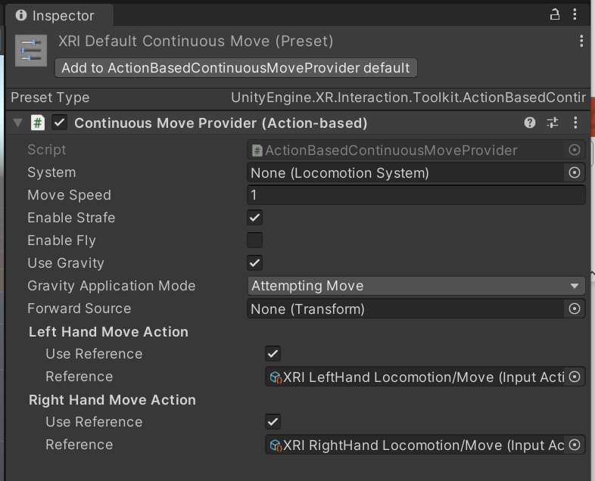
디폴트 액션 콘트롤러 추가

Slide 8
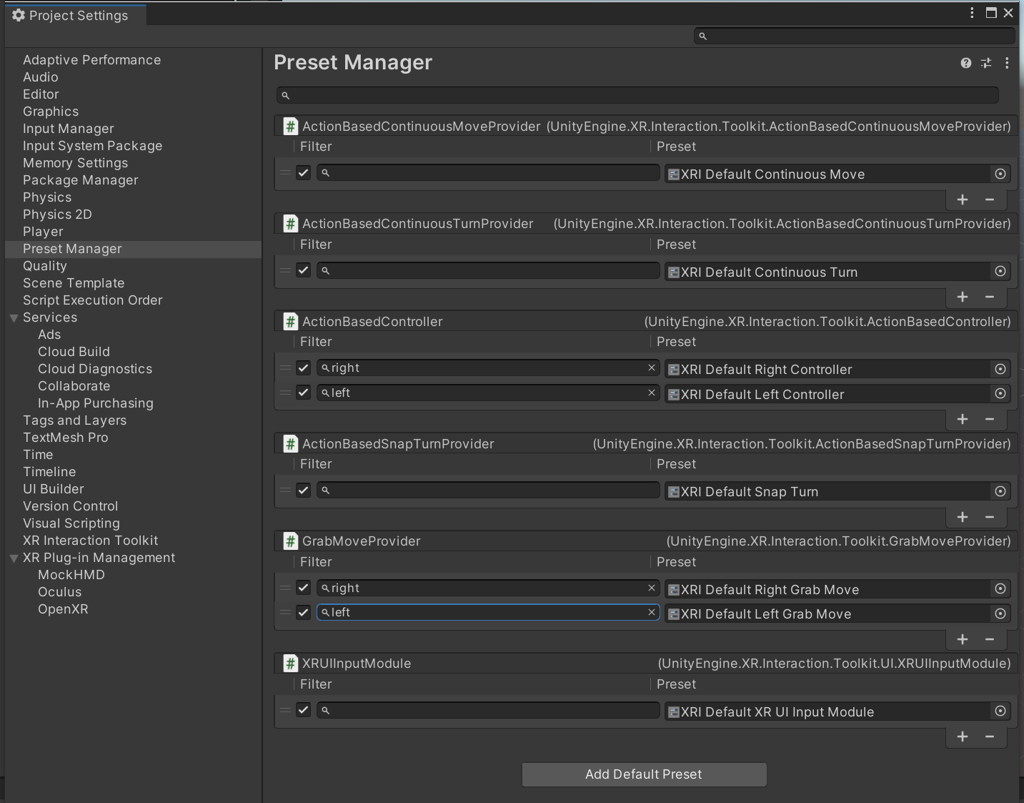
액션 필터 설정

Slide 9
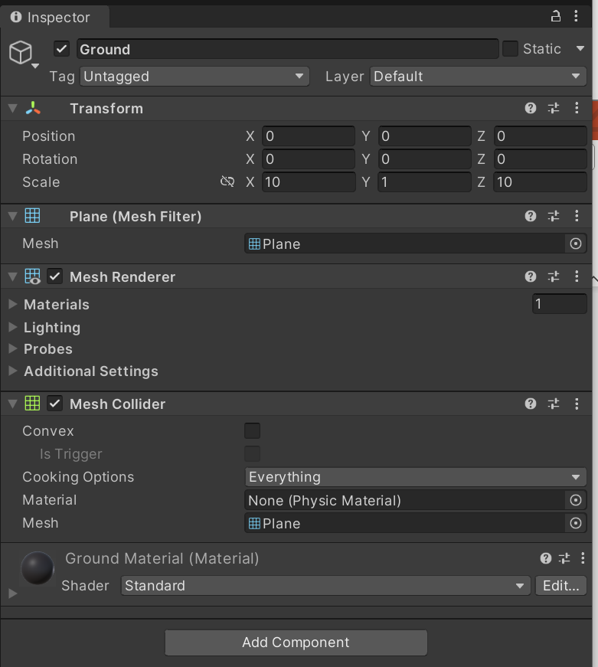
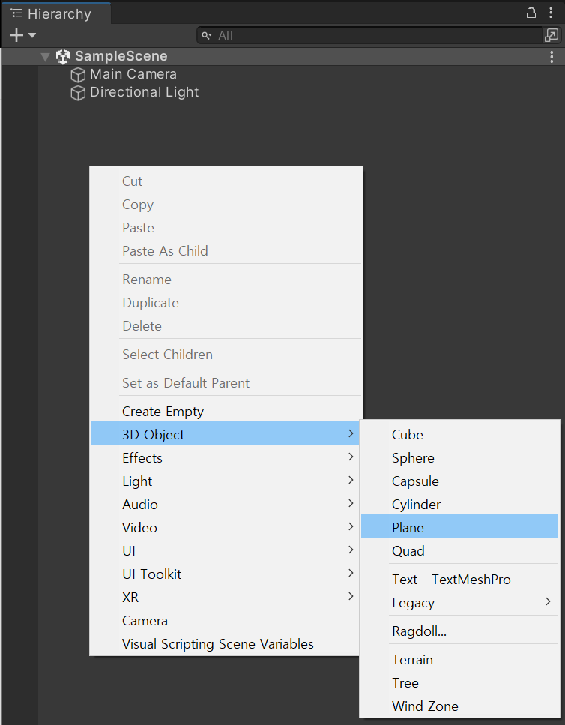
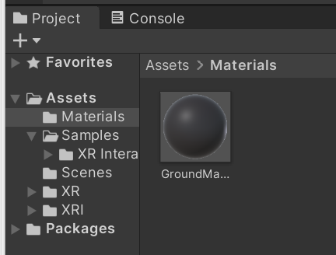
Plane 추가

Slide 10
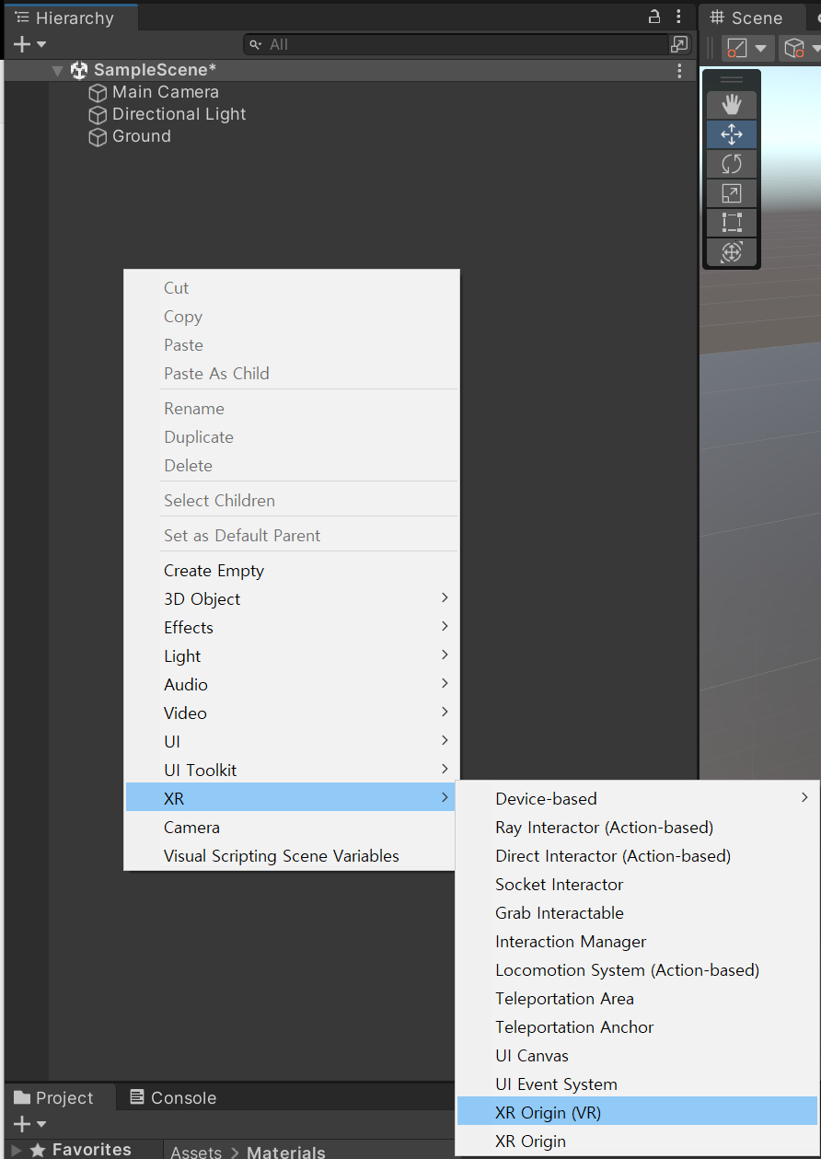
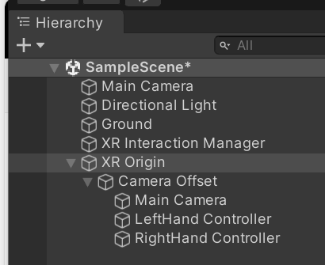
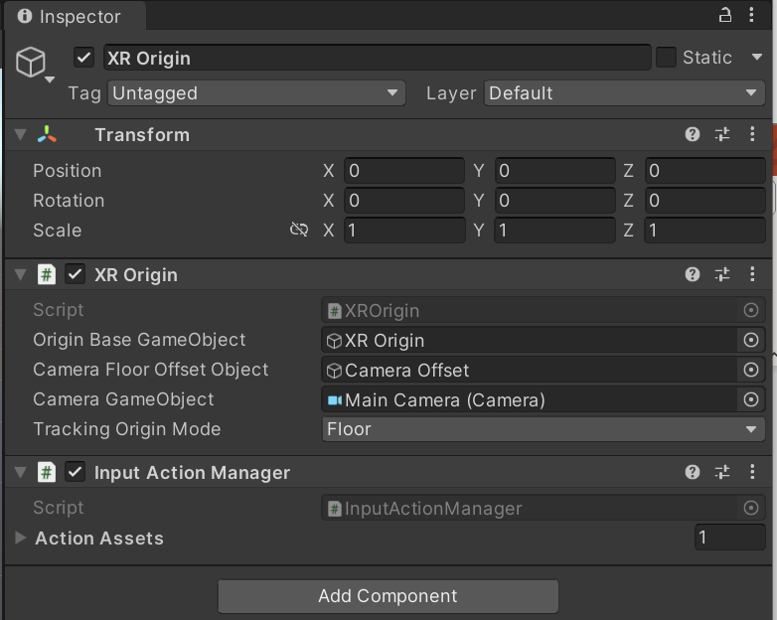
XR Origin(VR) 추가

Slide 11
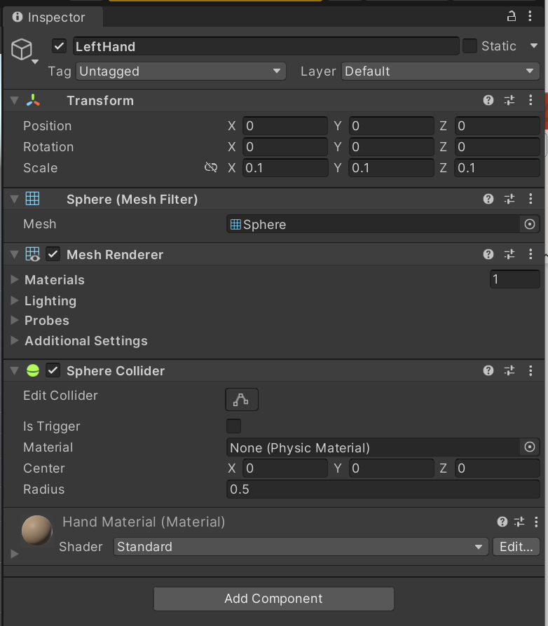
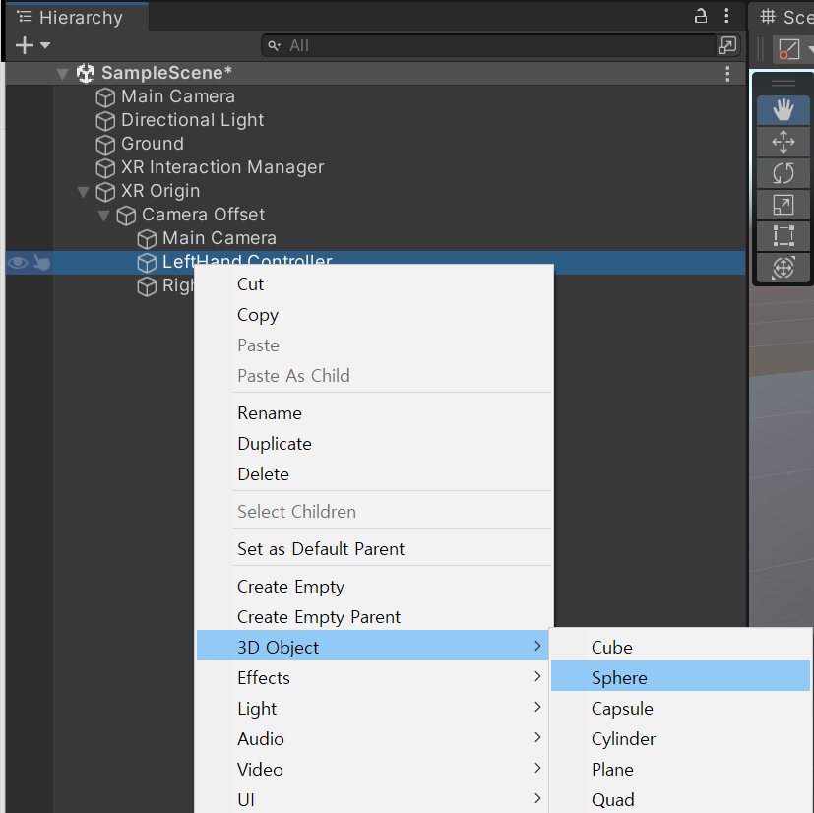
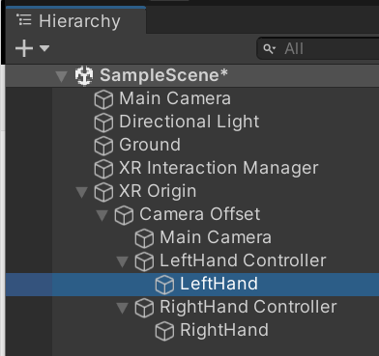
왼손 오른손 추가
실행화면
https://injeackr-my.sharepoint.com/:v:/g/personal/hwlee_live_inje_ac_kr/EaJZadUTJ_tFie8Z6V6PemkBoVGTsJh1OY0ApxkIesujLg?e=eutBO2

Slide 12
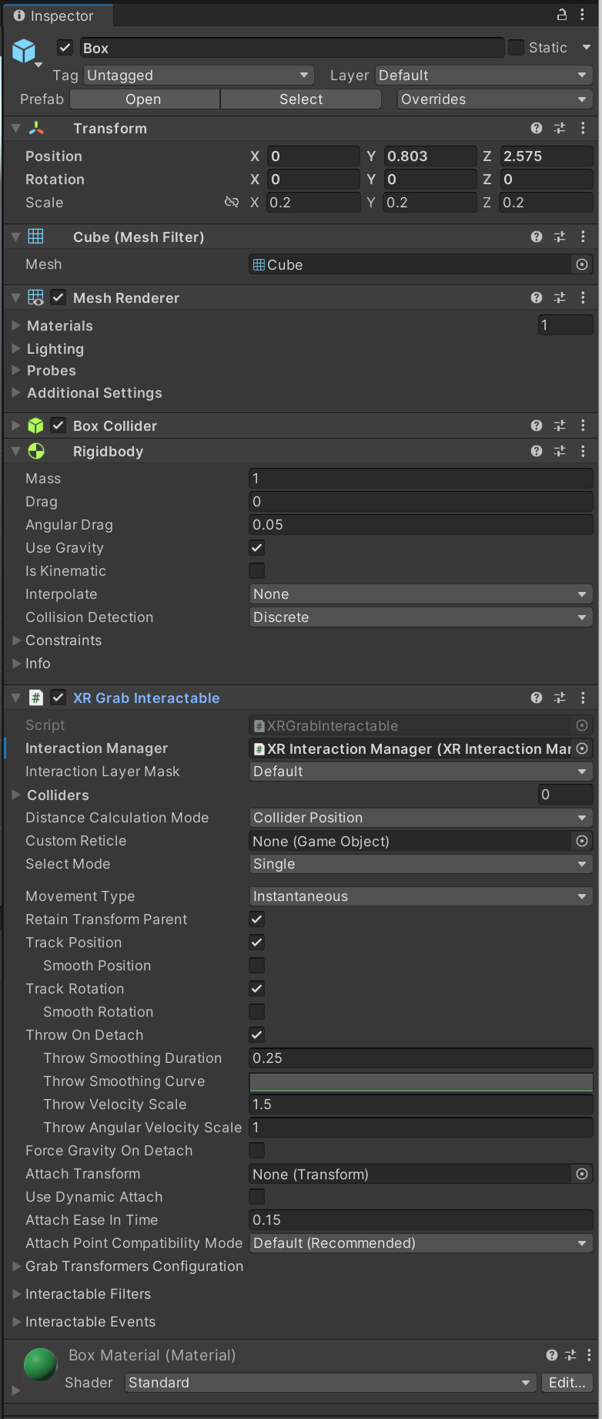
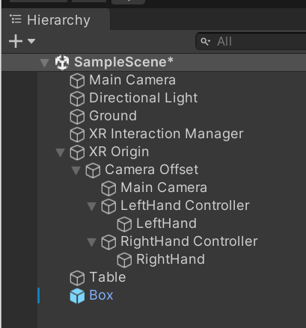
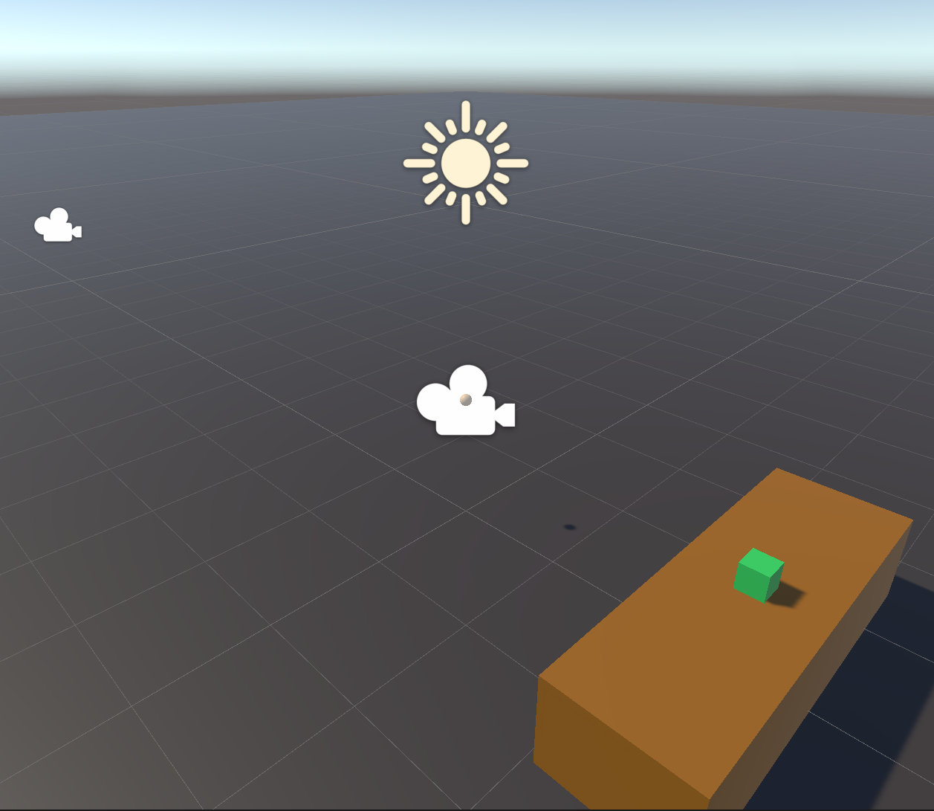
테이블과 상자 추가
실행영상
Hand01-테이블및상자추가.mp4

Slide 13
XR Interaction Architecture/States
State | Function
Hover | If an Interactable is a valid target for the Interactor its state changes to Hover. Hovering on an object signifies an intention to interact with it, but doesn't typically change the behavior of that object, though it might create a visual indicator for this change of state, like how a hovered button changes tint.
Select | Selection requires an action such as a button or trigger press from the user to enable the Select state. When an Interactable is in the Select state, Unity considers the selecting Interactor to be interacting with it. For example, Selection can simulate picking up a grabbable object, holding a lever, or preparing to push a door that has focus via hovering.
Activate | Activation is an extra action, typically mapped to a button or trigger that affects the currently selected object. This lets the user further interact with an object they've selected. The Activate action depends on the Interactable. For example, you can use Activate to toggle a grabbable flashlight on/off or shoot a ball launcher. You can hook the component to process Activate into an action without any additional code by hooking an existing callback using the Inspector window under Interactable Events and then add to Activated via UnityEvents.

Slide 14
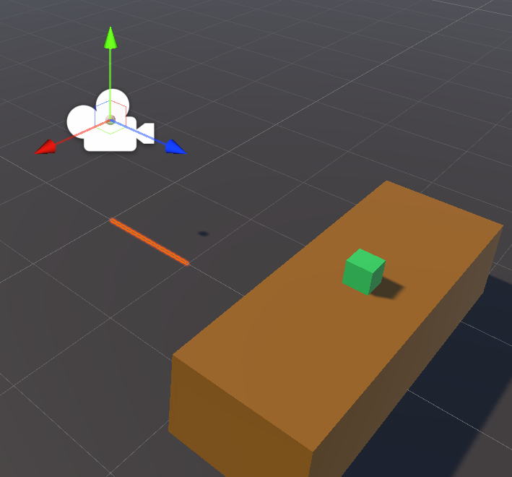
XR Interaction Architecture/Components
Interactors
XR Ray Interactor
상호작용 가능한 물체의 호버, 선택동작을 관장한다.
호버 또는 선택된 물체의 목록을 생성한다.
Interactables
Box, any Object in scene
Interaction 상태에 따른 행동을 정의한다.
Interaction Manager
XR Interaction Manager
Interactor와 Interactable 사이의 상호작용의 상태를 전환한다.
Interactor
Interaction Manager
Interactable

Slide 15
XR Interaction Architecture/Components
Controllers
XR Controller
입력 값들을 받아들이고 연결하는 역할을 한다.
여러 개의 Controller 를 가질 수 있다.
Controller Recorder
콘트롤러의 입력을 기록할 수 있다.
콘트롤러 없이 코드를 테스트할 때 유용한다.

Slide 16
Locomotion 시스템
XR Origin이 장면을 움직일 수 있도록 한다.
Components
XR Origin: 사용자
Locomotion System
Teleportation Provider/Interactables
Snap Turn Provider
Continuous Turn Provider
Continuous Move Provider
Grab Move Provider
Two Handed Grab Move Provider

Slide 17
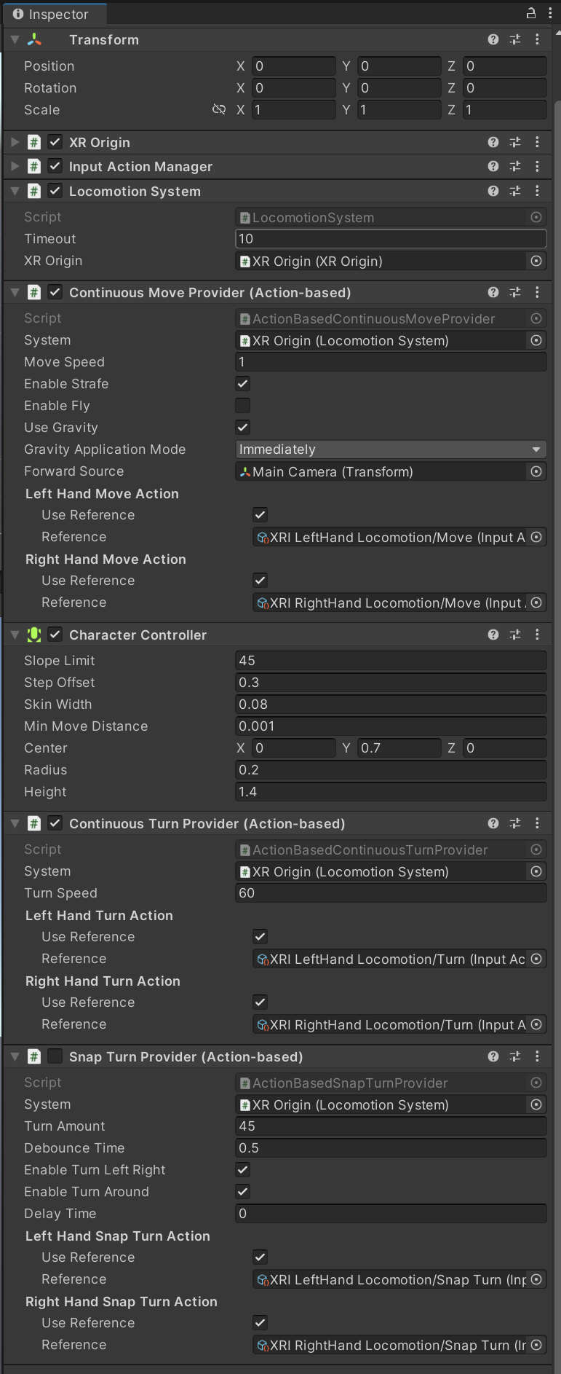
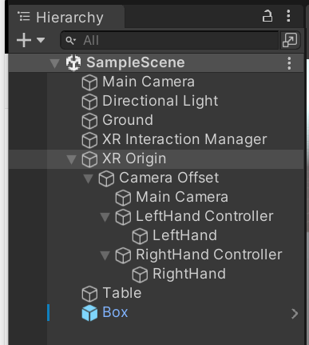
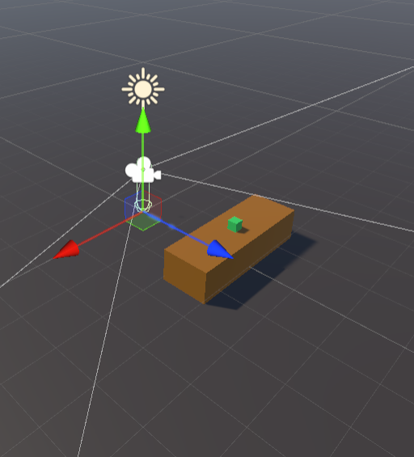
Locomotion System

Slide 18
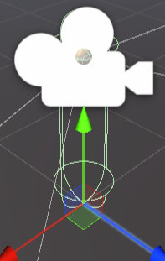
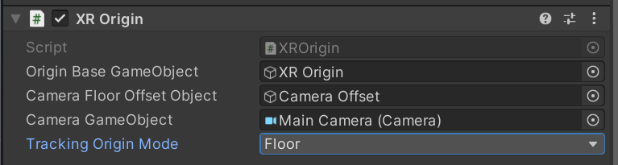
Locomotion/XR Origin
XR Origin
Property | Description
Origin Base Game Object | Indicates which GameObject acts as the Transform from tracking space into world space. In the recommended hierarchy, this is the XR Origin GameObject.
Camera Floor Offset Object | Sets which GameObject has a vertical offset applied if the device tracking origin doesn't contain the user's height.
Camera Game Object | Indicates which GameObject holds the user's Camera. This is important because the user's Camera might not be at the origin of the tracking volume. In the suggested hierarchy, this is the Camera GameObject.
Tracking Origin Mode | Sets the desired tracking origin used by the application.

Slide 19
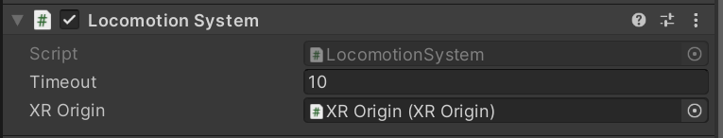
Locomotion System
Property | Description
Timeout | Controls the maximum amount of time a single Locomotion Provider can keep exclusive access of the Locomotion System. By default, the value is set to 10 seconds.
XR Origin | Selects which XR Origin this Locomotion System will control. You can have as many Locomotion Systems and XR Origins in your scene as necessary. By default, it will find the object of type XR Origin in the scene.

Slide 20
Locomotion Providers
Teleportation
Teleportation Provider
Teleportation Area
Teleportation Anchor Interactable
Snap Turn Provider
Continuous Turn Provider
Continuous Move Provider
Grab Move Providers
Grab Move Provider
Two Handed Grab Move Provider

Slide 21
할일
Locomotion System을 추가하여 XR Origin이 움직이게 하시오.
화면에 책상을 두 개 만들고 한 책상에 상자를 여러 개 만든 후에 상자를 다른 책상으로 옮기시오.

