Slide 1
Data Science Capstone
Zach Peagler

Slide 2
Executive Summary
Data collection and cleaning
Exploratory data analysis
Model creation
Visualization and dashboard creation

Slide 3
Introduction
I’m completing the MIT Data Science Professional Certificate to advance my career and show employers I mean business. Real business.

Slide 4
Exploratory Data Analysis Methodology
Histograms, bar charts, and scatter plots, oh my!

Slide 5
Predictive Analysis Methodology
Linear regressions, principal component analyses, and machine learning.

Slide 6
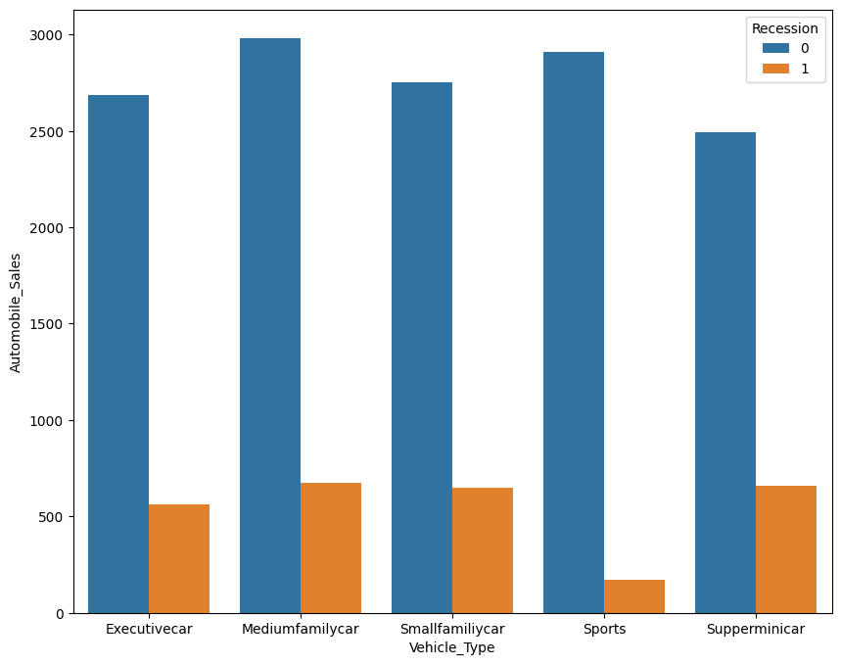
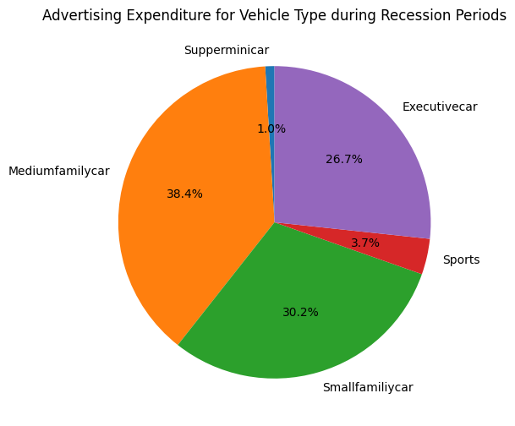
EDA with Visualizations

Slide 7
EDA with SQL
SQL in Python can be an excellent way to query databases without leaving your preferred IDE
“magic” SQL functions enhance this, and tools such as SQLite make it possible

Slide 8
Folium
I don’t have a screenshot of this
Folium is a tool for displaying interactive maps in Python, and is an excellent tool for dashboard creation

Slide 9
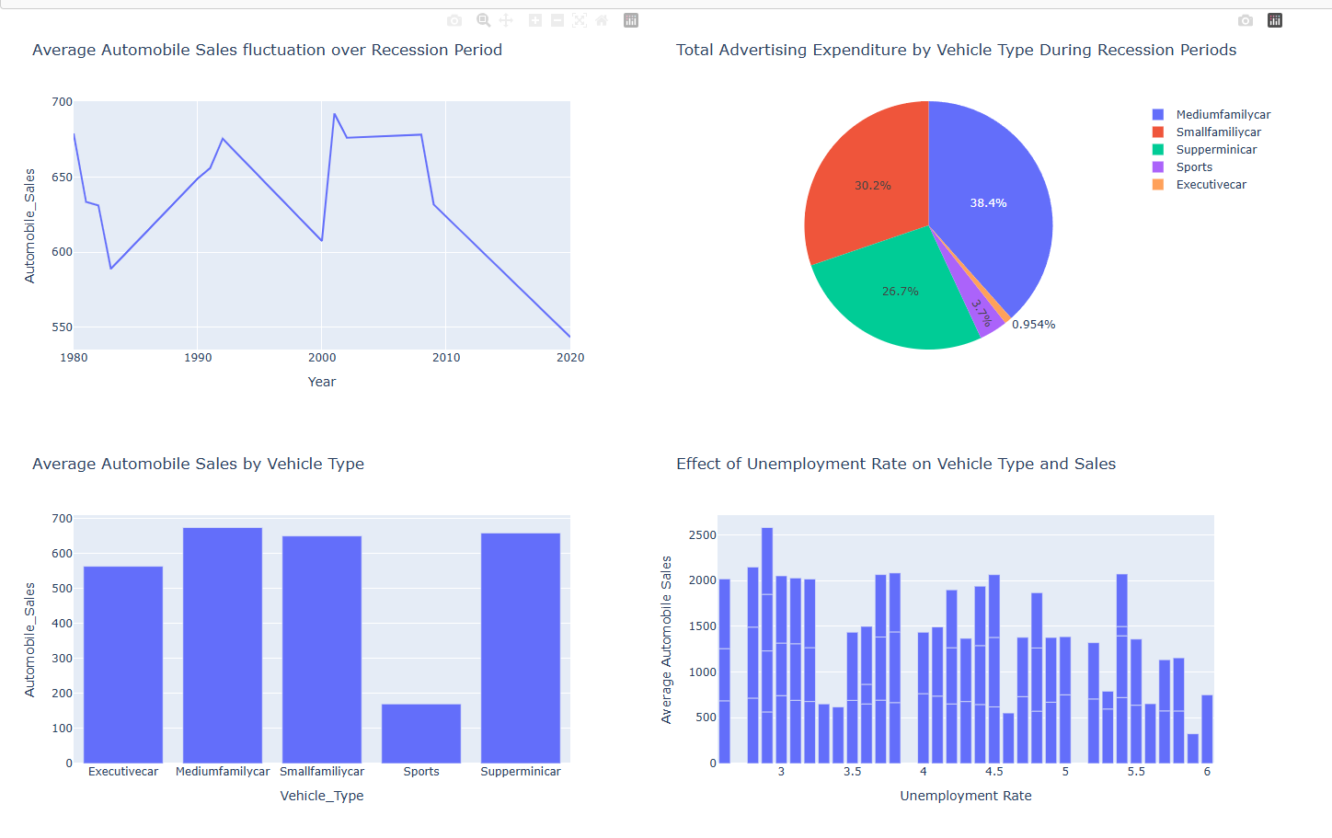
Plotly Dash

Slide 10
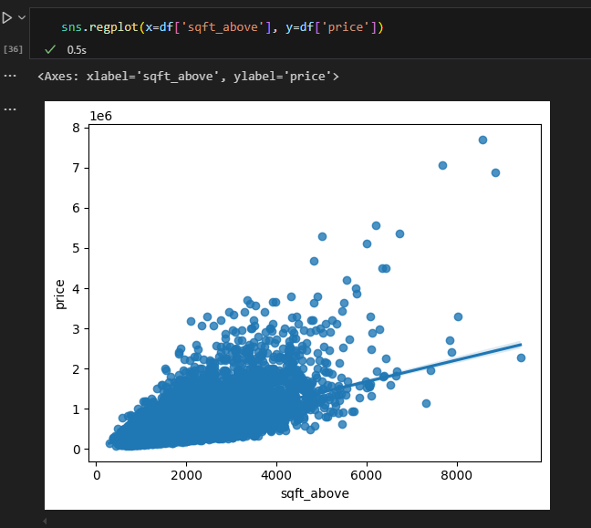
Predictive analysis results

Slide 11
Conclusion
I’m highly competent with many data science techniques.
Look at graph, Michael.

