Slide 1
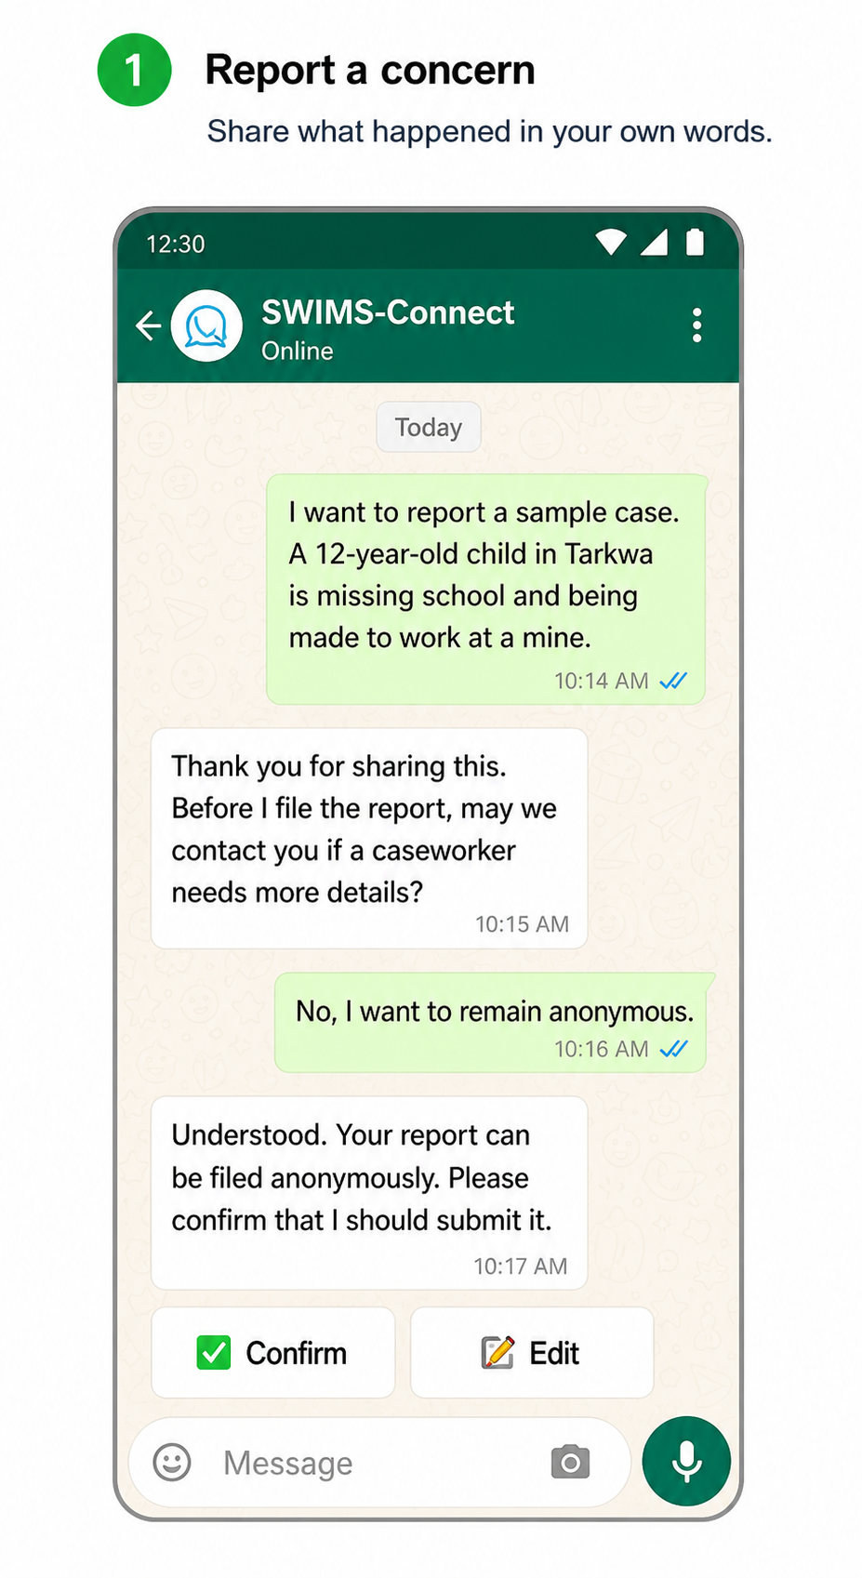

SWIMS-Connect
Conversational child-protection reporting and casework powered by UiPath
UNICEF StartUp Lab Challenge Winner • Track 1: UiPath Maestro Case

Slide 2
Problem statement and proposed solution
Problem
Solution
• Child-protection concerns can be delayed by unfamiliar or inaccessible reporting channels.
• Frontline workers face repeated data entry, fragmented referral information and heavy caseloads.
• Missed assessments, referrals and follow-ups can delay support for children and families.
• Sensitive case information should not be copied into general-purpose AI tools.
• Anonymous WhatsApp reporting through text, voice or images, creating a real Primero/SWIMS Case ID.
• Secure worker login with role-scoped case access, reports and casework assistance.
• Assessment, case-plan and referral drafts require explicit worker approval before saving.
• UiPath Maestro provides persistent deadline monitoring, verified against live Primero data.

Slide 3
Benefits and technologies used
End users | Community reporters, social workers, supervisors
User departments | Government social welfare and child-protection agencies
Industries | Government, social services, humanitarian protection
UiPath products used | Automation Cloud, Coded Agents, Orchestrator, Maestro Case, TypeScript SDK
Other integrations / APIs / technologies | Python, LangGraph, Gemini, Node.js, WhatsApp, Primero REST API
Benefits, impact and outcomes
• Familiar community access through WhatsApp, with anonymous reporting and consent controls.
• Less repetitive administration through structured intake, summaries, drafts and scheduled reports.
• Casework assistance without moving sensitive child information into an external AI chat.
• Proactive monitoring of assessments, plans, referrals, follow-ups and closure reviews.
• Configurable for Primero programmes across more than 80 countries and territories.

Slide 4
Solution architecture
Community & workers
WhatsApp text • voice • images
WhatsApp gateway
Consent • login • media • secure context
UiPath coded agent
Python • LangGraph • Gemini • typed tools
Primero / SWIMS
System of record • roles • workflow • audit
UiPath Orchestrator
Packages • assets • secrets • jobs • traces
UiPath Maestro Case
Persistent SLA clocks • verified overdue reminders
github.com/zachryit/swims-connect-uipath

Slide 5
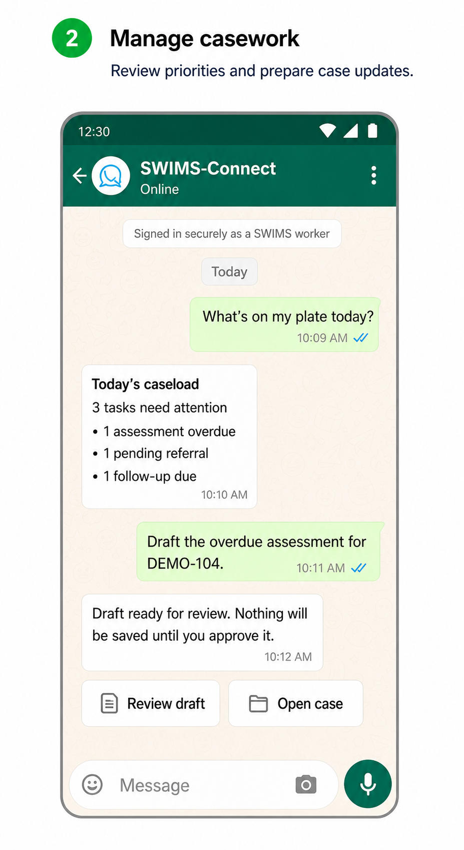
THANK YOU.
Helping every child-protection concern reach the people who can act.
WhatsApp +233 54 159 9802 GitHub github.com/zachryit/swims-connect-uipath

