Slide 1
Midterm Presentation
ECE 1160/2160
Max Reno, Tyler Garrett, Christen Rittiger, Zach Scheider

Slide 2
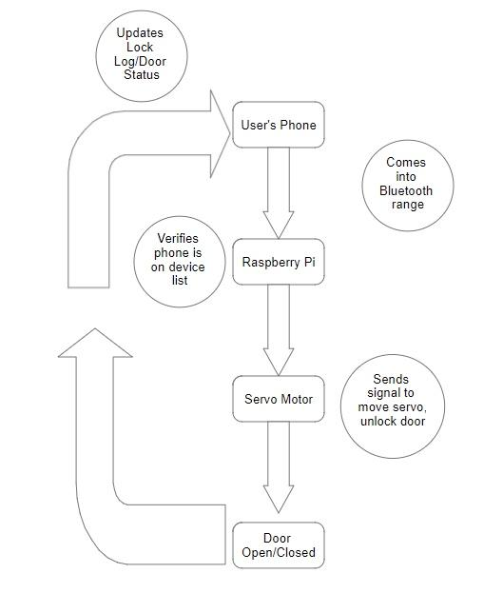
Operational Design - Requirements

Slide 3
Parts List
$19.95
$3.95
$1.95
$1.95
Sub-Total: $27.80
1 x Standard Size - High Torque - Metal Gear Servo[ID:1142]
1 x Magnetic contact switch (door sensor)[ID:375]
1 x 16mm Illuminated Pushbutton - White Latching On/Off Switch[ID:1478]
1 x Premium Female/Female Jumper Wires - 20 x 6" (150mm)[ID:1950]

Slide 4

Bluetooth Communication
Sufficient range
Pi is the source of the signal
Solves range limiting issues
Use RSSI value to determine distance
More consistent and standardized than WiFi

Slide 5

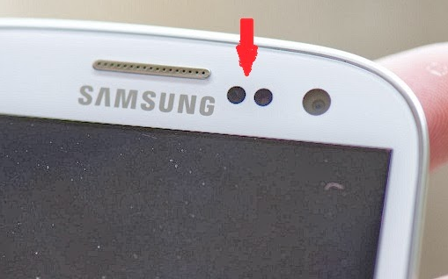

Communication Alternatives
Proximity Sensor
Pi located on inside of door for practical reasons
IR or Ultrasonic wouldn’t be able to penetrate door
WiFi
Range too large
Constriction difficult and not generalizable
Limits use case
Access to router required
Wouldn’t work in some locations
NFC
Lacks range
Less user friendly
Not hands free

Slide 6
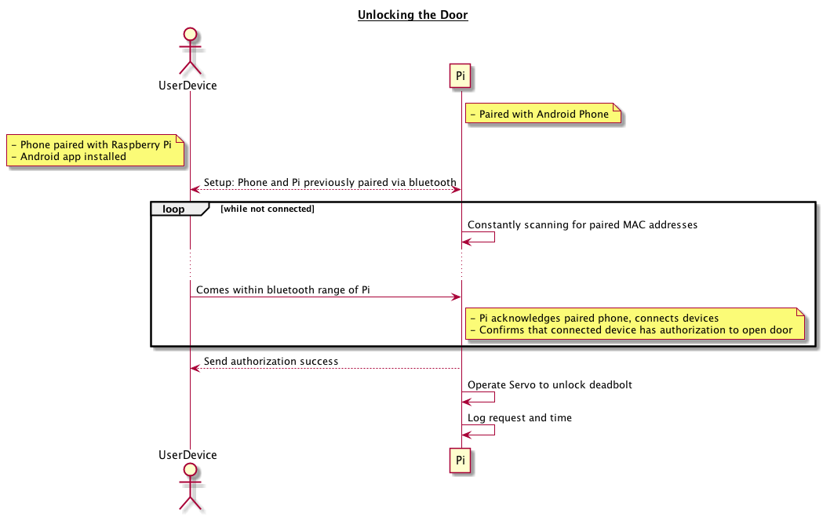
Operational Design - Specifications
Notes:
Server/Client Relationship
Pi = Server
Client = Android Phone

Slide 7
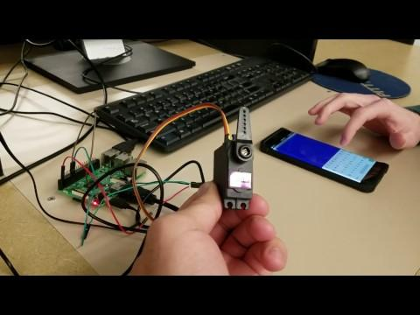
Bluetooth Demonstration

Slide 8
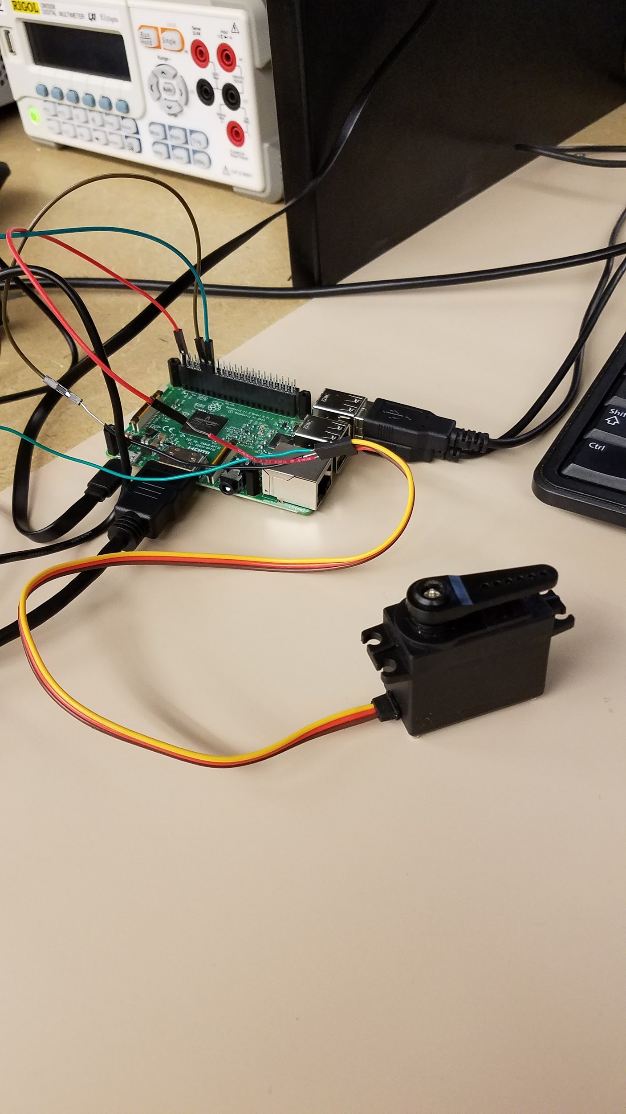
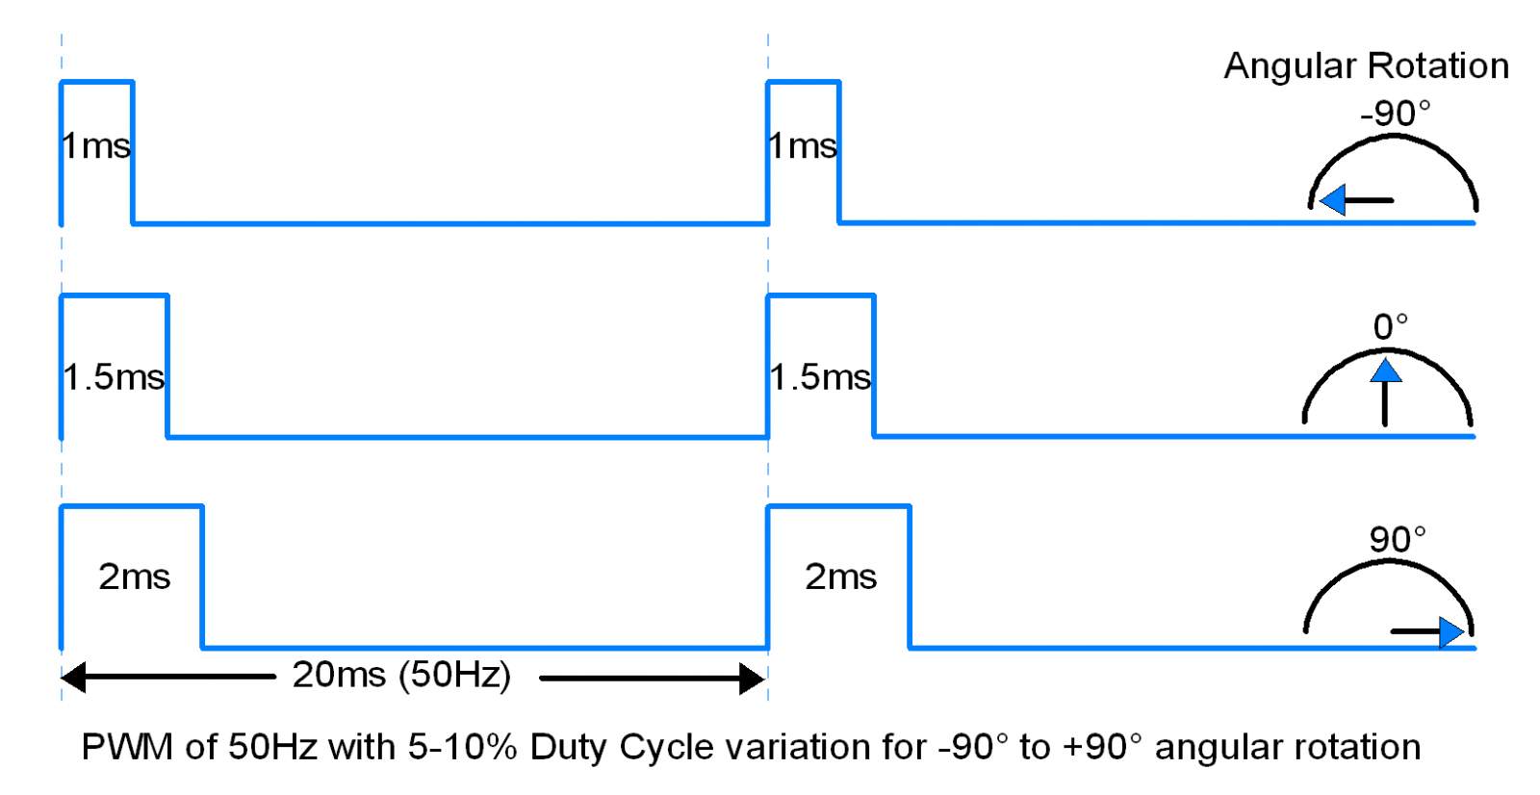
Physical Domain - Servo Motor
Notes:
Describe operation of Servo Motor

Slide 9
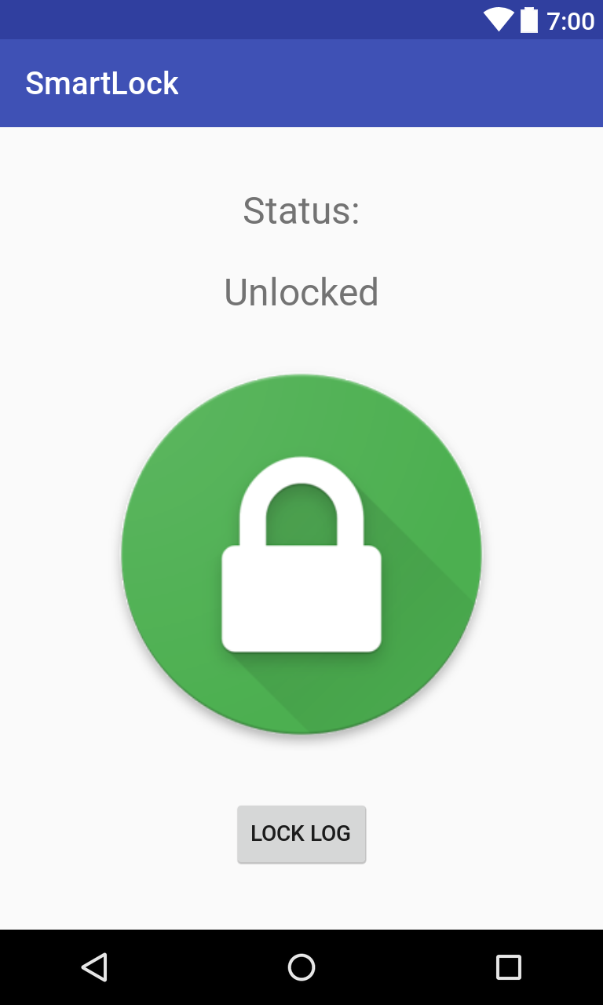
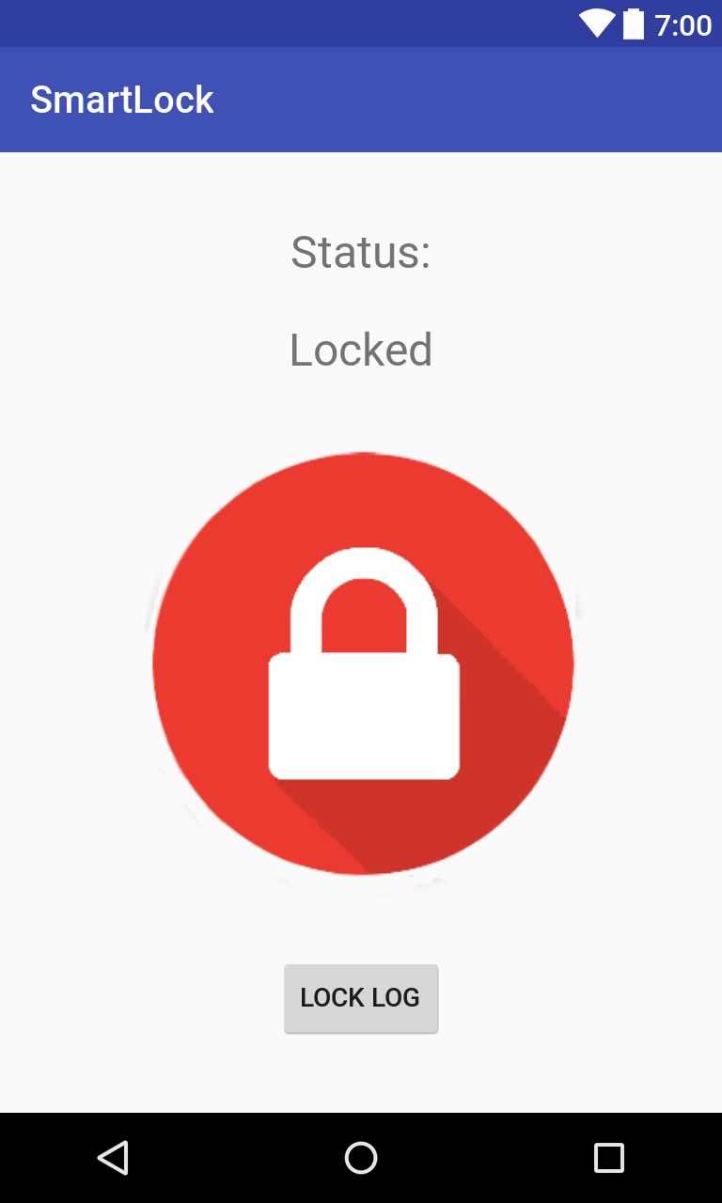
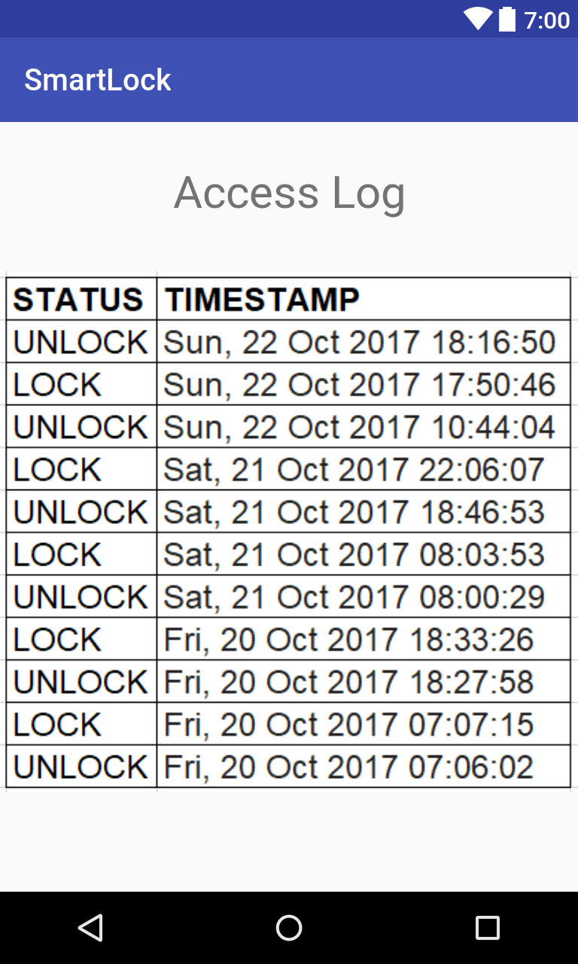
Android Application

Slide 10
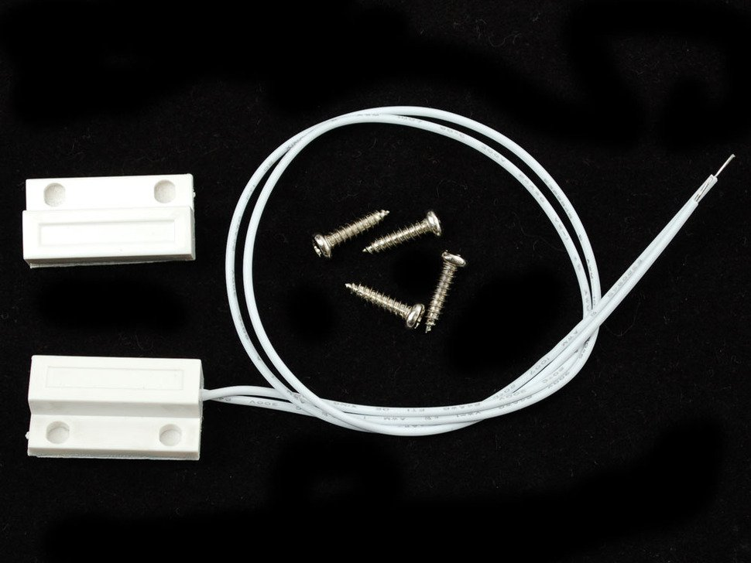
Door Sensor
Notes:
Describe troubleshooting/error handling feature with door sensor

Slide 11
Customizable Locking Methods
Timer Based
i.e. Automatically lock 1 minute after opening
Proximity Based
i.e. Automatically lock after bluetooth disconnects
Manual Lock Control
Always able to manually operate lock from phone

Slide 12
Possible Future Work
Leverage Sense Hat for orientation data
Send Push Notification when someone is trying to enter
Guest Permission
Temporary access
Remote Unlock over WiFi

Slide 13
Questions & Comments

