Slide 1
Dat Kingdoma Snowlanda
(also known as “Kingdom of Snowland” or “Snowland”)
A micronation.

Slide 2
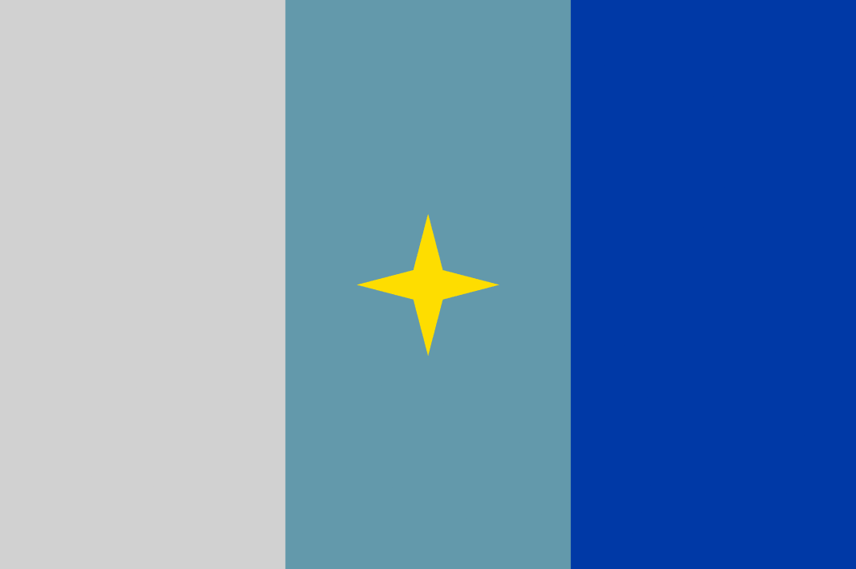
Flag
Blue resembles Water;
Cyan resembles Ice;
Gray resembles Snow.

Slide 3
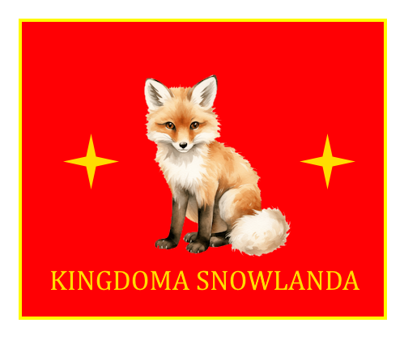
Coat of Arms

Slide 4
Population
Kingdoma Snowlanda has a population of 1, but I don’t actually live there.

Slide 5
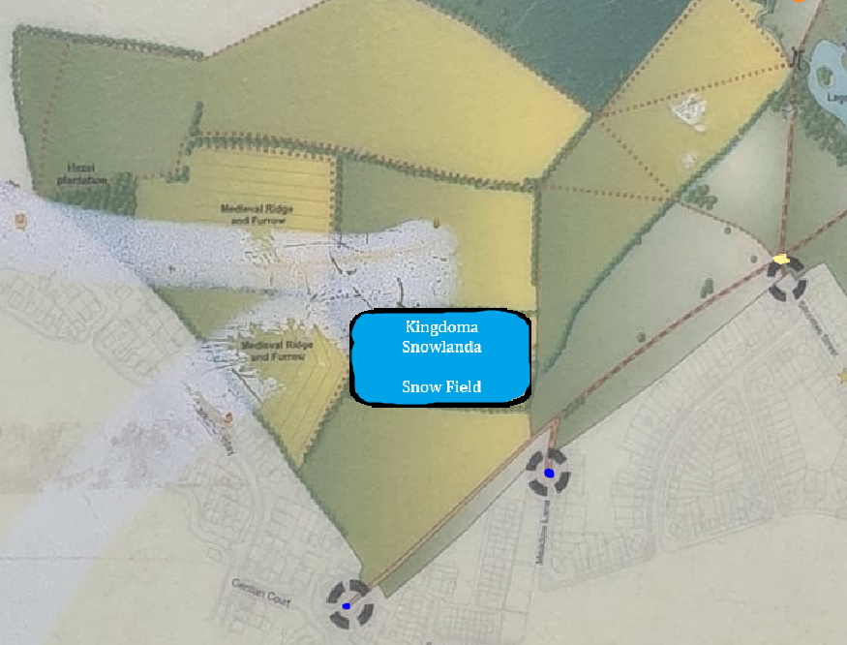
Location
Snow Field, Snowland,
Alverthorpe, Wakefield,
West Yorkshire, England.
Alverthorpe Meadows.

Slide 6
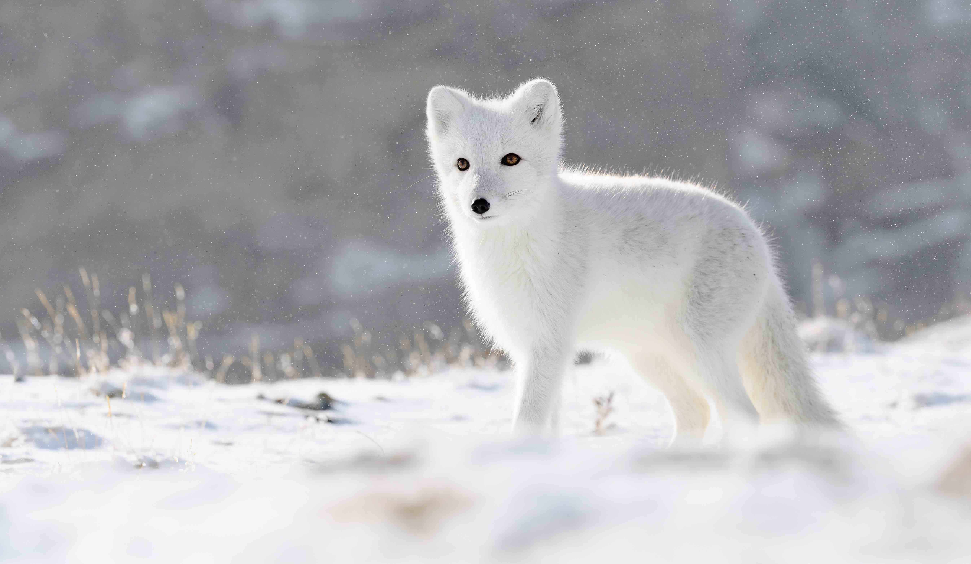
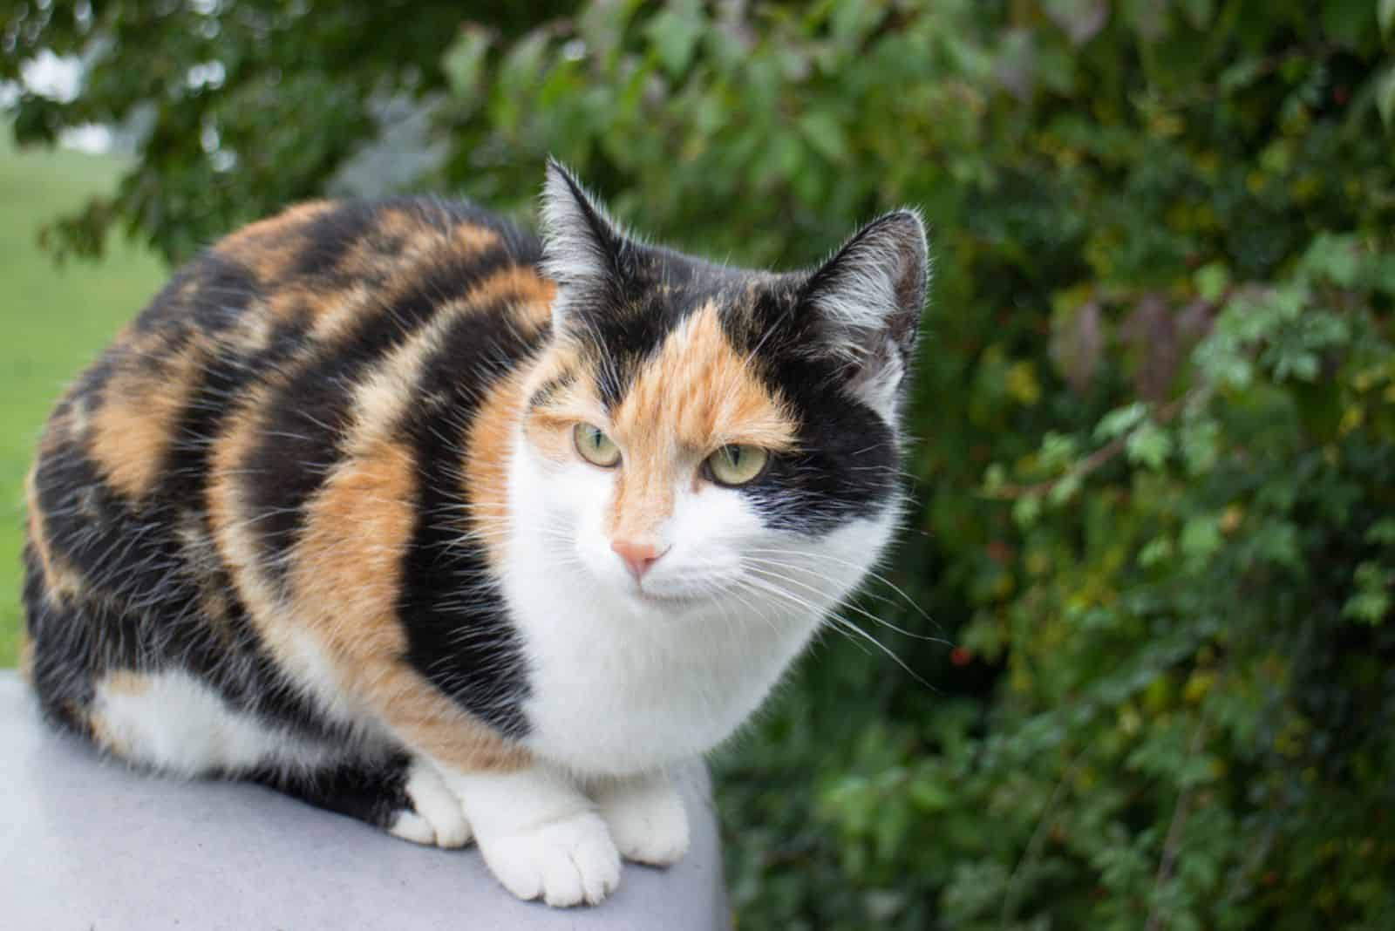
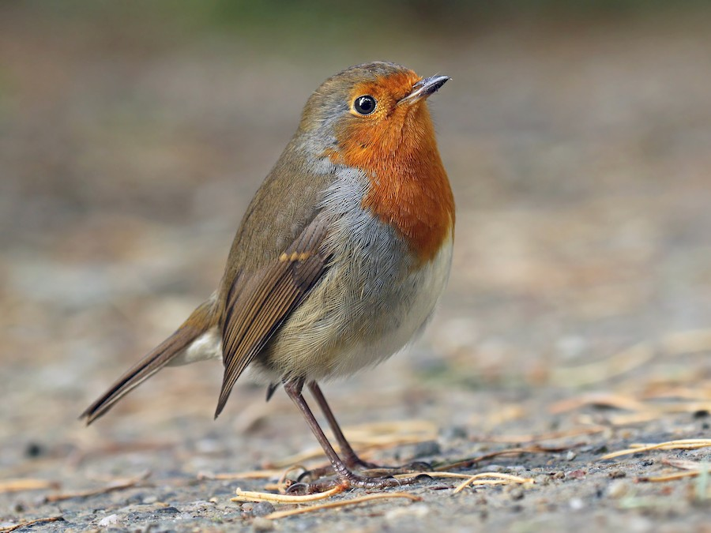
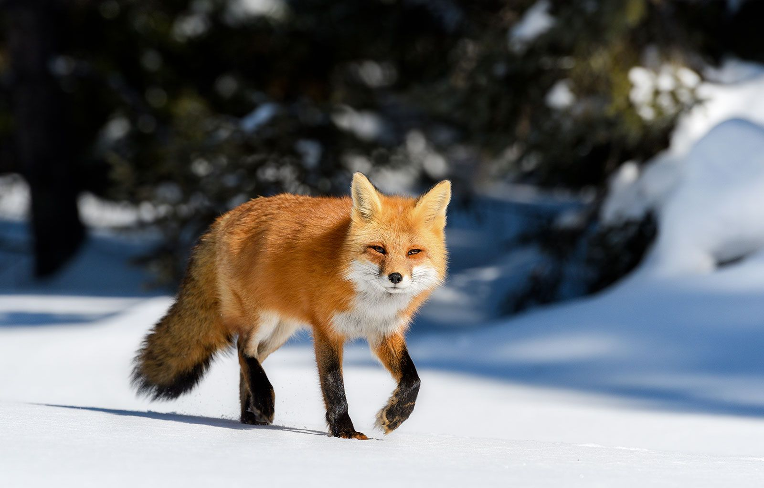
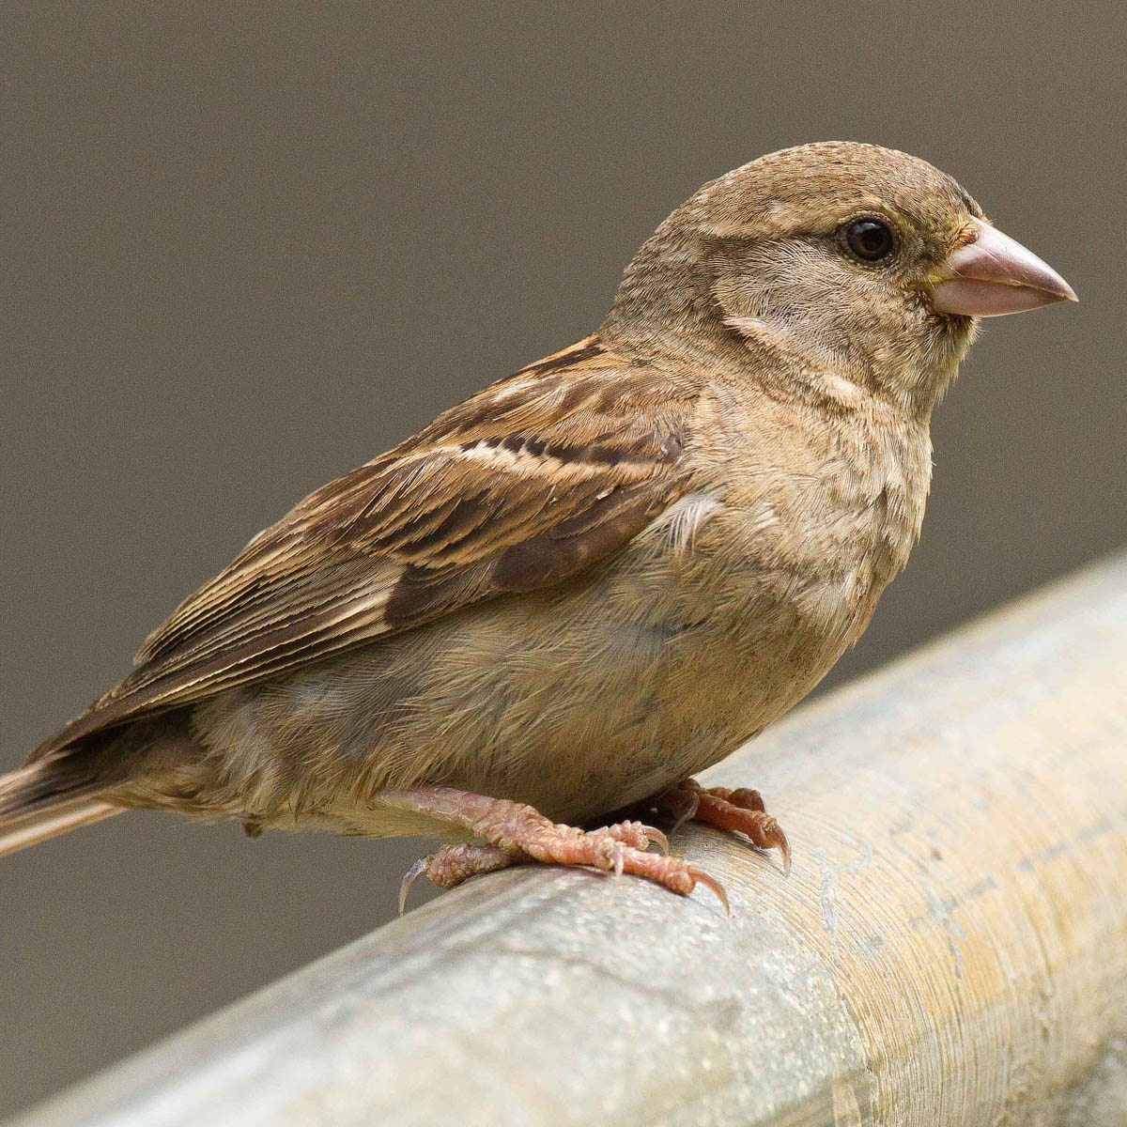
National Animals
Snowland has 3 national animals and 2 national birds: the cat, the arctic fox, the red fox,
and the european robin, and the sparrow.

Slide 7
Other information
National languages: North Sámi, Swedish, English
Motto: “Ruohttasa ja muohttaga eanan” (North Sámi for “Land of grass and snow”)
Status: Active
Capital: Snow Field
Currency: Snowlandanic Pound (SLP)
Demonyms: Snowlandanic, Snowlandaneir
Government: Full Monarchy
Independence from: United Kingdom (2025-08-06)
Time and Date format: HH.MM AM/PM, YYYY-MM-DD

Slide 8
Rules
No sand

