Slide 1
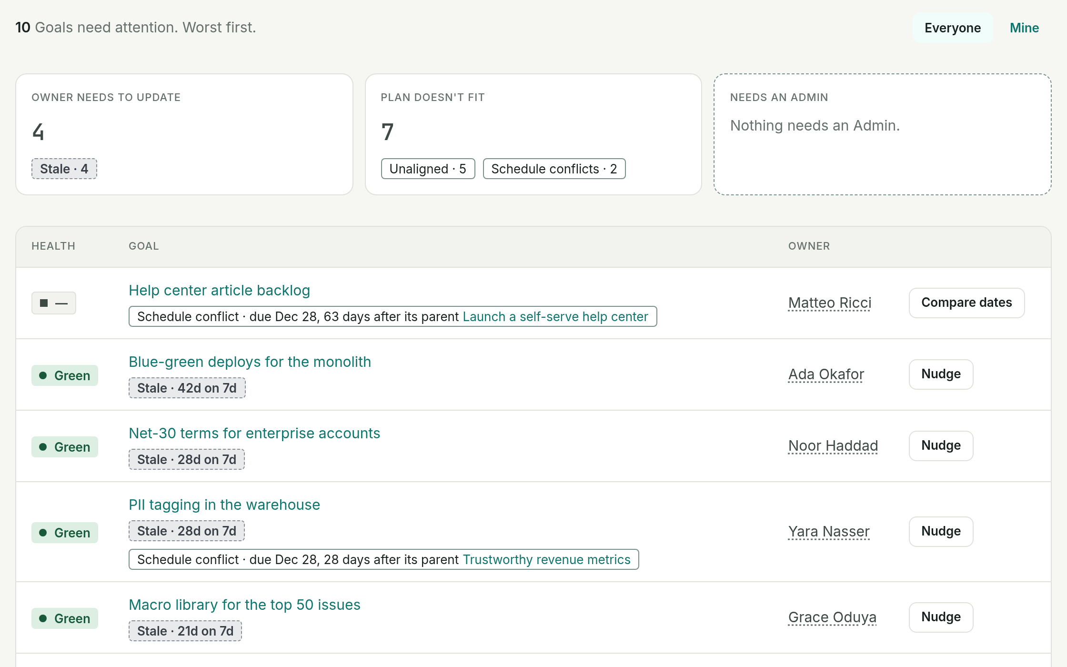
Goal Tracker
Find the goals that are in trouble before the review does.
Notes:
Goal Tracker is one place for the org to state its goals, update them weekly, and produce review-ready reports. The pitch in one line: leaders find trouble without waiting for the review or for someone to tell them.

Slide 2
The ask: replace one status deck for one cycle
One org
One cycle
One decision
Its goals move out of the PowerPoint status deck and into Goal Tracker.
Owners check in weekly. The review runs from a published Report.
At the end we expand it, extend the pilot, or stop.
The rest of this deck: why the status deck falls short, what the product does, what is ready, and how we would judge the pilot.
Notes:
Say the ask first so the rest of the deck is heard as evidence for it. Name the org and the start date here once they are chosen.

Slide 3
Trouble surfaces at the review, or after it
Silence looks like Green
The deck is rebuilt by hand
Bad news arrives without a plan
A goal nobody has updated keeps the colour it had last time. Nothing flags it.
Each review, status is collected and retyped into slides. The work goes into assembling, not reading.
A Red status says something is wrong. It rarely says what the owner will do, or by when.
Goal Tracker is built around one question: does this make trouble easier to find, or harder to hide?
Notes:
Three ways tracking goals in slides lets trouble hide. Replace these with a real incident from our own reviews before presenting.

Slide 4
What PowerPoint can't do for us
PowerPoint status deck
Goal Tracker
A goal nobody updated
Keeps its last colour. Nobody is told.
Flagged Stale, as prominently as Red.
Bad news
A red box. A plan is optional.
Needs a Path to Green and a back-to-Green date.
The review document
Assembled by hand every cycle.
Generated from check-ins, marking what changed.
History and follow-ups
Spread across old decks and notes.
Kept on the goal. Action Items carry forward.
Notes:
The first objection is 'why not keep the deck we have'. Slides are a fine way to present status and a poor way to track it: a slide can't notice that it is out of date. Check the left column against how our decks are really kept, and reword any row that isn't true of us.

Slide 5
One mechanism, from weekly update to review
1
2
3
Owners check in weekly
Risks flags what needs attention
The Report writes itself
Health, a short status, and any date changes. A routine week is one click: No change.
Red, Stale, unaligned and conflicting goals, grouped by who has to act, each with one fix.
Exceptions in full, on-track goals in one line each, with what changed since the last review.
The rigor of an MBR, the ease of a 5-15, the org-wide view of OKRs. Managers supply the data cheaply; leaders read it easily.
Notes:
Two audiences. Frontline and mid-level managers own goals and check in. VPs and above read. The manager side has to be cheap or the data goes stale; the leader side has to be easy to read.

Slide 6
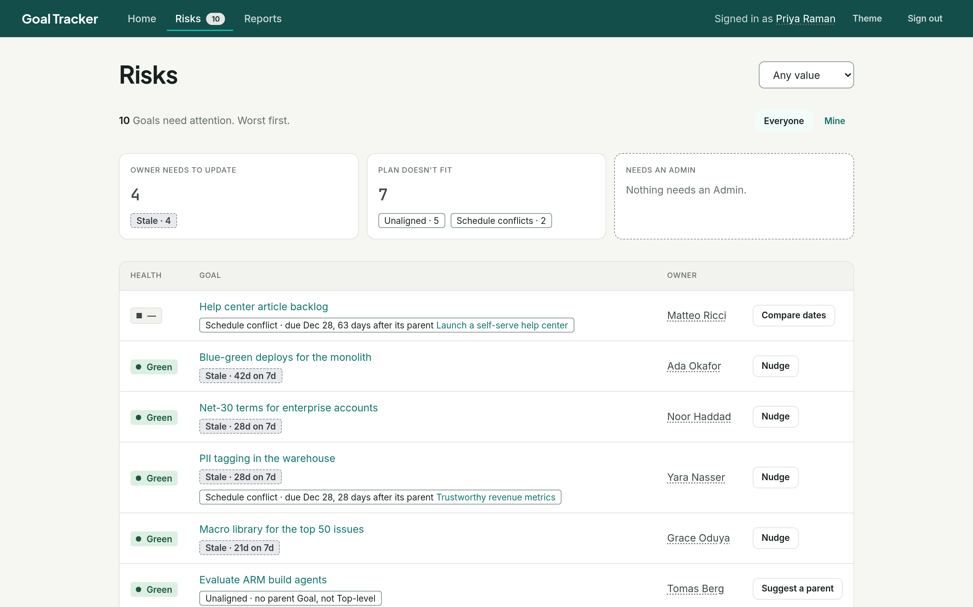
Find trouble: a silent goal is as loud as a Red one
Stale is a first-class signal
A goal past its check-in cadence is flagged, even when its last status was Green.
Grouped by who must act
Owner needs to update, plan doesn't fit, or needs an Admin.
One fix per row
Nudge the owner, suggest a parent, or compare dates. No looking up who owns what.
Screenshots from the product, on a seeded 50-goal demo org
Notes:
This is what a leader opens between reviews: which goals need attention, why, and who has to act. The count sits in the top bar on every page. In the demo org, 10 of 50 goals are flagged, and 4 of those are Green goals nobody has updated in three to six weeks.

Slide 7
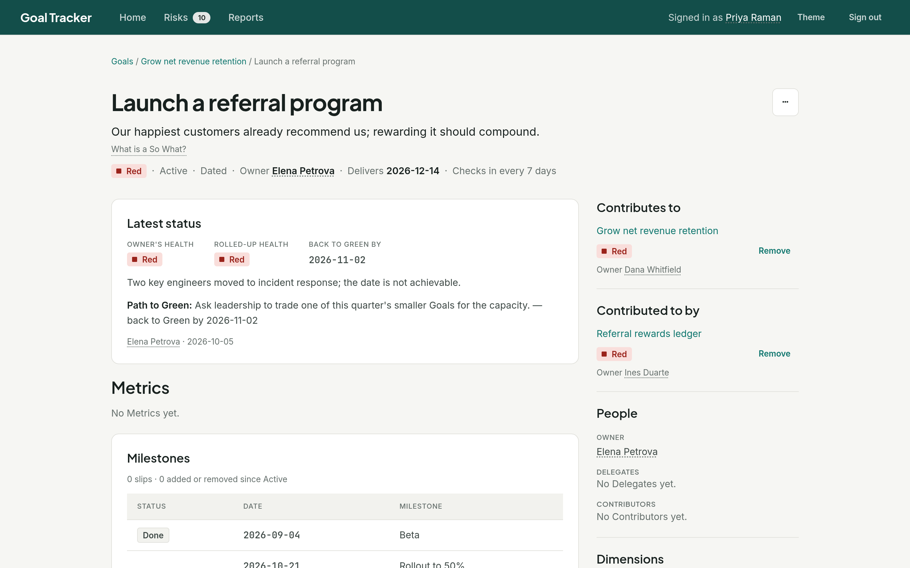
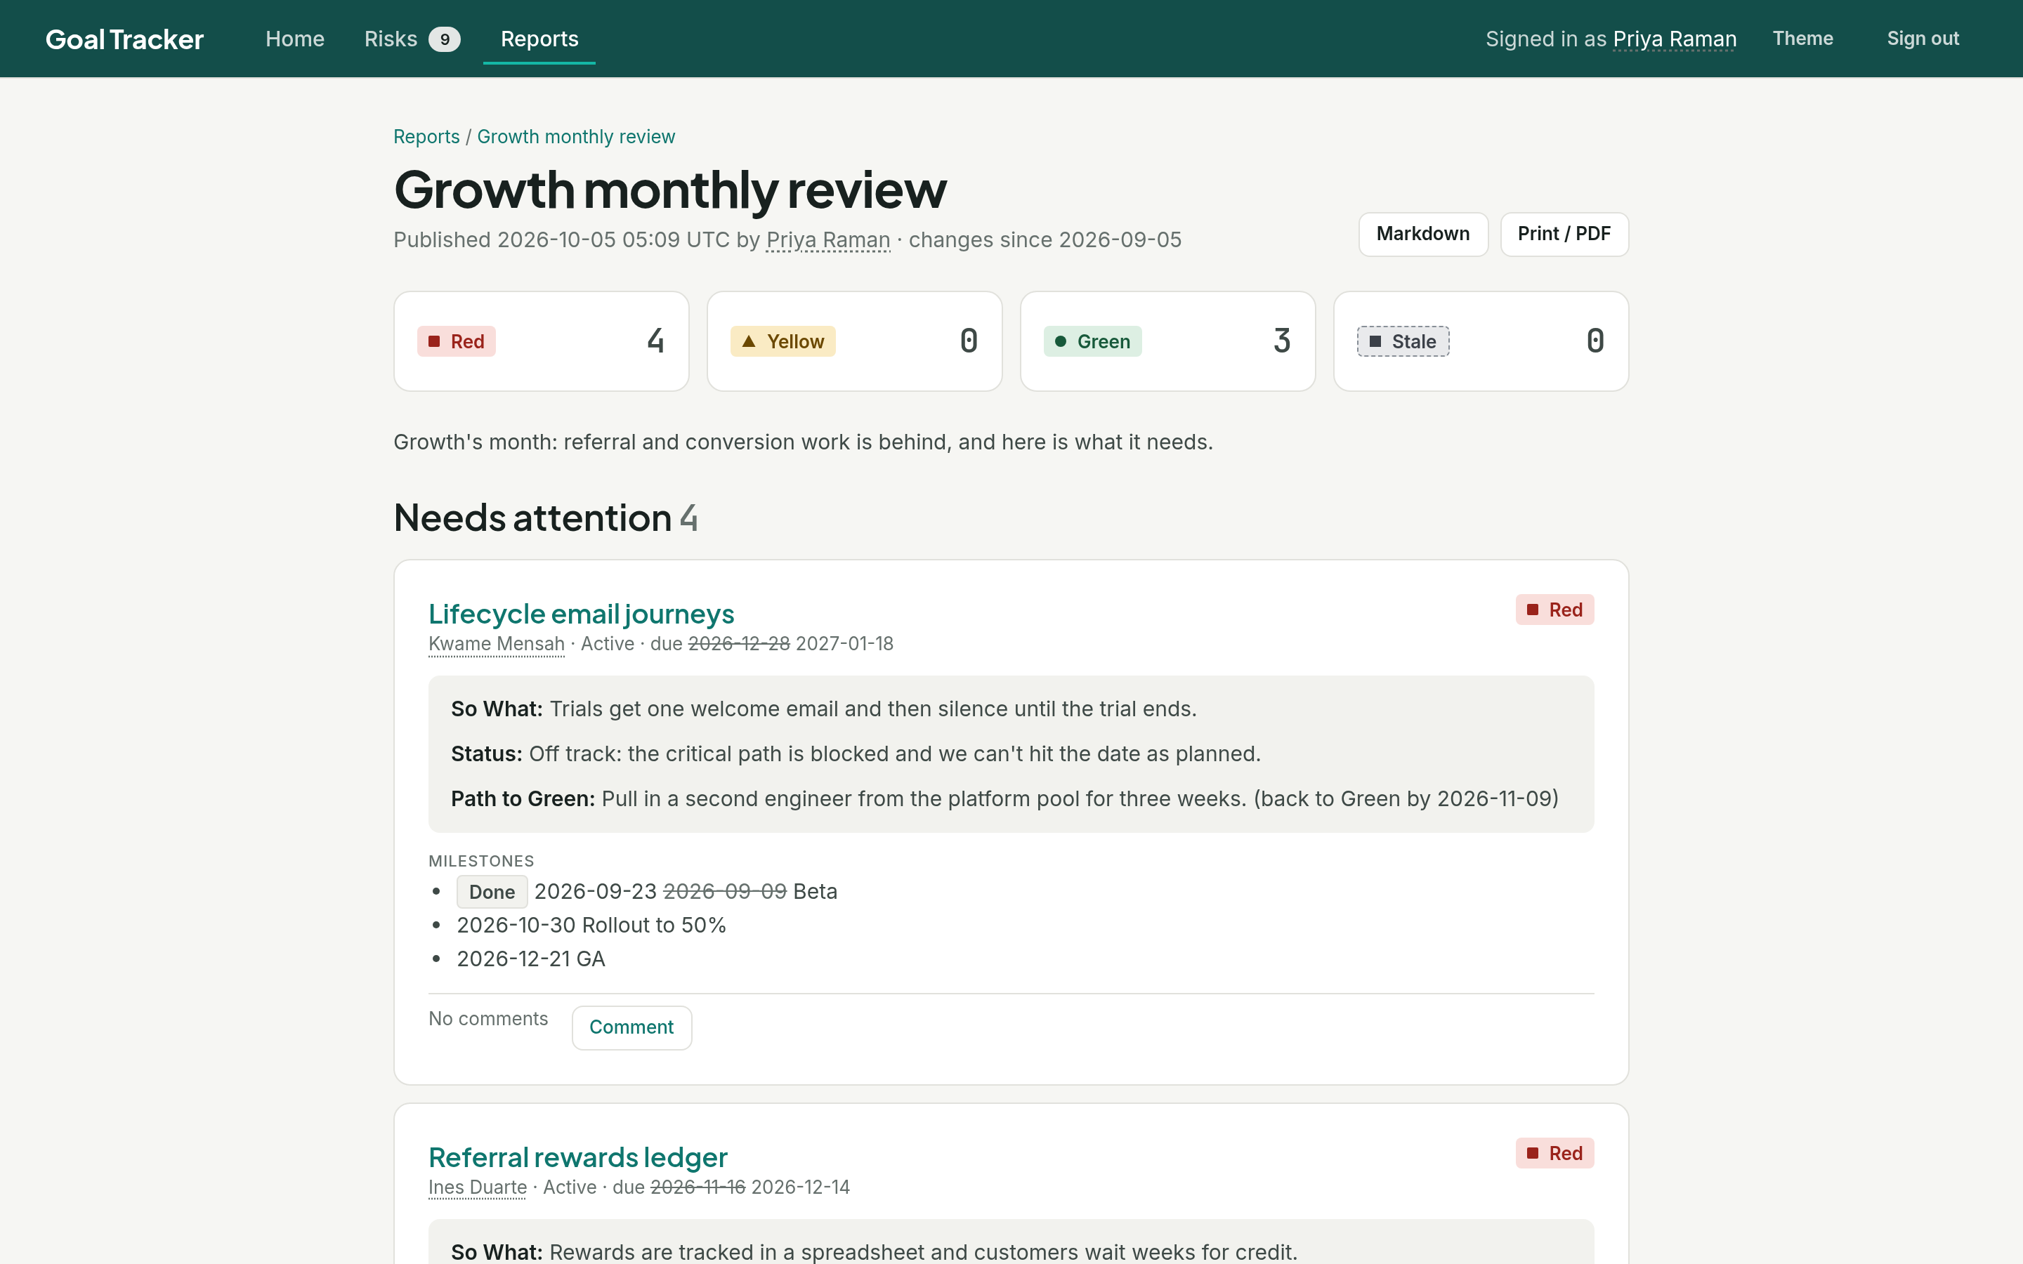
Understand it: the plan, the date, the review
Bad news comes with a plan
The review writes itself
A Yellow or Red check-in must state a Path to Green and a back-to-Green date. Miss that date and the goal is flagged.
Exceptions in full, on-track goals in one line, and what changed since the last one. Comments reach the goal's owner.
Screenshots from the product, on a seeded 50-goal demo org
Notes:
Left: any flagged goal opens to the owner's latest status and plan, the worst Health among its child goals beside the owner's own call, and the history of how it got here. Right: a Report built by one rule, Team is Growth, and published as it stands. The author writes only the introduction and their own notes. It shares from the tool, as Markdown, or printed to PDF.

Slide 8
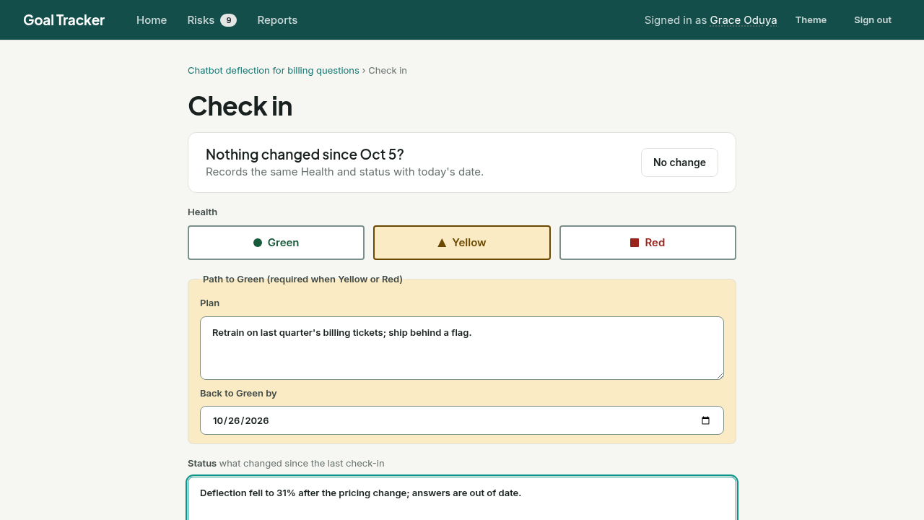
The cost: most weeks, one click per goal
Home says what's due
"Your week" lists the check-ins that need you, and why each is listed.
No change is one click
A routine week records the same Health and status with today's date.
A real update is one form
It starts from last week's answers and asks for a plan only when Health isn't Green.
Recording from the demo org: a one-click No change, then a full check-in. Click to play.
Notes:
The video: an owner lands on Home, clears a Stale goal with one click on No change, then checks in Yellow on another with a Path to Green. No change is refused when it would be wrong, such as a Green goal with an overdue milestone. This is the price of everything on the previous slides, so it has to stay low. We have not measured it with real managers yet; the pilot would.

Slide 9
What's built, and what a pilot still needs
Working today
Needed before a pilot
Goals, the links between them, and weekly check-ins
Company sign-in. Today any email address signs in.
Risks: Stale, unaligned, schedule conflicts, ownerless
Sending email. Reminders and alerts are logged, not sent.
Reports by rule or hand-picked, with Markdown and PDF
Hosting, and someone to run it.
Comments and Action Items on published reports
Spreadsheet import to load an org's goals
Notes:
It is a working prototype. Everything shown in this deck was captured from the running product. The three gaps on the right are what stand between it and real users: sign-in is a development one, emails are written to a log, and it has no production home.

Slide 10
Three ways this could fail, and the answer
"Managers won't check in"
A routine week is one click. A weekly reminder lists what's due, and anyone can nudge the owner of a Stale goal.
"It's one more tool"
It replaces the status deck. The Report is the review document, and it exports to Markdown or PDF.
"Owners will call it Green"
The worst Health among a goal's children shows beside the owner's call, and a difference must be explained. Stale goals and slipped dates show whatever the owner says.
Notes:
The first is the real risk: the tool is only as good as the check-ins. The reminder depends on email being sent, which is one of the gaps on the previous slide. The pilot's first measure tests exactly this.

Slide 11
The pilot: one org, one cycle, three measures
THE PLAN
HOW WE'D JUDGE IT
1
Load one org's goals
Each with its So What and what it contributes to.
1
Check-ins on time
Goals updated each week. Proposed bar: 80%.
2
Check in weekly for a month
Reminders and nudges do the chasing.
2
Trouble found early
Problems surfaced before the review, not at it.
3
Run the review from the Report
No hand-built status deck that cycle.
3
Review prep time
Hours to produce the Report, against the last deck.
Then one decision: expand it, extend the pilot, or stop.
Notes:
The ask is small and time-boxed. Fill in the org, the start date and the sponsor before presenting. The 80% bar is a proposal; agree the bar with the VP. For the third measure, note how long the last PowerPoint status deck took to assemble before the pilot starts.

