Slide 1

Functions & Examples for FPCA
--by Zach Wang
@BioRankings

Slide 2
5 functions implemented:
ReadFile
fourier_smooth
fPCA.nodes
node.scaler
row.check
Wave

Slide 3
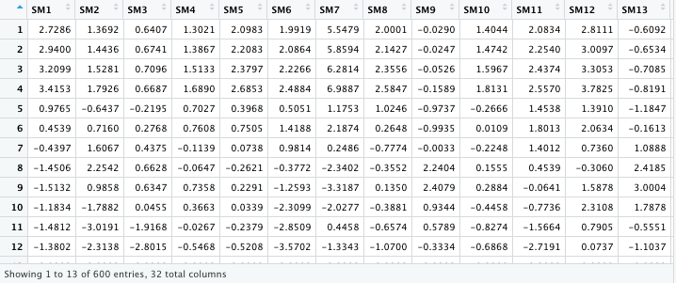
1. ReadFile
ReadFile(file_loc, time_subset=c(1:600), node_subset=c(1:32))

Slide 4
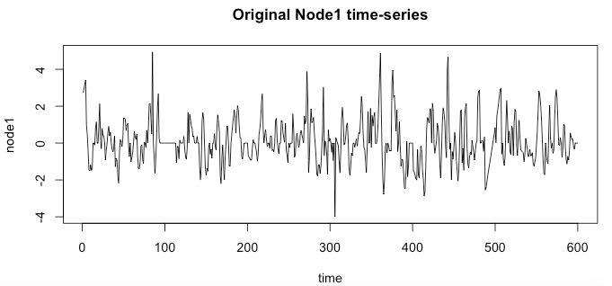
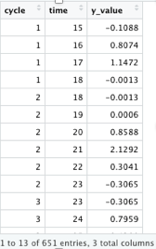
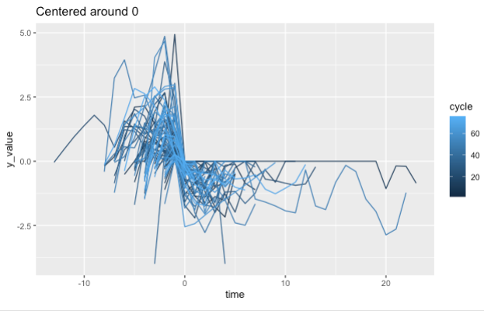
2. Wave
Wave(data_15may2020[,1], register=1)
One node (Columns) at a time
Register: centered around zero

Slide 5
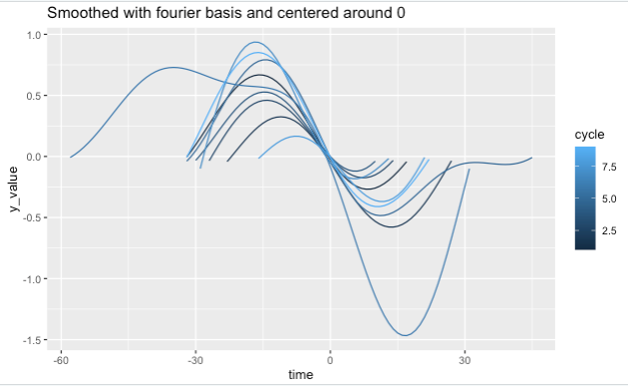
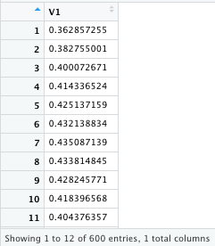
3. fourier_smooth
fourier_smooth(data_mat=data_15may2020, time_subset=c(1:600), node_subset=c(1), k=32)
Data_mat
Time_subset
Node_subset
k: specify the “nummber of fourier basis functions” to be used in the smoothing process
→ return ’fdSmooth’ object from fda package
Wave ( eval.fd (Fourier_smooth (…) ) )
Note: Fourier_smooth takes input data with 1 or more than 1 columns; However,
Wave function takes input with exactly 1 column

Slide 6
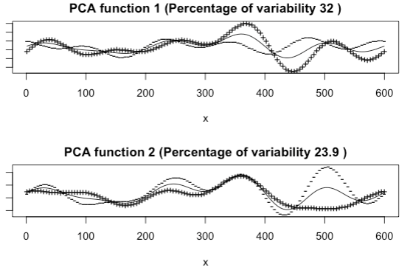
4. fPCA.nodes
fPCA.nodes(data_15may2020, k=11, nharm=2, plt=1)
data_mat
k
nharm → number of Principle Components to be used
plt
Note:
Performing fPCA requires at least 2 columns with identical number of rows.

Slide 7
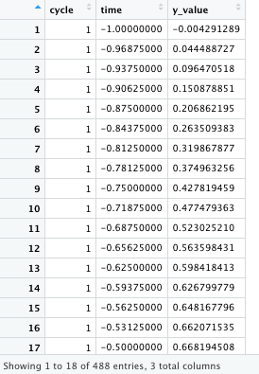
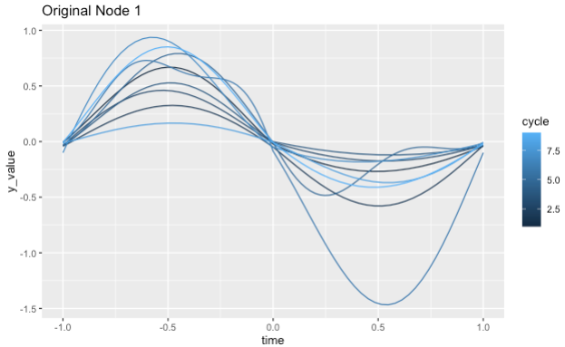
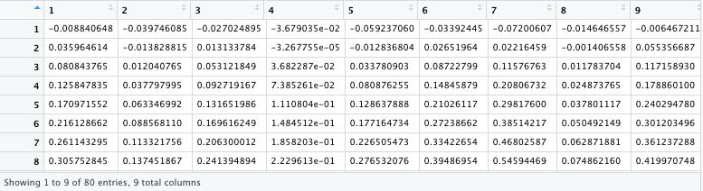
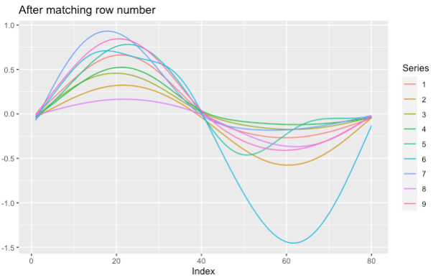
5. node.scaler & row.check
node.scaler (data_15may2020, node=c(1) )
One node at a time
row.check ( node.scaler(…) )
Takes the result from calling node.scaler as input

Slide 8
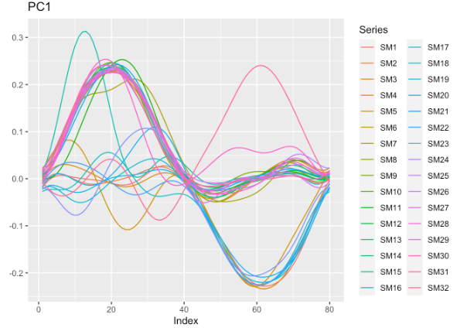
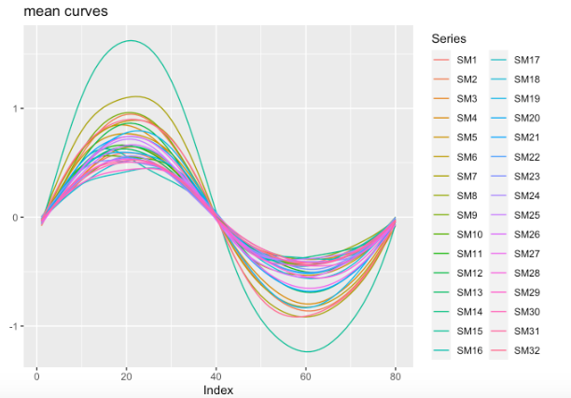
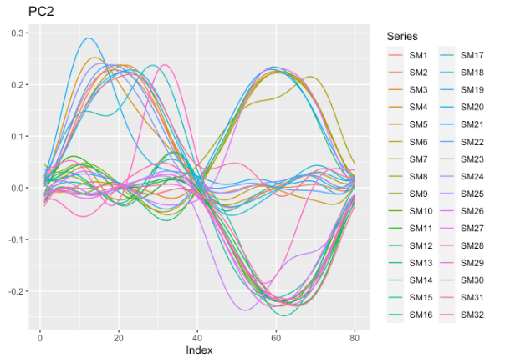
6. Applied functions to entire dataset (1 patient)

