Slide 1
“Testing Polygon Recognition Time by Complexity” Zach Zager May 6, 2015
Abstract: The study of human cognitive processes is important for developing more user-friendly technologies and to better accommodate those with visual and learning disabilities (Koller, 2012). This project is designed to study human polygon recognition, specifically to test for an association between polygon complexity (operationalized by number of vertices) and recognition time. The program measures response time to four different polygons and then runs statistical analyses and hypothesis testing. This work allows anyone (with MATLAB) to run this experiment, collect data and analyze the results.

Slide 2
Background
Understanding visual processes helps us better accommodate those with visual and learning disabilities (Koller, 2012). It can also assist us in forming computational models of our neural visual pathways. This is useful for creating computerized artificial visual system and developing improved user interfaces regarding our own visual networks (DiCarlo, Zoccolan, & Rust, 2012). I want to test if people take longer to recognize shapes with more vertices than shapes with fewer vertices. The results of this study could help us better understand how polygon schemas are stored in the brain and whether or not retrieval times differs based on complexity.

Slide 3
Technical Approach
This program uses two main scripts: ‘dataCollection.m’ and ‘dataAnalysis.m’. ‘dataCollection’ relies on the Psychtoolbox add-on functions for MATLAB to present participants with a series of shapes before storing the results in the file ‘CollectedData.mat’.
‘dataAnalysis’ uses a series of numerical methods to analyze the data and test it for statistical significance.
‘dataAnalysis’ also plots the data and best-fit regression line for easy visualization. It then saves the plots.

Slide 4
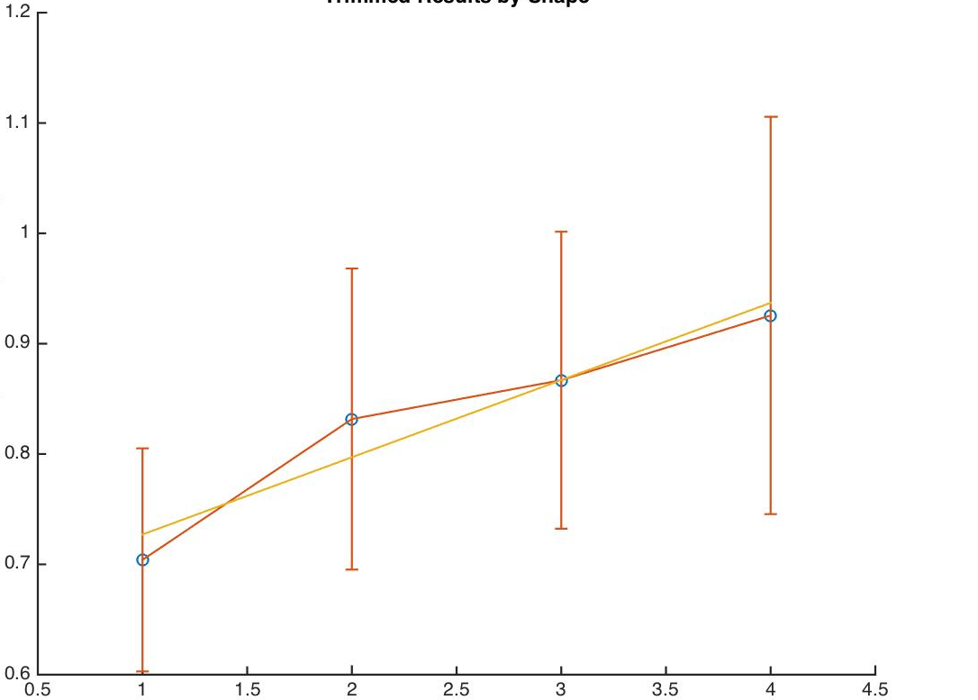
Results (1) - Trimmed Results Plot
Trimmed Results by Shape
Mean Response Time (seconds)
Triangle Square Pentagon Hexagon

Slide 5
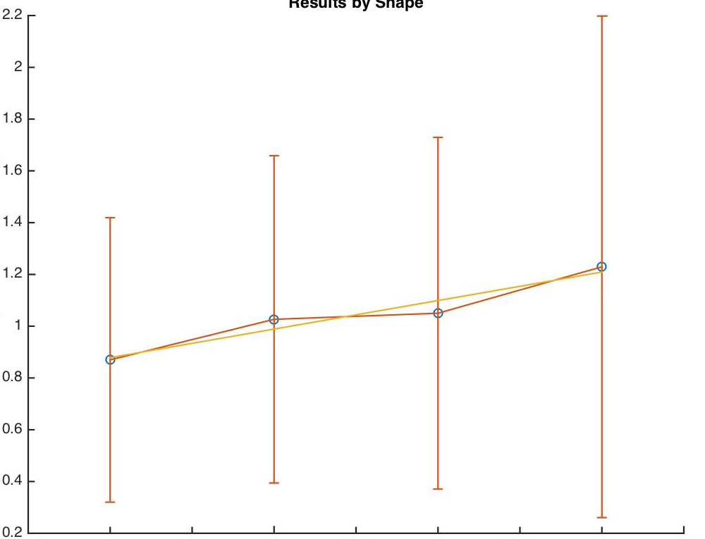
Results (2) – Untrimmed Results Plot
Results by Shape
Mean Response Time (seconds)
Triangle Square Pentagon Hexagon

Slide 6
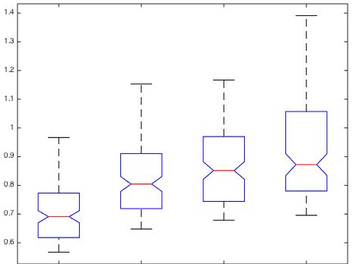
Results (3) – ANOVA Results
Source SS df MS F Prob>F
-------------------------------------------------------
Columns 3.4784 3 1.15948 58.41 1.37947e-32
Error 10.4022 524 0.01985
Total 13.8806 527
Response Time Distribution (seconds)
Results by Shape
Triangle Square Pentagon Hexagon

Slide 7
Conclusions and Next Steps
The results of this experiments were very (almost surprisingly) significant. This may have been due to the input configuration. Participants using their right hand to input data would have been able to press the <1> key (pointer finger) faster than the <4> key (pinky finger). This may have affected the validity of the results. The next step for this project is to utilize an applied task to test shape recognition speed. I could also explore recognition of more specific shapes (rhombus, different types of triangles, etc.). More analytical methods could also be interesting.

Slide 8
References
Koller, H. P. (2012). Visual processing and learning disorders. Current Opinion in Ophthalmology, 23, 377-383.
DiCarlo, J. J., Zoccolan, D., and Rust, N. C. (2012). How does the brain solve visual object recognition? Neuron, 73, 415-434.
Cooper, R. Creating experiments using Matlab and Psychtoolbox. (http://www.academia.edu/2614964/Creating_experiments_using_Matlab_and_Psychtoolbox)

