Slide 1
UFC Champion Rankings
Cloud Native Project – By Zach Zloof

Slide 2
Contents
I will be:
showing you how the project was planned
walking you through the back-end and front-end of the application showing you how it was done
explaining the testing with results
Giving a summary for the project
Demonstrating a demo of the application
Taking questions at the end

Slide 3
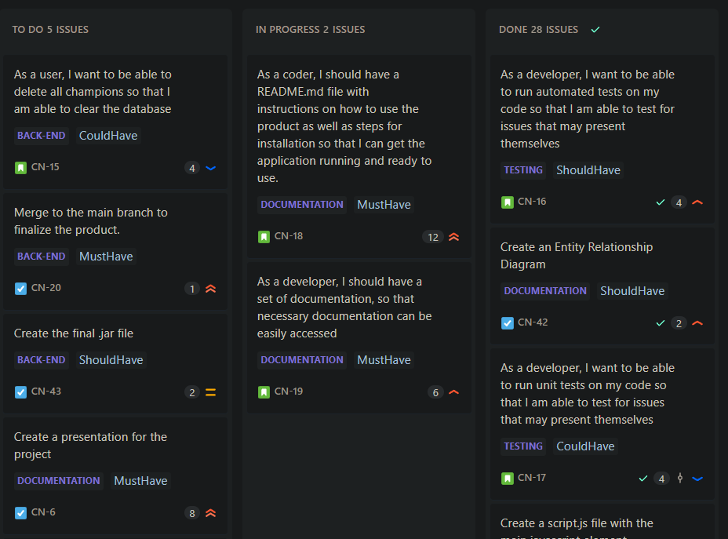
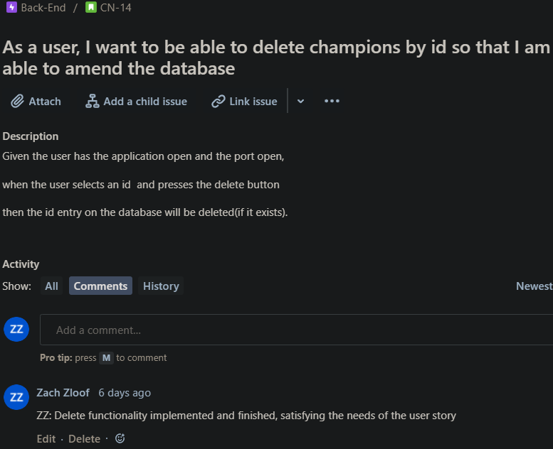
Planning
I used Jira to plan my project, splitting my work into 5 epics, 15 user stories and 20 tasks
I used MosCow, prioritisation, story points as well as acceptance criteria where applicable

Slide 4
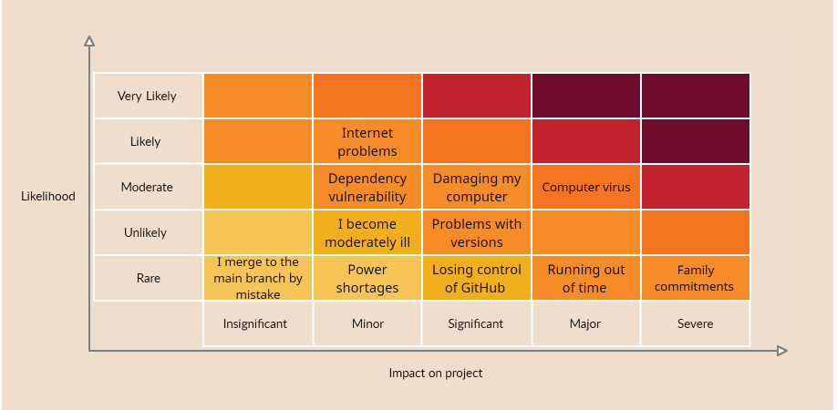
planning

Slide 5
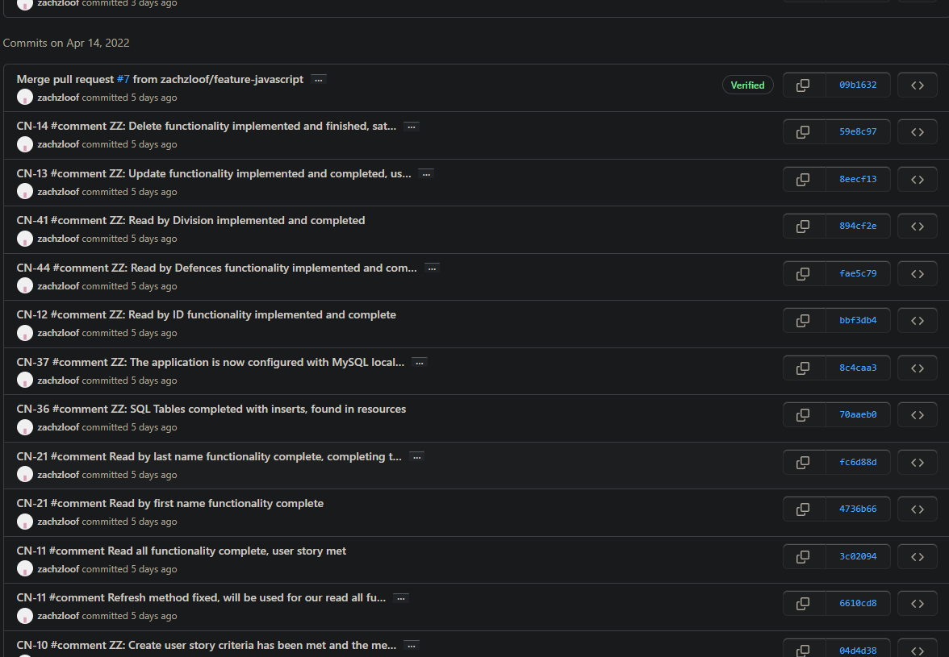
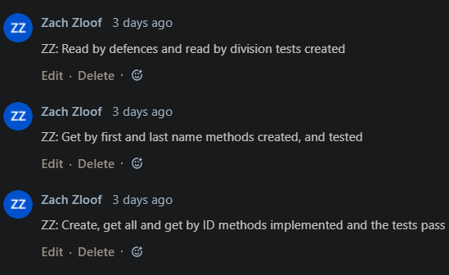
Version control
I linked my GitHub with my Jira board, and with this made every commit a smart-commit which automatically comments on my Jira
I used GitHub for my version control, and overall I used 10 different branches (8 features)

Slide 6
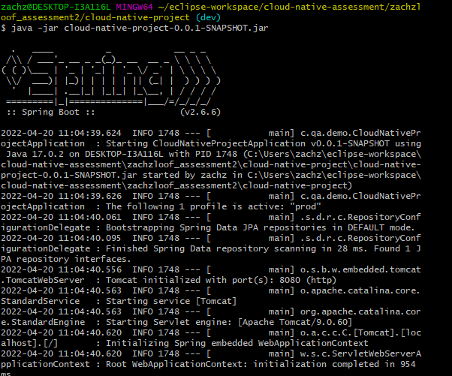
Spring
Spring was used to create a REST API for the application

Slide 7
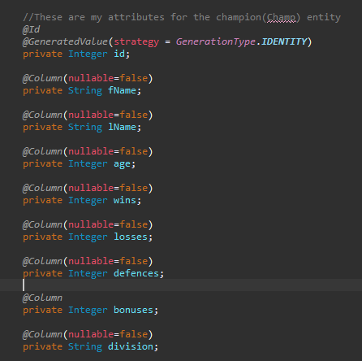
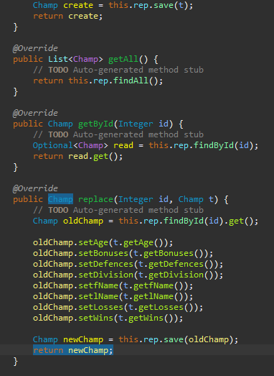
Java
This is my domain
This is my service

Slide 8
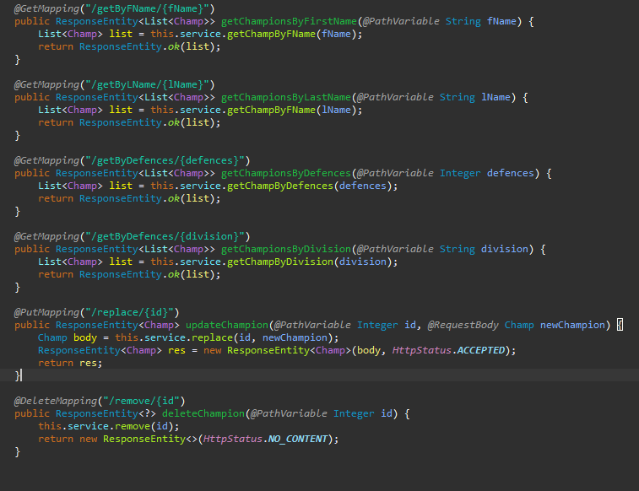
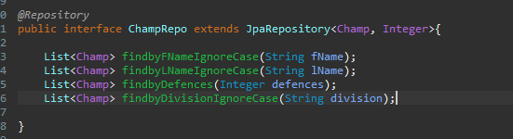
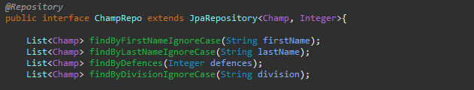
java
This is my repository originally, this caused problems
This is my repository after it was fixed
This is my controller

Slide 9
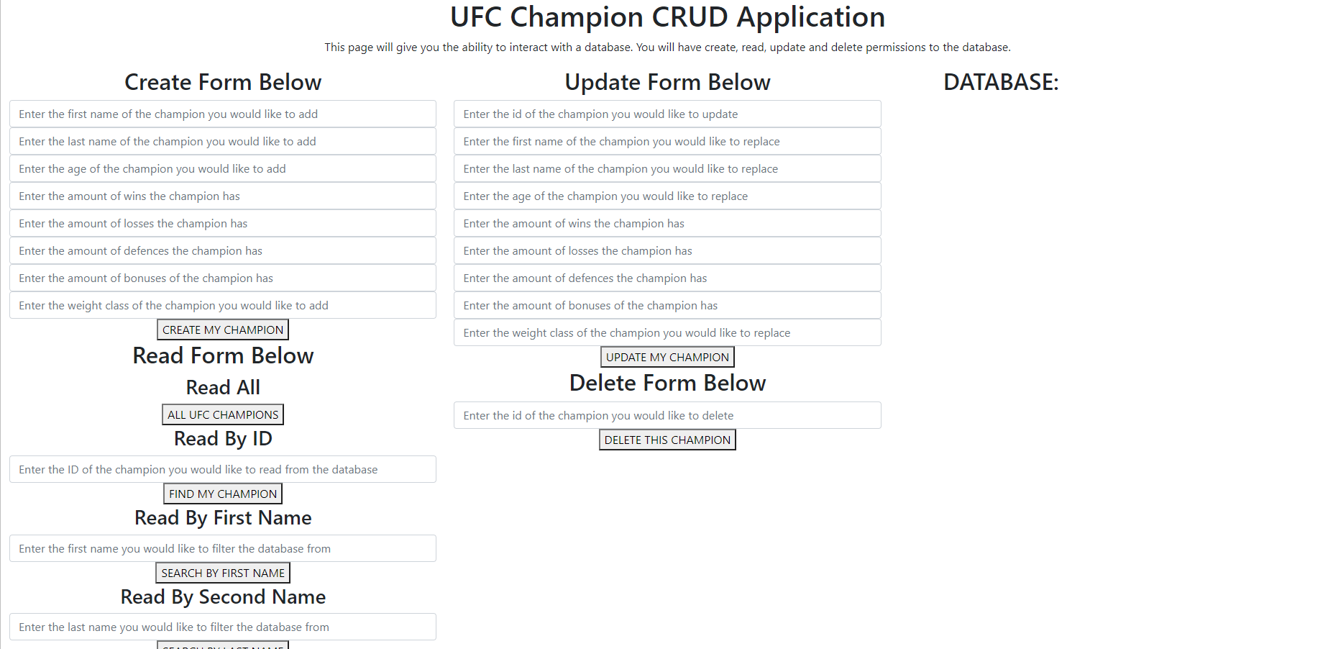
Front-end
Version 1

Slide 10
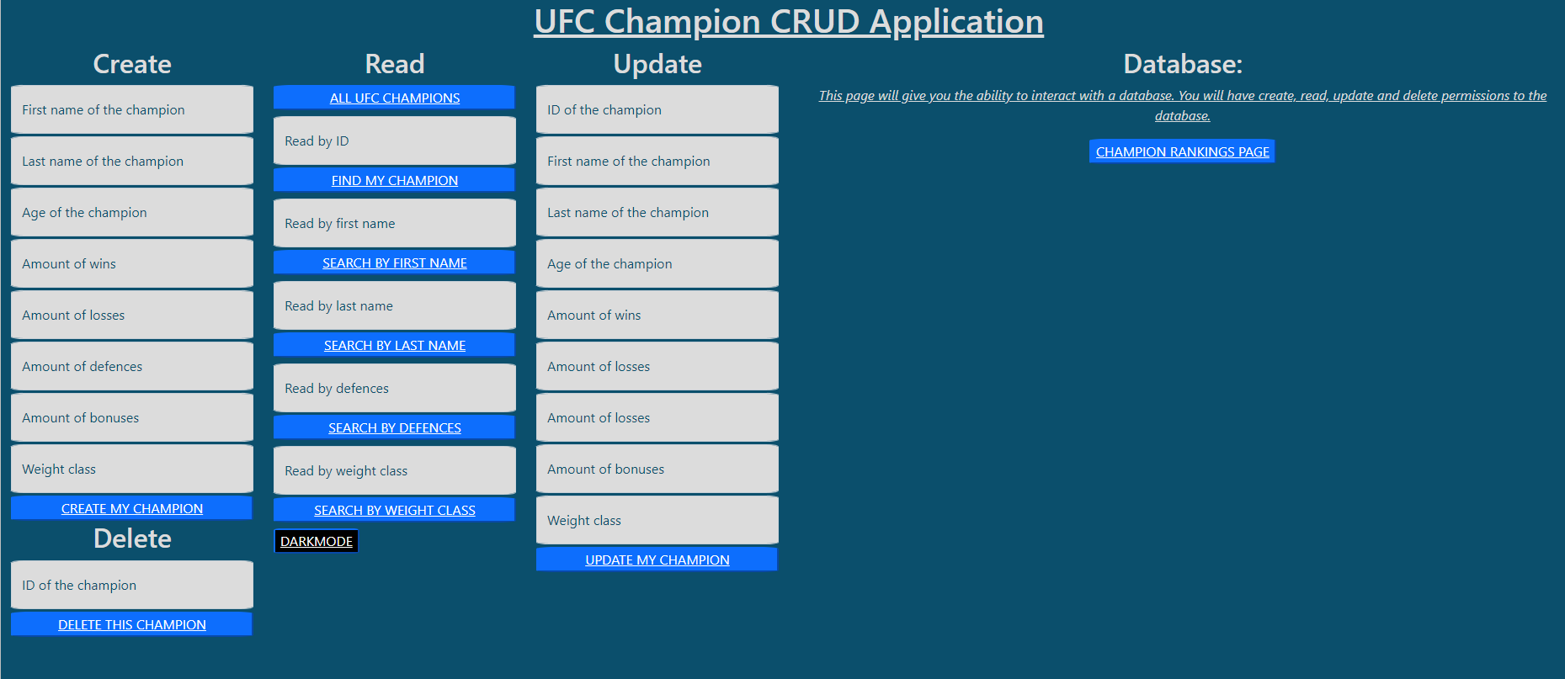
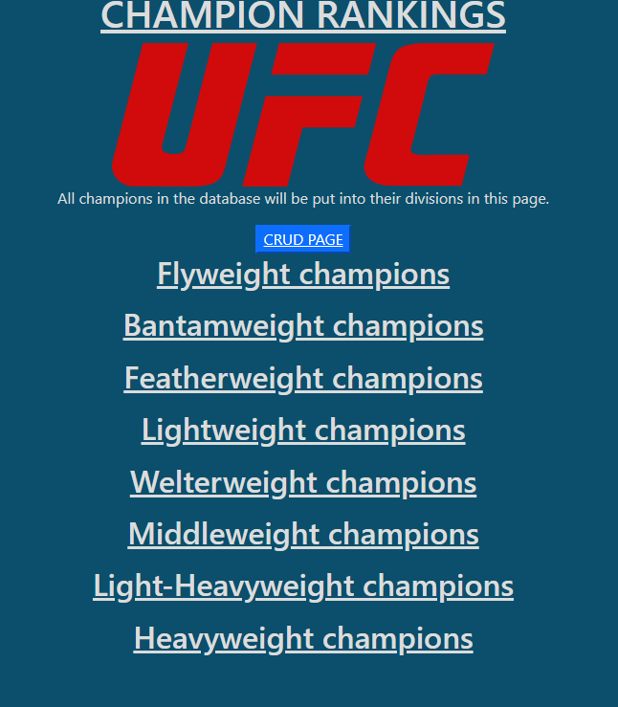
Front-end
CRUD page
This page implements changes made within the CRUD page

Slide 11
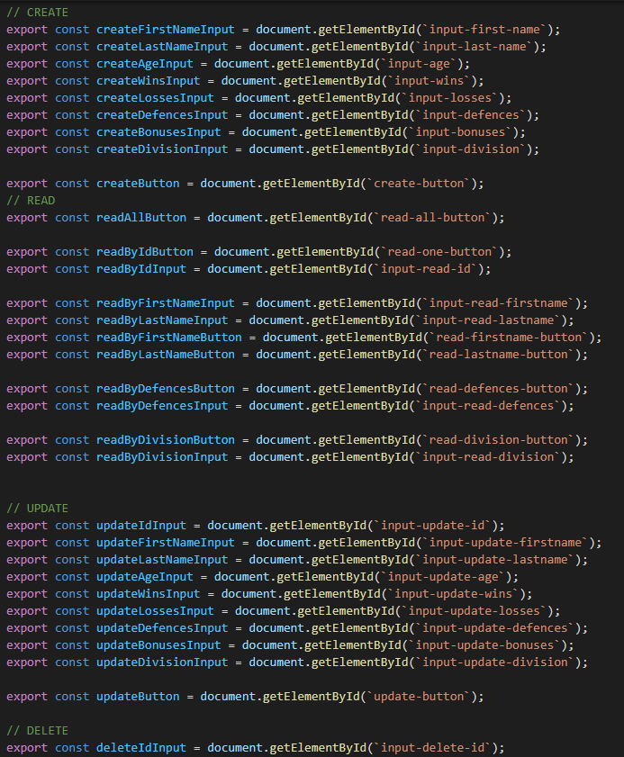
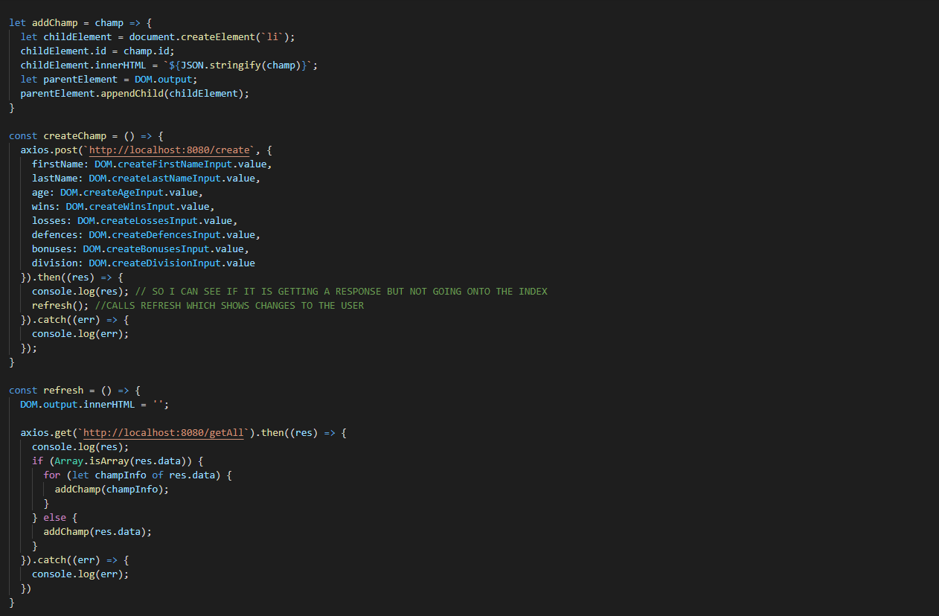
Javascript
DOMs for the CRUD
Basic functions for usage in script.js

Slide 12
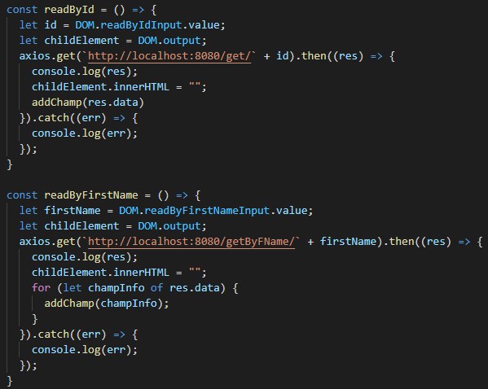
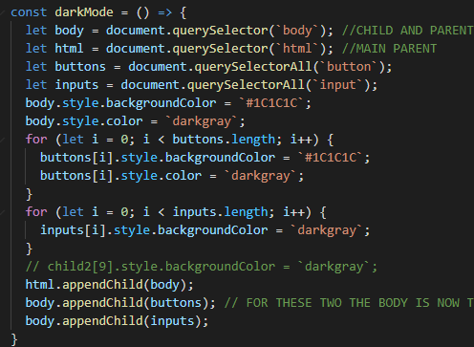
javascript
Read method, the rest are very similar
I implemented a ‘darkmode’ feature to my CRUD page

Slide 13
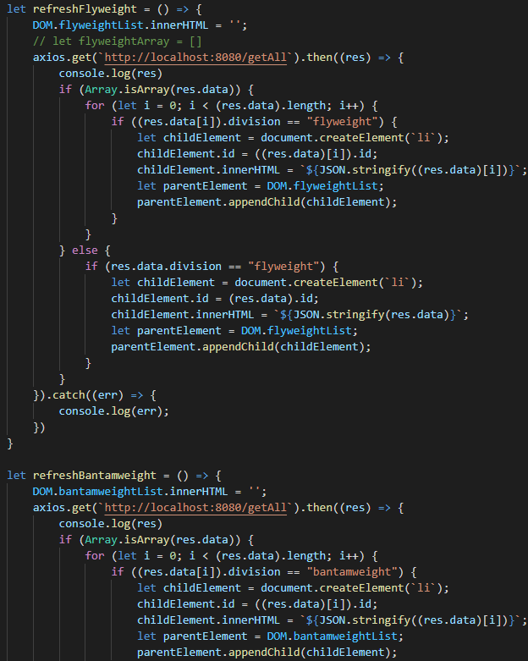
JAVASCRIPT FOR SECOND PAGE
This structure was followed throughout the script, however
I later realised the same functionality could be achieved by
using a different HTTP request

Slide 14
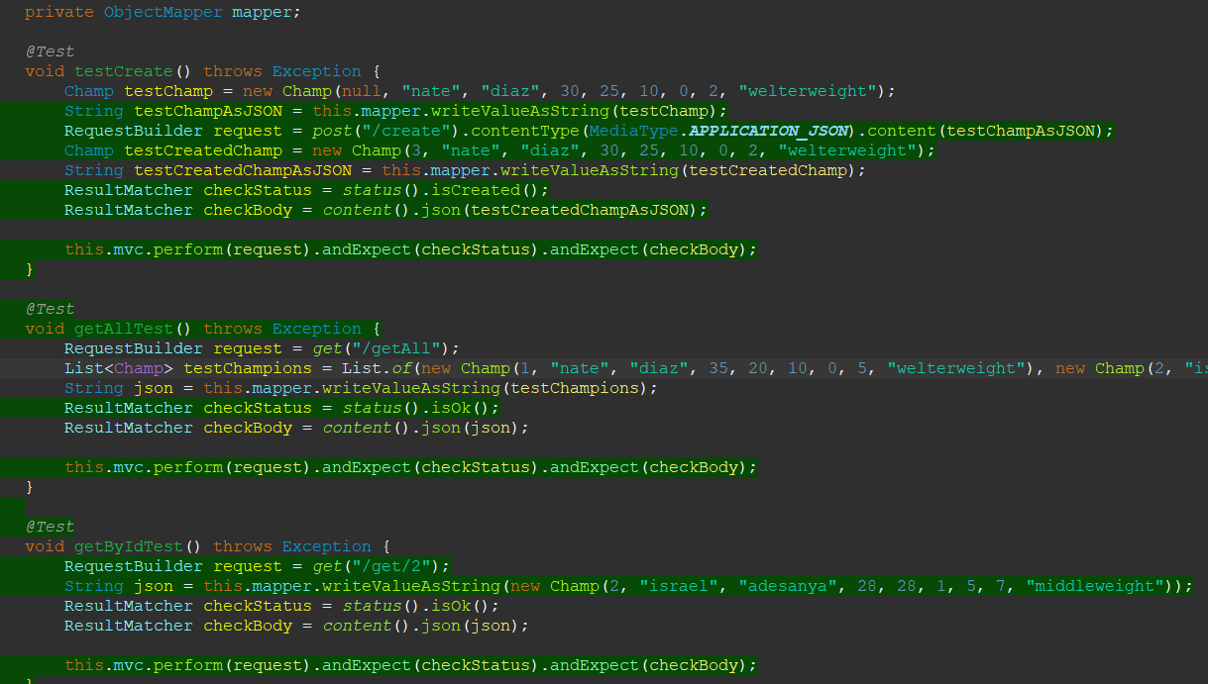
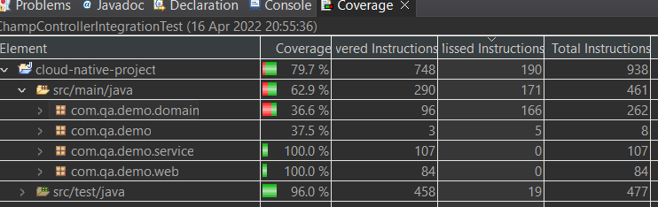
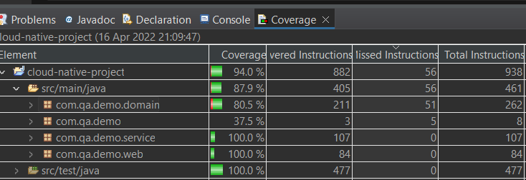
testing
Integration testing results
Integration testing
Results when unit testing was added

Slide 15
summary
What went well – generally really enjoyed the project and feel that the majority of the project went well despite a few small hiccups
What went bad – chrome accessibility and problems with naming additional functions in the repository
What would I change – add some animation to the front end of the application, possibly deal with the issues in chrome by displaying the page differently in chrome

