Slide 1
UFC Champion Rankings
Cloud Native Project – By Zach Zloof

Slide 2
Contents

Slide 3
Planning

Slide 4
Spring

Slide 5
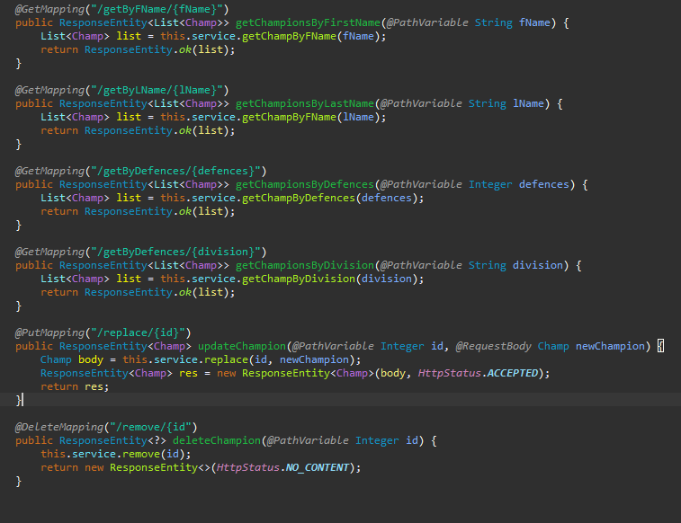
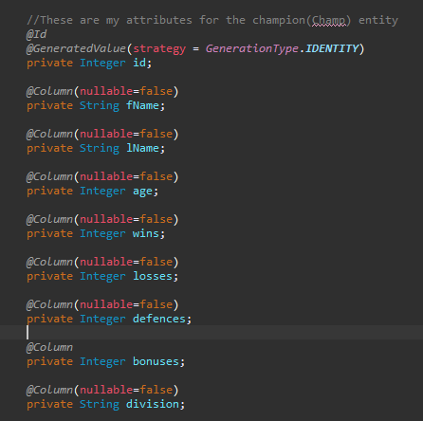
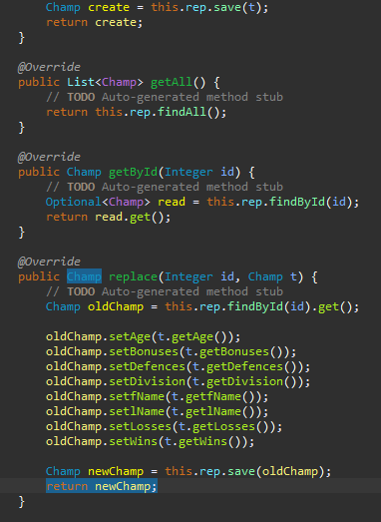
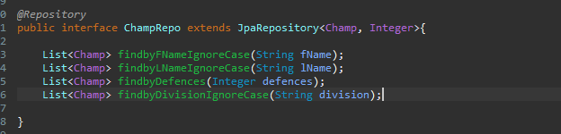
Java
This is my domain
This is my controller
This is my repository
This is my service

Slide 6
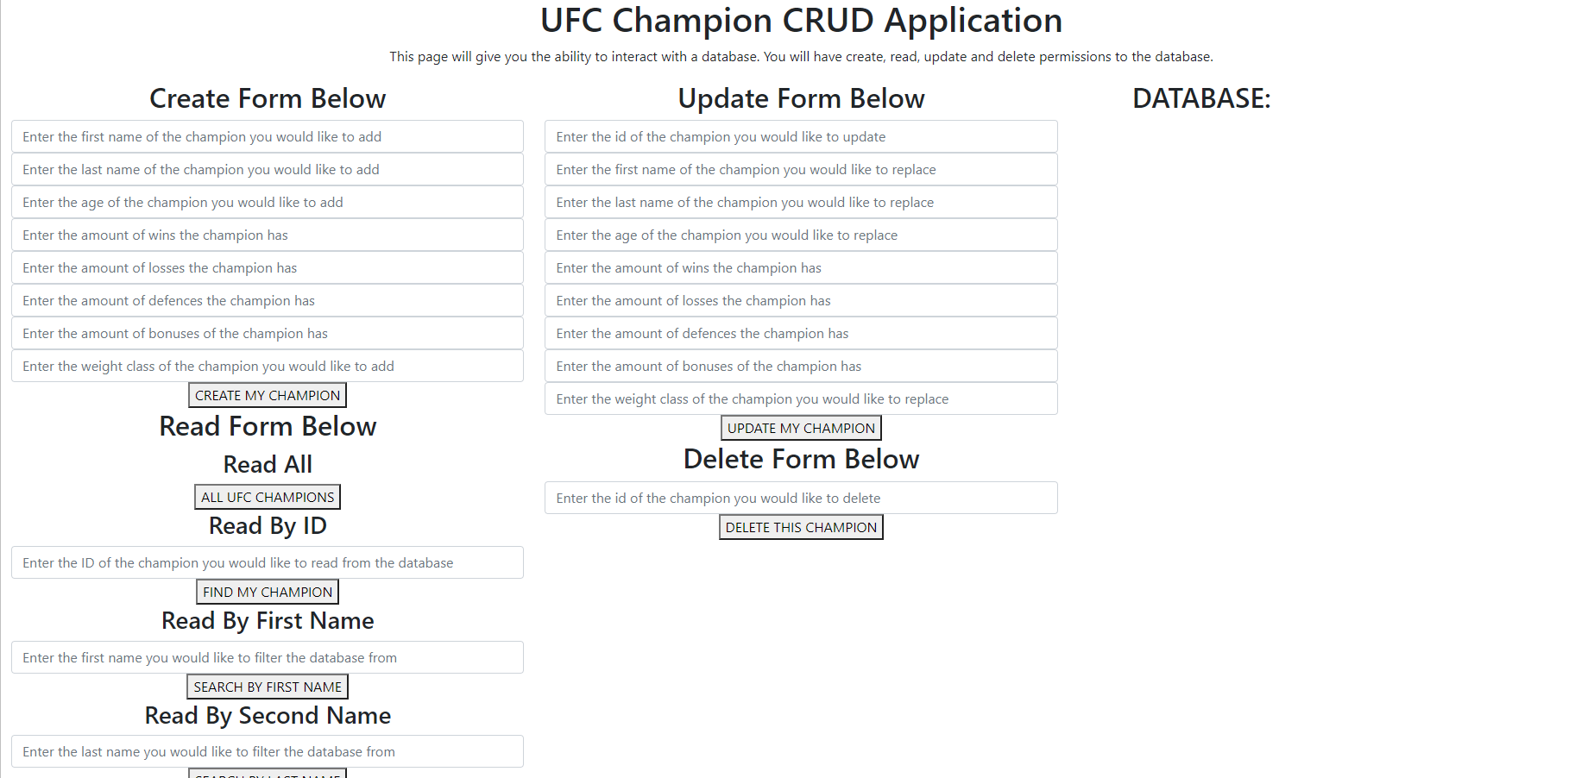
Front-end
Version 1

Slide 7
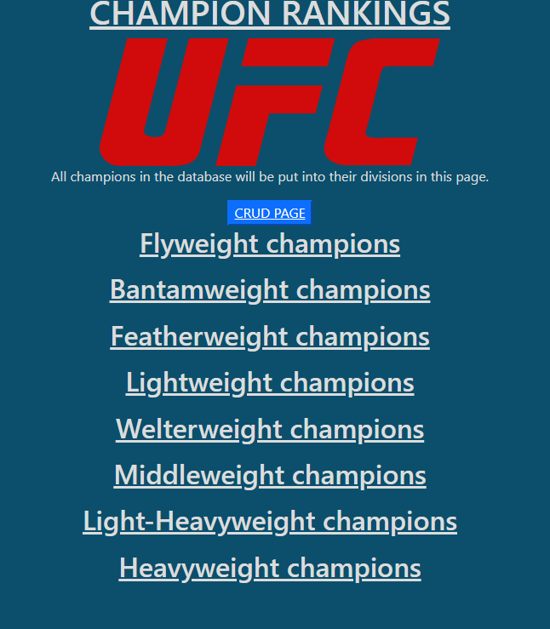
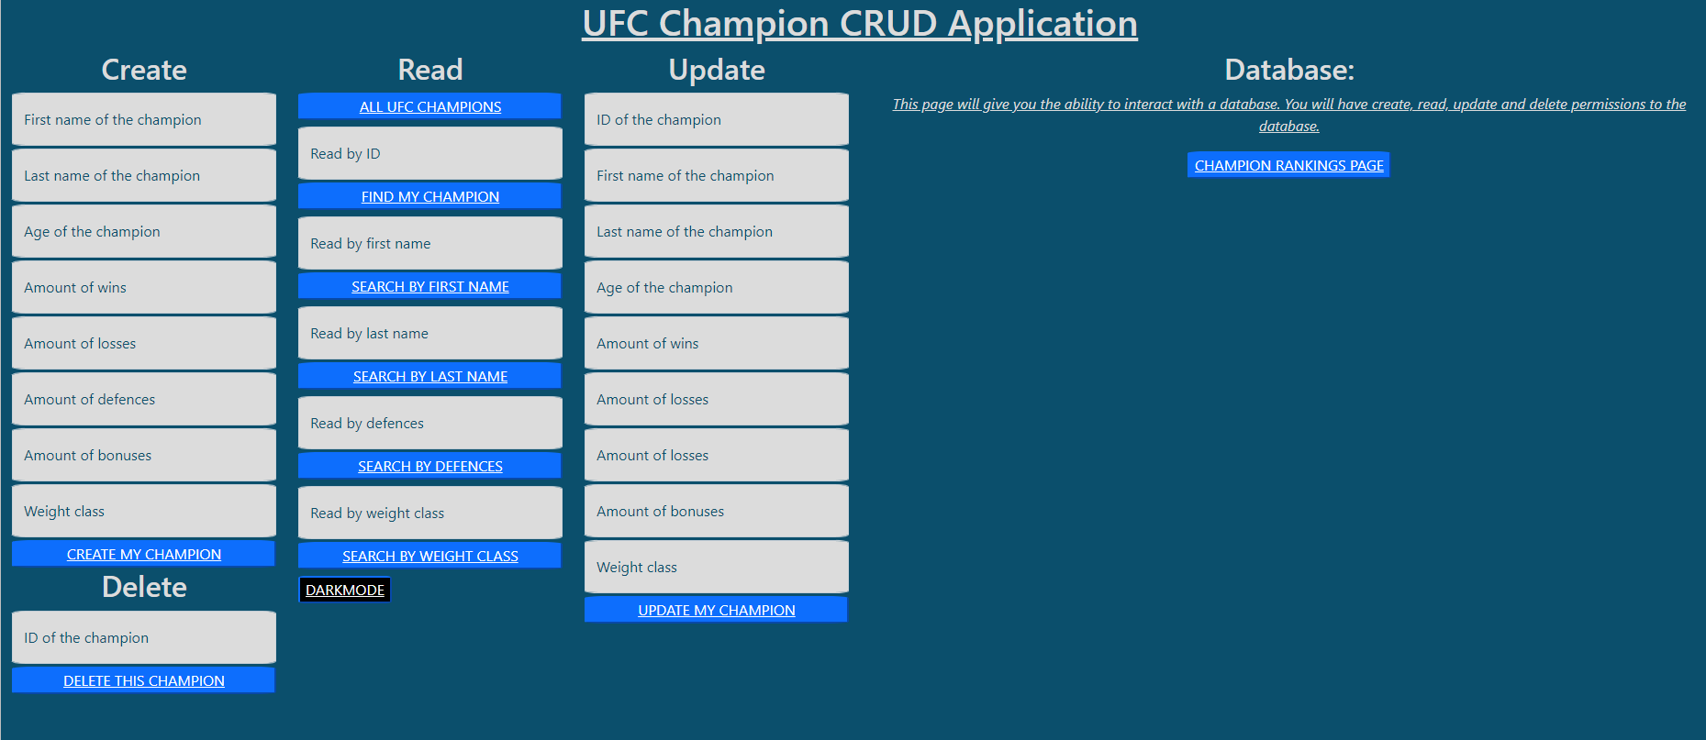
Front-end
CRUD page
This page implements changes made within the CRUD page

Slide 8
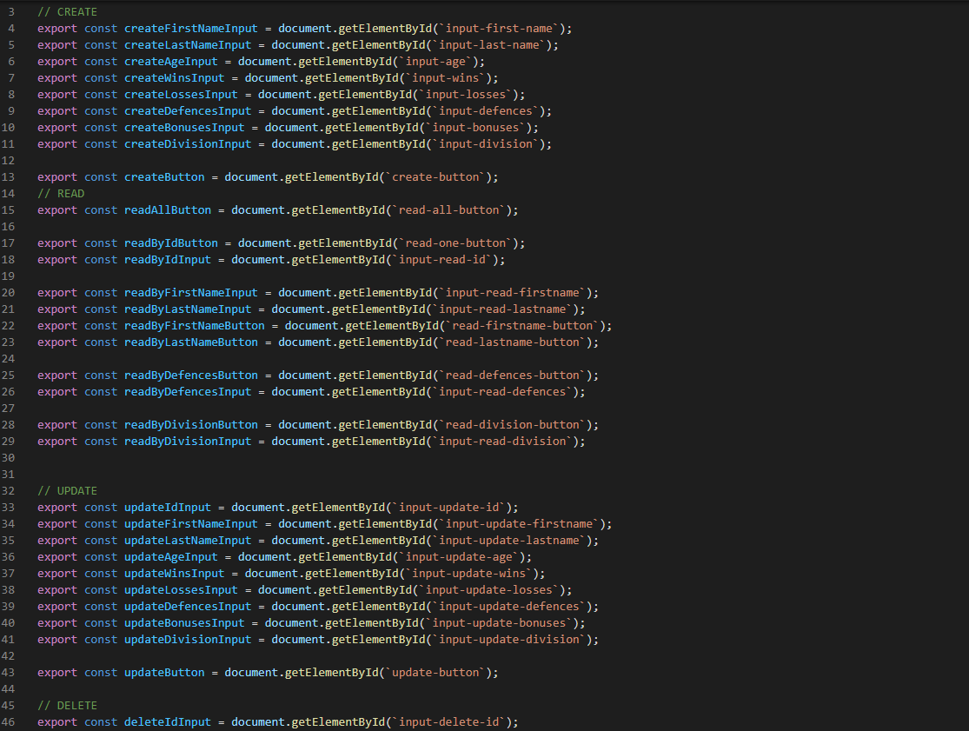
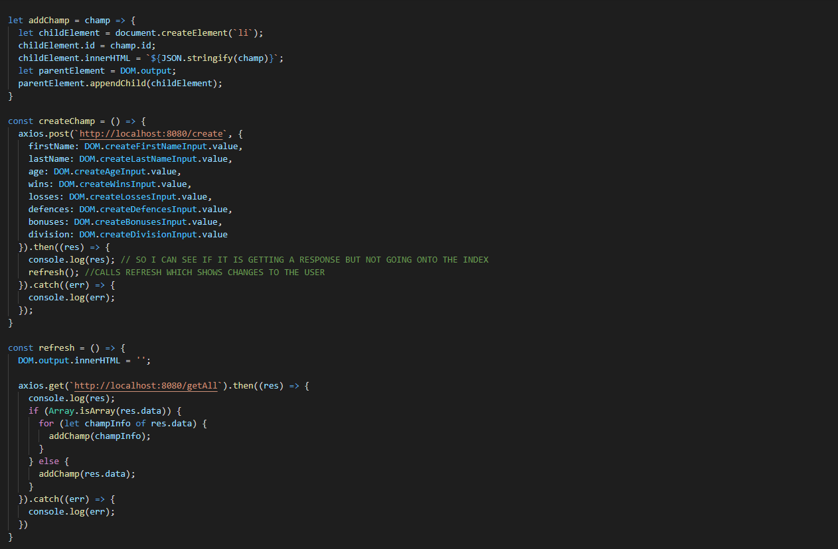
Javascript

Slide 9
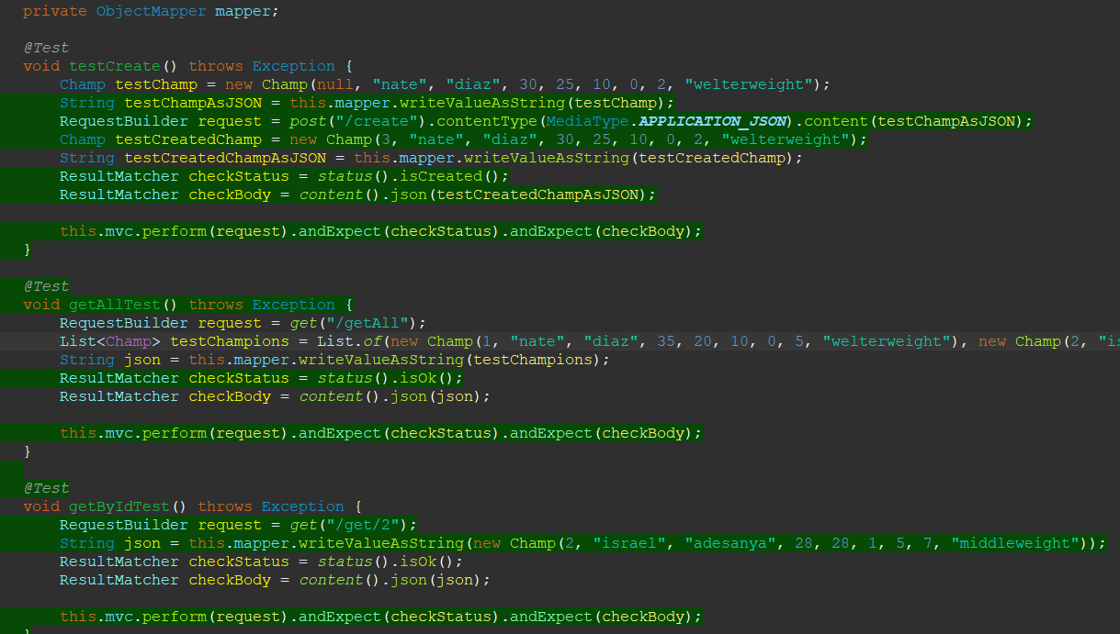
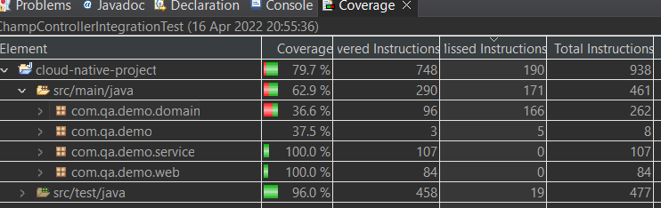
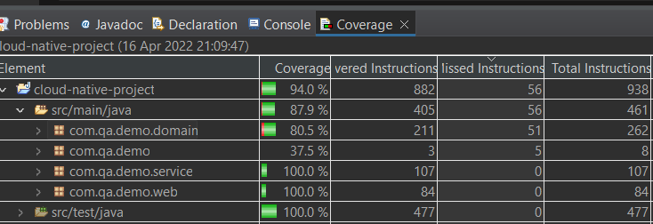
testing
Integration testing results
Integration testing
Results when unit testing was added

Slide 10
summary

