Slide 1

Contributing To Message Slack
Group members
Swayam Shah
Rahul Sharma
Nitin Vishwakarma
Hamza Shaikh
Project Guide:
Ms. Jayshree Jha
Notes:
1

Slide 2
Contents
Problem Statement
About Software
Licensing
What is the issue?
Proposed solution
Contribution
Result and Implementation
References
Notes:
2

Slide 3
1. Problem Statement
In today’s digital era, effective communication is essential—especially within teams and organizations. While Slack provides robust messaging features, there’s often a need for lightweight, customizable alternatives for internal communication or educational purposes.
Notes:
3

Slide 4
2. About Software
Message-Slack is a basic Slack-like messaging application that demonstrates the core functionalities of real-time communication. It likely involves:
i) Message posting
ii) Channel or group support
iii) User authentication or identification
iv) Backend to handle messages (e.g., Node.js, Express, etc.)
v) Frontend UI for interaction
Notes:
4

Slide 5
3. Licensing
The project has an MIT License.
The MIT License is a permissive free software license originating at the Massachusetts Institute of Technology(MIT) in the late 1980s.
As a permissive license, it puts only very limited restrictions on reuse and has high license compatibility.
Notes:
5

Slide 6
4. What is the issue
To integrate Notification feature.
To show how many users are currently active on platform.
To send Direct Message to a user.
To show currently typing user.
Notes:
6

Slide 7
5. Proposed Solution
1.Show Active Users Count - Use WebSocket connections to track online users on the server. Maintain a list of connected users and broadcast the current count to all clients whenever it changes.
2.Send Direct Messages - Implement private messaging via WebSocket events targeted to specific user sockets. Server routes messages only to the intended recipient.
3.Show Typing Indicator - Emit “typing” and “stop_typing” events when a user starts or stops typing
Relay these events from server to the specific user’s client.
4.Integrate Notification Feature - Use real-time WebSocket events to push notifications to users about
new messages, active users, typing indicators, or any other alerts dynamically.
Notes:
7

Slide 8
6.Contribution:
Implemented real-time active user tracking and broadcast active user count using WebSockets.
Developed direct messaging feature allowing private messages between users.
Added typing indicators to show when a user is typing in real-time.
Integrated notification system to push real-time alerts and updates to users.
Used Socket.IO for bidirectional communication between client and server.

Slide 9
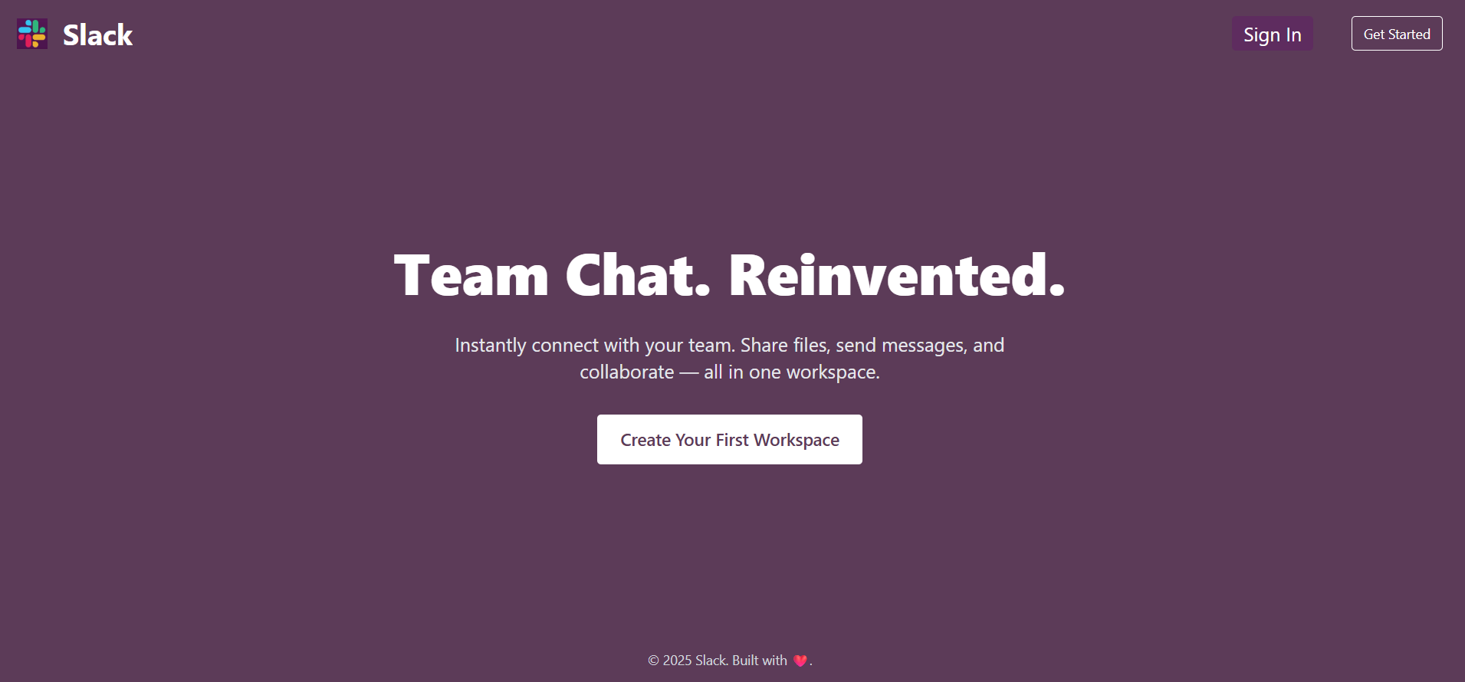
7.Results and Implementation
Fig 1. Landing Page

Slide 10
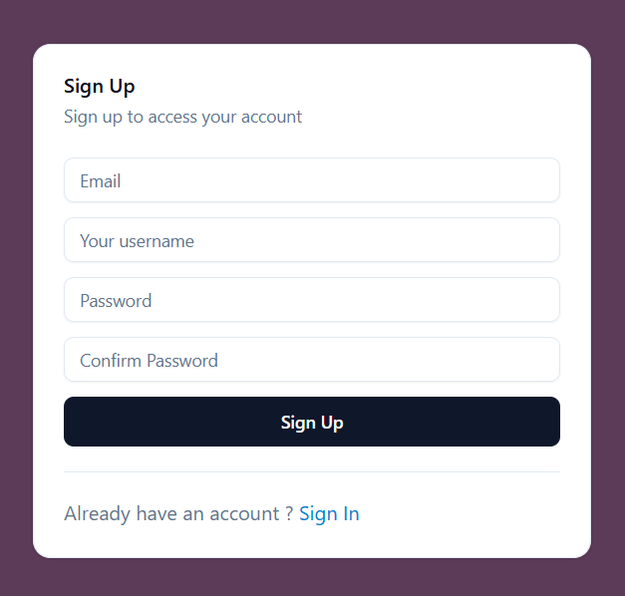
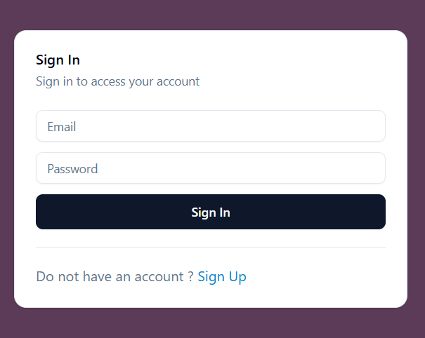
7.Results and Implementation
Fig 2.Sign up page
Fig 3.Sign In Page

Slide 11
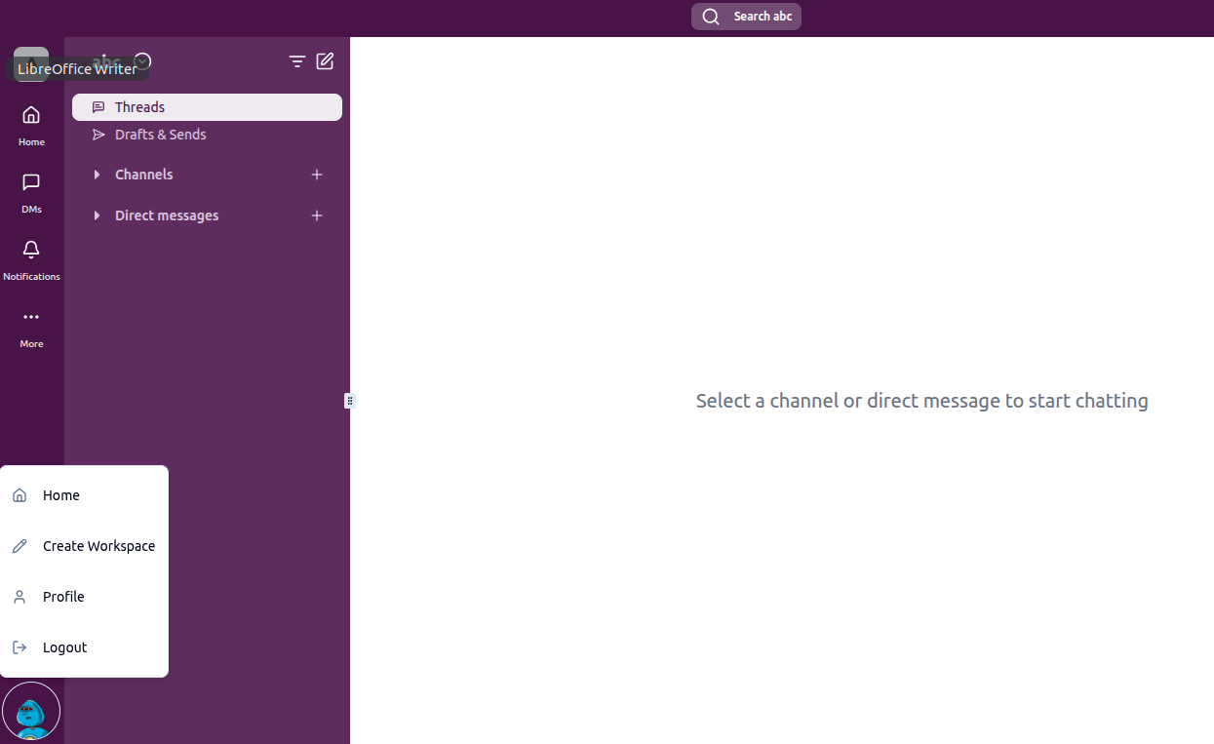
7.Results and Implementation
Fig 4. Dashboard

Slide 12
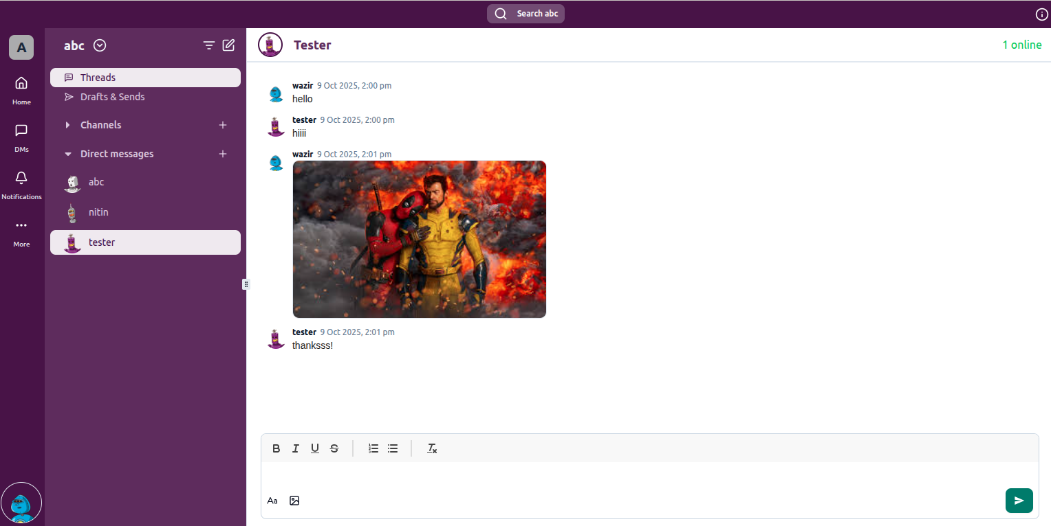
7.Results and Implementation
Fig 4. Chat Page

Slide 13
8.References
J. Heidemann, Y. Pradkin, R. Govindan, C. Papadopoulos, G. Bartlett and J. Bannis-ter, “Experiences with a continuous network archiving system” Proceedings of the ACMSIGCOMM, pp. 185–196, 2010.
G. Cantarella and L. Turello, “Real-time communication with Socket.IO” InternationalJournal of Computer Applications, vol. 118, no. 20, pp. 1–6, 2015.
I. Fette and A. Melnikov, “The WebSocket Protocol” IETF RFC 6455, Dec. 2011. Available:https://datatracker.ietf.org/doc/html/rfc6455.
D. Wheeler, “Open Source Alternatives to Slack: A Study of Mattermost, Rocket.Chat andZulip” Journal of Open Source Software, vol. 5, no. 50, pp. 1–6, 2020.

Slide 14
Thank You...!!
Notes:
14

