Slide 1


YOU CAN EAT YOUR CAKE AND HAVE IT WITH FARMFUNDS AFRICA

Slide 2

Introduction
TM
Farmify Agro Innovations Ltd. RC 1627509
Farmify Agro Innovations Ltd (Farmfunds Africa™) is a duly registered AgriTech Firm, established to empower African Farmers whilst enabling individual Farmfunders earn profits on their farm partnership which ultimately helps in strengthening global food security.
We are proudly Africa’s fastest growing AgriTech company.

Slide 3

Vision
Mission
To lead and raise a new breed of agro-preneurs who will be the food bank of the world.
Fueling Africa’s agricultural transformation everyday.

Slide 4

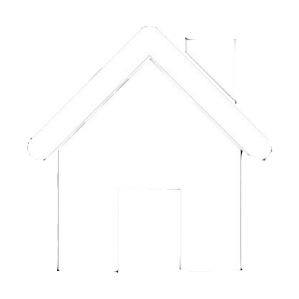
3 Core Values of Farmify Agro Innovations Ltd.
FINANCIAL FREEDOM
FOOD FOR ALL
HOMES FOR ALL

Slide 5

Farmify Market was birthed out of the desire to make “grocery and household item”shopping easier for every home in Nigeria.

Slide 6

About Farmify Market Food Bank
Sponsor our Greenhouse Vegetable Farm for just N100,000 per unit and get 60% ROI back within the space of 1 year.
The 60% will be broken down into 12 parts which means you will be paid 5% of your ROI monthly in form of groceries, foodstuff and household items.
After a whole year of free grocery shopping for your home, you get a whopping 70% of your capital back!
Healthy food
Fresh food
Farm Fresh
ORGANIC

Slide 7
About Farmify Market Food Bank
The remaining 30% of your capital will be used as your service charge throughout the year, which includes the delivery to your doorstep.
In other words, within a year, you spent just 30% of your investment on grocery shopping and household items.
For example; you normally spend N50,000 a month on groceries and household items.
Given that 1 unit of our greenhouse farm costs N100,000, in order for you to meet up with the amount of money you normally spend on your food, you can buy more units e.g. N1,000,000 worth of units, which is 10 units, can give you a shopping allowance of N50,000 monthly.
Healthy food
Fresh food
Farm Fresh

Slide 8
For Example:
N50,000 x 12 months = N600,000 worth of free food in a year.
70% of N1,000,000 = N700,000 will still be paid back from your capital at the end of the year.
30% of N1,000,000 = N300,000 will be charged for logistics and other services.
Healthy food
Fresh food
Farm Fresh

Slide 9


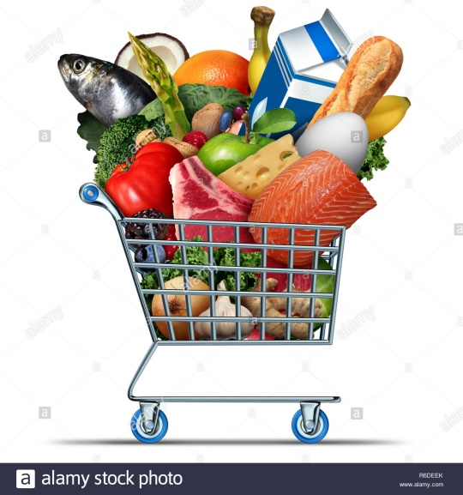
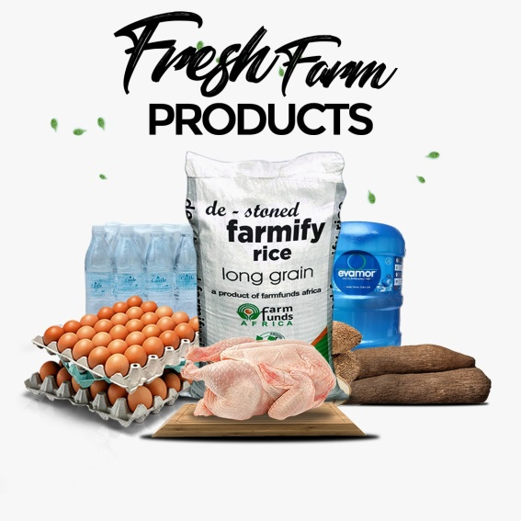
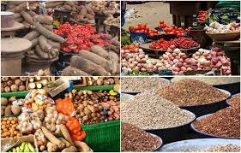

Items you can order for
Groceries & Provisions
Foodstuff
Toiletries/Cosmetics
Farmify Fresh Products

Slide 10

How it Works
You can adjust your shopping list every month.
You can require us to deliver to you once or twice in a month.
You can also skip a month or two and move your 5% to the next month.
If you do not update your list a week before delivery, there is a high probability that your old list will automatically be delivered to you.
Be assured that you will get more than what you ordered for, because it will be delivered to you in wholesale quantity.

Slide 11

You can visit us at:
12A, Sanyaolu Street, Off Kudirat Abiola Way, Oregun, Ikeja, Lagos, Nigeria.

Slide 12
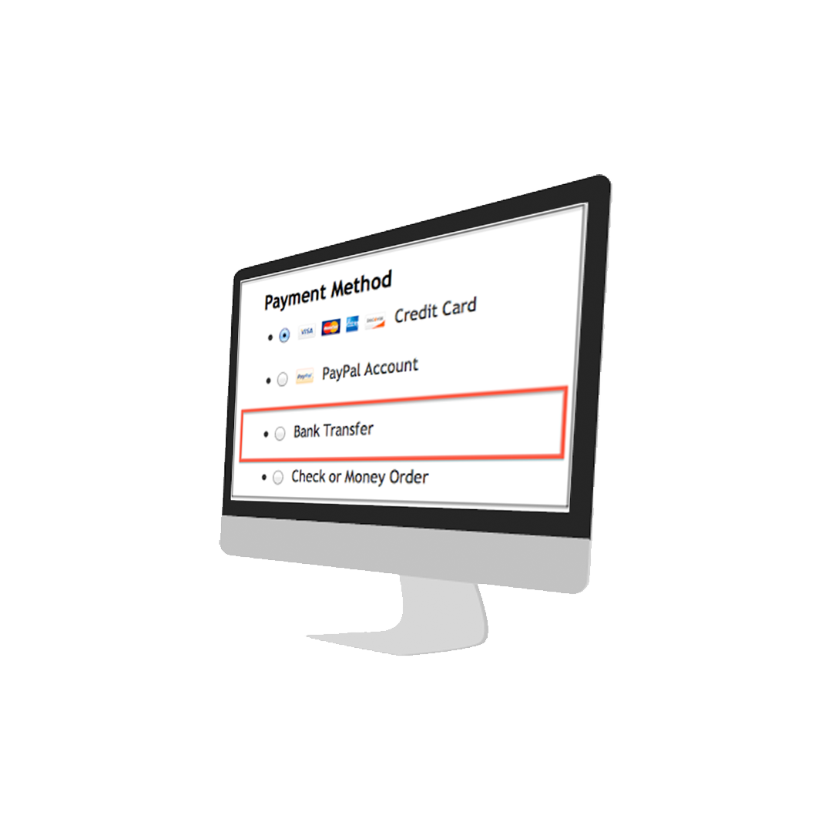
Bank Details:
Account Name: Farmify Agro Innovations Ltd.
Bank Name: Access Bank
Account Number: 1404450358

Slide 13
THANK YOU

