Slide 1
Currency Converter
Zack Mitchell

Slide 2
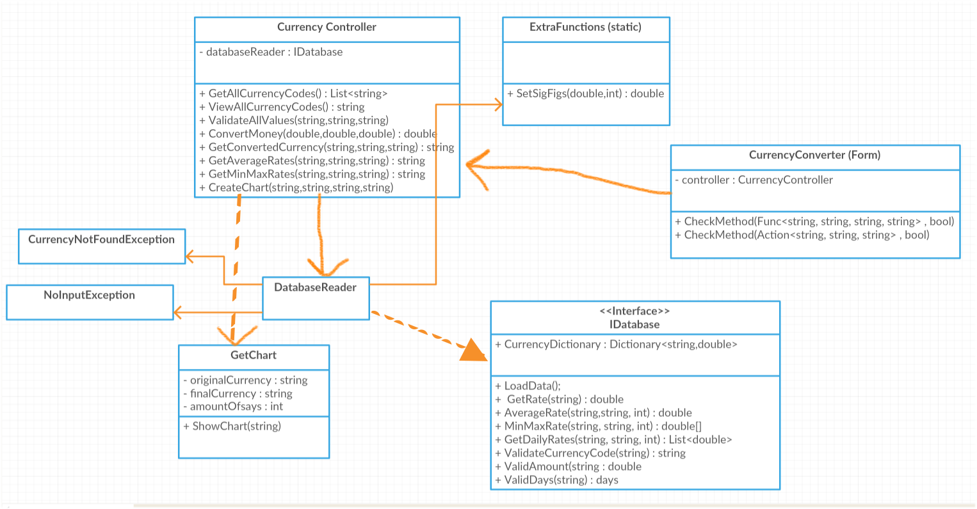
UML

Slide 3
Code demonstration

Slide 4
How you approached the project
What Went Wrong?
Rushed In
Didn’t Start With UML Or Testing
Struggled To Test Later On

Slide 5
How you approached the project
What Went Well?
Learnt How To Parse An XML From Online
Learnt Some More About MVC
Learnt About Creating Exceptions And Logging Them

Slide 6
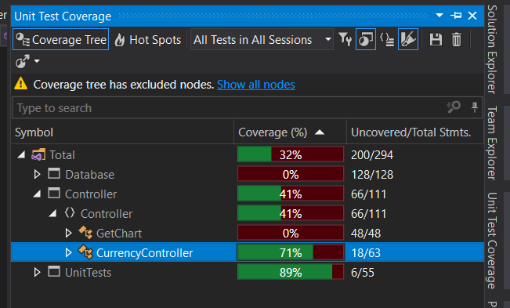
TDD

Slide 7
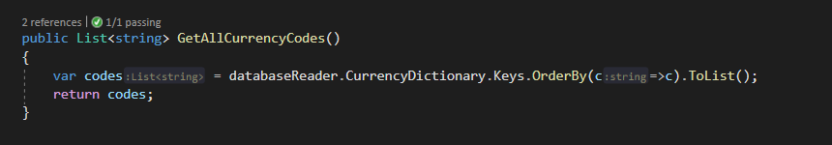
LINQ

Slide 8
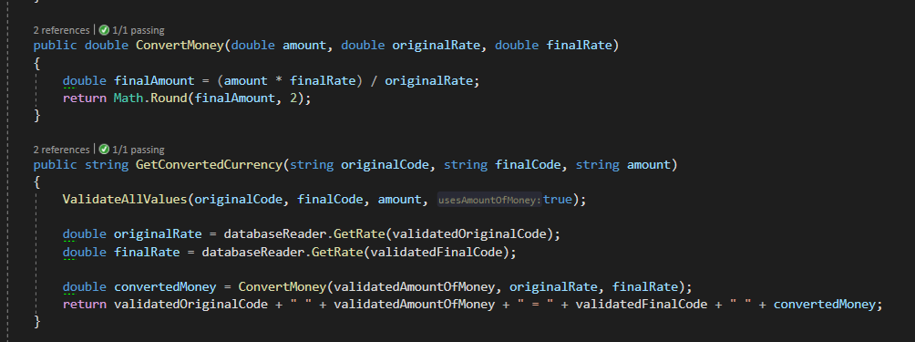
SOLID principles used in the project
Single Responsibility Principle

Slide 9
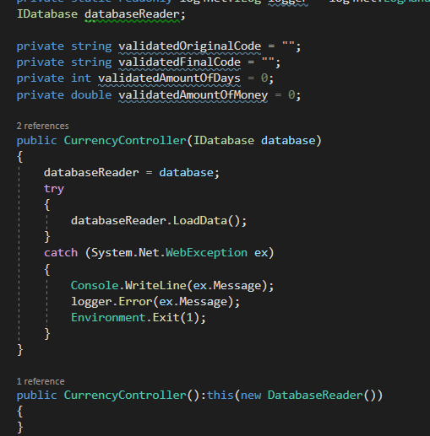
SOLID principles used in the project
Dependency Inversion Principle

Slide 10
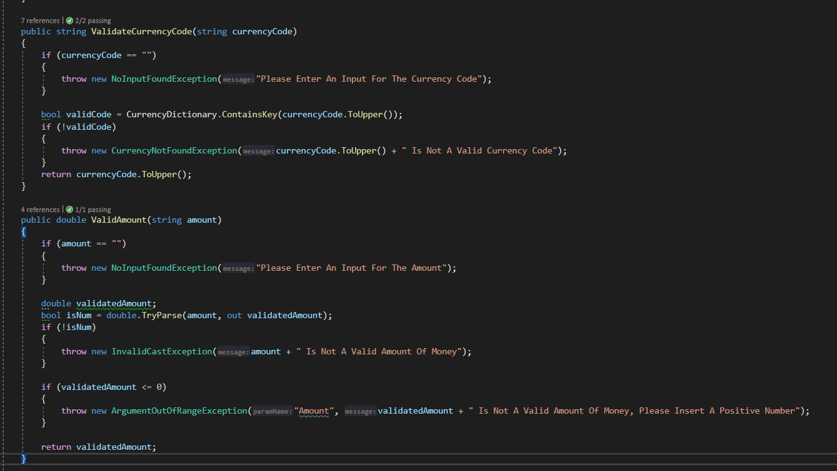
Error handling used in the project
Show Logging

Slide 11
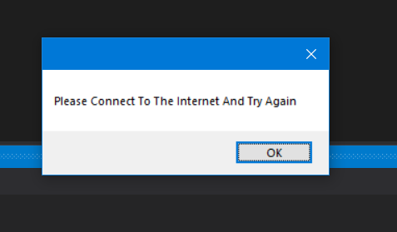
Error handling used in the project
No Internet Gives The Following Output

Slide 12
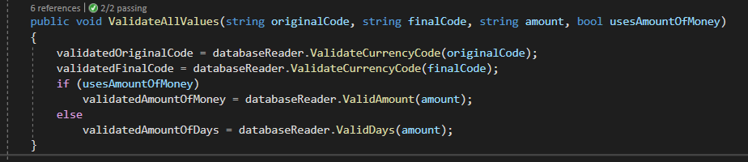
DRY Principle

Slide 13
Conclusion
It Is Best To Start With A UML And Then Unit Testing Rather Than Rushing In
Clean Code Makes It Much Easier To Understand
Every Class Should Have One Purpose To Increase Reusability

