Slide 1


PLAY-BY-PLAY, PLAYER-BY-PLAYER
COLLEGE BASKETBALL ANALYTICS

Slide 2
AGENDA
01
INTRODUCTION OF DATASETS
02
CLEANING
03
METHODOLOGIES
04
BUSINESS APPLICATIONS
ss Applications
05
LIMITATIONS & CONCLUSION
Notes:
Audrey

Slide 3
INTRODUCTION
INTRODUCTION
Player Performance Data from Kaggle
Text-Based Data from NCAA
Copied information onto Excel file, then converted to CSV
6 columns x 120 rows
Player names, draft team, grade, and description of player
28 players from high school or outside of U.S.
Consists of college player performance with 66 features and 61,061 rows
Several missing values with no way to know how to fill
Player names repeating due to:
multiple year careers
Player names repeating due to common names
Notes:
Audrey

Slide 4
CLEANING
Initial
Cleaning
Addressing Irregularities
Handling
Null Values
Final Refinement and Standardization
Replaced null values in the 'Recruit_Rank' column with 0 and 'Assist / Turnover ratio' column with the median to preserve statistical relevance.
Dropped rows with null values in columns ranging from 'Defensive_rating' to 'Points' to ensure data accuracy.
Dropped the 'ht' column as it was deemed irrelevant to the analysis.
Identified and replaced irregular entries in the 'num' column such as 'None', '--', '23B', '4A', and '31/24' with NaN.
Assigned NaN values to missing jersey numbers based on the available numbers from 1 to 100 per team.
.
Checked unique values in the 'Pick_drafted' column to identify drafted players.
Examined the 'year_of_college' column for unique and null values.
Dropped rows with specific values ('None', '0', '57.1', '42.9') in the 'year_of_college' column for data consistency.
Examined and dropped the 'Role/Position', 'conference', and 'Type' columns to focus on relevant data.
Filled missing values in 'Rim_shots %', 'Midrange_shots %', and 'Dunks %' columns with 0 to maintain consistency..
Identified unique player values in the 'player_name' and 'Player_ID_(recurring for each year)' columns to maintain data integrity.
Notes:
Jai

Slide 5
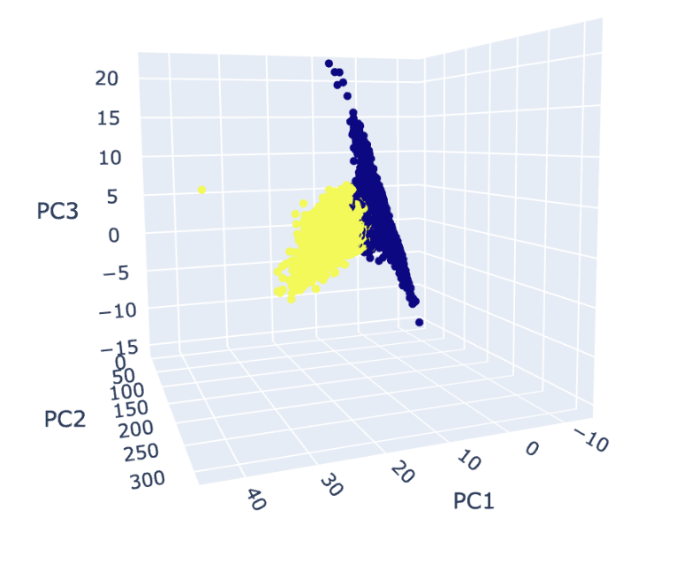
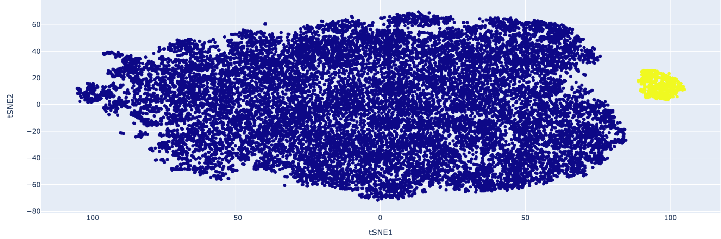
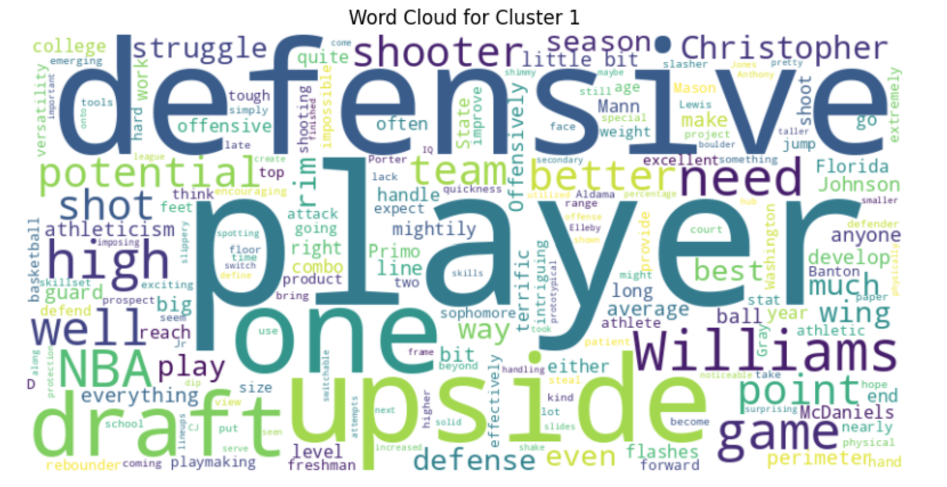

METHODOLOGIES
METHODOLOGIES
WRITE -P
1
2
3
4
From our elbow plot, 14 principal components explain 90% variance
Logistic Regression on top 14 components to predict if drafted and got 98% accuracy
Created clustering on top 3 PCA components
Created KMeans clustering with optimal number of clusters = 4 from elbow plot
Ran t-SNE analysis using standardized data, setting "n_components" to 2.
2 clusters corresponded to drafted and not drafted outcomes of the target variable.
Used the Tokens to create word clouds for clusters of Drafted players
Sentiment analysis comparing higher sentiment to higher draft pick? Pick grade? Player position?
PCA
CLUSTERING
T-SNE
TEXT BASED-ANALYSIS
Notes:
Zack

Slide 6
BUSINESS APPLICATIONS
BUSINESS APPLICATIONS
BUSINESS APPLICATIONS
DRAFTING
STRATEGY
Can help the NBA and other overseas leagues to make decisions on who to draft
Player recruitment strategies
Assist coaches in game strategy against other teams based on player statistics
TRANSFER PORTAL
SPONSORSHIPS
Guide college coaches in the transfer portal in who they recruit
Direct coaches on scholarship offers
Allows companies to reach out to the best players to create Name, Image, and Likeness (NIL) deals
Allows companies to reach out to the best players to create Name, Image, and Likeness (NIL) deals
Notes:
Priyanka

Slide 7
LIMITATIONS
LIMITATIONS
Data Loss and Assumptions:
Dropping of rows could lead to data loss
Assumptions made about which values to drop or replace with NaN
t-SNE Computational Complexity:
Large number of features and rows in our dataset
Large dataset makes comparisons very computationally expensive and time consuming
Completeness and Impact on Analysis:
Filling missing values with 0 in columns could artificially skew the data and impact the analysis.
Cleaning decisions could potentially lead to biased or inaccurate insights.
Sentiment Analysis:
Training the model requires understanding references to old NBA players.
Limited size of dataset gives few features which the model can be trained on.
Standardization and Interpretation:
Standardizing the dataset using StandardScaler might obscure certain patterns or variations in the data.
Dropping uninterpretable' columns may result in the loss of valuable information if there are alternative ways to use the data.
Notes:
Varun

Slide 8
CONCLUSION
CONCLUSION
NCAA data has no clear performance indicators for whether a player gets drafted
The average drafted player stands out in offense vs the average NCAA player
Sentiment can only be tracked with multiple years of data
Dataset can be used for tracking general performance trends in college ball, but not used as a benchmark for whether they go pro
Notes:
Varun

Slide 9

THANK
YOU.
AUDREY SELLERS
JAISHANKAR GOVINDARAJ
PRIYANKA CHAUDHARI
VARUN KAZA
ZACK BATCHELDER
TEAM INFO

