Slide 1
SuperTux Software Architecture
Assignment 1: Conceptual Architecture
CMPE 326
Team: Pingu Simulator TA: Dayi Lin Date: October 18, 2017

Slide 2
SuperTux
“
SuperTux is a free and open-source two dimensional platform game that was released in 2003. The game was inspired by Nintendo’s Super Mario Bros. series. It was originally created by Bill Kendrick and is currently maintained by the SuperTux Development Team.
”

Slide 3
High-Level Architecture
Derivation Process
First impression of the system was that is was an Object Oriented architecture style
By creating a general architecture we were able to visualize that the architecture was layered
The architecture has no concurrency as levels are loaded first and then the user plays them
The layered architecture is split into six subsystems
Interaction
Input Handler
Game Elements
Data Manager
Resource Manager
Hardware Abstraction

Slide 4
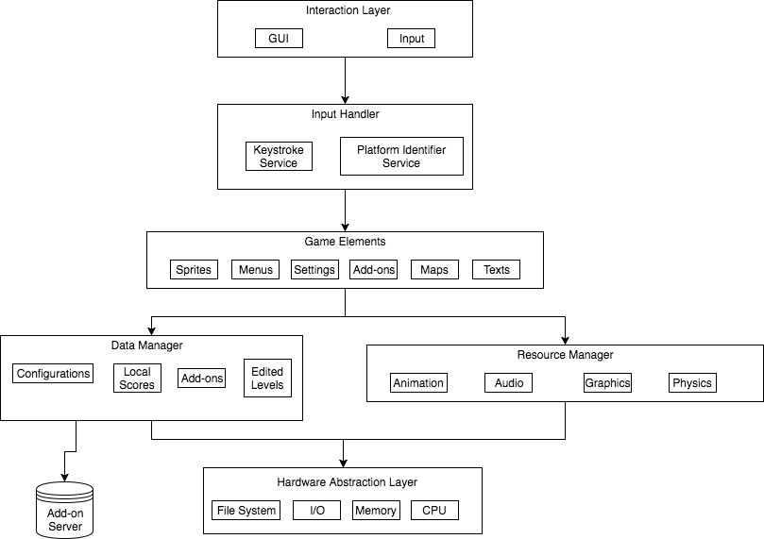
High-Level Architecture

Slide 5
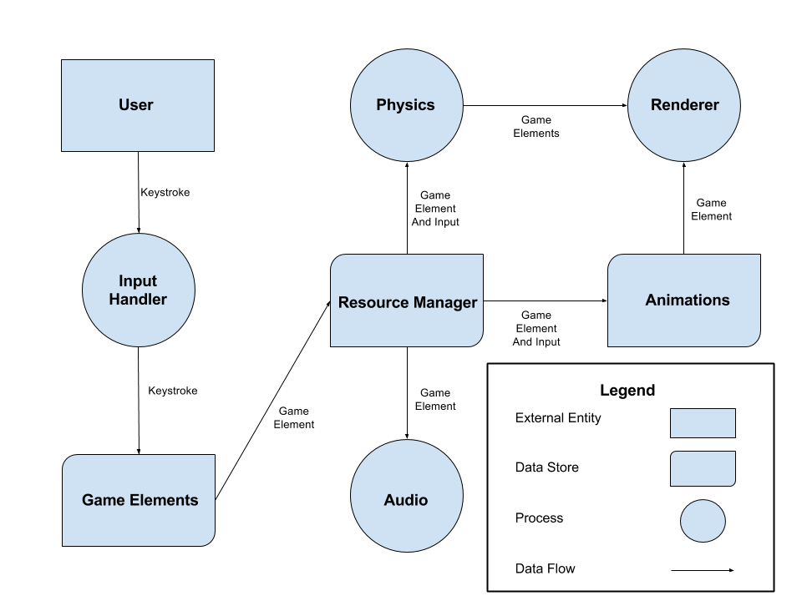
Data Flow Diagram

Slide 6
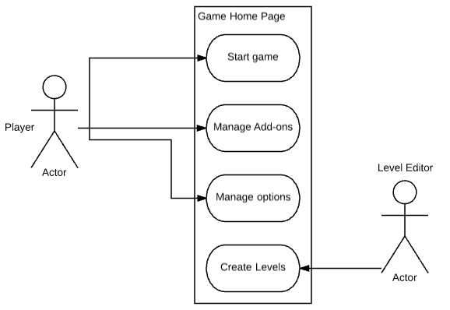
Use Case Diagram

Slide 7
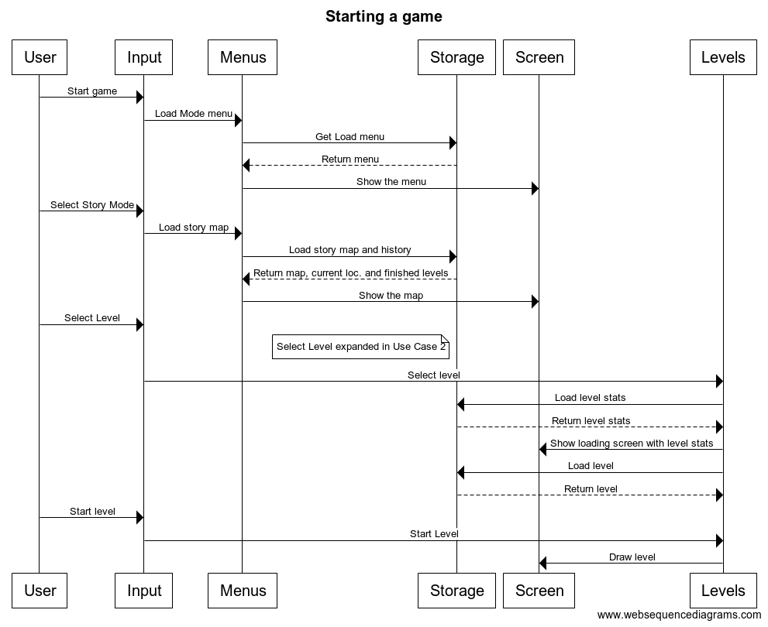
Sequence Diagram

Slide 8
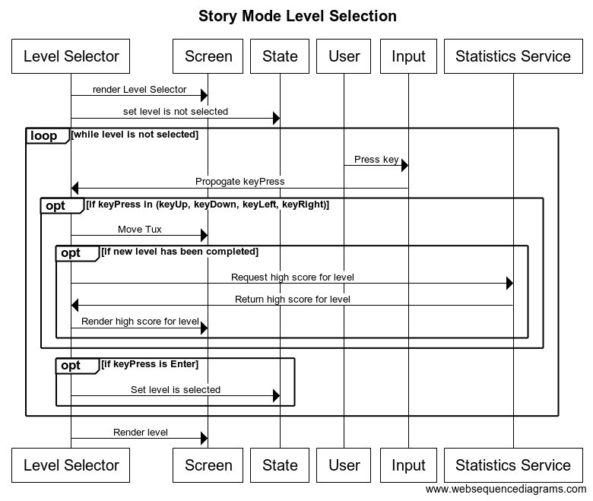
Sequence Diagram

Slide 9
Team Responsibilities & Issues
SuperTux’s development team is split up into the following groups:
Graphics
Level design
Programming
Documentation
Coordination
Packaging
Nightly Builds
Voice Acting
Music Translations
Potential Team Issues:
Lack of management
No enforcement of quality or deadlines
Global team does not allow for efficient development

Slide 10
Thank You

