Slide 1
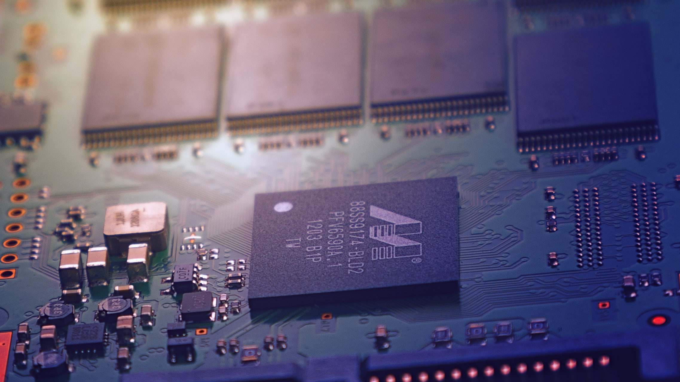
SuperTux Software Architecture
Assignment 3: Enhancement Proposal
CMPE 326
TA: Dayi Lin
Team: Pingu Simulator Date: December 1, 2017

Slide 2
Overview
Proposed Feature
Implementations Considered
SAAM Analysis
Plans for Testing
Sequence Diagram
Concurrency & Team Issues
Limitations

Slide 3
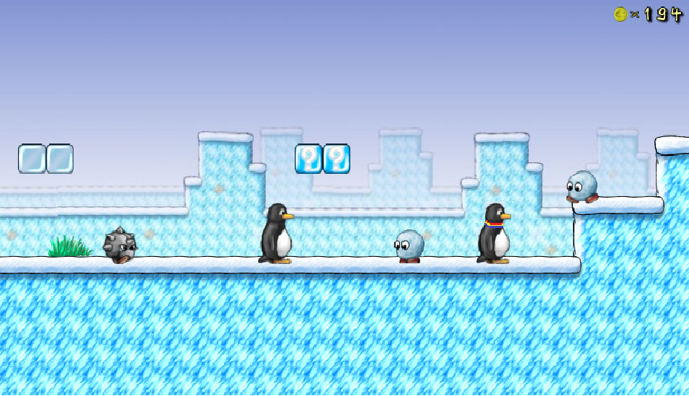
Proposed Feature – Local Multiplayer
Idea: Two-Player Local Co-op
Current implementation: SuperTux is a one-player game where the player controls Tux
Add the option for a second player to join the first player, controlling a separate tri-colour Tux
The second player can do all things the first player can, including hitting enemies and picking up power-ups

Slide 4
Motivation for Feature
This would allow SuperTux to be a more social game, so you could play with your friends.
You could work together to beat hard missions.
As multiplayer would be optional, the game could still be played alone.
Scalable, so more players could be added if we want.

Slide 5
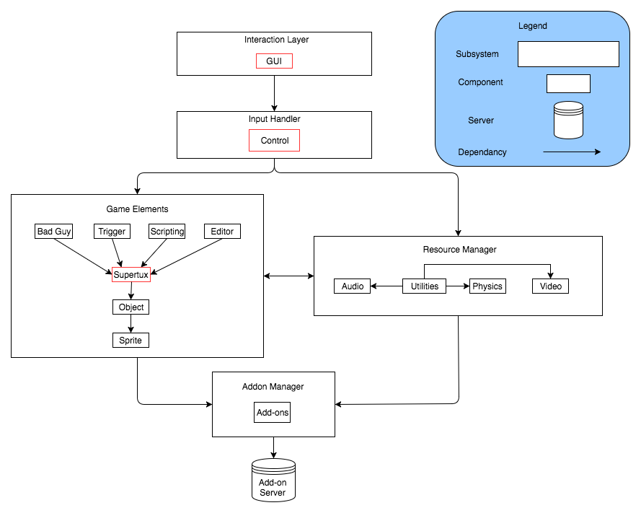
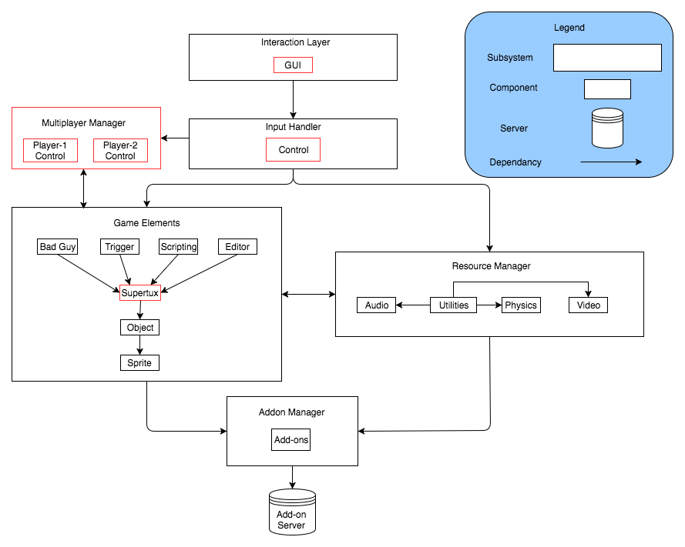
Implementations Considered
Idea 1: Enhancing the SuperTux component within Game Elements
Idea 2: Create a Multiplayer subsystem

Slide 6
SAAM Analysis
In our SAAM Analysis, we considered the following non-functional-requirements:
Scalability
Maintainability
Usability
Reliability

Slide 7
Alternative Approach Considered

Slide 8
Proposed Approach

Slide 9
SAAM Analysis – Stakeholders
Stakeholder (NFR) | SuperTux Factory | Multiplayer Subsystem
Developer (Scalability) | High. With a SuperTux factory, scaling the multiplayer capacity is as easy as calling the SuperTux factory. | Low. With a dedicated Multiplayer Subsystem, all components that the SuperTux subsystem now handles 2 players, but no more.
Developer (Maintainability) | High. Changes to the SuperTux factory (i.e. changes to Supertux features/behaviour) affect all SuperTux instances | Low. Changes to single player SuperTux need to be reflected in the Multiplayer Subsystem.
Player (Usability/Reliability) | High. Multiplayer is enabled and can be played by multiple users. | Medium. Multiplayer is enabled and can be played by at most 2 players.

Slide 10
Potential Risks
High coupling can cause unexpected interactions and side effects of our changes
Difficulty isolating only the functionality we want to change, without affecting other parts of the code
Difficulty identifying and addressing all edge cases, which will make it hard to test

Slide 11
Plans for Testing
Unit testing at the code level
Integration testing at the subsystem level
System level testing
Regression testing

Slide 12
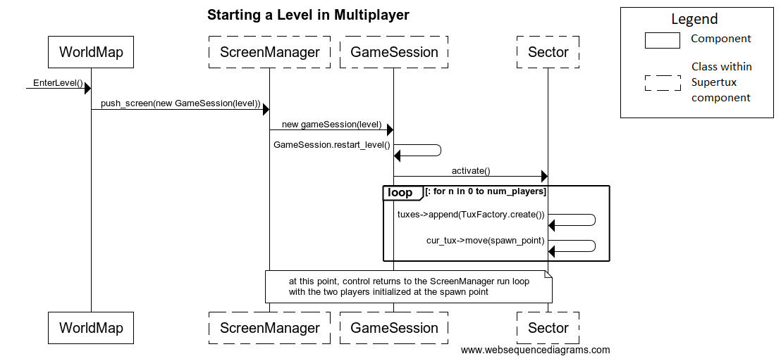
Sequence Diagram

Slide 13
Concurrency
Due to having another player in the game, concurrency is a big issue
The second player will have to run in parallel with the first player
Other concurrent processes will run in the background
Audio and Graphics
Physics and Math
System might display audio/visual lags or errors if the user input is not rendered and received properly

Slide 14
Team Issues
Open source contributions from the community could lead to divided code that is not unified
Components are written to perform very specific functionalities, not built to easily extend
Code needs to be well document

Slide 15
Limitations
This approach isn’t very flexible to changes to the gameplay that have the two players interacting in novel ways, as these changes could affect other components we don’t intend to change.
No support for networked multiplayer, or multiple screens
We did the analysis but did not try to implement the feature, so things may not work the way we expect

Slide 16
Lessons Learned
There is no one right way to add a feature
High coupling makes adding new features very difficult
We learned the true importance of comments
Doing things correctly the first time would make extensions like this much easier

Slide 17
Closing Points
Our new feature is local multiplayer
Achieved by enhancing the SuperTux component
We chose to enhance the component instead of trying to create a new subsystem that would be able to interact with the whole system

Slide 18
Thank You!

