Slide 1








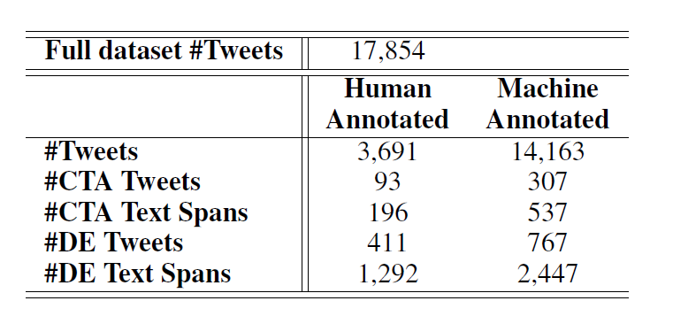
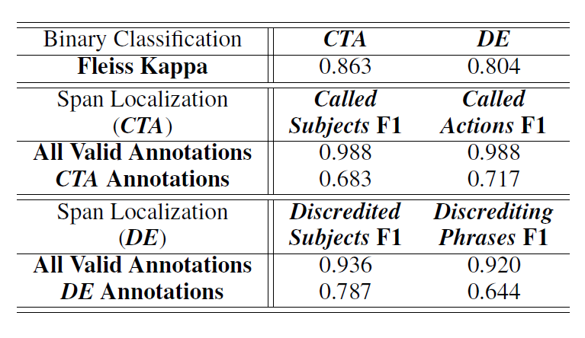
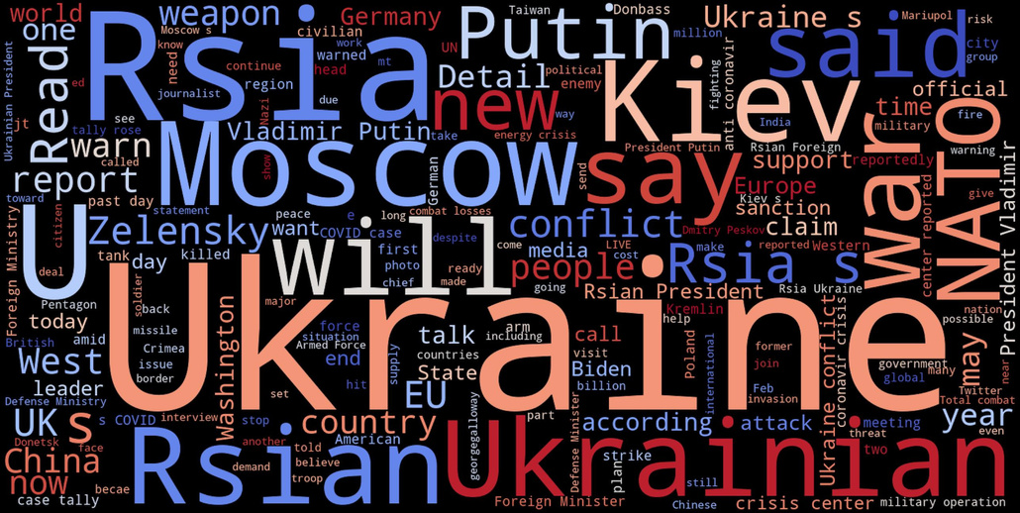
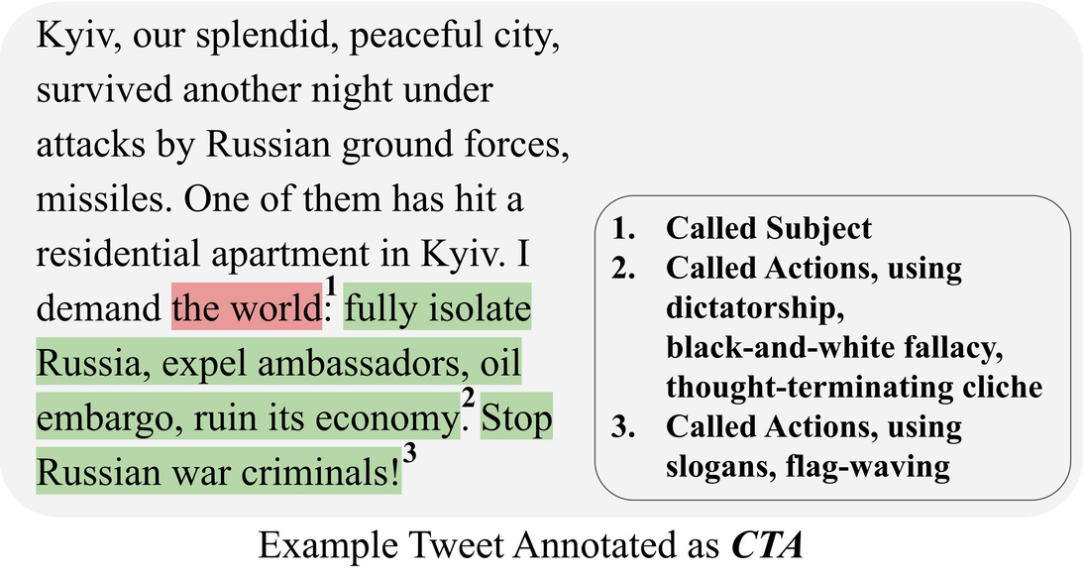
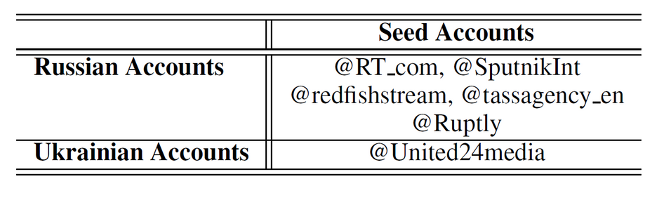
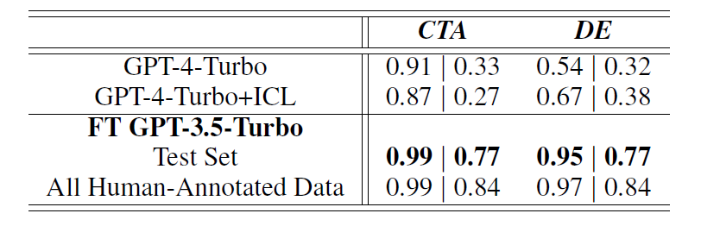

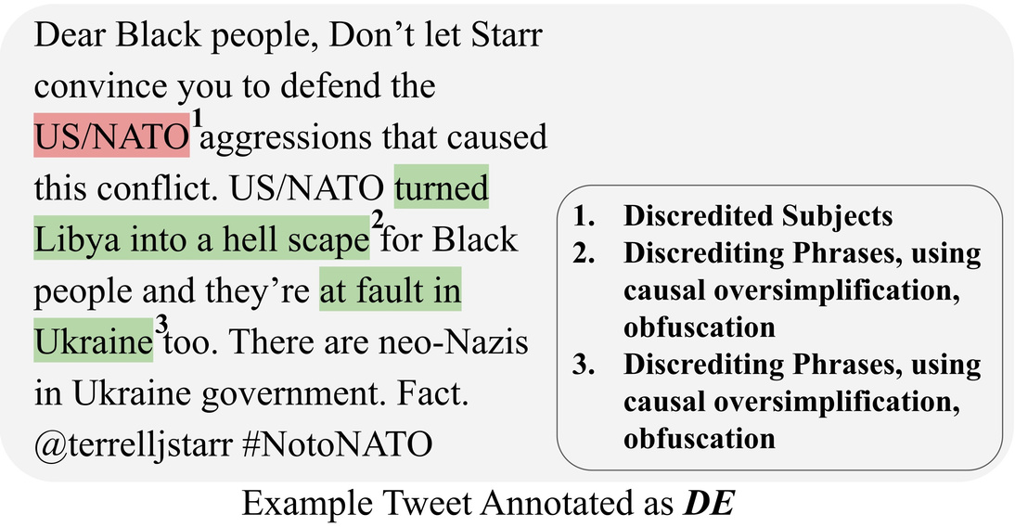
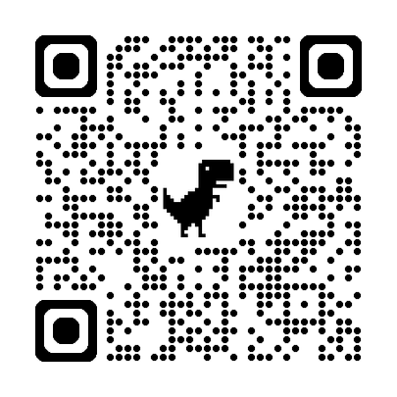
TweetIntent@Crisis: A Dataset Revealing Narratives of Both Sides in the Russia-Ukraine Crisis
Lin Ai, Sameer Gupta, Shreya Oak, Zheng Hui, Zizhou Liu, Julia Hirschberg
Computer Science Department, Columbia University
Abstract
Methodology
Result & Key Findings
Conclusion
This paper introduces TweetIntent @Crisis, a novel Twitter dataset centered on the Russia-Ukraine crisis. Comprising over 17K tweets from government-affiliated accounts of both nations, the dataset is meticulously annotated to identify underlying intents and detailed intent-related information. Our analysis demonstrates the dataset’s capability in revealing fine-grained intents and nuanced narratives within the tweets from both parties involved in the crisis. We aim for TweetIntent@Crisis to provide the research community with a valuable tool for understanding and analyzing granular media narratives and their impact in this geopolitical conflict.
Data Collection:
Time Frame: February 2022 to February 2023.
Source: Tweets from verified Russian and Ukrainian government-affiliated accounts.
Annotation:
Types of Intents:
Call To Action (CTA): Urges audience to take specific actions.
Discredit Entity (DE): Aims to harm reputation of entities.
Process: Combination of human annotation and machine annotation using fine-tuned GPT-3.5-Turbo models.
Techniques Used:
Latent v Allocation (LDA): For topic modeling to filter relevant tweets.
Fine-Tuning GPT Models: To enhance accuracy in detecting and localizing intents in tweets.
Dataset Statistics:
Impact: TweetIntent@Crisis provides valuable insights into the media narratives and their strategic dissemination during the Russia-Ukraine crisis.
Applications: This dataset aids researchers in understanding the dynamics of information warfare and the construction of media narratives on social media.
Future Work: Potential for expanding the dataset to include multilingual tweets and further refining annotation techniques to capture more nuanced intents.
Inter-Annotator Agreements:
Datasets sources
Intent Binary Classification using LLMs:
Acknowledgements and More
Funding: Defense Advanced Research Projects Agency (DARPA).
Contributors: Kitware Inc. for annotation assistance.
Introduction
Narrative Analysis:
CTA Ukrainian Accounts: Focus on rallying international support, sanctions, and weapon requests from international.
CTA Russian Accounts: Broad calls to global audience for peace.
DE Ukrainian Accounts: Focus on discrediting Russia, using terms like "invasion" and "killing civilians".
DE Russian Accounts: Target NATO, Ukraine, and Western governments. Use strong negative language to discredit entities.
Context: The digital battleground of the Russia-Ukraine crisis involves strategic use of social media to rally support and disseminate narratives.
Objective: Introduce TweetIntent@Crisis, a Twitter dataset that captures narratives from both Russian and Ukrainian government-affiliated accounts, focusing on intents behind tweets.
Dataset: Over 17,000 tweets, including 3,000 human-annotated and 14,000 machine-annotated tweets using fine-tuned GPT models.
Scan for More!
@Zheng hui 2024

