Slide 1

Facial Recognition and Detection With OpenCV
Zack McGinnis

Slide 2
Background
Facial Detection
  Not as difficult as recognition
  Haar Cascades method (aka Viola-Jones method)
  A pre-trained XML classifier is used in our method.
Facial Recognition
  More difficult, many different algorithms
  Must match face within the input image with a face/person within the training set
  We will use:
    Eigenfaces
    Fisherfaces
    LBPH (Local Binary Patterns Histograms)

Slide 3
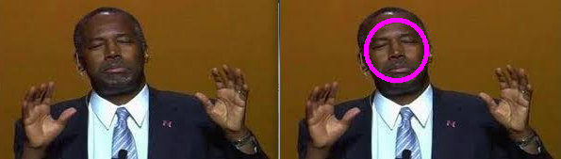
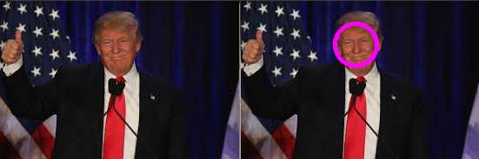
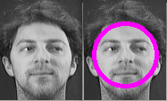
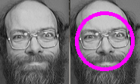
Facial Detection – Input and Output
Haar Cascades
  Input image is inspected for features according to the classifier.
  Once our features are detected, our application draws an ellipse around the x,y coordinates of each feature.

Slide 4
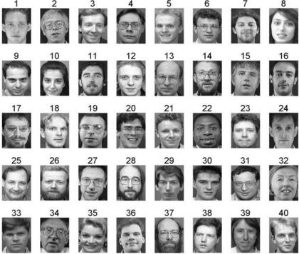
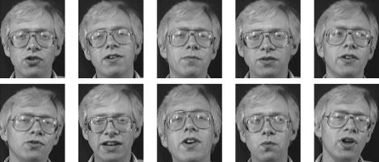
Training Set for Facial Recognition
AT&T Face Database
  Collection of 40 classes (separate people)
    10 Images in each class (or 10 images per person)
  All 400 total images are frontal view
        We will remove 1 image from our database (before training).
        This image will be used as the input image to be recognized.

Slide 5
Recognition Algorithm #1:
Eigenfaces
How it works
The Eigenface method uses Principal Component Analysis (PCA) to linearly project the image space to a low dimensional feature space.
We want to find vectors with the greatest variance within the data.
This is easily done after each image is converted to grayscale; essentially turning each image into a vector within a vector space.
After a PCA is performed on these vectors, we obtain the eigenvectors which make up the basis of the vector space.
The eigenvectors we obtain are very important to us since they usually represent the most prominent features of the data in question (faces).
We can decompose an unknown face and assess which eigenvectors most closely correlate to the image in question.

Slide 6

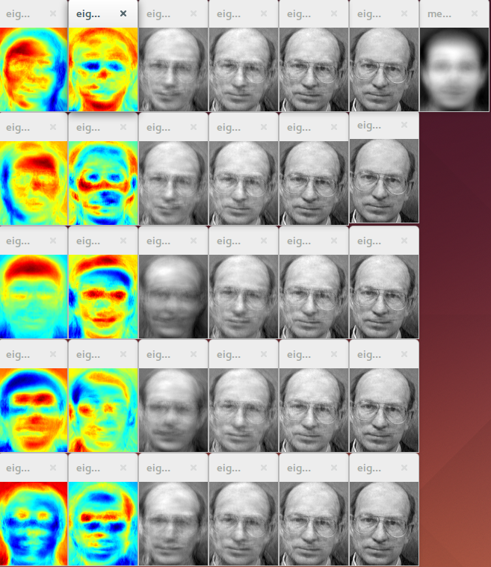
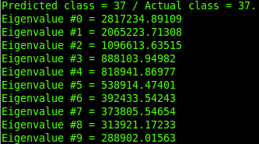
Recognition Algorithm #1:
Eigenfaces
Recognition Algorithm #1:
Eigenfaces
Recognition Algorithm #1:
Eigenfaces
Actual class (label) of input image = 37
Predicted class = 37
Eigenvalues are given
10 Eigenfaces
20 Reconstruction images
1 training set mean face

Slide 7
Recognition Algorithm #2:
Fisherfaces
How it works
Eigenface method utilizes PCA to project the image space to a low dimensional subspace and maximize the total scatter across all classes (faces)
  Fisherface method uses LDA (Linear Discriminant Analysis) to maximize the ratio of between-class scatter to that of within-class scatter.
The Fisherfaces allows a reconstruction of the projected image, just like the Eigenfaces did.
  But since we only identified the features to distinguish between subjects, you can’t expect a nice reconstruction of the original image.

Slide 8
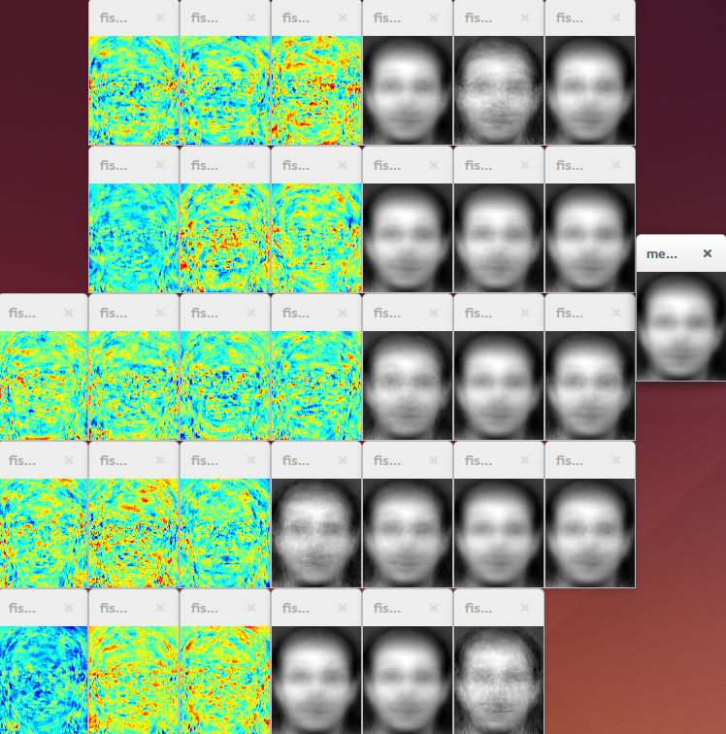
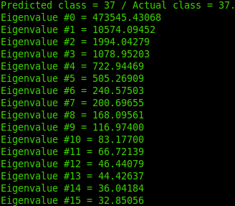
Recognition Algorithm #2:
Fisherfaces
Actual class (label) of input image = 37
Predicted class = 37
Eigenvalues are given
15 Eigenfaces
Reconstruction is not as helpful
1 training set mean face

Slide 9

Recognition Algorithm #3: LBPH
(Local binary patterns histograms)
How it works
In contrast to the previous two methods, LBPH analyzes each image independently rather than inspecting the whole dataset.
LBPH summarizes the local structure in an image by comparing each pixel with its neighborhood.
When an unknown input image is provided, we perform the same analysis on it and compare the result to each of the images in the dataset.
By characterizing the local patterns found in specific image locations, we can successfully analyze each image based on these results.

