Slide 1

Implementing Artificial Intelligence Features In a No-Limit Texas Hold'em Poker Bot
By Zack McGinnis

Slide 2
Overview
The game of Texas Hold'em Poker
Summary of my two added AI features:
  SPR-Weighted UCT heuristic to the MCTS (Monte Carlo Tree Search) Bot.
  Opponent model used to predict the probability distribution of the opponents next move.
Results of my experiments
Conclusions
Demonstration?

Slide 3
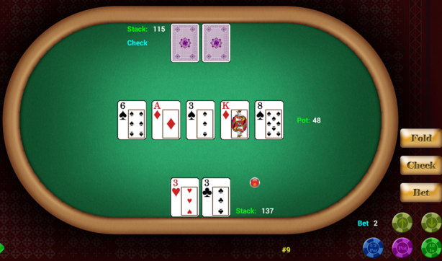
Texas Hold'Em poker: a brief overview
Difficult to account for stochastic elements (unseen cards, bluffing, etc)
Players have the option to: check, bet, call, raise, or fold
My bot will be playing against one opponent
  No-limit betting rules (not fixed limit)
  Our opponent will be a rule-based bot, without the capability to learn from previous games.

Slide 4
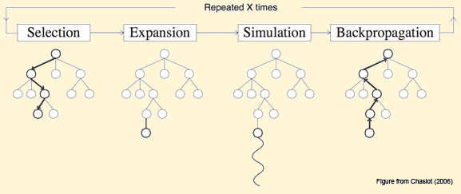
The MCTS (Monte Carlo Tree Search) Bot
Modified existing MCTS Bot from open-source project
  https://code.google.com/p/opentestbed/
Monte Carlo Search Tree Algorithm
  Selection: Starting at root node R, recursively select optimal child nodes (explained below) until a leaf node L is reached.
  Expansion:If L is a not a terminal node (i.e. it does not end the game) then create one or more child nodes and select one C.
  Simulation:Run a simulated playout from C until a result is achieved.
  Backpropogation:Update the current move sequence with the simulation result (estimated value, and visit count).

Slide 5
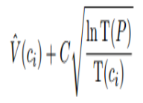
Upper Confidence Bound as applied to Trees (UCT)
Used in the first stage (selection) of MCTS
  Acts as a heuristic to MCTS
Where:
  V(c_{i}) is the estimated value of the node,
  (c_{i}) is the number of the times the node has been visited
  P is the total number of times that its parent has been visited.
C is a tunable bias parameter.

Slide 6
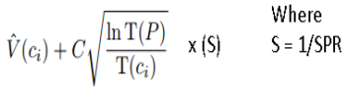
My weighted UCT implementation
My UCT implementation will weight branches containing moves resulting in a higher SPR more heavily.
  This will favor more aggressive actions throughout each iteration of the MCTS
  e.g. More betting and raising, less checking and calling.
SPR = Stack-to-Pot Ratio
  ex. playerStack = $100, currentPotSize = $25, then SPR = 4.0

Slide 7
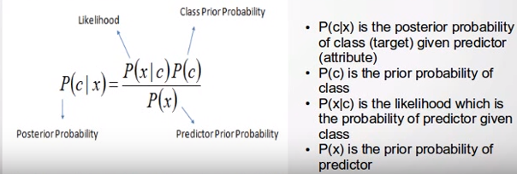
The Opponent Model
Utilized during the "simulation" stage of MCTS
NaiveBayes classifier
WEKA (Waikato Environment for Knowledge Analysis) machine learning library
  Trained on hand history data (10,000 hands) collected from a testbot vs. testbot game

Slide 8
The Opponent Model
Models trained for many different gamestates:
  820 instances of post-flop check or bet actions
  2363 instances of post-flop fold, call, or raise actions
  10 instances of pre-flop check or bet actions
  6973 instances of pre-flop fold, call, or raise actions.
Why NaiveBayes
  Nominal actions of our opponent are classified based on attributes collected from previous hands
  We can assign a probability of a class (action) occurring, given attribute values (approximately 32 per gamestate).
  e.g. We can determine that the opponent will fold to a flop bet 80% of the time, so we assign 80% to our opponent node probability distribution for that particular gamestate

Slide 9
Experiment Setup
Our opponent (testbot)
  Rule based, (e.g. only makes decisions based on it's own two hole cards, and the exposed community cards)
  No opponent model or ability to learn from prior games
10,000 games (hands) per test
Y-axis = profit (measured in terms of bankroll ($1.00 per bankroll)
X-axis = # of games
Blue line = our MCTS bot
Red line = testbot (opponent)

Slide 10
Experiment Setup
Experiment #1
  Standard UCT with no trained opponent model
Experiment #2
  Standard UCT with NaiveBayes trained opponent model
Experiment #3
  SPR weighted UCT with no trained opponent model
Experiment #4
  SPR weighted UCT with NaiveBayes trained opponent model

Slide 11
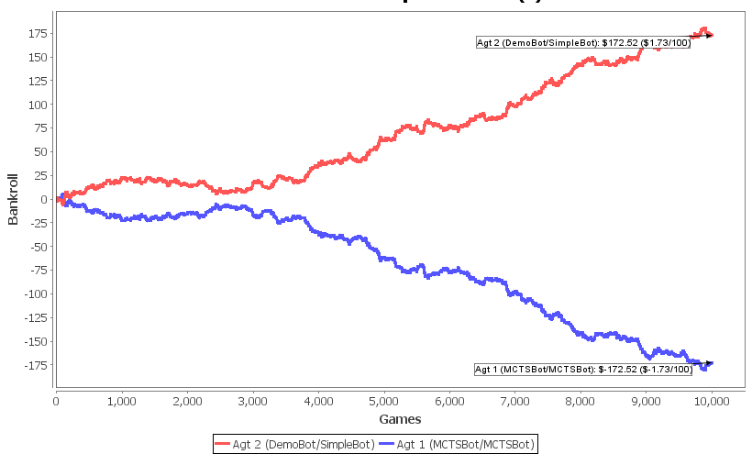
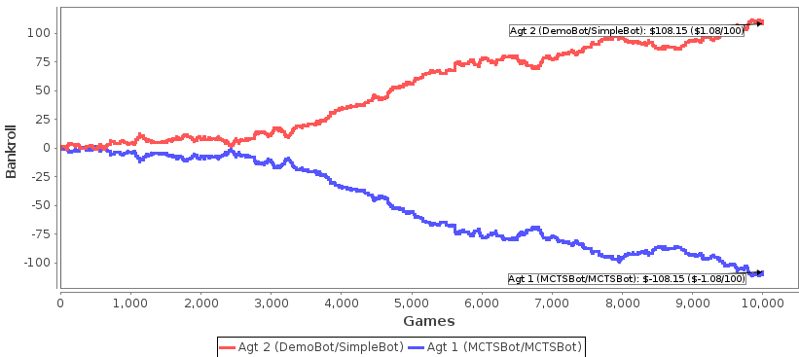
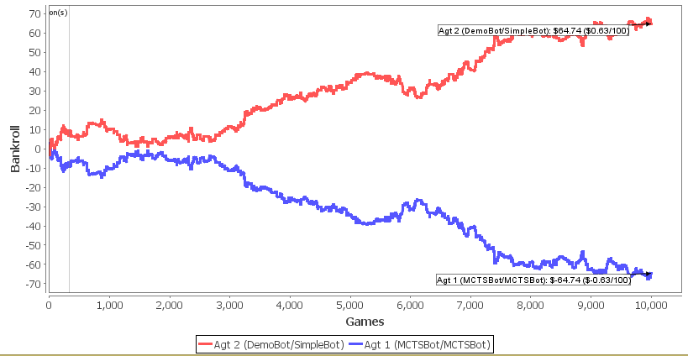
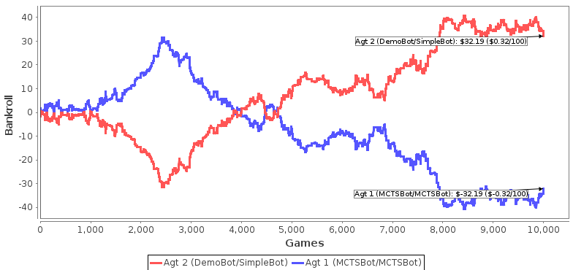
Results

Slide 12
Experiment Setup
Experiment #1
  Standard UCT with no trained opponent model
  Lost at a rate of -$1.73/100 games
Experiment #2
  Standard UCT with NaiveBayes trained opponent model
  Lost at a rate of -$1.08/100 games
Experiment #3
  SPR weighted UCT with no trained opponent model
  Lost at a rate of -$0.63/100 games
Experiment #4
  SPR weighted UCT with NaiveBayes trained opponent model
  Lost at a rate of -$0.32/100 games

Slide 13
Conclusions
I'm less of a loser!
Strange activity occuring around 2500-3000 games
  Variance?
Would like to create and test opponent models using different classifiers (SVM, Multi-layer perceptron, etc)

Slide 14
Demonstration?
MCTS bot vs testbot
  Visualization of game-tree and MCTS algorithm iterations

