Slide 1



Minimax Search and the Structure of Cognition!
Zack M. Davis
!!Con West 2019
zackmdavis.net/blog
zackmdavis
@zackmdavis
(followers welcome!)

Slide 2
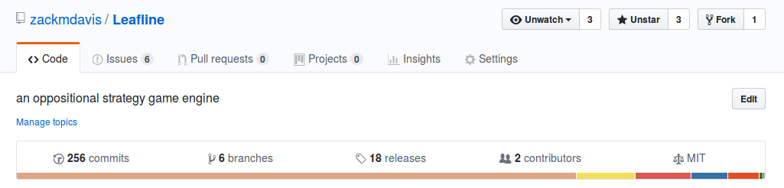
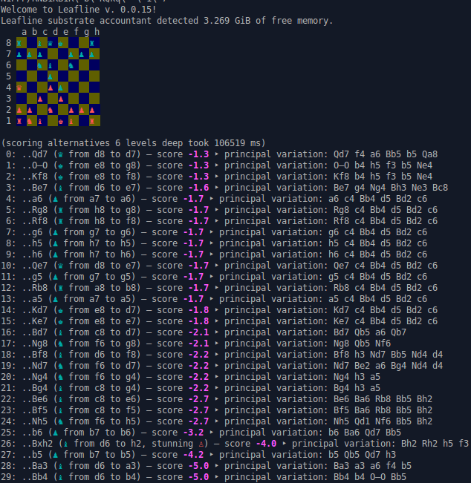
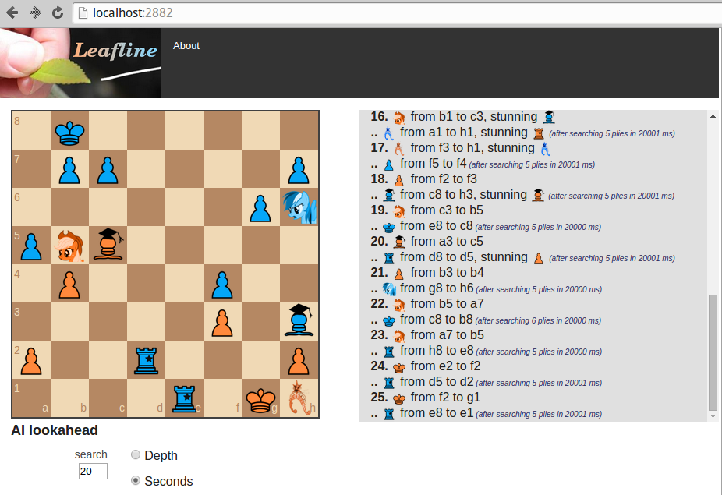

Slide 3
























 | servant | “pawn”
 | pony | “knight”
 | scholar | “bishop”
 | cop | “rook”
 | princess | “queen”
 | figurehead | “king”

Slide 4
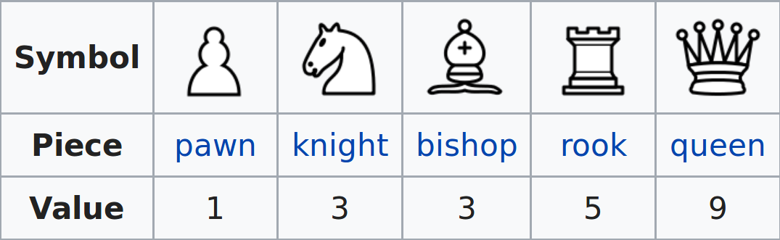

Slide 5
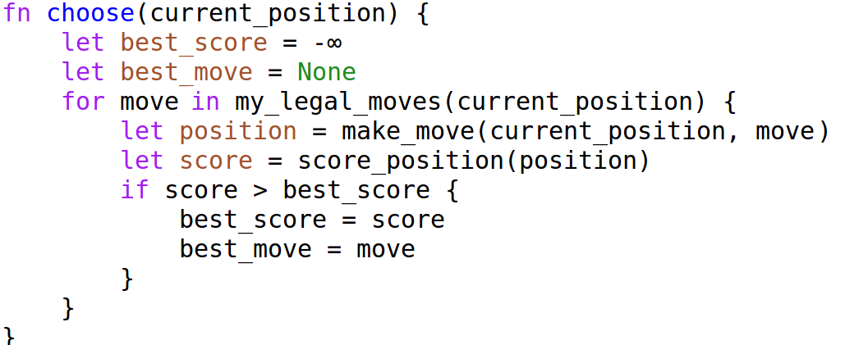

Slide 6
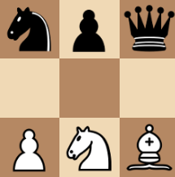
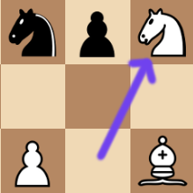
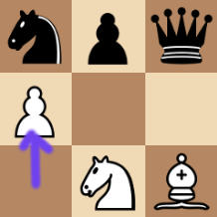
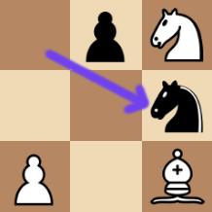
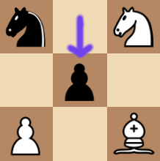
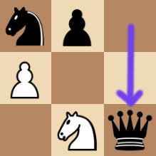
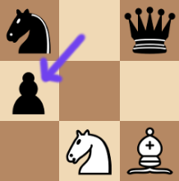
Score: max(
min(3, 3, …),
min(–9, –7, …),
...
)
...
Score: min(3, 3, ...)
Score: min(–9, –7, ...)
...
...
Score: 1 + 3 + 3 – 3 – 1 = 3
1 + 3 + 3 – 3 – 1 = 3
1 + 3 – 3 – 1 – 9 = –9
3 + 3 – 1 – 3 – 9 = –7

Slide 7
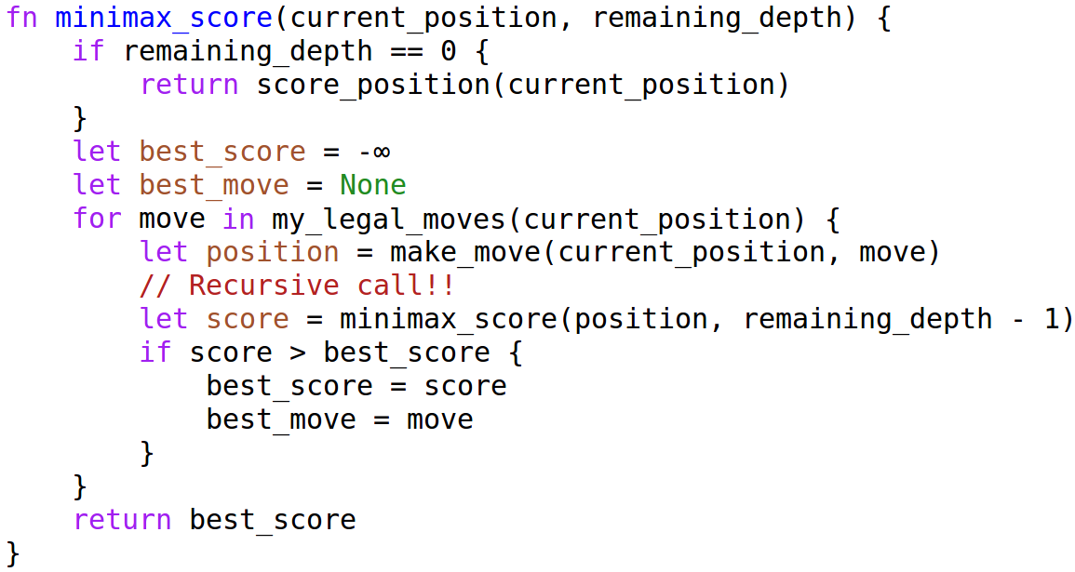

Slide 8
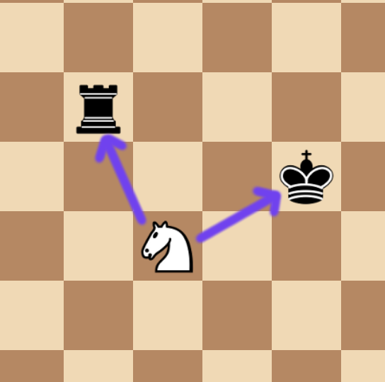

Slide 9
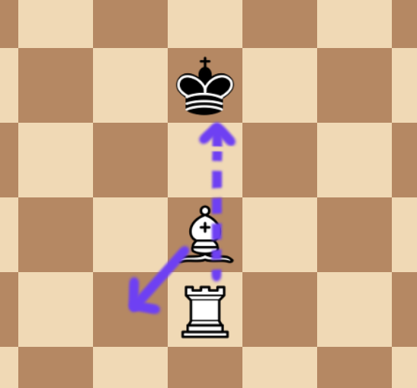

Slide 11
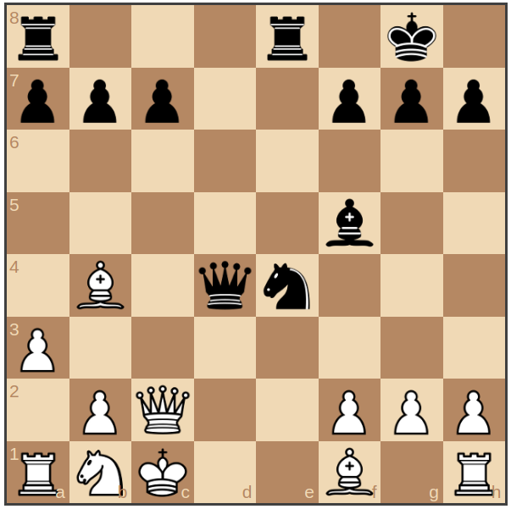

Slide 12
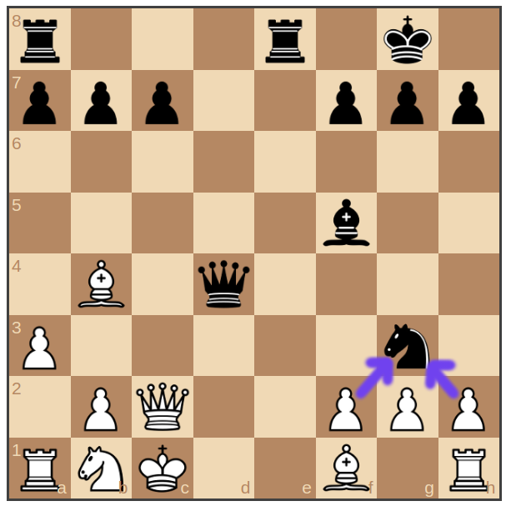

Slide 13
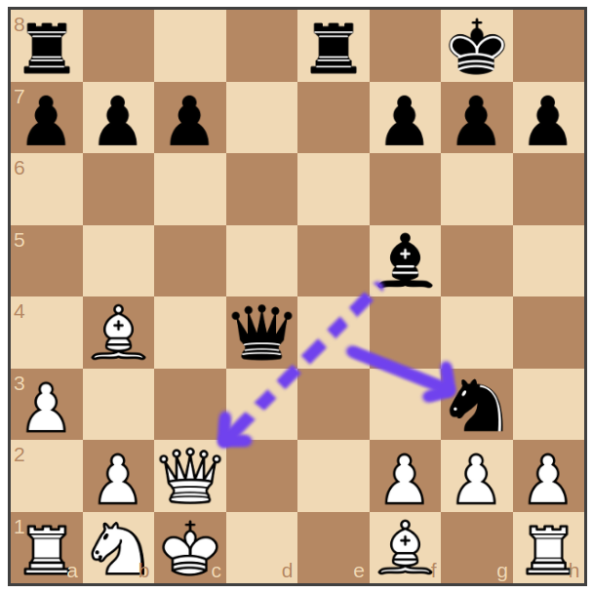

Slide 14
