Slide 1
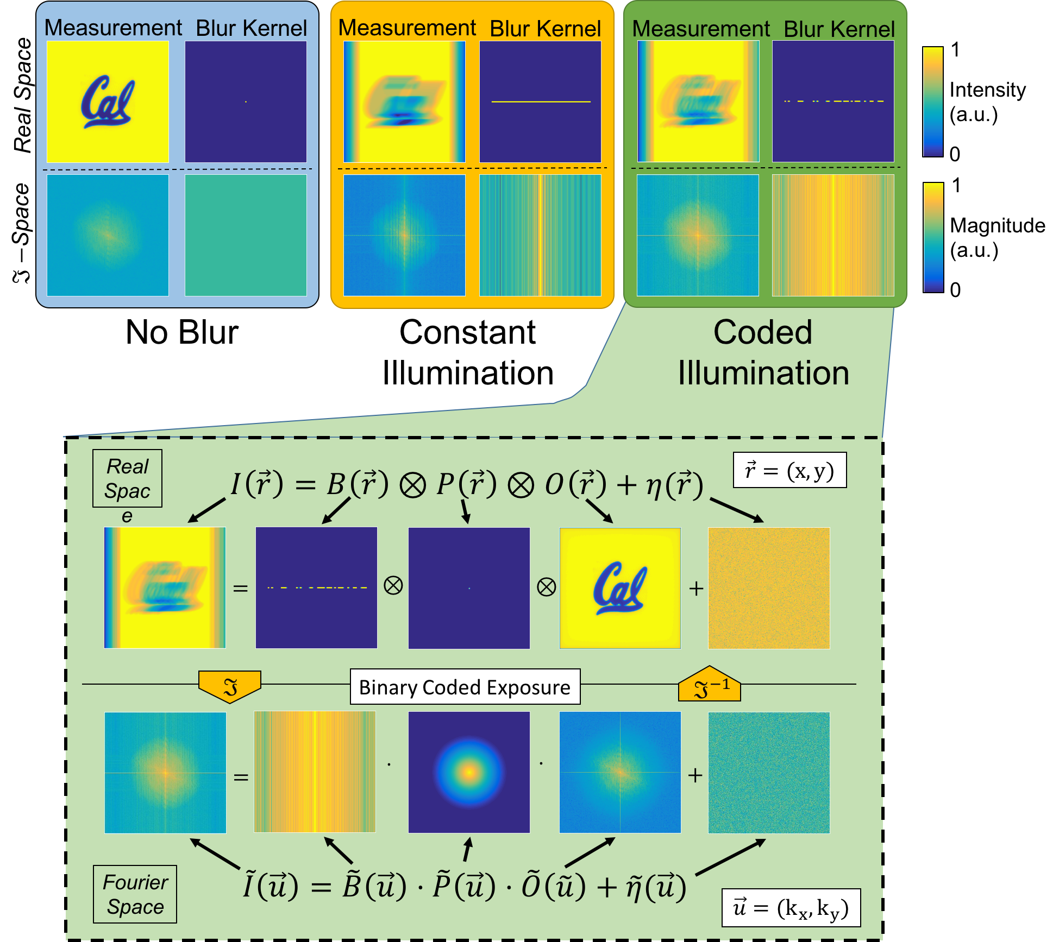
Real Space

Slide 2

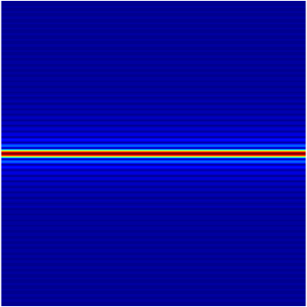

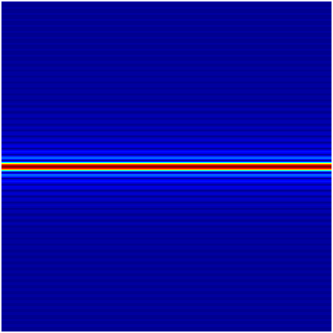
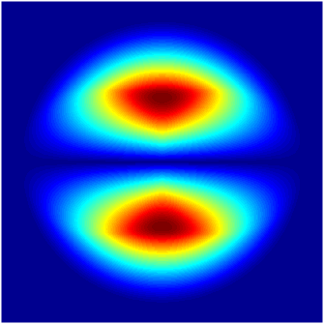
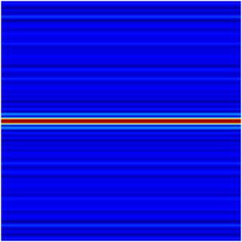
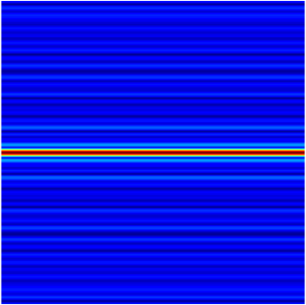
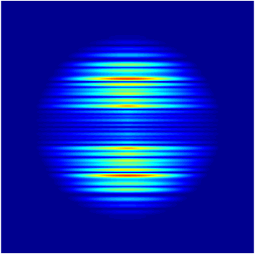
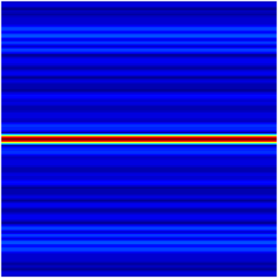
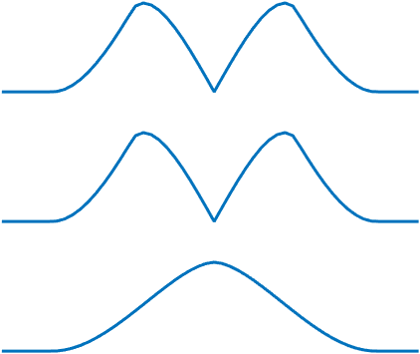
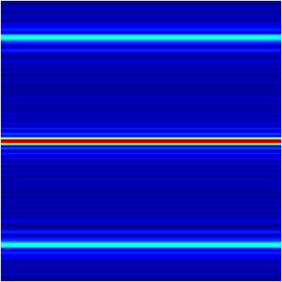
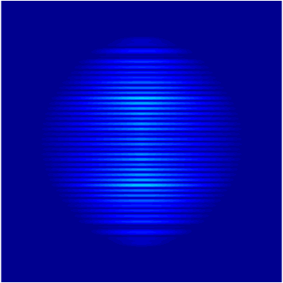
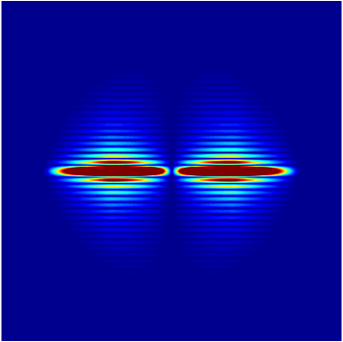

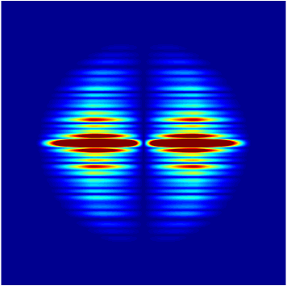
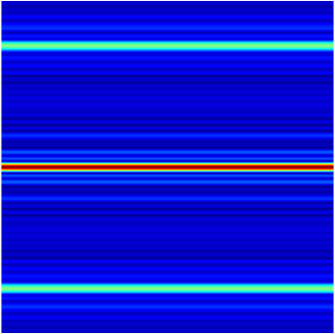
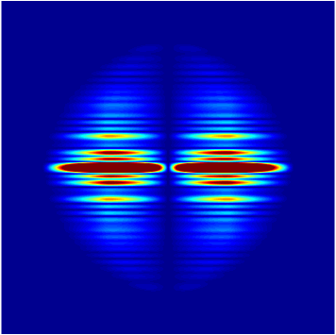
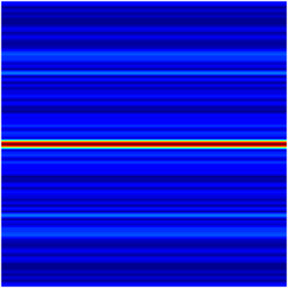
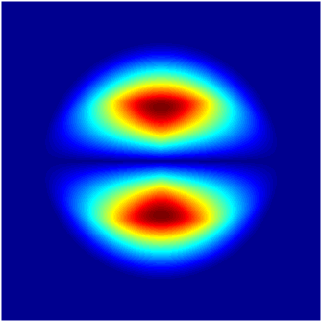
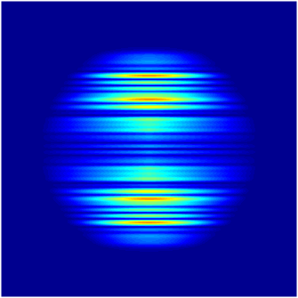


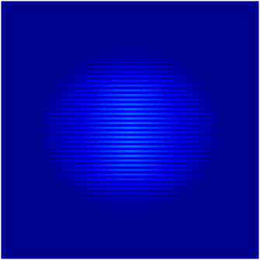


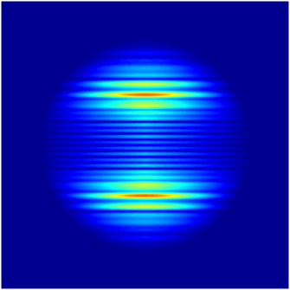

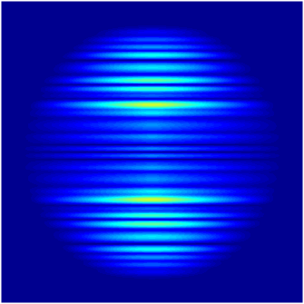




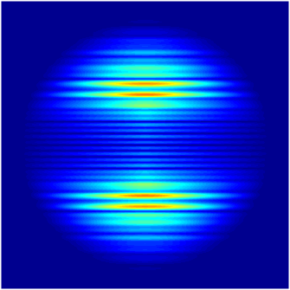
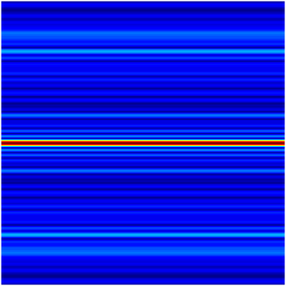
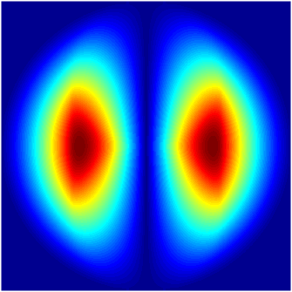
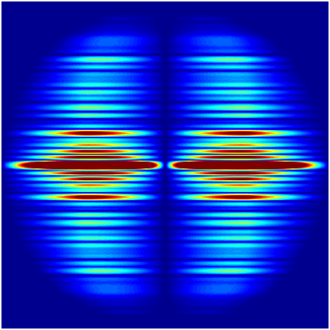

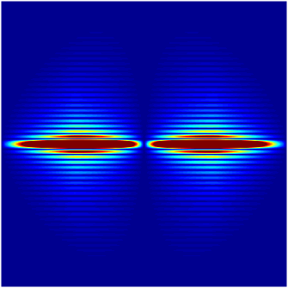

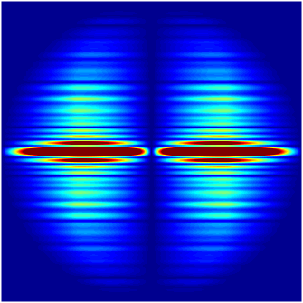










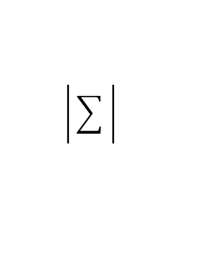
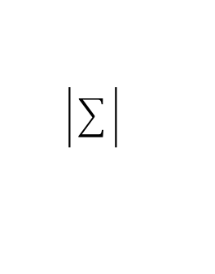
Blur Kernel
𝓕-Spectrum
Product
𝓕-Spectrum
1
Phase Transfer Function
𝓕-Spectrum
Magnitude
(a.u.)
Constant
Illumination
0
Blur Direction
$$k_{y}$$
$$k_{x}$$
$$k_{y}$$
Coded Illumination
(Previous Method)
$$=$$
$$k_{x}$$
Sum Magnitude
(a.u)
Spatial Frequency
Coded Illumination
(Our Method)
Projection Reference
Blur Kernel
𝓕-Spectrum
Product
𝓕-Spectrum
1
Phase Transfer Function
𝓕-Spectrum
Magnitude
(a.u.)
Constant
Illumination
0
Blur Direction
$$k_{y}$$
$$k_{x}$$
$$k_{y}$$
Coded Illumination
(Previous Method)
$$=$$
$$k_{x}$$
Sum Magnitude
(a.u)
Spatial Frequency
Coded Illumination
(Our Method)
Spectral
Reference

Slide 3
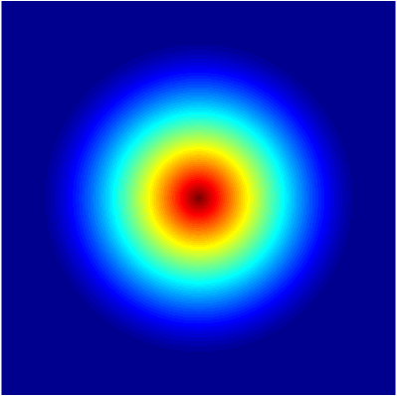
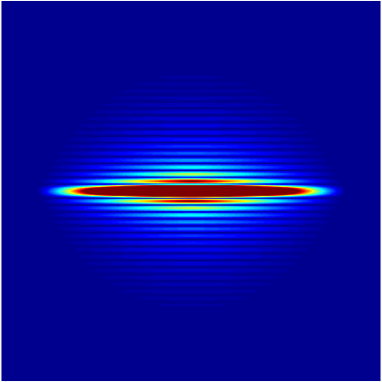
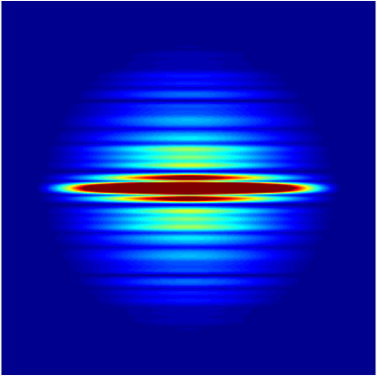
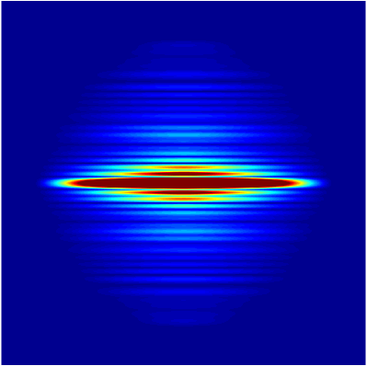
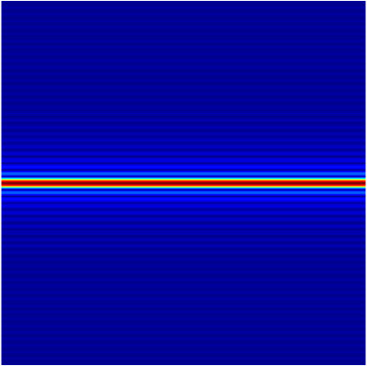
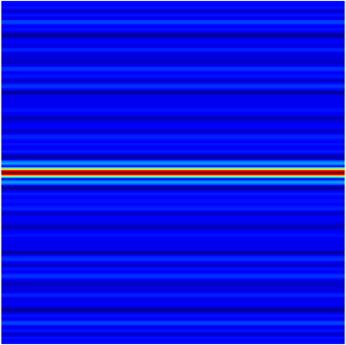
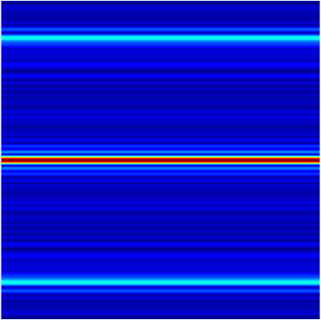
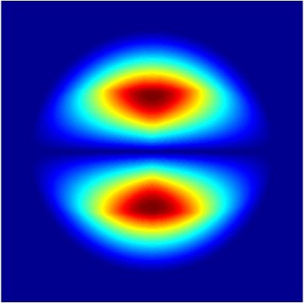
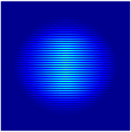
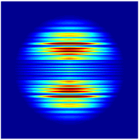
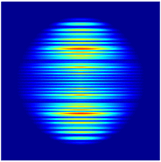











Constant Kernel
Prev. Method
Our Method
$$H_{A}$$
$${ℱ\{b}_{2D}\}⋅H_{A}$$
Abs. Transfer Function
1
$$k_{y}$$
1
$$k_{y}$$
0
1
1
$$k_{x}$$
0
$$k_{x}$$
$${ℱ\{b}_{2D}\}$$
0
0
$$k_{y}$$
$$k_{x}$$
$$H_{φ}$$
$${ℱ\{b}_{2D}\}⋅H_{φ}$$
Phase Transfer Function
$$k_{y}$$
1
$$k_{y}$$
0.5
0.5
0.5
$$k_{x}$$
0
$$k_{x}$$
0
0
0

Slide 4
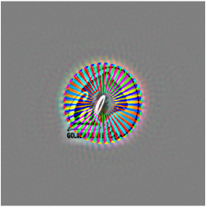

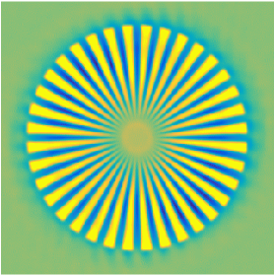






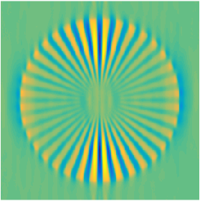
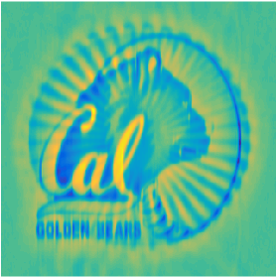

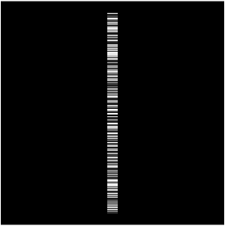

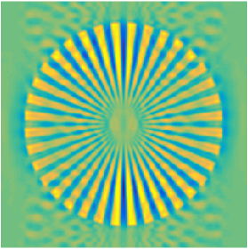
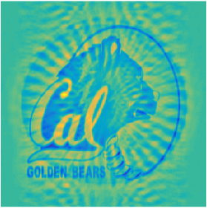
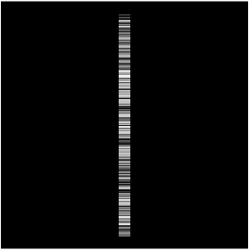
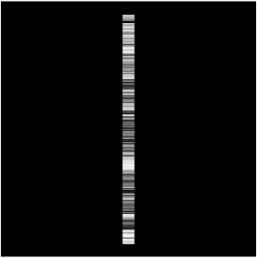
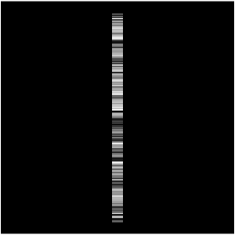





Measurment
Blur Kernel
Recovered Phase
Recovered Amplitude
$$b_{r}$$
$$b_{g}$$
$$b_{b}$$
1.0
1.1
True Phase
No Blur
rad
a.u.
1.0
0.0
0.9
rad
1.0
1.1
Constant
Illumination
rad
a.u.
True Amp.
0.0
24.1% N-SSE
0.0
1.4% N-SSE
0.9
1.1
1.0
1.1
a.u.
Raskar
et. al.
rad
a.u.
0.9
16.3% N-SSE
0.0
1.8% N-SSE
0.9
Our
Method
1.0
1.1
rad
a.u.
13.0% N-SSE
0.0
1.9% N-SSE
0.9

Slide 5




















Blurred Sample
(Previous Method)
Blurred Sample
(Our Method)
LED Intensity
LED Intensity
Static Sample
t
t
t
No Blur
$$300μm$$
Blur
$$300μm$$
Blur
Raw Data
(Background Subtracted)
$$200μm$$
4.0
Recovered
Absorption
a.u.
$$200μm$$
0.0
20
Recovered
Phase
radians
$$200μm$$
0
20
0
20
0
20
0
Phase Cutline
(Radians)
0 100 200 300 400 500
0 100 200 300 400 500
0 100 200 300 400 500
20
0
20
0
20
0
0 100 200 300 400 500
0 100 200 300 400 500
0 100 200 300 400 500
Position (microns)
Position (microns)
Position (microns)
Notes:
TODO - Axes

