Slide 1
JS Design Patterns
Reference: Design Patterns by Stoyan Stefanov
(see SAKAI->Resources->Books)

Slide 2
Design Patterns
What is a Pattern? Reusable solutions that can be applied to commonly occurring problems in software design and architecture.
Proved to successfully solve similar problems in the past
The concept of design patterns can be traced back to Christopher Alexander who published about experience in designing building and towns.
He recognized certain design constructs lead to a optimal effect time and time again.
He published a paper titled “A Pattern Language” in 1977
Gang of Four (GoF)
The GoF included Erich Gamma, Richard Helm, Ralph Johnson & John Vlissides
They published their book “Design Patterns: Elements Of Reusable Object-Oriented Software” in 1995 outlining important software patterns.

Slide 3
Benefits of Design Patterns
Patterns are proven solutions: They provide solid approaches to solving issues in software development using proven techniques that reflect the experience and insights the developers that helped define them bring to the pattern.
Patterns can be easily reused: A pattern usually reflects an out of the box solution that can be adapted to suit our own needs. This feature makes them quite robust.
Patterns can be expressive: When we look at a pattern there’s generally a set structure and vocabulary to the solution presented that can help express rather large solutions quite elegantly.

Slide 4
Design Patterns
Patterns are not an exact solution.
It’s important that we remember the role of a pattern is merely to provide us with a solution scheme.
Patterns don’t solve all design problems nor do they replace good software designers, however, they do support them.
Patterns usually fall into three category types as shown next slide.

Slide 5
Three Types of Patterns
Creational patterns:
Deal with initializing and configuring classes and objects
Structural patterns:
Deal with decoupling interface and implementation of classes and objects
Composition of classes or objects
Behavioral patterns:
Deal with dynamic interactions among societies of classes and objects
How they distribute responsibility

Slide 6
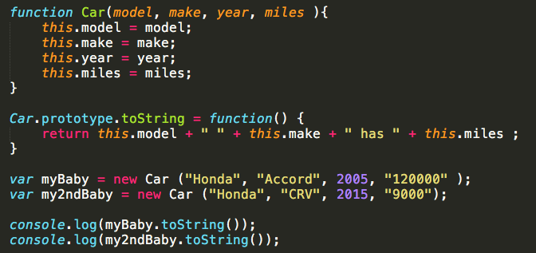
Constructor Pattern
This is nothing new … we have been using the constructor pattern in previous examples.
It is used to initialize a newly created object
Notice I used a property prototype to create a function toString.
Now each instance of Car will have its own properties but share one copy of the function toString.

Slide 7
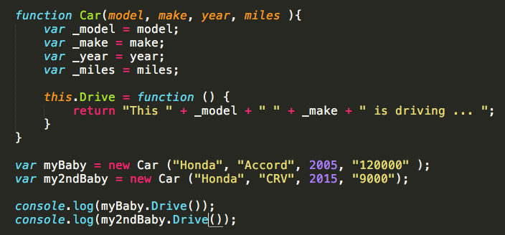
Module Pattern
Traditionally, the Module pattern is used to provide both private and public encapsulation for classes.
In JavaScript, the Module pattern is used to further emulate the concept of classes.
This is achieved by including public/private methods and variables inside a single object, thus shielding particular parts from the global scope.

Slide 8
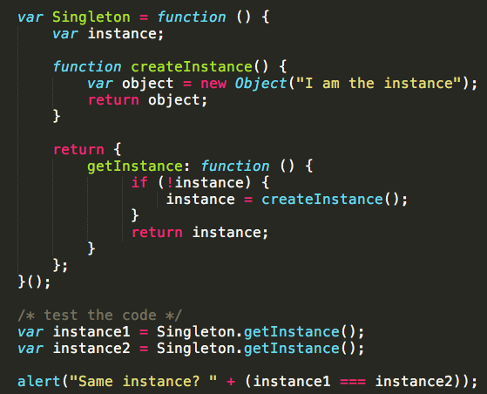
Singleton Pattern
Creational Patterns
The Singleton pattern restricts instantiation of a class to a single object. Singleton -- In sample code: Singleton
defines getInstance() which returns the unique instance.
responsible for creating and managing the instance object.
getInstance()
Singleton

Slide 9
Prototype Pattern
The prototype pattern creates objects based on a template of an existing object through cloning.
We can think of the prototype pattern as being based on prototypal inheritance where we create objects which act as prototypes for other objects. The prototype object itself is effectively used as a blueprint for each object the constructor creates. If the prototype of the constructor function used contains a property called name for example (as per the code sample lower down), then each object created by that same constructor will also have this same property

Slide 10
Factory Pattern
Creational Patterns
The objective of Factory Pattern is extensibility.
Its used to manage collection of objects that are different but still have properties in common.
factoryMethod()
Creator
Abstract Product
The objects participating in this pattern are: Creator -- In sample code: Factory
the 'factory' object that creates new products
implements 'factoryMethod' which returns newly created products
AbstractProduct -- not used in JavaScript
declares an interface for products
ConcreteProduct -- In sample code: Employees
the product being created
all products support the same interface (properties and methods)
Creator
Products

Slide 11
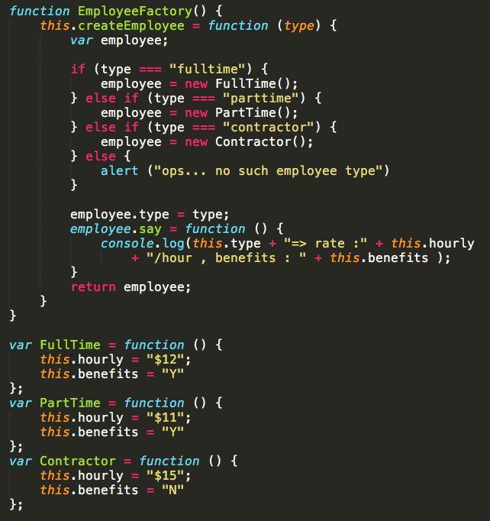
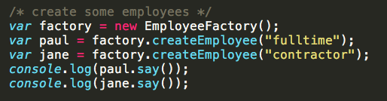
Factory Pattern (Cont.)
Create different type of employees using the factory

Slide 12
Observer Pattern
Behavioral Patterns
The Observer is a design pattern where an object (known as a subject) maintains a list of objects depending on it (observers), automatically notifying them of any changes to state.
The objects participating in this pattern are: Subject -- In sample code: Click
maintains list of observers. Any number of Observer objects may observe a Subject
implements an interface that lets observer objects subscribe or unsubscribe
sends a notification to its observers when its state changes
Observers -- In sample code: clickHandler
has a function signature that can be invoked when Subject changes (i.e. event occurs)
Subject
Subscribe
Unsubscribe
notify
Creator
Creator
Observers

Slide 13
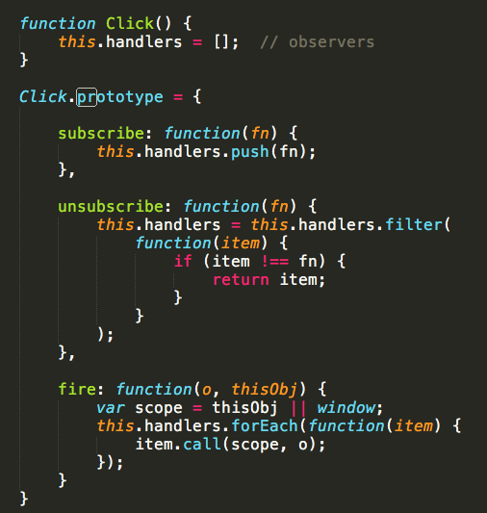
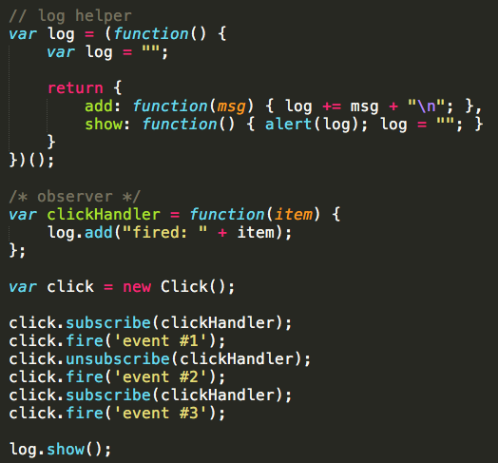
Observer Pattern (Cont.)

