Slide 1
How does a browser communicate with a program on a server

Slide 2
Outline
Go over PHP Superglobal Array and Forms
PHP examples
Note: Examples can be found on SAKAI under the appropriate week’s folder
Examples can also be found on my github account: https://github.com/msalloum/cs135
Today, we will look at the following examples:
elementsQuizPHP - we will write the code from scratch using the elementsQuiz_template folder
snowman - alternative game to hangman
miscExamples – collection of examples (send email, validate form, etc.)

Slide 3
How does a browser communicate with a program on a server
By submitting an HTTP request to the server (possibly via an XHTML form).
Such a request is made by a HTTP request method.
There are several different possible requests, but we will concentrate on the two most frequently used ones: GET and POST.
GET (most common)
For simple document requests and small forms submission
POST
For submitting large forms to the server to be processed

Slide 4
HTTP method GET
Browsers can pass parameters to a server script via a request URI.
Example: http://www.cmc.edu/~msalloum/serverscript.php?x=1&y=2
The URL of the target PHP script http://www.cmc.edu/~msalloum/serverscript.php
The query string is: x=1&y=2
A form can send data this way, but you do not need a form to use this method.

Slide 5
Query String
What is a query string?
appear after a question mark ? in a URL.
consist of name=value pairs separated by ampersands (&).
name is the name attribute of a widget or control of the XHTML form
spaces in value can be replaced by + signs
Widget values in a query string can have special characters encoded as a % followed by a 2 digit hex ASCII code representing the special character. For more detail, consult :
http://www.permadi.com/tutorial/urlEncoding/

Slide 6
GET vs. POST
GET method:
Values (query string) are encoded directly into URI.
Requests are cached by the browser, server, or proxy.
Appropriate if the amount of data to send is small, and there are no side effects on the server.
POST method:
Values encoded in a separate part of the HTTP request (query string is not visible in URL as it is in GET).
Requests cannot be cached (each request is independent and matters).

Slide 7
Submitting an HTTP request using a form
Click the submit button of the XHTML form to send form data to the script or JavaScript function that will process the form.
The action attribute is a URI or a JavaScript function call.
The method attribute specifies the HTTP request method.
<form action="http://www.cmc.edu/some.php" method="post” >
…..................
</form>

Slide 8
Processing Form Data
How does a PHP script get information from a client?
How does a PHP script get information from the server it is running on?
How does PHP save information from a session with a client?
Answer: Using PHP superglobal arrays

Slide 9
Superglobal Arrays
Superglobals are built-in variables that are always available in all scopes. There is no need to do global $variable; to access them within functions.
$_SERVER - stores data about the currently running server.
$_ENV - stores data about the current client's environment.
$_GET - stores data sent to the server using HTTP method GET.
$_POST - stores data sent to the server using HTTP method POST.
$_COOKIE - stores data contained in cookies on the client's computer.
$_SESSION - used by PHP to stores data pertaining to a the server's session with a client.

Slide 10
Form example using GET
Uses the superglobalarray $_GET to get the appropriate keys from the form.
<form action="../PHP/calculator.php" method="get">
<fieldset>
<label for="x"> x: </label>
<input type="text" name="x" id="x" /> <br/>
<label for="y"> y: </label>
<input type="text" name="y" id="y" /><br/>
<input type="submit" value="Calculate Sum" />
<input type="reset" />
</fieldset>
</form>
<?php
// Get the form data
$x = $_GET['x'];
$y = $_GET['y'];
// Process form data
print("$x" . " + " . "$y = " .
($x + $y) . "<br />");
?>

Slide 11
Example using post
Uses the superglobalarray $_POST to get the appropriate keys from the form.
<form action="../PHP/calculator.php" method=”post">
<fieldset>
<label for="x"> x: </label>
<input type="text" name="x" id="x" /> <br/>
<label for="y"> y: </label>
<input type="text" name="y" id="y" /><br/>
<input type="submit" value="Calculate Sum" />
<input type="reset" />
</fieldset>
</form>
<?php
// Get the form data
$x = $_POST['x'];
$y = $_POST['y'];
// Process form data
print("$x" . " + " . "$y = " .
($x + $y) . "<br />");
?>

Slide 12
Processing form data
Often when we process form data we have to check what data was actually submitted through the form.
Common method is illustrated in the following example:
Here we are checking if $_post array has value for the key called from. If it does we simply access the key and assign the value to a PHP variable that we call $from. If there is no such key/value we assign the default value of empty string ("") to the $from variable.
We use the common C++ syntax:(bool expression) ? do this : do that. Where do this is done if bool expression is true and do that is done if it is false.
$from = (isset($_POST["from"])) ? $_POST["from"] : "” ;

Slide 13
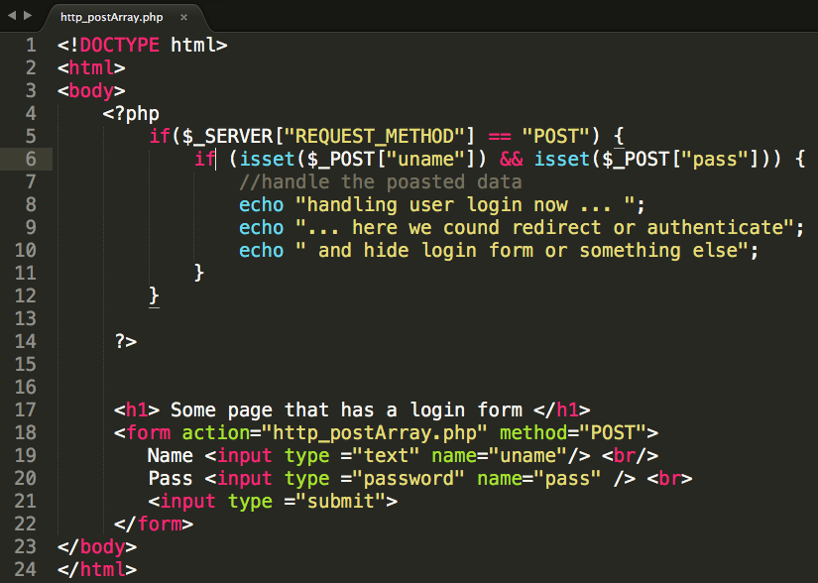
There is also a _SERVER array that has information about the server, such as the request method.

Slide 14
$_SERVER
The $_SERVER associative array contains
HTTP request headers (send by client)
configuration options for PHP
To use the $_SERVER array, you simply refer to the relevant case-sensitive keyname:
echo $_SERVER["SERVER_NAME"] . "<br/>";
echo $_SERVER["SERVER_SOFTWARE"] . "<br/>";
echo $_SERVER["REMOTE_ADDR"] . "<br/>";

Slide 15
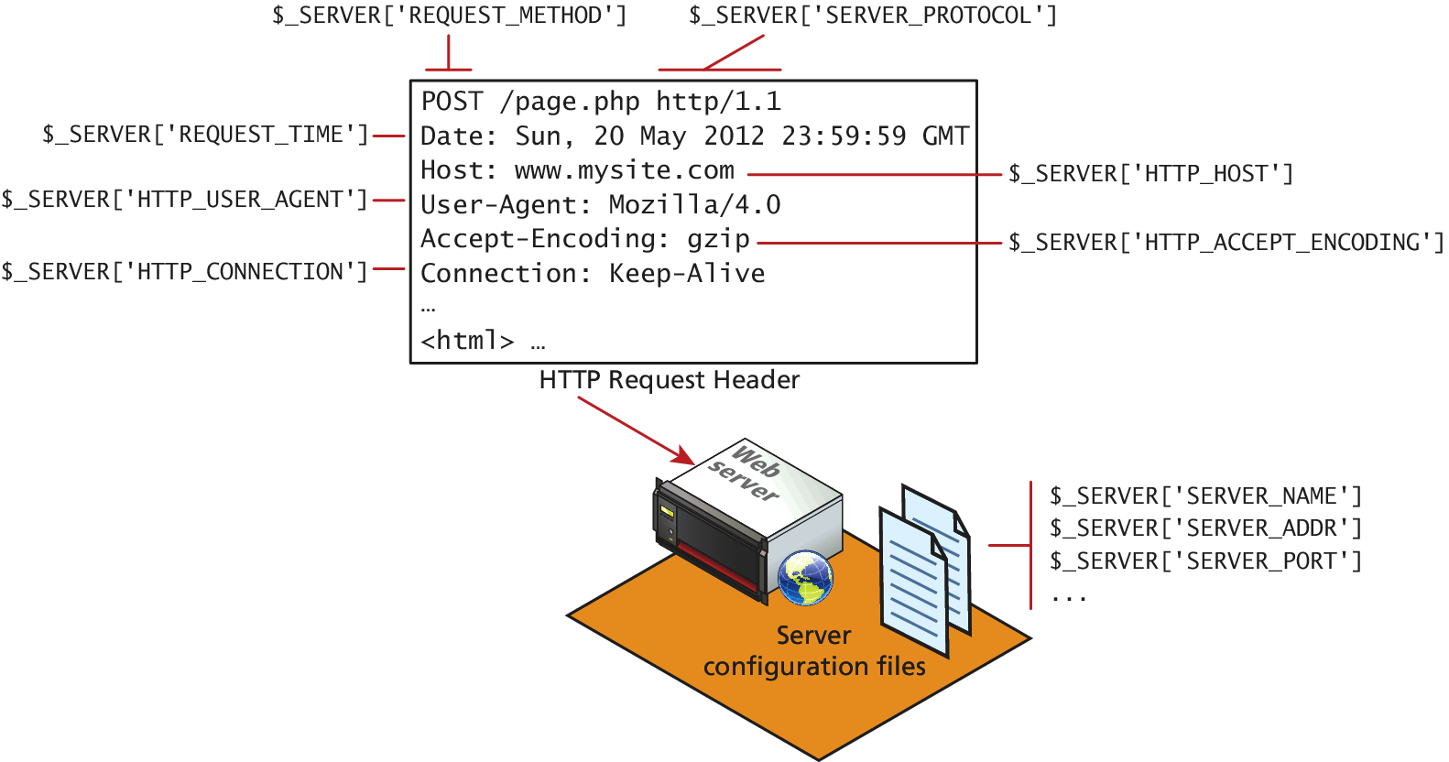
$_SERVER

Slide 16
SERVER INFORMATION KEYS
SERVER_NAME contains the name of the site that was requested
SERVER_ADDR tells us the IP of the server
DOCUMENT_ROOT tells us the location from which you are currently running your script
SCRIPT_NAME key that identifies the actual script being executed

Slide 17
Request Header Keys
REQUEST_METHOD returns the request method that was used to access the page: that is, GET, HEAD, POST, PUT
REMOTE_ADDR key returns the IP address of the requestor
HTTP_USER_AGENT contains the operating system and browser that the client is using
HTTP_REFERER contains the address of the page that referred us to this one (if any) through a link

Slide 18
Note about security
All headers can be forged!
The HTTP_REFERER header can lie about where the referral came from
The USER_AGENT can lie about the operating system and browser the client is using.

Slide 19
$_FILES Array
The $_FILES associative array contains items that have been uploaded in the current request.
A server script must process the upload file(s) in some way; the $_FILES array helps in this process.
the $_FILES array will contain a key=value pair for each file uploaded in the post
First a refresher on HTML forms for uploading files…

Slide 20
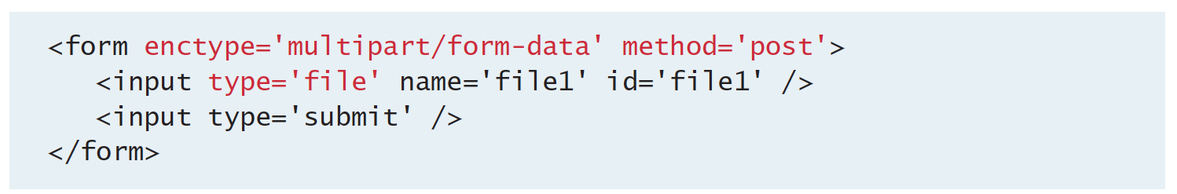
HTML Required for File Uploads
You must ensure that the HTML form uses the HTTP POST method, since transmitting a file through the URL is not possible.
You must add the enctype="multipart/form-data" attribute to the HTML form that is performing the upload so that the HTTP request can
You must include an input type of file in your form.
See examples:
https://www.w3schools.com/php/php_file_upload.asp

Slide 21
Session
Session is the time span during which a browser interacts with a particular server.
It begins when a browser connects to a server.
Ends when the connection is terminated or the browser connects to a different server.

Slide 22
PHP Session Tracking
You can create a unique session ID for your session by calling the function session_start().
Subsequent calls to session_start() retrieves the $_SESSION superglobal array.
$_SESSION array contains key-value pairs that were created by the script during the session.

Slide 23
Session folder
Create your own session save folder:
public_html/sessions Then set the permissions to the folder so everyone can read and write to it.
Now include the line in your PHP that sets the new session save path.
session_save_path('/net/stuff/msalloum/public_html/sessions');

Slide 24
Using session to authenticate
One of the common situations is that a person will have to log onto the website to gain access.
Once in the website they are free to move among many pages. If the user has already logged in he should not have to re-login when he goes to the next page.
We can keep track of the user and whether the user has logged in or not through the session variable.

