Slide 1
Server-Side Validation

Slide 2
Outline
Last lecture we covered PHP Superglobal Array and Forms
Today we will briefly cover server-side validation
Lets do some PHP examples
Note: Examples can be found on SAKAI under the appropriate week’s folder
Examples can also be found on my github account: https://github.com/msalloum/cs135
Today, we will look at the following examples:
elementsQuizPHP - we will write the code from scratch using the elementsQuiz_template folder
girlScoutCookies – girlScoutCookies order form
snowman - alternative game to hangman
miscExamples – collection of examples (send email, validate form, etc.)
If you haven’t already done so, install MAMP/XAMP
Consider installing PHP competition for Sublime
Consider installing Xdebug: https://www.sitepoint.com/debugging-xdebug-sublime-text-3/

Slide 3
Differences between Client and Server Side Validation
Client-Side
No round trip to server = quicker validation, instant feedback to user
User may skip client-side validation by turning off java script
Server-Side
Ensures 100% validation of input even if front end validation fails
User cannot skip server-side validation
Ensures that improper data sent will be filtered correctly, a detailed error message can be sent back to user
Takes longer time to vaildate – information must do a round trip to the server.

Slide 4
What we shall Discuss
Methods used when validating different form data
Number validation
URL validation
Email Validation
See
https://www.w3schools.com/php/php_form_validation.asp
Another great link: https://code.tutsplus.com/tutorials/sanitize-and-validate-data-with-php-filters--net-2595

Slide 5
Validating Numbers
is_numeric() - Checks to see if input is numeric
is_numeric allows:
Integers e.g. 998878
Scientific notations e.g. 15e4
Floating points e.g. 10.25
Hexadecimal e.g. 2xff
Negative numbers e.g -56
if ( !is_numeric( $n ) ) {
print “Does not conform to function” ;
}
else {
print "Validation passed!! Input was: $n” ;
}
But I want to verify it’s an int, not just numeric???

Slide 6
filter_var In Action
filter_var does it all, both, sanitize and validate data.
What's the difference between the two?
Sanitizing will remove any illegal character from the data.
Validating will determine if the data is in proper form.
Note: why sanitize and not just validate? It's possible the user accidentally typed in a wrong character or maybe it was from a bad copy and paste. By sanitizing we remove any possibility of malicious input.

Slide 7
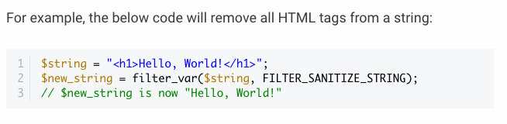
How to use filter_var
Using filter_var is incredibly easy. It's simply a PHP function that takes two pieces of data:
The variable you want to check
The type of check to use
This is an example of sanitizing the data

Slide 8
Validate Integers
This is an example of validating the data
<?php
$int = 100; if (!filter_var($int, FILTER_VALIDATE_INT) === false) { echo( ‘Variable is an integer’ ); } else { echo( ‘Variable is not an integer’ ); }
?>

Slide 9
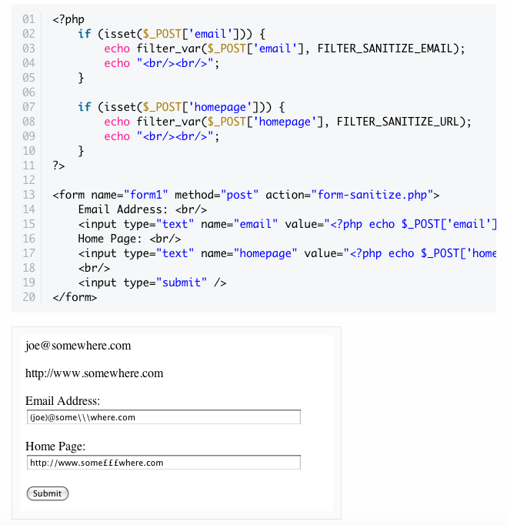
This is an example of sanitizing URL and Email
Any illegal characters will be removed

Slide 10
Validating URL
<?php
$url = "https://www.w3schools.com" ; if (!filter_var($url, FILTER_VALIDATE_URL) === false) { echo( ‘$url is a valid URL’ ); } else { echo( ‘$url is not a valid URL’ ); }
?>
Can also use preg_match or
FILTER_VALIDATE_REGEXP
to validate a regular expression matching a URL
Will output the following:
https://www.w3schools.com is a valid URL

Slide 11
IP validation
<?php
$ip_a = '127.0.0.1'; $ip_b = '42.42'; if (filter_var($ip_a, FILTER_VALIDATE_IP)) { echo "This (ip_a) IP address is considered valid."; } if (filter_var($ip_b, FILTER_VALIDATE_IP)) { echo "This (ip_b) IP address is considered valid."; }
?>
Will output the following:

Slide 12

Email Validation code
<?php
$email_a = 'joe@example.com'; $email_b = 'bogus'; if (filter_var($email_a, FILTER_VALIDATE_EMAIL)) { echo "This ($email_a) email address is considered valid.\n"; } if (filter_var($email_b, FILTER_VALIDATE_EMAIL)) { echo "This ($email_b) email address is considered valid.\n"; } else { echo "This ($email_b) email address is considered invalid.\n"; }
?>
Will output the following:

