Slide 1
PHP 4

Slide 2
PHP sessions
By default, HTML and web servers don’t keep track of information entered on a page when the client’s browser opens another page. Thus, doing anything involving the same information across several pages can sometimes be difficult.
Sessions help solve this problem by maintaining data during a user’s visit, and can store data that can be accessed from page to page in your site.
You can use session variables for storing information (this is one way that a “shopping cart” function can work for an online shop, for example).
Servers keep track of users’ sessions by using a session identifier, which is generated by the server when a session starts and is then used by the browser when it requests a page from the server. This session ID can be sent through a cookie (the default behavior) or by passing the session ID in the URL string.
Sessions only store information temporarily, so if you need to preserve information, say, between visits to the same site, you should likely consider a method such as using a cookie or a database to store such information.

Slide 3
PHP sessions (cont.)
To start a session, use the function session_start() at the beginning of your PHP script before you store or access any data. For the session to work properly, this function needs to execute before any other header calls or other output is sent to the browser.
<?php
session_start();
?>
<html> <body>
<?php
include_once ('object.php'); // Includes definition of the Person class
$_SESSION['hello'] = 'Hello world';
echo $_SESSION['hello'] . "<br/><br/>\n";
$_SESSION['one'] = 'one';
$_SESSION['two'] = 'two';
$me = new Person("Russ", 36, 2892700);
$_SESSION['name'] = $me->get_name();
echo "Testing " . $_SESSION['one'] .", " . $_SESSION['two'] . ", " . $me- >get_number() . " . . .<br/>\n";
?>
</body> </html>

Slide 4
More on session variables
You need to include a call to the session_start() function for each page on which you want to access the session variables.
Once a session variable has been defined, you can access it from other pages.
A session will end once you quit the browser or you can call the session_destroy() function. (Note, however, even after calling the session_destroy() function, session variables are still available to the rest of the currently executing PHP page.)
The function session_unset() removes all session variables. If you want to remove one variable, use the unset($var) function call.
The default timeout for session files is 24 minutes. It’s possible to change this timeout.

Slide 5
Deleting all session variables
<?php
session_start();
?>
<html >
<head> <title>Session example 3</title> </head>
<body>
<?php
echo "Deleting all session variables using session_unset(); <br/>\n";
session_unset();
echo "Now the session variables are gone. <br/>\n";
if (isset($_SESSION['name']))
{ echo $_SESSION['name'] . "<br/>\n"; }
else
{ echo "Session variable is not here."; }
?>
</body>
</html>

Slide 6

Stateful client/server interaction
Sites like amazon.com seem to "know who I am” !!!
How does a client uniquely identify itself to a server, and how does the server provide specific content to each client?
Chief Problem: Keeping track of which requests ”go together”
Security challenge : If a user submits a username & password in http request X, then tries to access resources in http request Y, how does the server know that request Y is from somebody who already logged in?
By the time that request Y comes in, the server will already have forgottten that request X ever occurred.
And on a replicated system, request Y might be served by a different machine than request X.

Slide 7
What is a cookie?
cookie: a small amount of information sent by a server to a browser, and then sent back by the browser on future page requests.
cookies have many uses:
authentication
user tracking
maintaining user preferences, shopping carts, etc.
a cookie's data consists of a single name/value pair, sent in the header of the client's HTTP GET or POST request.
Because the cookie is stored on the user’s computer, it does not require any server space no matter how many users you have.

Slide 8
How cookies are sent
When the browser requests a page, the server may send back a cookie(s) with it
If your server has previously sent any cookies to the browser, the browser will send them back on subsequent requests
Alternate model: client-side JavaScript code can set/get cookies
Note: Cookies can only be read by the site that created them, or a site ‘underneath’ the site that created them. This prevents other website from stealing cookies.

Slide 9
Myths about cookies
Myths:
Cookies are like worms/viruses and can erase data from the user's hard disk.
Cookies are a form of spyware and can steal your personal information.
Cookies generate popups and spam.
Cookies are only used for advertising.
Facts:
Cookies are only data, not program code.
Cookies cannot erase or read information from the user's computer.
Cookies are usually anonymous (do not contain personal information).
Cookies CAN be used to track your viewing habits on a particular site.

Slide 10
Types of cookies
session cookie : the default type; a temporary cookie that is stored only in the browser's memory
When the browser is closed, temporary cookies will be erased
Can not be used for tracking long-term information
Safer, because no programs other than the browser can access them
persistent cookie : one that is stored in a file on the browser's computer
Can track long-term information
First Party Cookies : are written by your site and can be read by your site
Third Party Cookies : are created by advertising in your page that is loaded from a third party site. These can only be read by the advertising code on any site displaying the same ads.

Slide 11
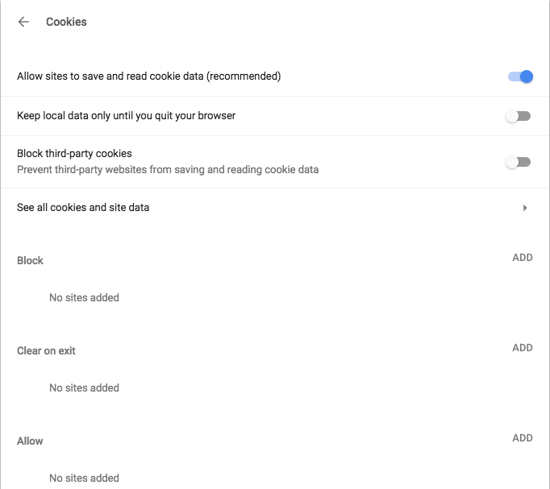
Where are the cookies on my computer?
It depends on your browser and OS.
On a mac running Chrome:
session cookies can be found via Chrome -> Settings -> Advanced -> Privacy and Security –> Cookies
Persistent cookies are saved under : ~/Library/Application Support/Google/Chrome/Default/Cookies

Slide 12
Setting a cookie
Property | Description | Example
Name=value | This sets both the cookie’s name and its value | Username = matt
Expires = date | This optional value sets the date that the cookie will expire on. The data should be in the format returned by the toGMTString() or toUTCString() methods of the Date object. If the expires value is not given, the cookie will be destroyed the moment the browser is closed. | Expires = 20/06/2018 00:00:00
Path = path | The path gives you the chance to specify a directory where the cookie is active. So if you want the cookie to be only sent to pages in the directory cgi-bin, set the path to /cgi-bin. Usually the path is set to /, which means the cookie is valid throughout the entire domain. | Path=/tutorials/
Secure | This optional flag indicates that the browser should use SSL when sending the cookie to the server | Secure
Domain=domain | This optional value specifies a domain within which the cookie applies. Only sites in this domain will be able to retrieve the cookie. If blank, then it means the domain the set the cookie can retrieve it. | Domain=www.cmc.edu

Slide 13
Setting a cookie in JavaScript
This code sets a cookie called username, with a value of “John” that expires on Feb. 21, 2018.
This code does exactly the same thing as the previous example by specifies the date using the Date.toUTCString() method instead.
document.cookie = “username=John; expires=21/02/2018 00:00:00”;
var cookie_date = new Date (2018, 02, 21);
document.cookie = “username=John; expires=” + cookie_date.toUTCString();

Slide 14
Setting a cookie in JavaScript (Cont.)
This code sets a cookie called logged_in, with a value of “yes”. As the expires attribute as not been set, the cookie will expire when the browser is closed.
We should escape or cookie values (i.e. encoding non-alphanumeric characters such as spaces and semicolons. This is to ensure that our browser can interpret the values properly.
document.cookie = “logged_in=yes”;
document.cookie = “username” + escape (“John Smith”)
+ “; expires = 15/21/2018 00:00:00”;

Slide 15
Setting a cookie in JavaScript (Cont.)
JS has a global document.cookie field (a string)
you can manually set/get cookie data from this field (sep. by ;), and it will be saved in the browser
to delete a cookie, set it to 'expire' in the past
document.cookie = "username=smith";
document.cookie = "password=12345";
document.cookie = "age=29; expires=Thu, 01-Jan-1970 00:00:01 GMT";
// (later)
var allCookies = document.cookie.split(";");
for (var i = 0; i < allCookies.length; i++) {
var eachCookie = allCookies[i].split("=");
var cookieName = eachCookie[0];
var cookieValue = eachCookie[1];
}

Slide 16
Setting a cookie in PHP
setcookie causes your script to send a cookie to the user's browser
setcookie must be called before any output statements (HTML blocks, print, or echo)
you can set multiple cookies (20-50) per user, each up to 3-4K bytes
// setcookie("name", "value");
setcookie("username", "martay");
setcookie("favoritecolor", "blue");

Slide 17
Setting a cookie in PHP (Cont.)
Retrieving information from a cookie
any cookies sent by client are stored in $_COOKIES associative array
use isset function to see whether a given cookie name exists
$variable = $_COOKIE["name"]; # retrieve value of the cookie
if (isset($_COOKIE["username"])) {
$username = $_COOKIE["username"];
print("Welcome back, $username.\n");
} else {
print("Never heard of you.\n");
}
print("All cookies received:\n");
print_r($_COOKIE);

Slide 18
Setting a cookie in PHP (Cont.)
Setting a persistent cookie in PHP
to set a persistent cookie, pass a third parameter for its timeout in seconds
time function returns the current time in seconds
date function can convert a time in seconds to a readable date
Removing a persistent cookie
if the server wants to remove a persistent cookie, it should set it again, passing a timeout that is prior to the present time
// setcookie("name", "value", timeout);
$expireTime = time() + 60*60*24*7; # 1 week from now setcookie("CouponNumber", "389752", $expireTime); setcookie("CouponValue", "100.00", $expireTime);
// setcookie("name", "", time() - 1);
setcookie("CouponNumber", "", time() - 1);

Slide 19
Browsers that don't support cookies

Slide 20
Browsers that don't support cookies
if a client's browser doesn't support cookies, it can still send a session ID as a query string parameter named PHPSESSID
this is done automatically; session_start detects whether the browser supports cookies and chooses the right method
if necessary (such as to build a URL for a link on the page), the server can find out the client's session ID by calling the session_id function
Sessions are a combination of a server-side cookie and a client-side cookie.
Client-side cookie simply holds a value (session token) that uniquely identifies the client to the server, and corresponds to a data file on the server.
Thus, when the user visits the site, their browser sends the reference code to the server, which loads the corresponding data.

Slide 21
HTTP Session Token
A session token is a unique identifier that is generated and sent from a server to a client to identify the current interaction session.
The client usually stores and sends the token as an HTTP cookie and/or sends it as a parameter in the GET or POST request.
The reason to use session token is that the client only has to handle the identifier – all session data is tored on the server (usually in a database, to which the client does not have direct access linked to that identifier).
Examples of the names that some programming languages use when naming their HTTP cookie include:
JSESSIONID (JSP) ,
PHPSESSION (PHP),
ASPSESSIONID( ASP).

Slide 22
Sessions Advantages
Your server-side cookie can contain very large amounts of data with no hassle – client-side cookies are limited in size.
Your client-side cookie contains nothing other than a small reference code – as this cookie is passed each time someone visits a page on your site, you are saving a lot of bandwidth by not transferring large client-side cookies around.
Session data is much more secure – only you are able to manipulate it, as opposed to client-side cookies which are editable by all.

