Slide 1

Final Project: Common Terminology Criteria for Adverse Events (CTCAE) calculator
Zacharia Sawaged
Intro to Programming
Fall 2019
Mark Grivainis

Slide 2
What is a CTCAE?
The Common Terminology Criteria for Adverse Events (CTCAE) is used almost universally by clinical trial offices at hospitals, research and academic centers to categorize clinical conditions that may arise during a clinical trial¹
This is provided by the NIH in the USD Health and Human Services
The list contains roughly 1000 conditions that are graded from a scale of 1 to 5
These adverse events are reported to pharmaceutical companies who report it to the FDA to insure proper understanding of harmful side affects
1. https://ctep.cancer.gov/branches/pmb/agent_management.htm

Slide 3
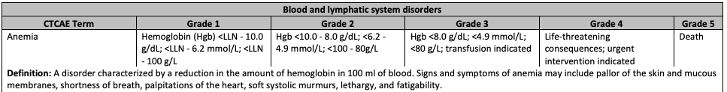
Examples:

Slide 4
Typical workflow:
Research nurses and clinical trial coordinators identify the clinical symptom
Google CTCAE and locate the PDF
Search in the document for the adverse event
Decide on the grade depending on subjective terms or laboratory values
Record and send to sponsor

Slide 5
Would you like to search for the AE or input the term?
Output the Key (AE Term)
Confirm term (AE Term)
Search
Go through my CSV dictionary and search definitions
Input
Request definition?
Create correct key variable from input
Yes
Output definition using the dictionary
No
Use input to get definition from dictionary
Character (subjective) based
Lab Based
Character (subjective) based
Lab Based
Character (subjective) based
Lab Based
Enter word description
Enter numerical value
Enter word description
Enter numerical value
Enter word description
Enter numerical value
Grade Given

Slide 6
DEMO

Slide 7
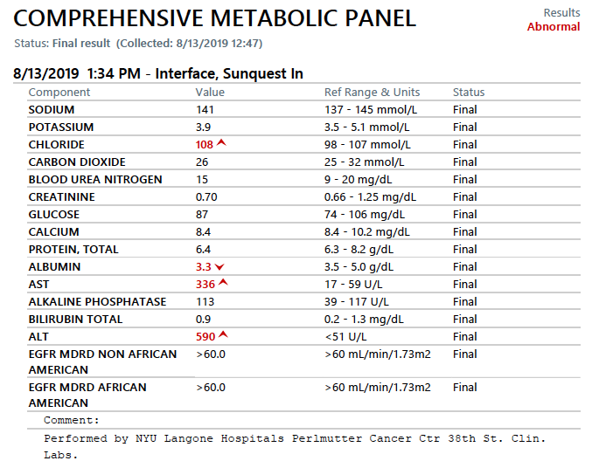

Slide 8
Future plans
Make the code more dependent on the CSV file
Be able to search within the grade descriptions as well
Make it scalable by using more functions that read the CSV

Slide 9
Thank you
David Fenyo
Kasthuri Kannan
NYU HPC Admins
Mark Grivainis

