Slide 1
Tetris
Zack Seliger, Yifan Chen, Andrew Olsen

Slide 2
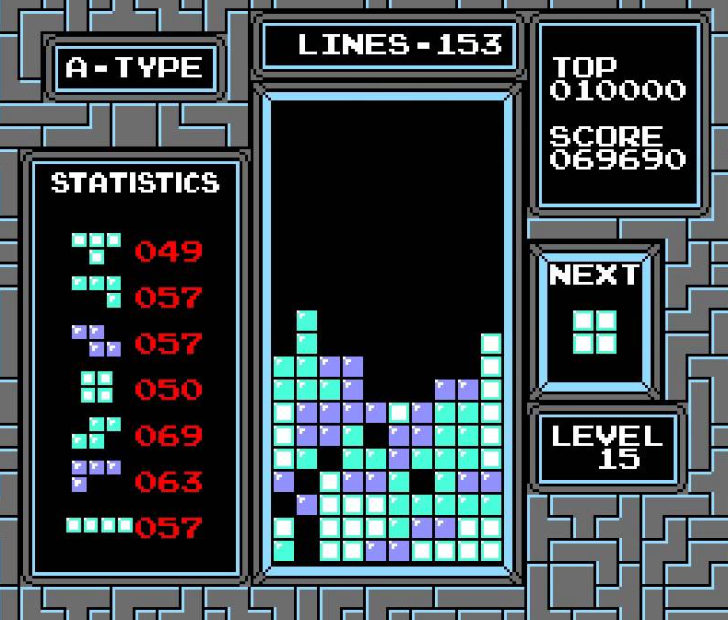
Tetris
Tile drops down
10 columns
Get points by clearing rows
That’s it

Slide 3
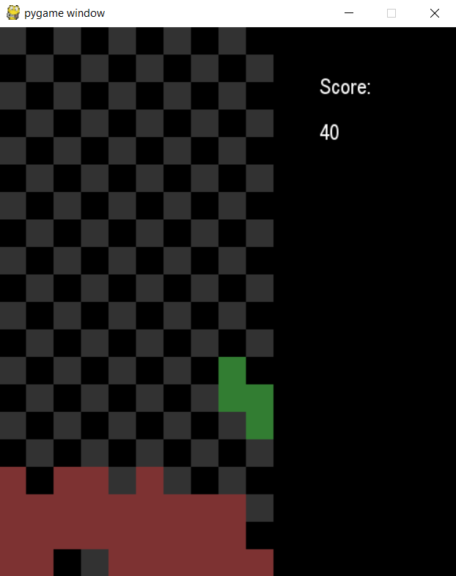
Approach
Make a working Tetris game
Turn that into separate classes
Multithreading
Make heuristics

Slide 4
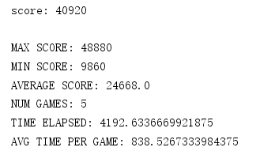
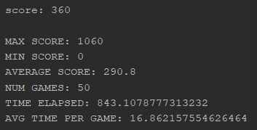
Results
We made three: Yifan’s produces highest results
All check for holes, height differences, filled rows
Yifan
Drew
Zack

Slide 5
Results
High level play
Rotations at last minute
Tucks

