Slide 1
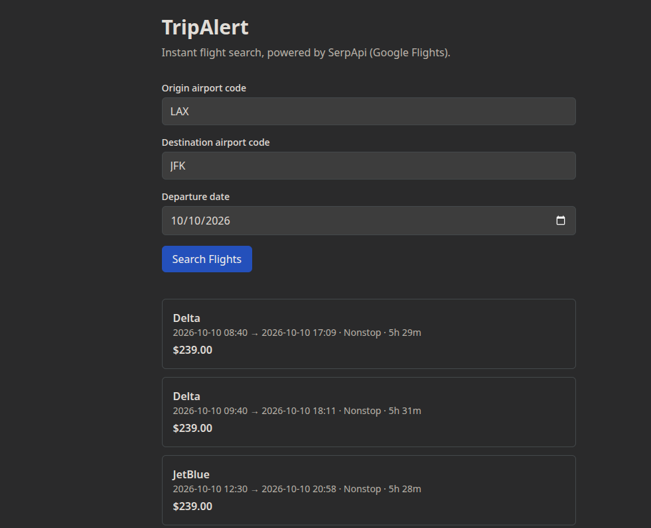
UX/UI: Instant Flight Search By: Zackary Siddiqi
Main search screen — real results returned from SerpApi (Google Flights)
[ Insert screenshot here ]
Main page — origin, destination, and date fields, with a live list of
flight results (airline, price, duration, stops) returned from SerpApi
Confirms: form input → FastAPI → SerpApi → rendered results — works end to end with real flight data.

Slide 2
Core Logic: How a Search Becomes Real Flight Data
1. User submits form
(origin, destination, date)
8. Frontend receives JSON,
updates state, renders cards
Key ideas
Client-server split: frontend never talks to SerpApi directly — only the backend holds the API key
One request = one exact search (no date range yet, that's Phase 2)
Steps 3–6 are all in one FastAPI endpoint function
Errors (bad input, SerpApi failure, zero results) are handled at each step, not just the happy path
2. Frontend sends
HTTP GET /search/flights
7. Return list of
FlightResult objects (JSON)
3. Backend validates input
4. Backend builds SerpApi
request parameters
5. Backend calls SerpApi
(Google Flights engine)
6. Parse raw JSON →
extract price, airline, times

Slide 3

Project Outline
TripAlert: instant flight search using SerpApi
Phase Status
Phase 0 — Environment & scaffold: complete
Phase 1 — SerpApi integration: in progress (this week's goal)
• Backend endpoint calling SerpApi: written
• Frontend form + results display: written
• Live end-to-end test with real key: next step
Phase 2 — Flexible dates + hotels: not started
Phase 3 — Accounts + group function

Slide 4

Challenges and tasks Ahead
How to handle input error
  making sure users are not able to search for flights that have already passed
  if the user types in an invalid airport code
How to actually build the flexible date range feature
  User picks a date range for their trip and receives multiple flight and hotel options to choose from
Need to add a return date as well on
on the current frontend

