Slide 1

Survival Analysis of Pancreatic Cancer Patients using Methylation Data
Zachary Siegfried

Slide 2
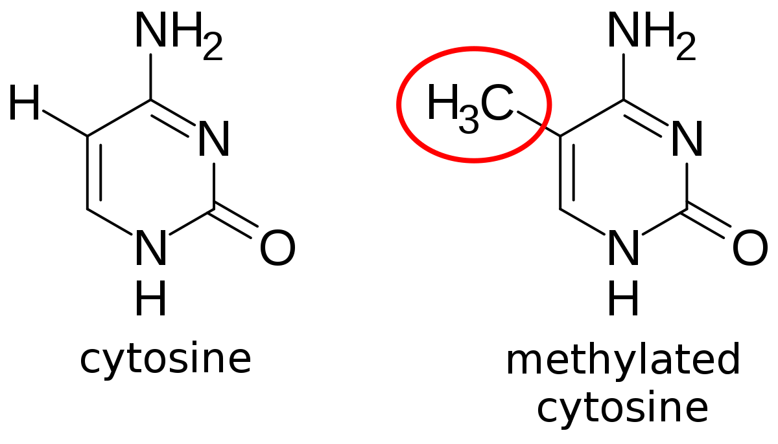
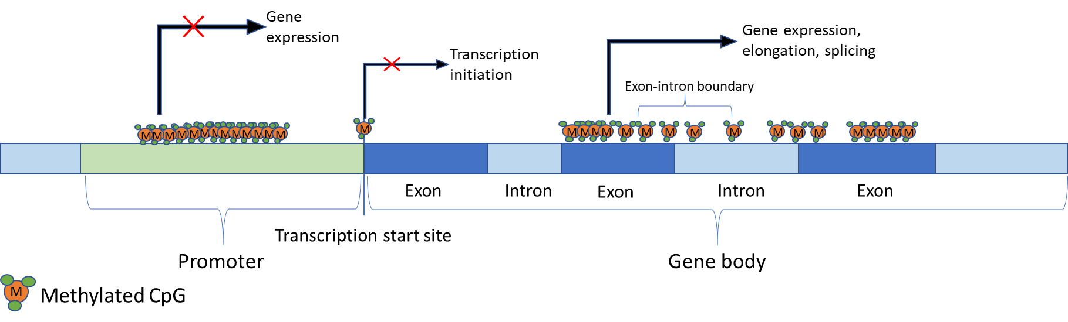
Methylation
Epigenetic marker
Linked to gene expression
  Highly methylated promoter regions prevent TF binding
Potential biomarker for early cancer detection

Slide 3
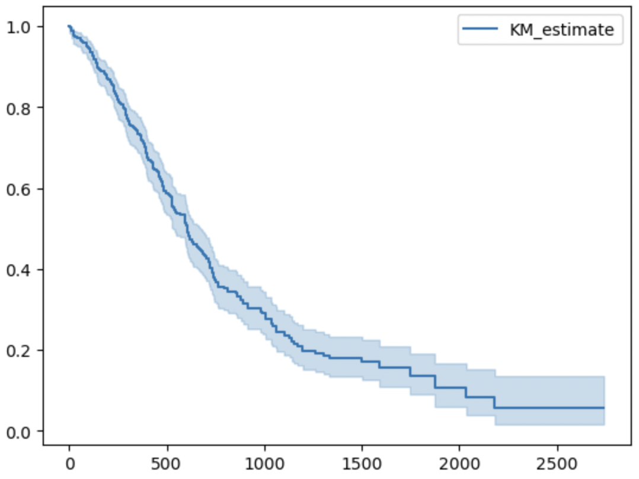
Objectives
Study the relationship between methylation and cancer
Build a basic survival model to predict time of death for cancer patients
  Using methylation data
Time (days)

Slide 4
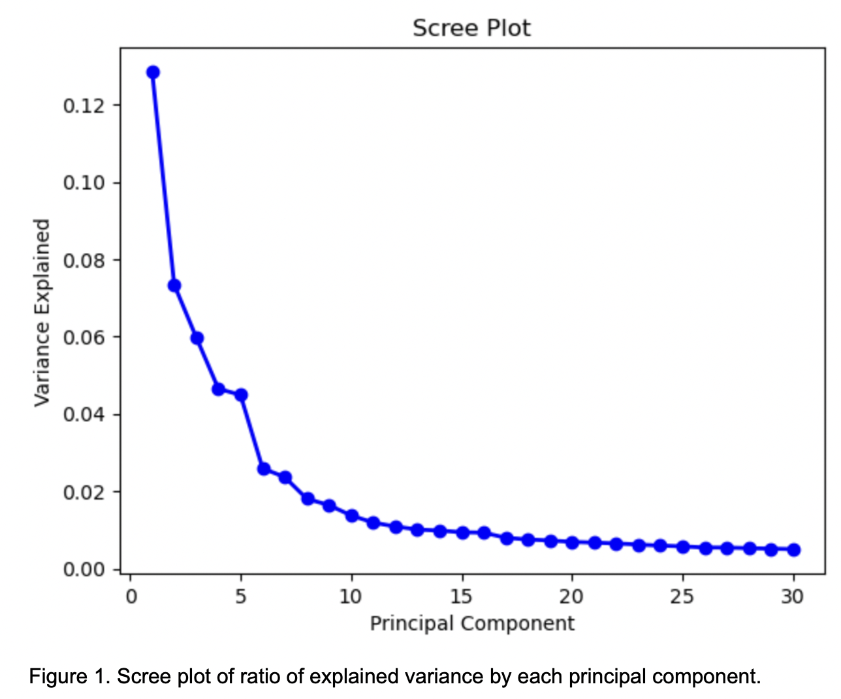
Methods
Data
  400 NCI patients
  Incomplete excluded
Dimension reduction
  PCA
Modeling
  Cox PH model

Slide 5
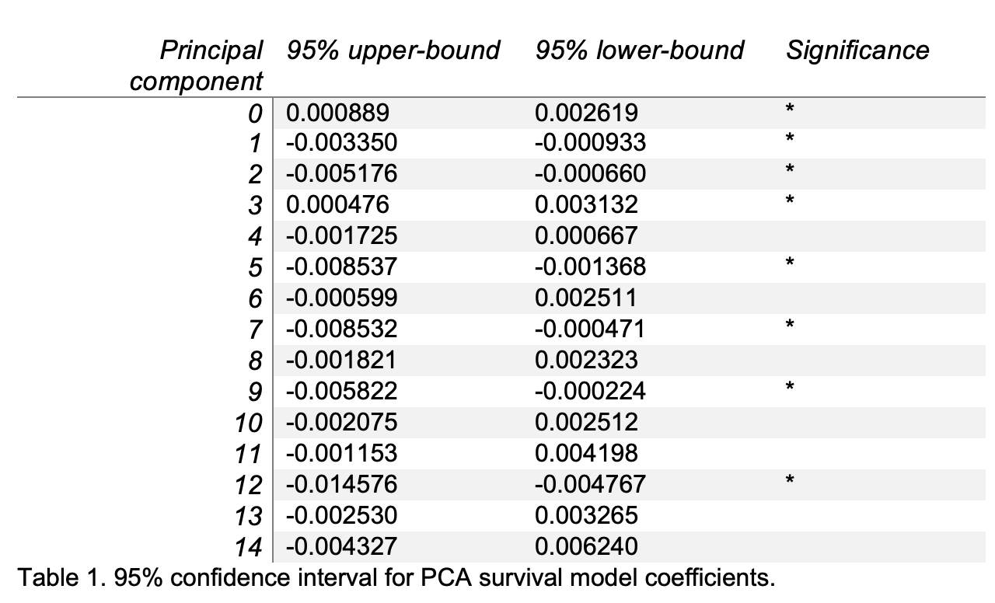
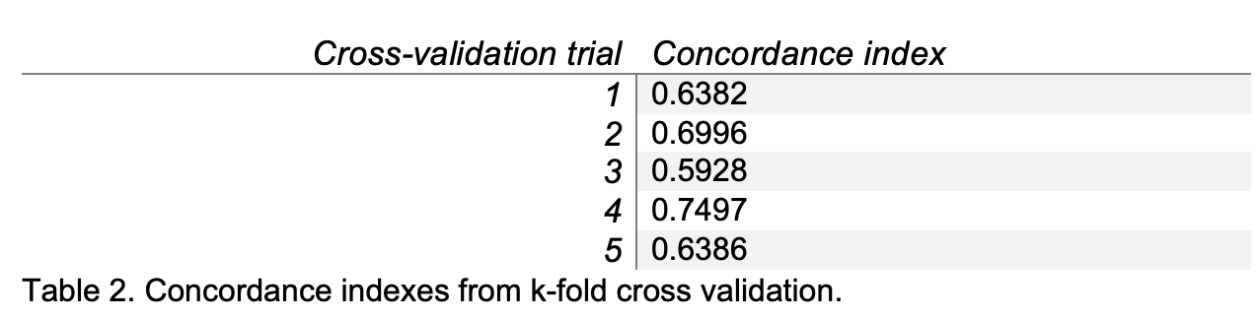
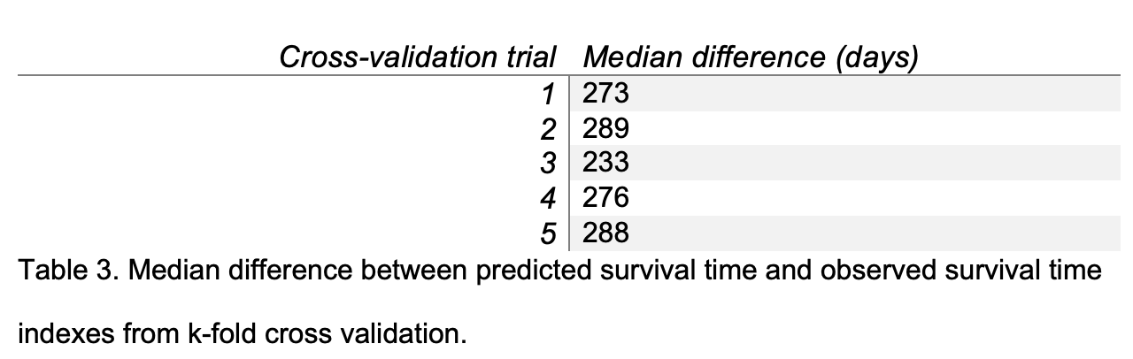
Results
Cox model coefficients
K-fold cross validation
  Concordance index
  Median difference between estimated and observed event times

Slide 6
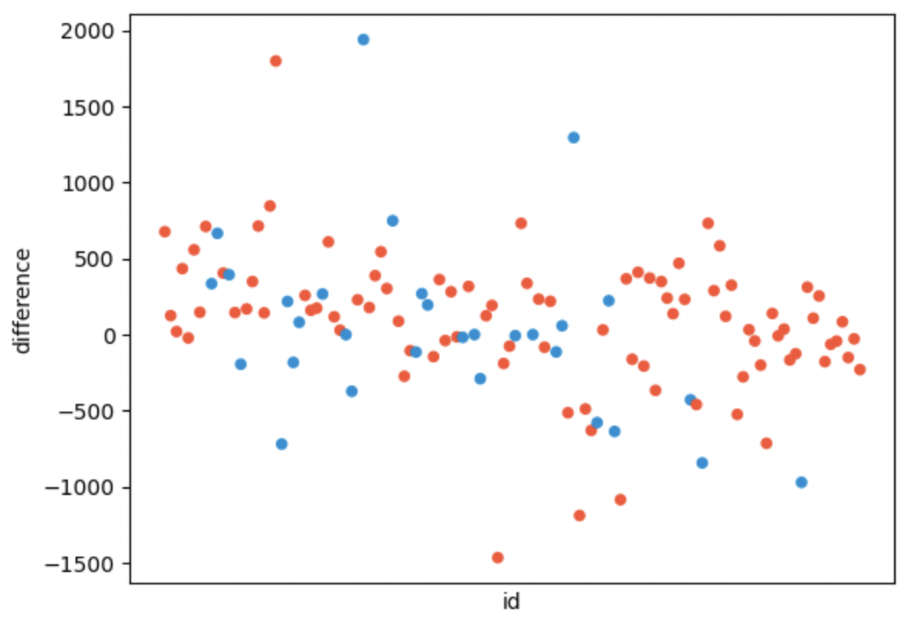
Improvements
Dimension reduction
  Genomic methylation mapping
More predictive data
  Age, BMI, smoker status…
  Treatment status
Complex modeling
  Time varying survival analysis
  Comparing models
Plot from one cross validation trial showing the difference between predicted and observed event times for dead (red) and alive (blue) cases

