Slide 1
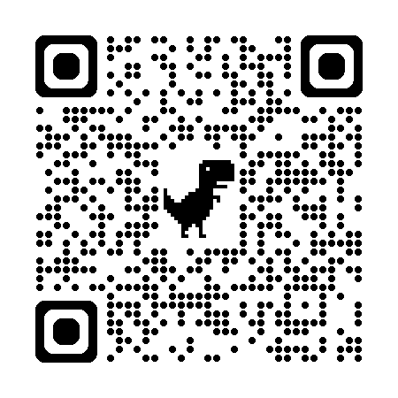
Self Introduction
Wei-Hsin Yen
顏維新

Slide 2
2016.09
B.S. of Computer Science
資訊工程學系
National Taiwan Normal University
國立師範大學
2018.09
Exchange Student
日本文學專攻交換學生
Meiji University, Japanese Literature
明治大學
2019.02
Education
2022.06
2022.09
M.S. of Computer Science
資訊工程研究所
National Central University
國立中央大學
2024.07

Slide 3
2022.09
Teaching Assistant, Compiler Design
Department of Computer Science, National Central University
Guided students in using LEX and Yacc for lexical analysis, syntax analysis, IR conversion,and optimization.
Assisted in grading and testing compiler projects.
Awarded the Outstanding Graduate Teaching Award.
Work
Experience
2023.02
2023.02
Teaching Assistant, Python Programming
Department of Computer Science, National Central University
Assisted students in learning fundamental Python concepts.
Developed and maintained an online Python programming grading system (Online Judge).
Graded assignments, provided student feedback, and evaluated team projects.
2023.07

Slide 4
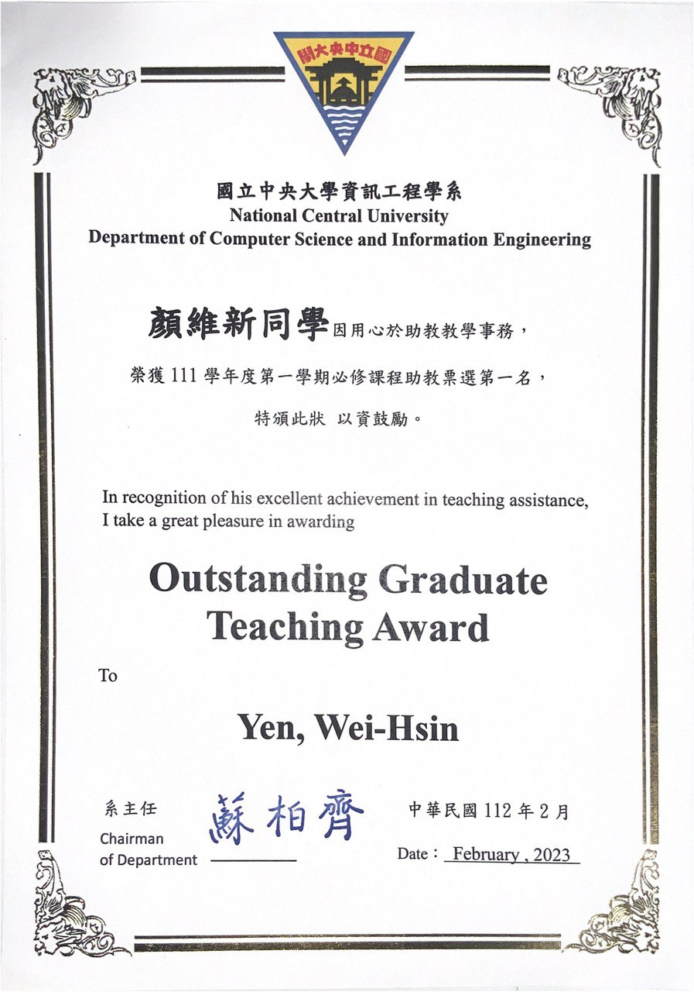
2022.09
Teaching Assistant, Compiler Design
Department of Computer Science, National Central University
Guided students in using LEX and Yacc for lexical analysis, syntax analysis, IR conversion,and optimization.
Assisted in grading and testing compiler projects.
Awarded the Outstanding Graduate Teaching Award.
Work
Experience
2023.02
2023.02
Teaching Assistant, Python Programming
Department of Computer Science, National Central University
Assisted students in learning fundamental Python concepts.
Developed and maintained an online Python programming grading system (Online Judge).
Graded assignments, provided student feedback, and evaluated team projects.
2023.07

Slide 5
2022.09
Linux Operating System Project
Projects
UML Editor
2023.02
2023.09
JudgeCoder
2023.07
Personal Website

Slide 6
2022.09
Linux Operating System Project
Link
Explored Linux system internals by tracing source code and implementing custom system calls.
Designed a system call to validate memory segment sharing and isolation across different processes, calculating start addresses, end addresses, and sizes.
Added a systemcall to count process context switches within a given time interval.
Projects
Tools
C
Linux
Bash
2023.02
UML Editor
Link
Developed a UML diagram editor using Java, following Object-Oriented Analysis and Design (OOAD) principles.
Designed an event-driven UI with intuitive drag-and-drop, scaling, and connection features.
Applied modular design to separate concerns such as graphics rendering, event handling, and data storage, enhancing maintainability and scalability.
Tools
Java
Swing

Slide 7
2022.09
Linux Operating System Project
Explored Linux system internals by tracing source code and implementing custom system calls.
Designed a system call to validate memory segment sharing and isolation across different processes, calculating start addresses, end addresses, and sizes.
Added a systemcall to count process context switches within a given time interval.
Tools
C
Linux
Bash
Projects
UML Editor
2023.02
Developed a UML diagram editor using Java, following Object-Oriented Analysis and Design (OOAD) principles.
2023.09
JudgeCoder
Link
Developed an automated code generation and validation system using Large Language Models (LLM).
Integrated Chain-of-Thought reasoning to refine LLM-generated code based on test results, improving GPT-3.5-turbo’s performance on the HumanEval benchmark.
Implemented automated code testing: LLM-generated code is tested against autogenerated unit tests, collecting and analyzing errors.
Designed a modular architecture, dividing functionalities into code generation, test data creation, test execution, and result evaluation.
2023.07
Tools
Python
C++
Shell Script
ChatGPT API
Personal Website
Link
Developed a personal website using Next.js to showcase projects and personalbackground.
Integrated GitHub for data storage and deployed via Vercel, utilizing Edge Functions for real-time updates.
Tools
Next.js
git
CSS
TypeScript

Slide 8
Language Certifications
English - TOEIC 885
Japanese JLPT N1
Certification

Slide 9
Thank you for listening.

