Slide 1
Sample Superstore Analysis
Zachary Ziman

Slide 2
Source
All data is fictional and was sourced from the Tableau superstore sample dataset

Slide 3
process
The data was imported into Excel for cleaning, I then used SQL to combine and organize the data, Tableau was used for data visualization

Slide 4
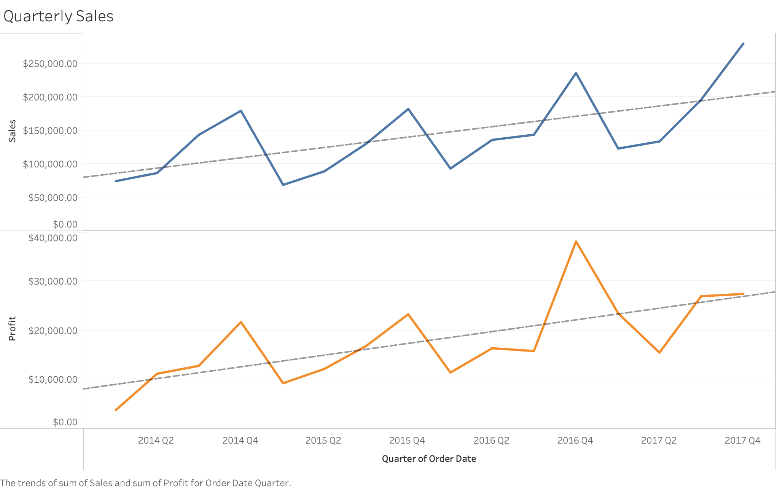

Slide 5
First Quarter Profits
Continually start the year with low first quarter sales and profits
I would recommend increasing marketing and advertisement at the beginning of the year to increase sales.

Slide 6
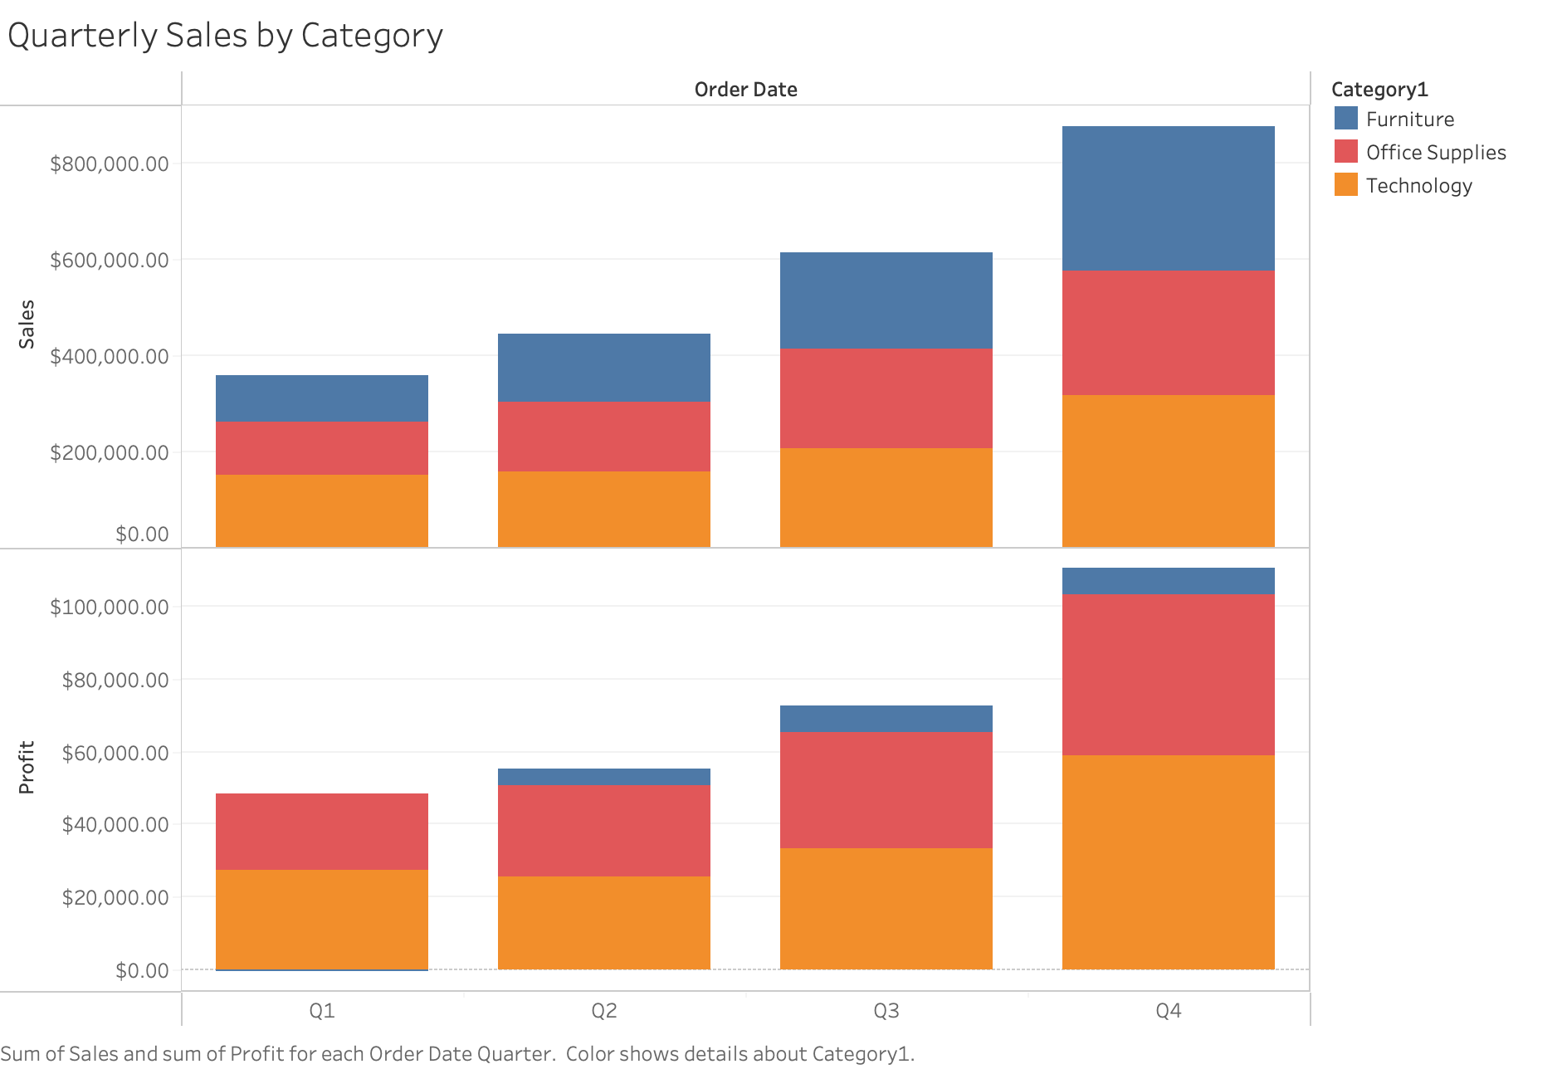

Slide 7
Furniture Profits
Furniture is the worst performing category in terms of superstore profits
Furniture sales have operated at a net loss in the first quarter over the past four years.

Slide 8
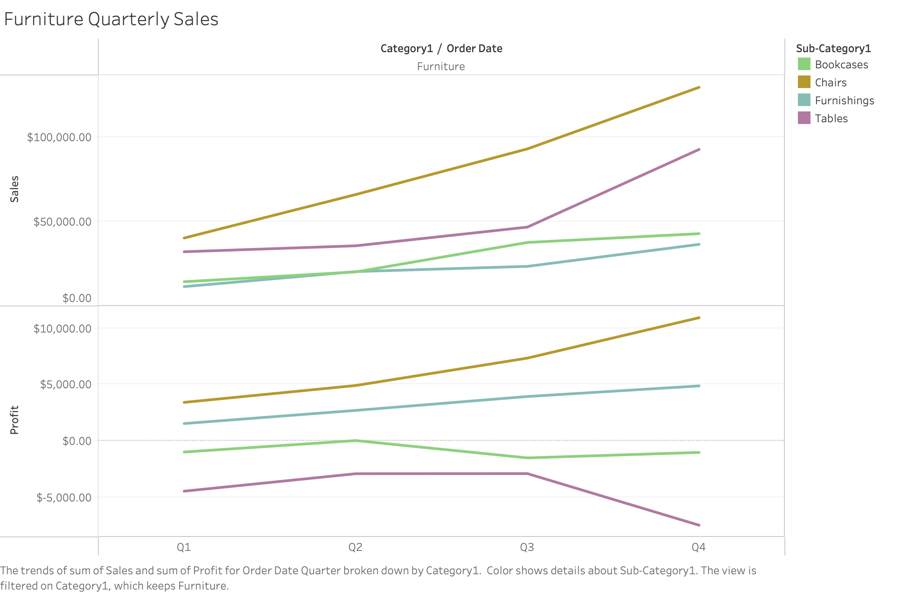

Slide 9
Losses from Tables
While chairs and furnishings are bringing a profit, tables have consistently cost the superstore money.
As we look further into this data, we can see which specific tables are operating at the biggest losses

Slide 10
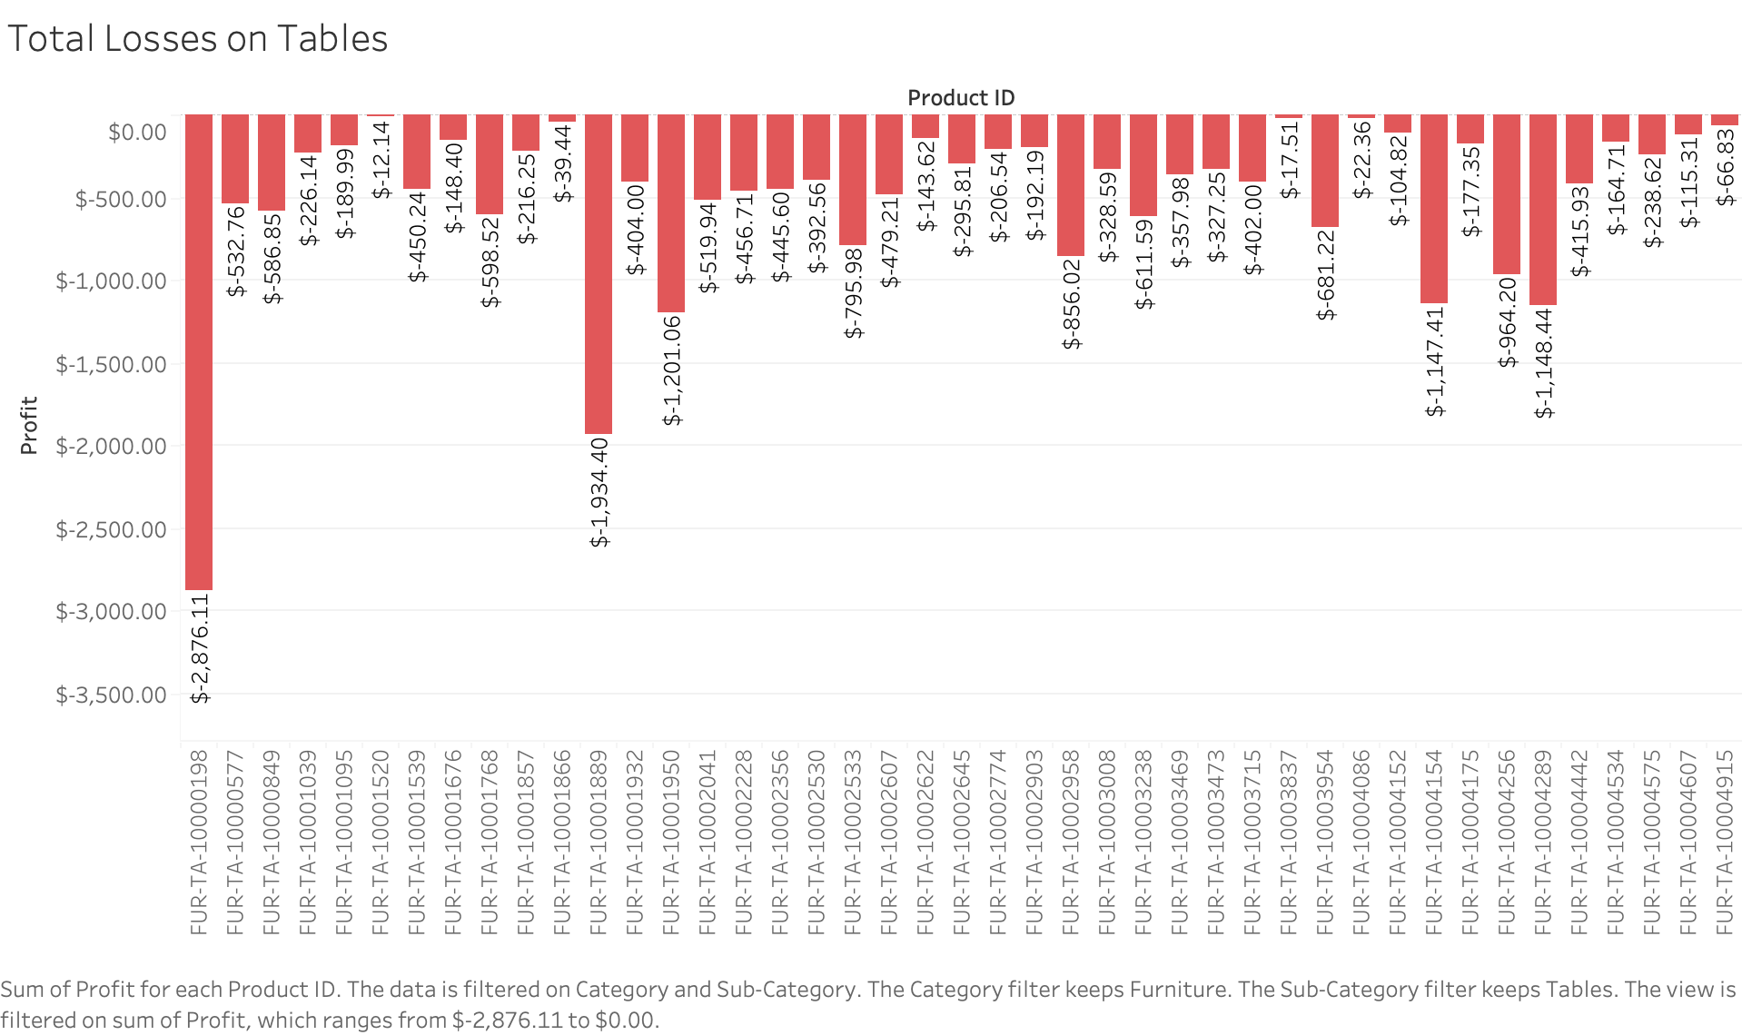

Slide 11
Losses per product
The previous graph highlights which individual products have lost the superstore money over the last four years.
I would recommend increasing the price of the items operating at the biggest loss in order to mitigate product losses

Slide 12
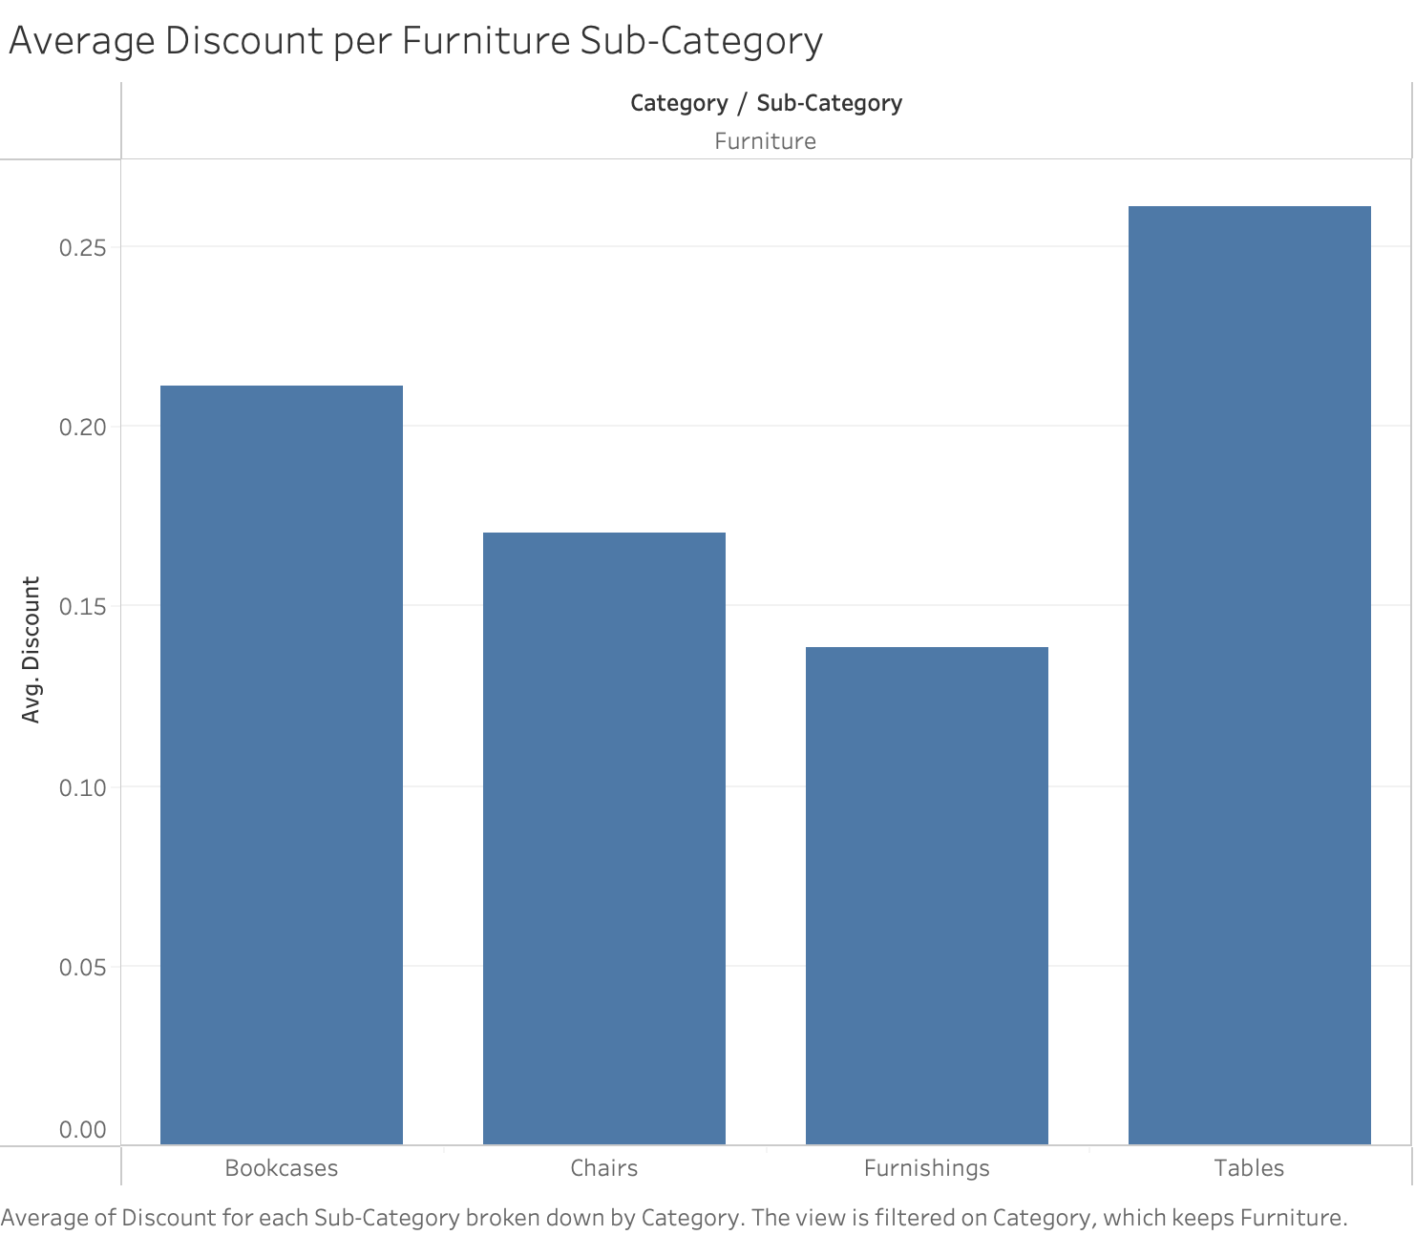

Slide 13
Average discount per furniture sub-category
This chart shows us that when a discount is applied to a furniture product, the greatest discount is typically on the tables sub-category.
Since this sub-category typically operates at a net-loss, I would recommend decreasing the average discount for table products.

Slide 14
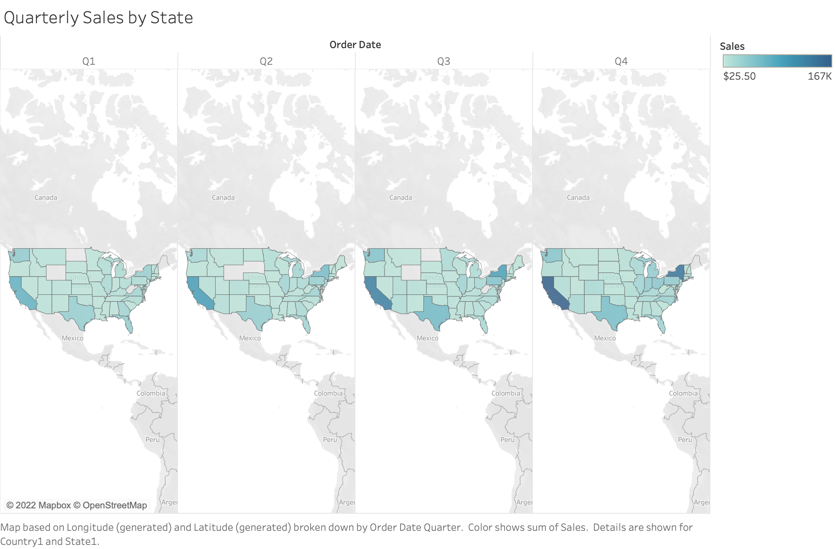

Slide 15
Quarterly Sales By State
This map shows a breakdown of sales per state by quarter for the previous four years
As sales increase, the area becomes a darker shade of blue
I circled the state of New York as it had the biggest increase in sales from Q1 to Q4, the next slide will show a breakdown on which category had the biggest changes across quarters.

Slide 16
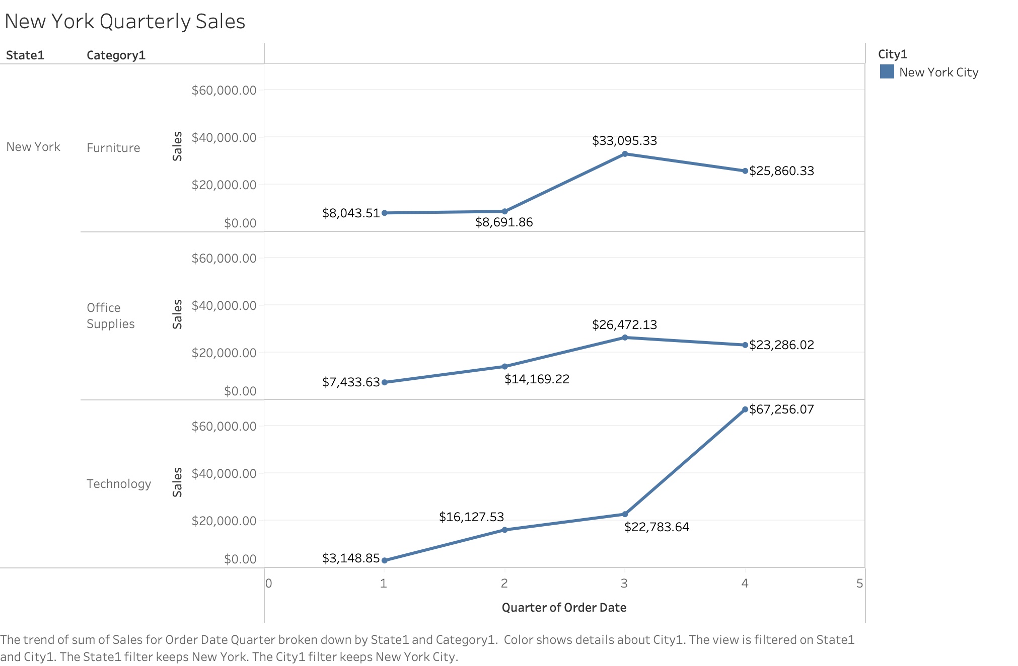

Slide 17
NYC Category Sales Breakdown
Although every category increases from Q1 to Q4, the biggest gains were in the technology category.
Technology product sales increased 22x from Q1 to Q4!

Slide 18
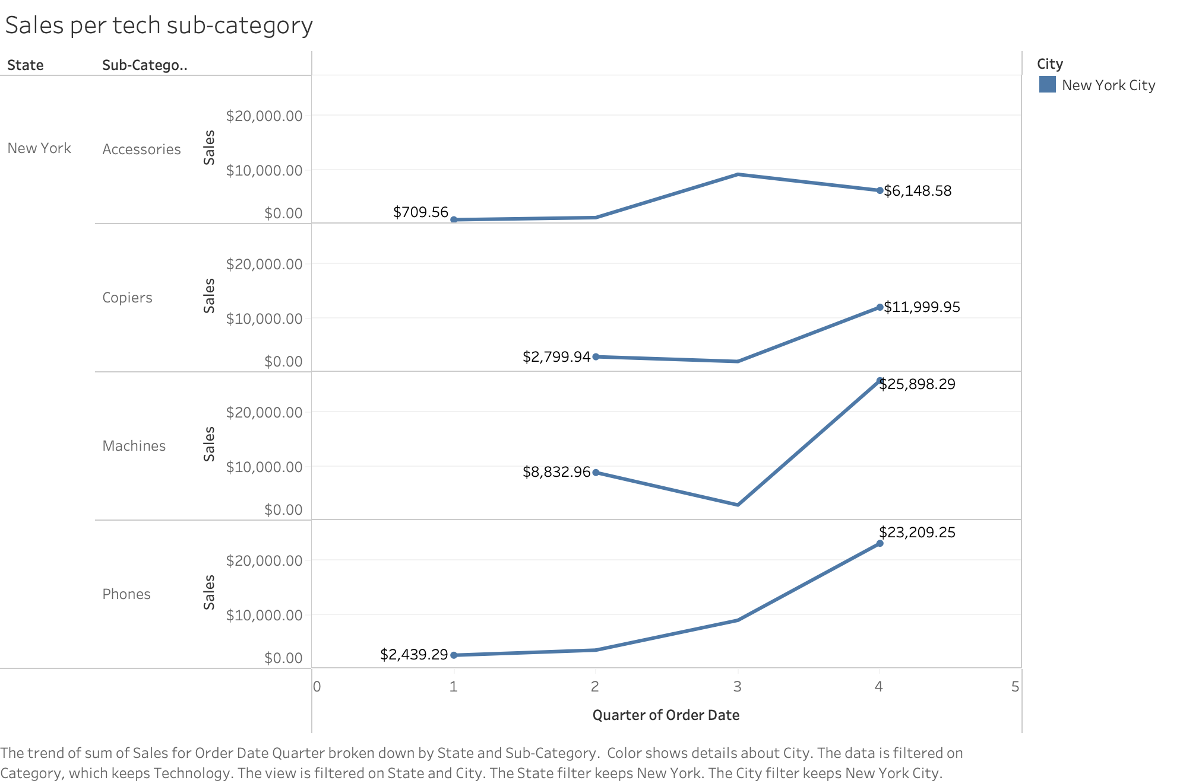

Slide 19
NYC Tech sales analysis
Every sub-category in technology sales increased from Q1 total sales to Q4 total sales
Phones had the biggest increase of almost 10x
I would recommend promoting phone sales in Q1 as there is a high-ceiling for sales in this category.

Slide 20
Item Returns
The next two slides show a breakdown of returns by category and sub-category.
They highlight how office supplies are the majority of customer returns and more specifically the items returned are typically binders and paper

Slide 21
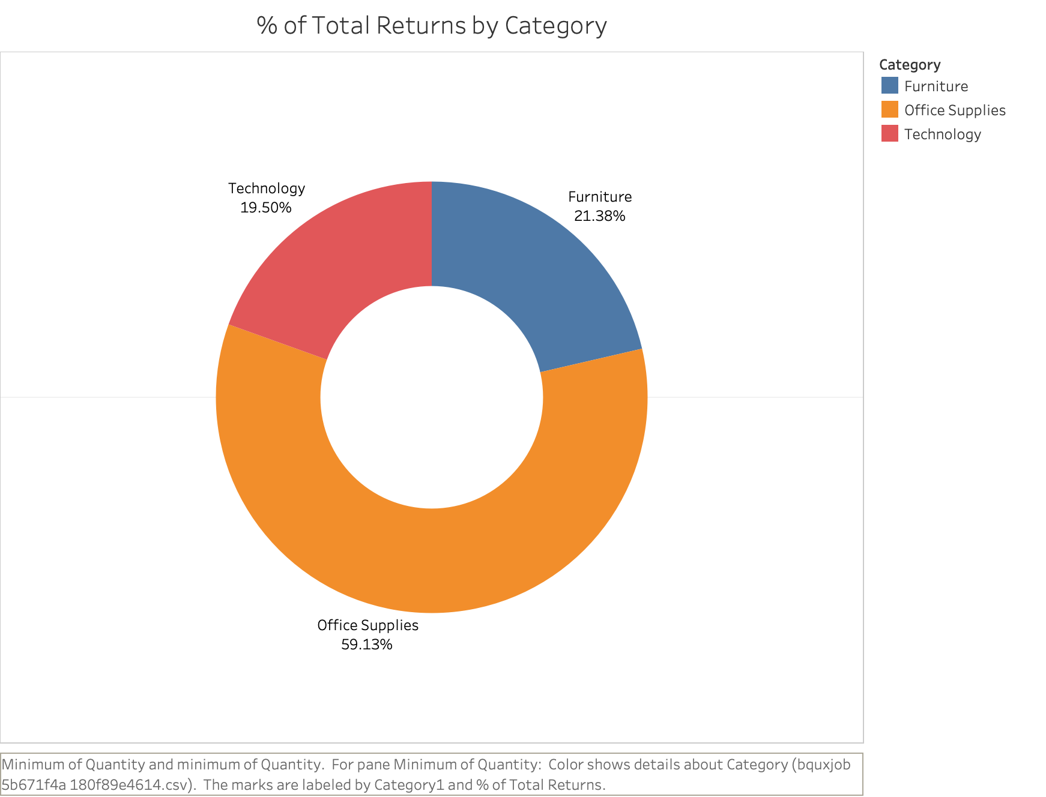

Slide 22
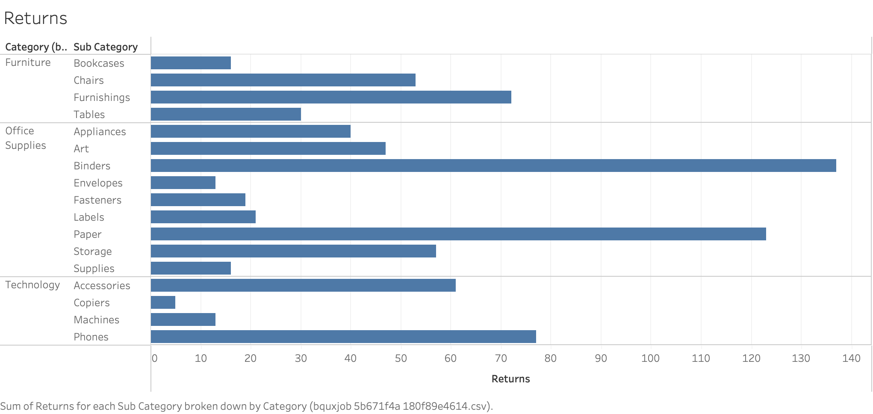

Slide 23
Returns Analysis
I would suggest implementing a customer survey when an item is returned in order to find out why a customer was unsatisfied with their item.
I would also look perform a quality check specifically on binders and paper to see if they are up to industry standards.

