Slide 1

ECE4078 Intelligent robotics
AI art generated by https://www.craiyon.com/
(prompt: “a penguin robot shopping for fruits and vegetables in a supermarket”)
Lab 5: Integrated System

Slide 2
ECE4078 Intelligent robotics
Week | Objectives | Milestones
1: C1-1 | Introduction and setup
2: M1-1 | Calibration, ARUCO markers | C1 due
3: M1-2 | SLAM
4: M1-3 | SLAM
5: M2-1 | Object recognition & localisation | M1 due
6: M2-2 | Object recognition & localisation
7: M3-1 | Navigation & Planning | M2 due
8: M3-2 | Navigation & Planning
9: C2 | Integration & Improvement | M3 due
10: Final | Trial run of final demo | C2 due
11: Final | Final demo | Final demo due
12: No lab | N/A | N/A
*

Slide 3
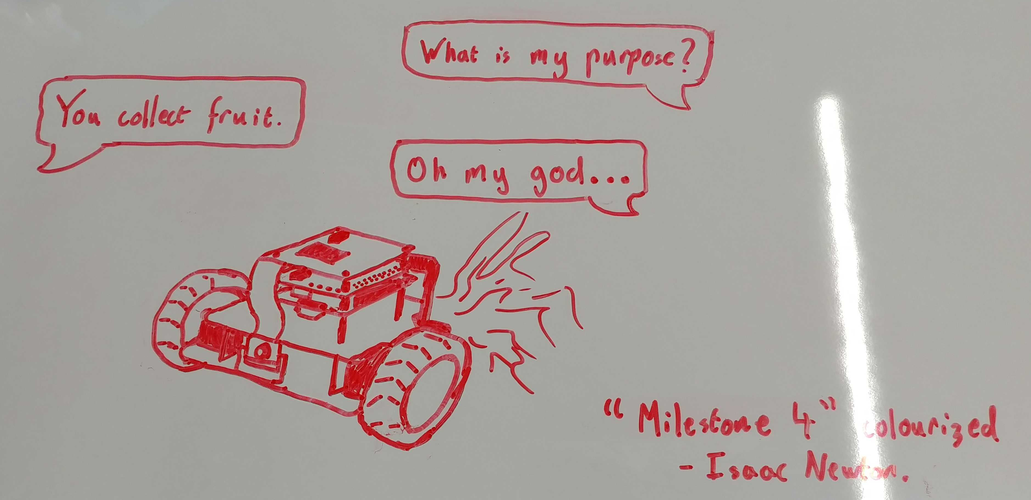
ECE4078 in a nutshell
- By unknown 2022 student

Slide 4
Checkpoint 2: Integration
Checkpoint 2 (C2) is designed to give you time to integrate all the modules you completed in the previous milestones and an opportunity to practice the final demo. It integrates your work from M1 to M3 so that the robot can create a map of the arena containing the estimated poses of 10 ArUco markers (M1), 10 objects (M2), to then perform the grocery shopping task (M3).
C2 is a practice run of the Final demo process.
Final Demo Information:
The arena will contain:
10 ArUco markers
5 unique fruits&vegs as targets for navigation (given shopping list)
5 obstacle fruits&vegs (can contain duplicates)
There are two evaluation components:
Final Demo Tasks:
Arena mapping (manual or fully-autonomous)
SLAM map
Target map
Grocery shopping / navigation: fully-autonomous navigation
Fully-autonomous mapping must be done simultaneously with navigation

Slide 5
Final Demo: Levels
The task is separated into three task levels, these levels are:
Level 1: Manual Mapping and Fully-Autonomous Navigation
The robot can be teleoperated for the Mapping task
The robot must navigate around the arena autonomously
You must navigate to targets on the shopping list in the specified order
Level 2: Manual Mapping and Fully-Autonomous Navigation with Swapped Objects
The robot can be teleoperated for the Mapping task
The robot must navigate around the arena autonomously
After mapping occurs, target and/or obstacles objects will change locations
You must navigate to targets on the shopping list in the specified order
Level 3: Fully-Autonomous Mapping and Navigation
The robot performs simultaneous mapping and navigation around the arena autonomously
You may navigate to objects in any order
You are still provided a shopping list, but you do not need to navigate to the targets in the same order as the list. Due to the removal of shopping list order, you must clearly indicate if the robot is stopping for an object by printing the label of the specified object to terminal and notifying the TA of the robot's intention to stop at the specific target.

Slide 6
Additional recommendations (optional)
Practice practice practice! (again)
The easiest and most influential recommendation.
Remember this ALSO includes setting up the environment as quick as you can.
Try and practice on a wide range of maps whilst trying your best to replicate the EXACT same conditions you will be performing the live demo under.
Develop, plan and discuss a strategy
Try and find a “meta” strategy that will give you the most marks in the limited live demo time
Is it better to brute force the task with many fast attempts as possible? Or is it better to try and take it slow and be more consistent?
Is there a specific driving strategy you should follow when mapping the arena?
Discuss and solidify a plan with your group with what kind of strategy you should use.

Slide 7
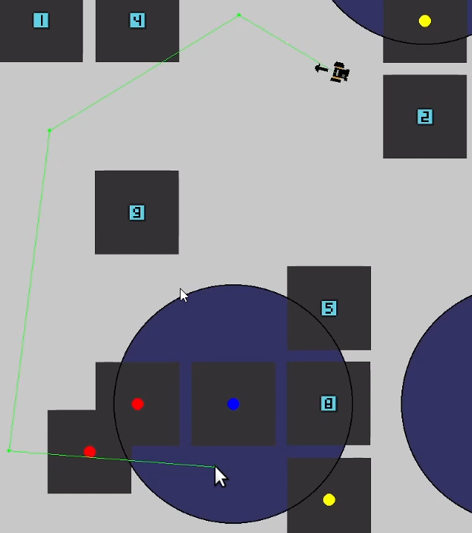
Additional recommendations (optional)
- Improved GUI
An improved GUI can really help out the mapping and navigation
Rendering the trajectory on screen can be helpful to check early on if the generated path of the robot is a viable one (and for you to decide if you want to go ahead with this path / waypoint or to generate a new one before starting the navigation)
- Path planning selection If you are using a stochastic path planning algorithm (or multiple path planning algorithms), it may be beneficial to initially generate multiple potential trajectories which the robot can select from
Remember, you can only press ONE button to start your script

Slide 8
Additional recommendations (optional)
- Waypoint thresholding
You can set an appropriate threshold so the robot doesn’t have to get too close to a waypoint point and get fixated at trying to do so
If this fixation is due to the robot thinking it “teleported” due to an update of its position from seeing an ArUco marker, then you may need to decrease the uncertainty in the predict step so it relies on the robot’s dynamics a bit more
Remember, the skeleton codes are for reference only and you’ll have to improve the codes or write your own to get better marks. As long as your codes perform the task and generate estimation maps that can be marked according to the evaluation schemes and scripts you are free to modify the skeleton codes.

Slide 9
M3: Evaluation
Live demo marking in wk9 using new arena
Each of the 3 levels have different marks associated
Level 1: (Total marks: 50pt)
For each successful navigation in order +10pts
Level 2: (Total marks: 20pt)
You get the Lv1 50pt if you can achieve a qualified run in Lv2
For each successful navigation in order +4pts
Level 3: (Total marks: 15pt)
You get the Lv1+Lv2 70pt if you can achieve a qualified run in Lv3
For each successful navigation in order +3pts
Level 4: (Total marks: 15pt)
You get the Lv1+Lv2+Lv3 85pt if you can achieve a qualified run in Lv4
For each successful navigation in order +3pts
You will receive penalties if:
Robot collides with marker/object (-5pt)
Robot touches the arena boundaries (-5pt)
Max 5 penalties allowed: Fifth time a penalty happens that run is stopped

Slide 10
M3: Marking Rules
(see M3_marking.md for more info)
No more than 5 penalties (collision) applied in a run and no more than 5 penalties allowed. After the 5th time, the run is stopped and marks are awarded if run is qualified.
End condition to achieve a qualified run: Your robot attempts to navigate to (stop past within 0.5m radius) 3/4 targets in order (skips allowed) for lvl2/lvl3 and 5 targets in any order for lv4. (You will only get marks for targets navigated in order and if it is a qualified run or level 1)
You have to show a qualified Lv2/Lv3/Lv4 run to get marked by the Lv2/Lv3/Lv4 formula
The entire robot needs to stop within the 0.3m radius to count as successful navigation to that target
If we don’t see appropriate implementation of navigation and path planning in your codes for the level you are attempting you’ll get 0pt for M3
If we find that your Level 3 (auto nav with partial map) made use of the full map you’ll get 0pt for M4. The same goes for level 4.
You are only allowed ONE COMMAND to launch auto nav in Lv2&Lv3&Lv4. No teleoperation allowed in any levels (you’ll get 0pt for M4 if you are suspected of teleoperating during the demo). Once you have a qualified run, you are allowed to stop the robot at any time.
Successful navigation / collision avoidance by luck will not give you marks for those targets

