Slide 1
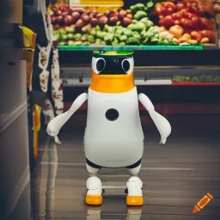
ECE4078 Intelligent robotics
AI art generated by https://www.craiyon.com/
(prompt: “a penguin robot shopping for fruits and vegetables in a supermarket”)
Final Demo: Integrated System

Slide 2
ECE4078 Intelligent robotics
Week | Objectives | Milestones
1: C1-1 | Introduction and setup
2: M1-1 | Calibration, ARUCO markers | C1 due
3: M1-2 | SLAM
4: M1-3 | SLAM
5: M2-1 | Object recognition & localisation | M1 due
6: M2-2 | Object recognition & localisation
7: M3-1 | Navigation & Planning | M2 due
8: M3-2 | Navigation & Planning
9: C2 | Integration & Improvement | M3 due
10: Final | Trial run of final demo | C2 due
11: Final | Final demo | Final demo due
12: No lab | N/A | N/A
*

Slide 3
Final Demo
Your task will be the same as described in C2:
Your task will be to first map out the arena of all 10 ArUco markers (M1) and 10 targets (M2) which you can do so by manually driving around the arena (C1).
Once the arena is mapped you will then be tasked to navigate to targets on a shopping list following the given order (M3).
The arena will always contain:
10 ArUco markers
5 unique fruits&vegs as targets for navigation (given shopping list)
5 obstacle fruits&vegs (can contain duplicates)
There are two evaluation components:
Final Demo Tasks:
Arena mapping (manual or fully-autonomous)
SLAM map
Target map
Grocery shopping / navigation: fully-autonomous navigation
Fully-autonomous mapping must be done simultaneously with navigation

Slide 4
Additional recommendations
Practice practice practice! (again)
The easiest and most influential recommendation.
Remember this ALSO includes setting up the environment as quick as you can.
Try and practice on a wide range of maps whilst trying your best to replicate the EXACT same conditions you will be performing the live demo under.
Develop, plan and discuss a strategy
Try and find a “meta” strategy that will give you the most marks in the limited live demo time
Is it better to brute force the task with many fast attempts as possible? Or is it better to try and take it slow and be more consistent?
Is there a specific driving strategy you should follow when mapping the arena?
Discuss and solidify a plan with your group with what kind of strategy you should use.

Slide 5
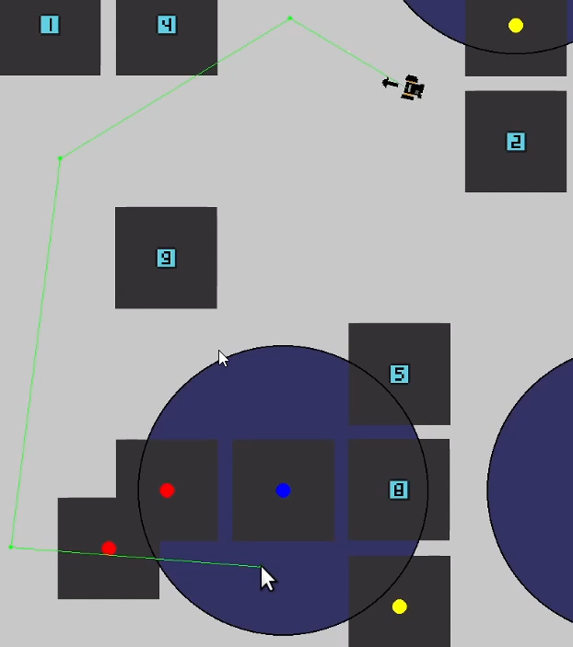
Additional recommendations (optional)
- Improved GUI
An improved GUI can really help out the mapping and navigation
Rendering the trajectory on screen can be helpful to check early on if the generated path of the robot is a viable one (and for you to decide if you want to go ahead with this path / waypoint or to generate a new one before starting the navigation)
- Path planning selection If you are using a stochastic path planning algorithm (or multiple path planning algorithms), it may be beneficial to initially generate multiple potential trajectories which the robot can select from
Remember, you can only press ONE button to start your script

Slide 6
Additional recommendations
- Add a stop button
Adding a stop button that makes the robot wheels stop without shutting the robot down or stopping your operate script would save some time and effort when you want to quickly start a new run.
- Optimise turning and reverse driving
Turning is the reason to many collisions when your robot gets too close to a marker or a target. Optimising robot movements by turning the shorter (as opposed to fixed left turning, for example) and allow reverse driving would prevent this. This also reduce the driving time.
- Clean up your submission
A clean submission prevent the risk of using the wrong files for your final demo, so make sure it only contains the files you need.

Slide 7
Additional recommendations
- Optimise sample-based path planner
Sample-based path planners like RRT does not produce the optimal path most of the time, but they run very fast. To further optimise this, you can generate multiple potential paths and select the best one based on certain criteria. For example:
- Number of waypoints
- Total distance travelled
- Average distance between the waypoints and the obstacles
- Collision detection
Your robot can use its camera to work out the distance towards a marker (using aruco_detector.py) for a fruit&veg (using detector.py). If the distance is too close, you will want to stop a robot and find a detour / back off.

Slide 8
Additional recommendations
- Everything is variable
As changing the submitted code is not allowed, it’s best not to hardcode your important variables and make them dynamic arguments than can be changed by the command line. Some important variables:
- Obstacle radius
- Distance to the target (to consider collection)
- Input files name
- etc.
Alternative, some of these can even dynamically change while the script is running. For example, if your path planner is stuck, you might want to reduce the obstacle radius automatically.
- Get out of obstacles
Sometimes you will find your robot stuck inside an obstacle and all the proposed paths are failed due to collision. Follows are some suggestions:
- Reduce the obstacle radius automatically
- Trace back to your previous waypoints or origin
- Go to a random non-occupied point

Slide 9

Final Demo: Mapping
Mapping (30 points):
ArUco slam map (0 ≤ slam_score ≤ 15pt):
Target map (0 ≤ target_est_score ≤ 15pt):
target_accuracy_rating[object] = $\frac{0.5 − estimation_error\left[object\right]}{0.5−0.025}$= TAR
target_est_score = $\frac{base^{mean\left(TAR\right)}– 1}{base – 1} ∗15$, base = 8
Example submission folder structure format (Please read the marking instructions carefully for this!):
.
├── C2_Team_X0
│ ├── slam_auto_4.txt
│ ├── slam_manual_1.txt
│ ├── slam_manual_2.txt
│ ├── targets_auto_4.txt
│ ├── targets_manual_1.txt
│ ├── targets_manual_2.txt

Slide 10
Final Demo: Navigation
Full auto navigation (max 70 points):
Level 1
15 marks awarded for a qualified run.
Each successful collection (within 0.3 m, in the correct shopping list order) is worth 5 marks.
Maximum contribution: 40% of 70%.
Level 2
25 marks awarded for a qualified run.
Each successful collection (within 0.3 m, in the correct shopping list order) is worth 5 marks.
Maximum contribution: 50% of 70%.
Level 3
30 marks awarded for a qualified run.
Each successful collection (within 0.3 m, in the correct shopping list order) is worth 8 marks.
Maximum contribution: 100% of the Navigation mark (i.e. full 70%).
Penalties (Max of 5 penalties total,):
-5 points for any collision
Marks for reaching objects will always count, however you cannot stop a run manually until a run is qualified
More info see Week11/README.md

