Slide 1
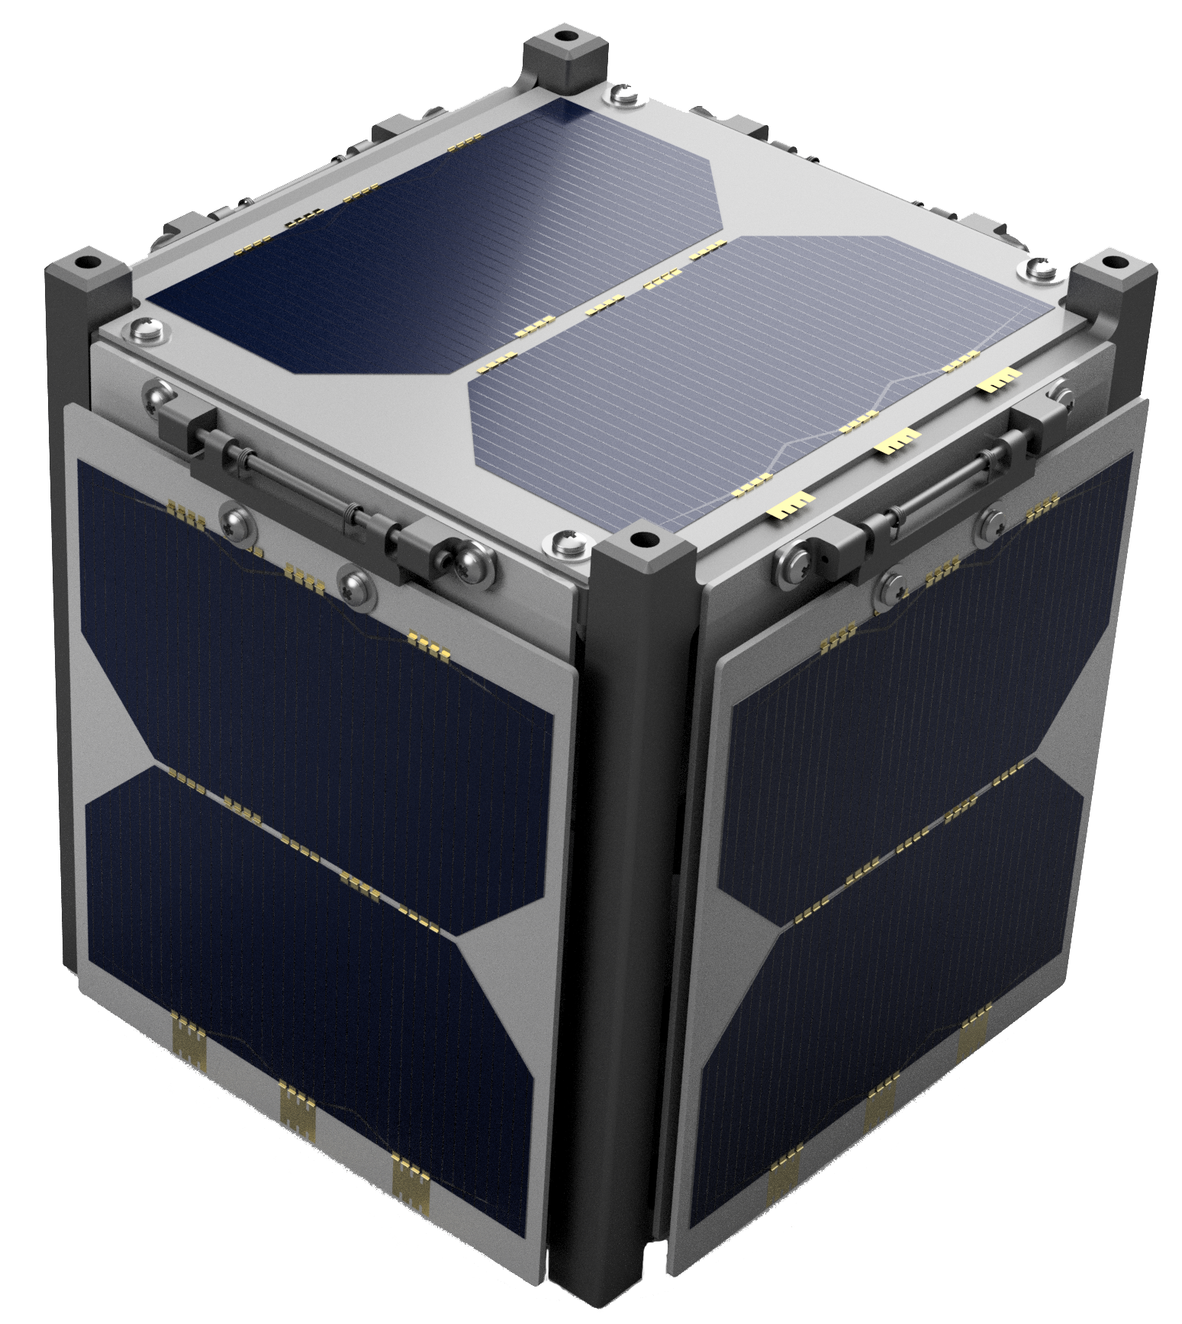

Navigation
Hub orbit determination is performed using NEN.
Time-of-flight ranging is performed between hub and nodes with the same radios used for cross-link communication.
A least-squares problem is solved on the ground that combines known hub positions, ranging data, and orbital dynamics to determine node positions.

