Slide 1
Introduction
What IS computer vision?
Where do images come from?
the analysis of digital images by a computer

Slide 2
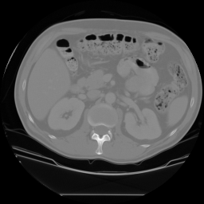
Applications
Medical Imaging
CT image of a
patient’s abdomen
liver
kidney
kidney

Slide 3
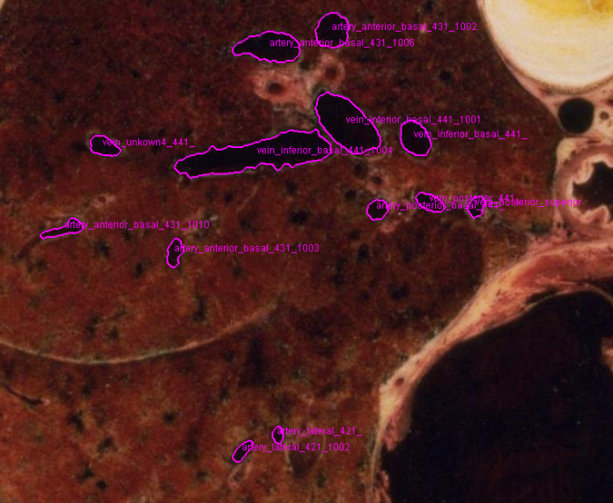
Visible Man Slice Through Lung

Slide 4
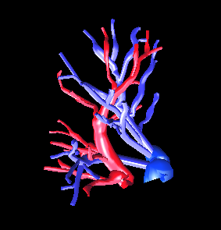
3D Reconstruction of the Blood Vessel Tree

Slide 5
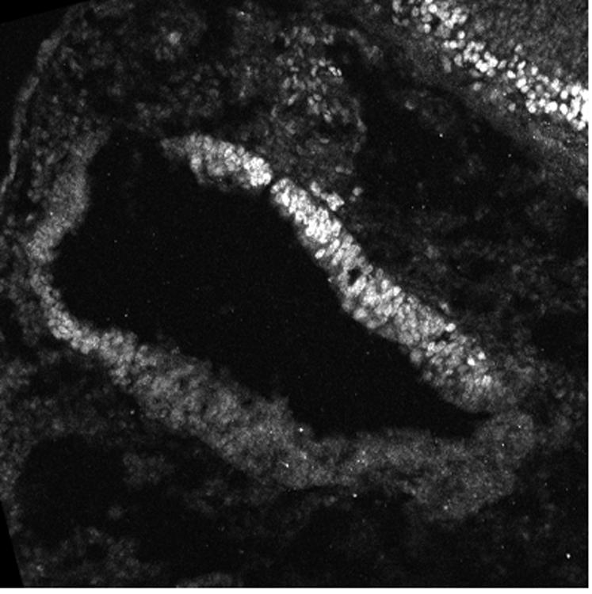
Slice of a Chicken Embryo’s Inner Ear

Slide 6
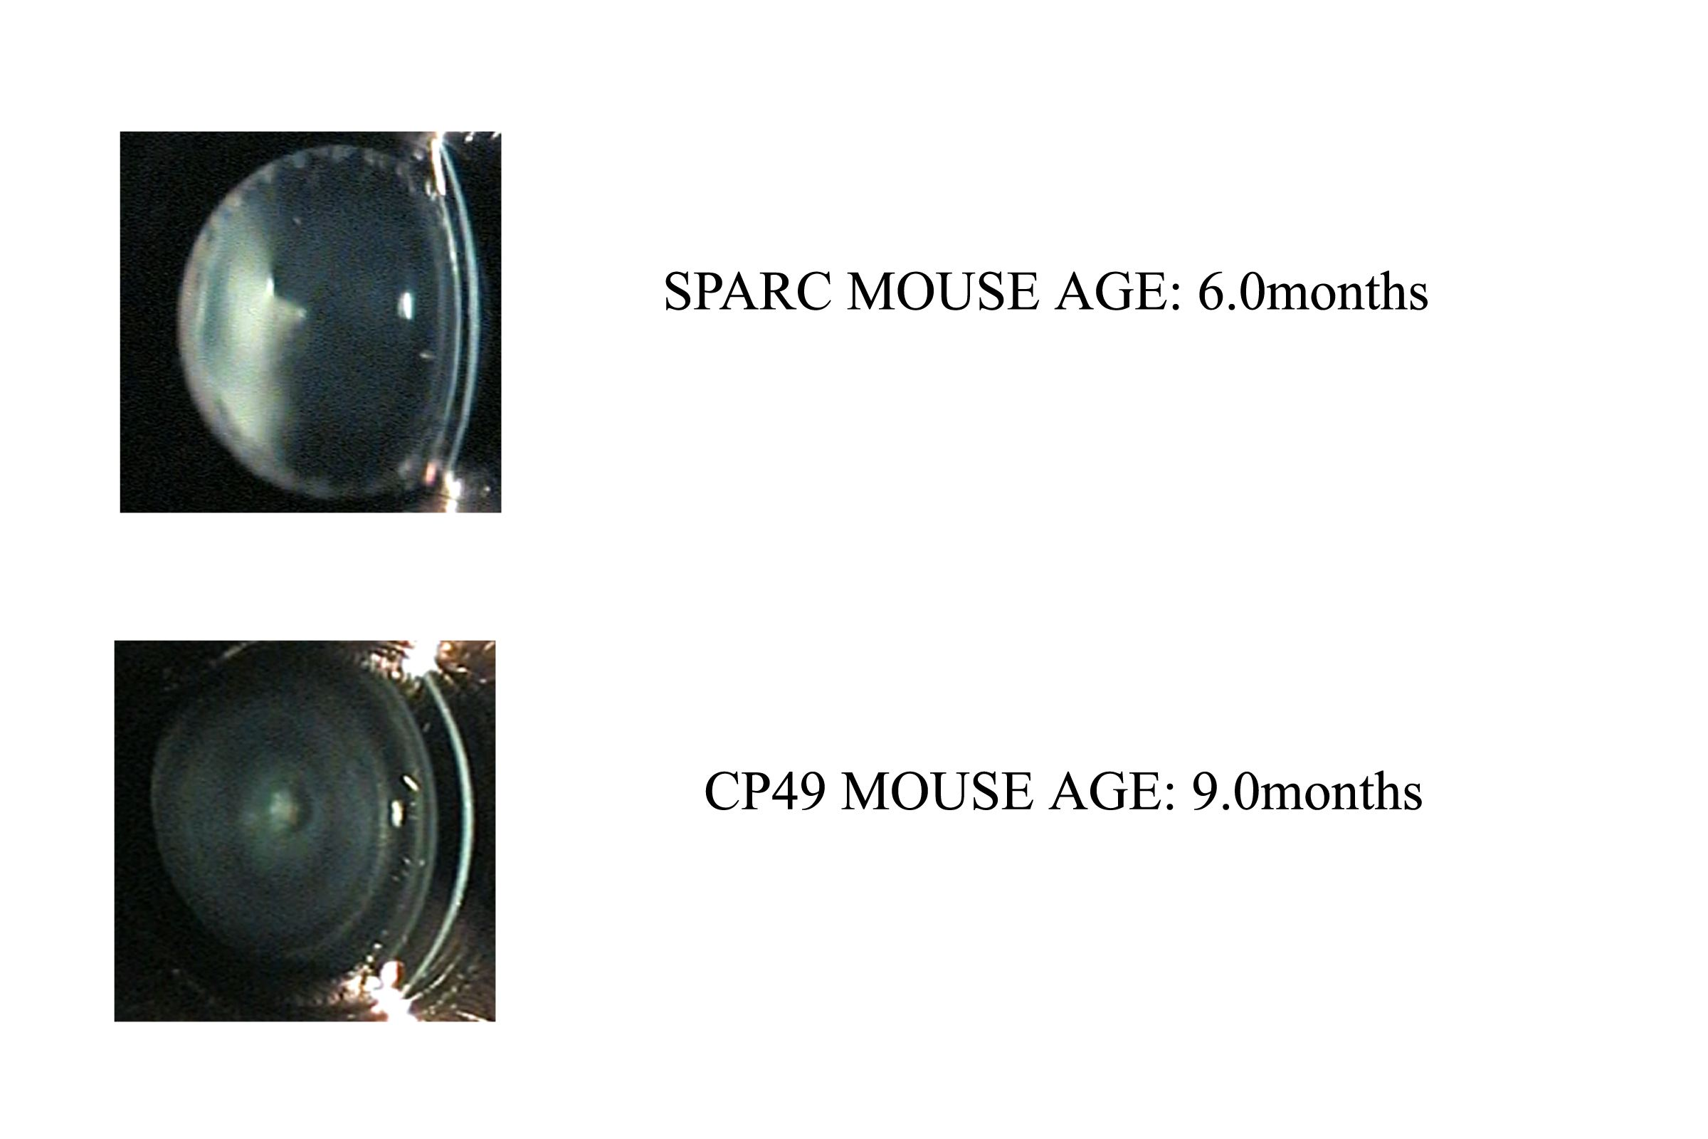
CBIR of Mouse Eye Images for Genetic Studies

Slide 7
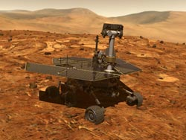
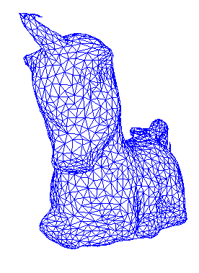
Robotics
2D Gray-tone or Color Images
3D Range Images
“Mars” rover
What am I?

Slide 8
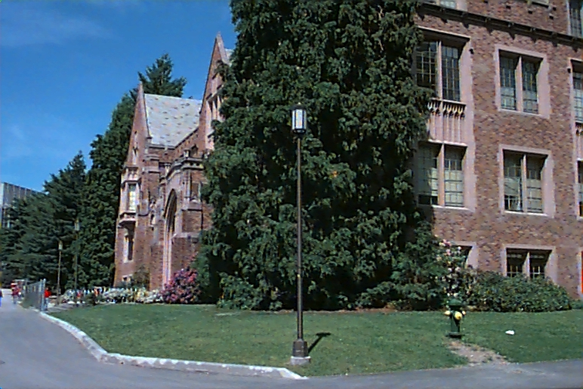
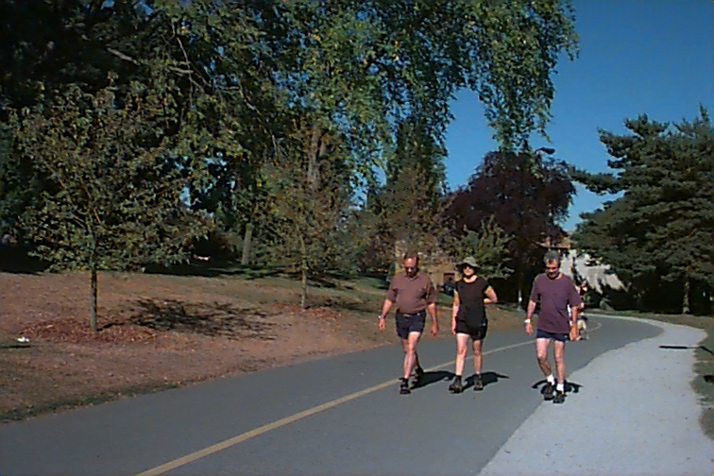
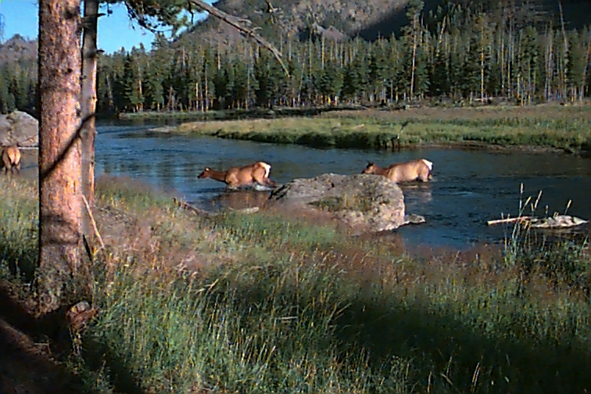
Image Databases:
Images from my Ground-Truth collection.
What categories of image databases exist today?

Slide 9
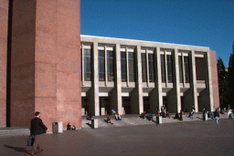

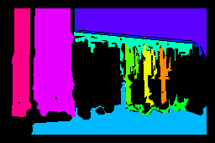
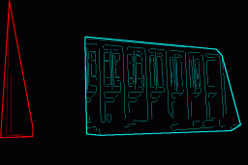
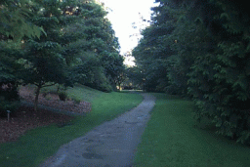

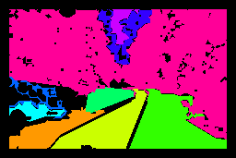

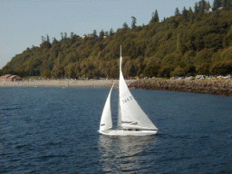

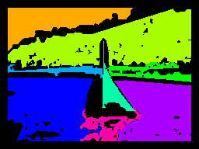
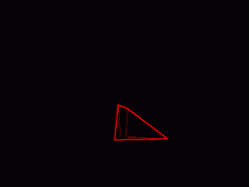
Abstract Regions for Object Recognition
Original Images
Color Regions
Texture Regions
Line Clusters
Notes:
Caption!

Slide 10
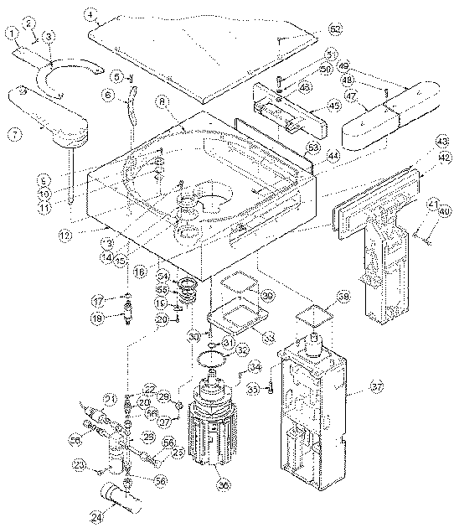
Documents:

Slide 11
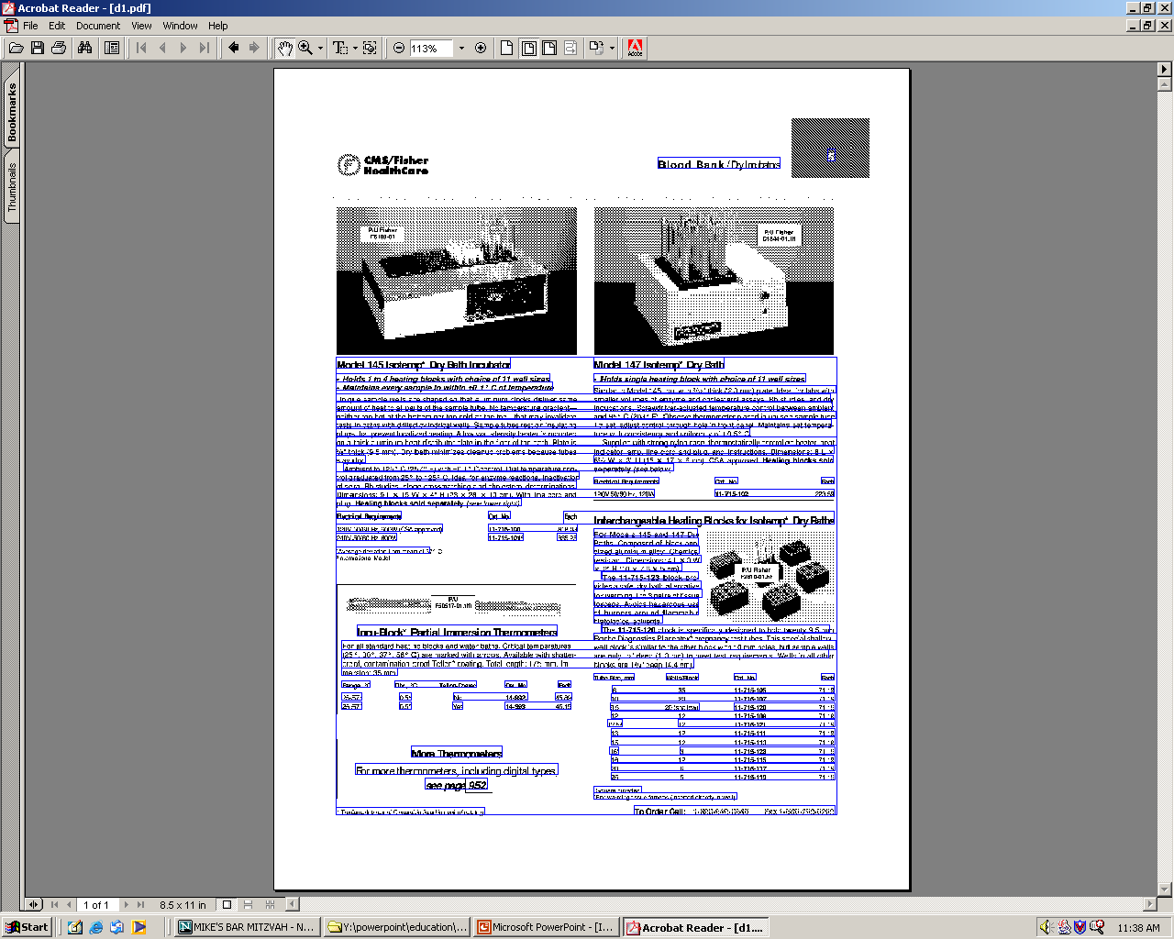

Slide 12
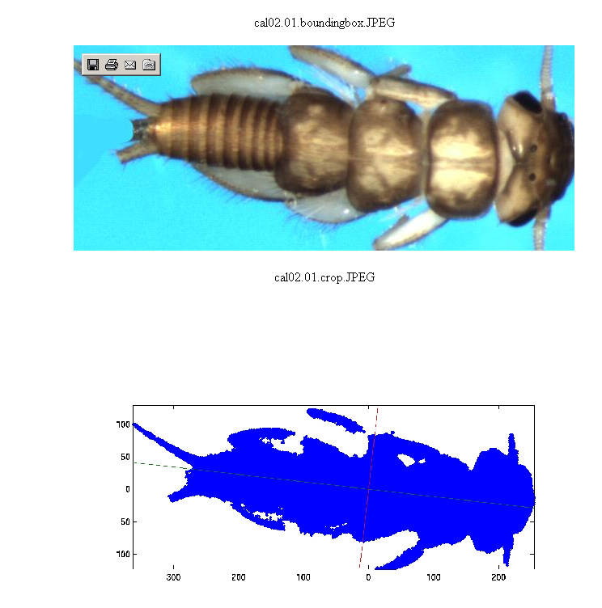
Insect Recognition for Ecology

Slide 13
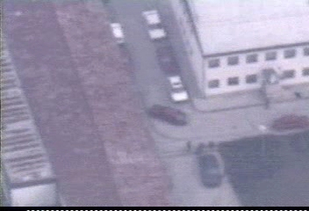
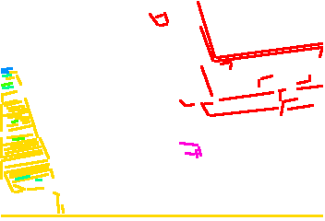
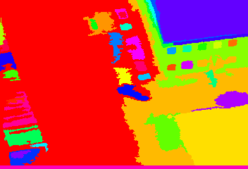

Surveillance: Event Recognition in Aerial Videos
Original Video Frame
Structure Regions
Color Regions
Color-Merge Regions

Slide 14
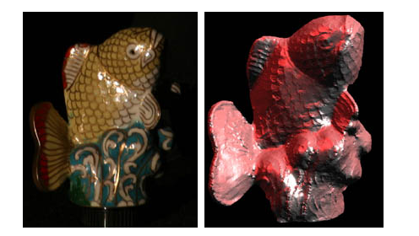
Vision for Graphics:
Recent work of Steve Seitz (CSE) and Aaron Hertzman
on Computing the Geometry of Objects from Images.

Slide 15
Some Applications from WACV
Face Detection / Skin Detection
Face Recognition
Gesture Recognition
Eye Gaze Estimation
Gender Classification
People Tracking
Group Behavior Recognition
Visual Navigation
Real-Time Precrash Vehicle Detection
Augmented Reality
Vehicle Inspection
Video de-Abstraction (save money on wedding videos)
Analysis of Auroral Appearance over Canada
Video Endoscopy

Slide 16
Digital Image Terminology:
0 0 0 0 1 0 0
0 0 1 1 1 0 0
0 1 95 96 94 93 92
0 0 92 93 93 92 92
0 0 93 93 94 92 93
0 1 92 93 93 93 93
0 0 94 95 95 96 95
pixel (with value 94)
its 3x3 neighborhood
region of medium
intensity
resolution (7x7)
binary image
gray-scale (or gray-tone) image
color image
multi-spectral image
range image
labeled image

Slide 17
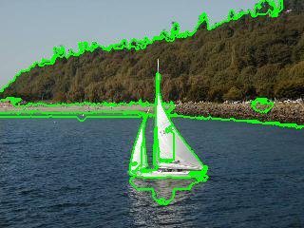
Goals of Image Analysis
Segment the image into useful regions
Perform measurements on certain areas
Determine what object(s) are in the scene
Calculate the precise location(s) of objects
Visually inspect a manufactured object
Construct a 3D model of the imaged object

Slide 18
The Three Stages of Computer Vision
low-level
mid-level
high-level
image image
image features
features analysis

Slide 19

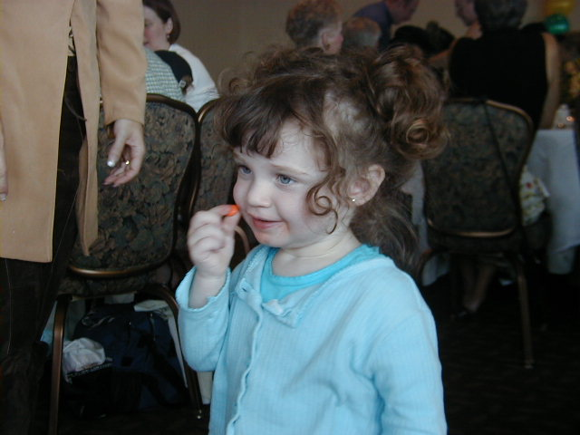
Low-Level
sharpening
blurring

Slide 20

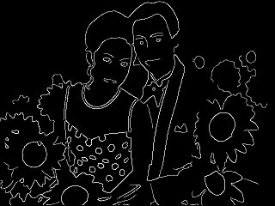
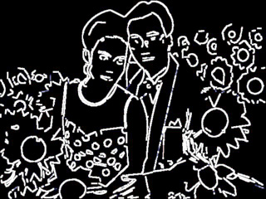
Low-Level
Canny
original image
edge image
Mid-Level
ORT
data
structure
edge image
circular arcs and line segments

Slide 21
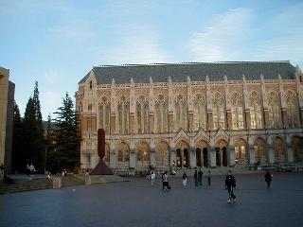
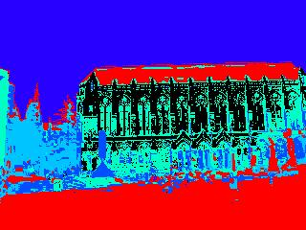
Mid-level
K-means
clustering
(followed by
connected
component
analysis)
original color image
regions of homogeneous color
data
structure

Slide 22
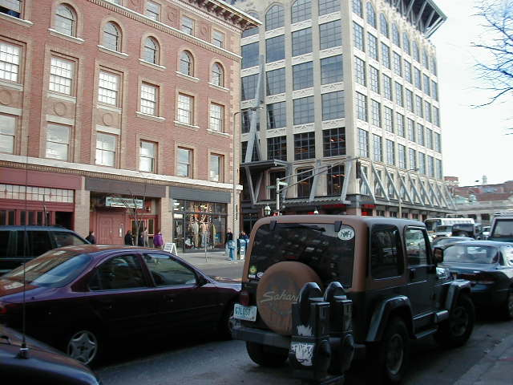
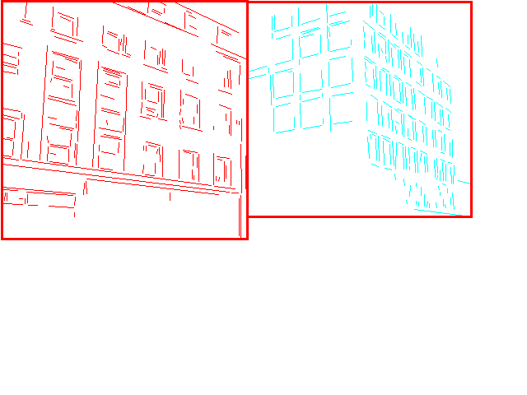
Low- to High-Level
low-level
edge image
mid-level
consistent
line clusters
high-level
Building Recognition

Slide 23
Difficulty of Computer Vision
Computer vision is far from completely solved.
There have been many successful systems used in
real applications.
There are lots of things that humans can do for
which vision programs don’t come close to success.
Like what?
Can you name some?

