Slide 1

Imaging and Image Representation
Sensing Process
Typical Sensing Devices
Problems with Digital Images
Image Formats
Relationship of 3D Scenes to 2D Images
Other Types of Sensors

Slide 2
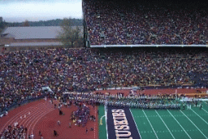
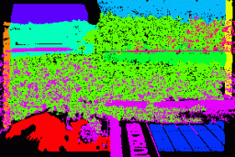
Images: 2D projections of 3D
The 3D world has color, texture, surfaces, volumes, light sources, objects, motion, …
A 2D image is a projection of a scene from a specific viewpoint.

Slide 3
Images as Functions
A gray-tone image is a function:
g(x,y) = val or f(row, col) = val
A color image is just three functions or a
vector-valued function:
f(row,col) =(r(row,col), g(row,col), b(row,col))

Slide 4

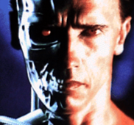
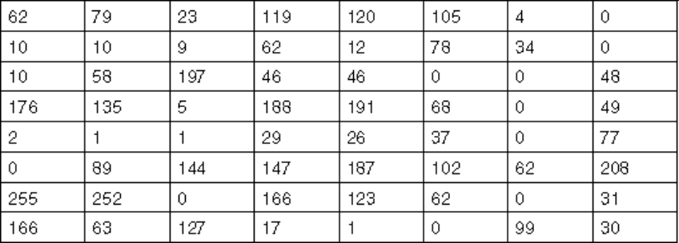


Image vs Matrix
Digital images (or just “images”) are typically stored in a matrix.
There are many different file formats.

Slide 5
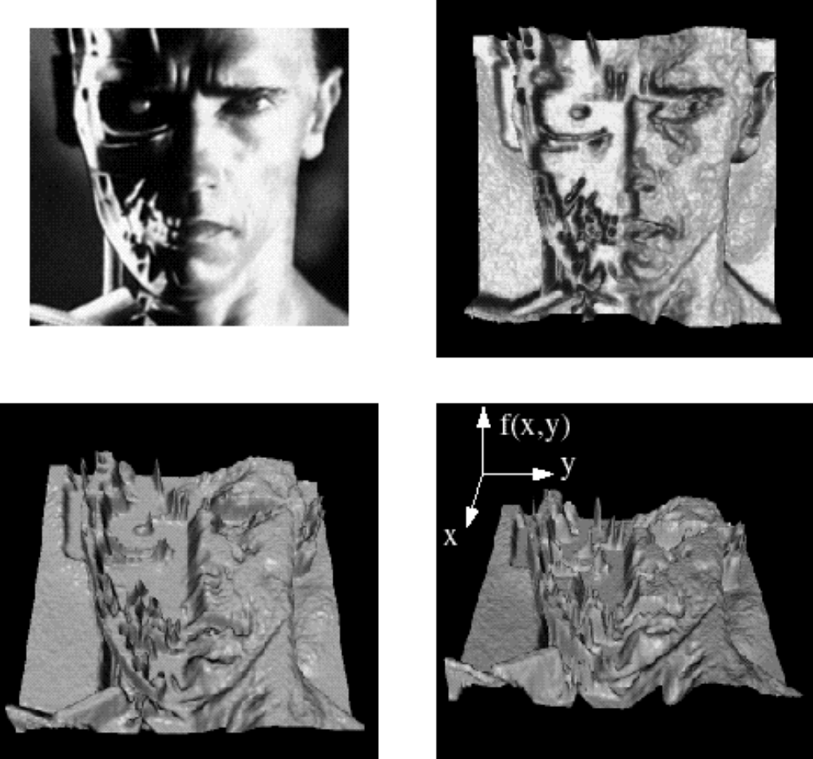
Gray-tone Image as 3D Function

Slide 6
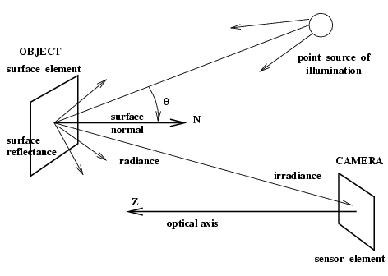
Imaging Process
Light reaches surfaces in 3D
Surfaces reflect
Sensor element receives light energy
Intensity counts
Angles count
Material counts
What are radiance and irradiance?

Slide 7
Radiometry and Computer Vision*
Radiometry is a branch of physics that deals with the
measurement of the flow and transfer of radiant energy.
Radiance is the power of light that is emitted from a
unit surface area into some spatial angle;
the corresponding photometric term is brightness.
Irradiance is the amount of energy that an image-
capturing device gets per unit of an efficient sensitive
area of the camera. Quantizing it gives image gray tones.
From Sonka, Hlavac, and Boyle, Image Processing, Analysis, and
Machine Vision, ITP, 1999.

Slide 8
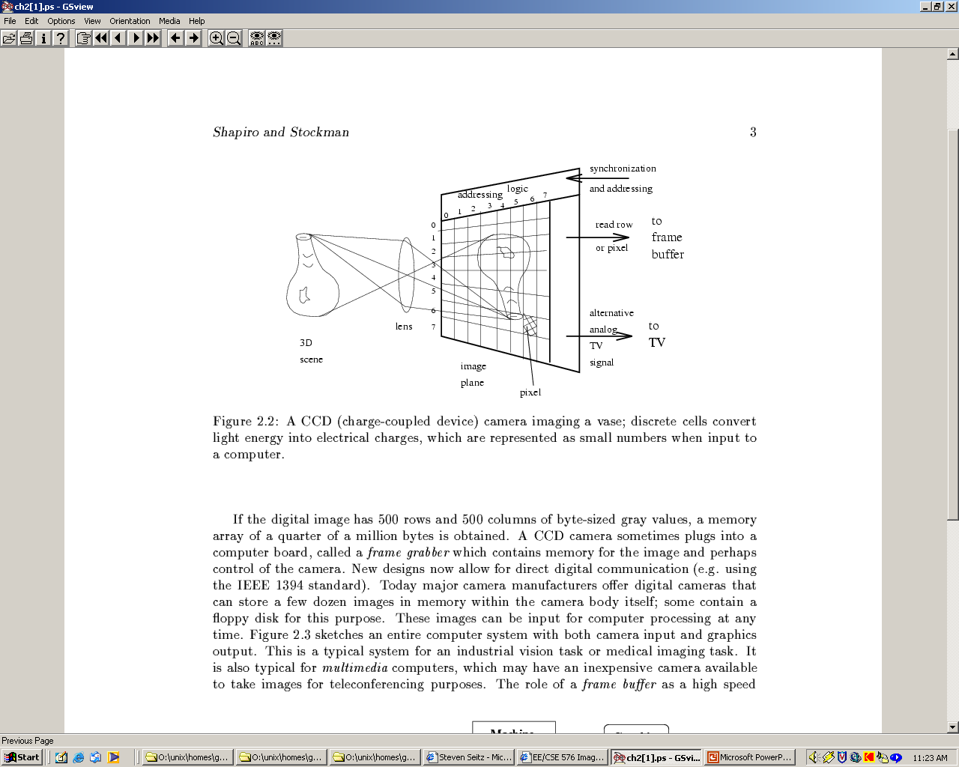
CCD type camera:
Commonly used in industrial applications
Array of small fixed elements
Can read faster than TV rates
Can add refracting elements to get
color in 2x2 neighborhoods
8-bit intensity common

Slide 9
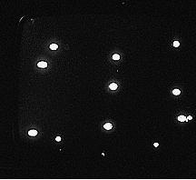
Blooming Problem with Arrays
Difficult to insulate adjacent sensing elements.
Charge often leaks from hot cells to neighbors, making bright regions larger.

Slide 10
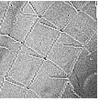
8-bit intensity can be clipped
Dark grid intersections at left were actually brightest of scene.
In A/D conversion the bright values were clipped to lower values.

Slide 11
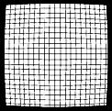
Lens distortion distorts image
“Barrel distortion” of rectangular grid is common for cheap lenses ($50)
Precision lenses can cost $1000 or more.
Zoom lenses often show severe distortion.

Slide 12
Resolution
resolution: precision of the sensor
nominal resolution: size of a single pixel in scene
coordinates (ie. meters, mm)
common use of resolution: num_rows X num_cols
(ie. 515 x 480)
subpixel resolution: measurement that goes into
fractions of nominal resolution
field of view (FOV): size of the scene a sensor can
sense

Slide 13
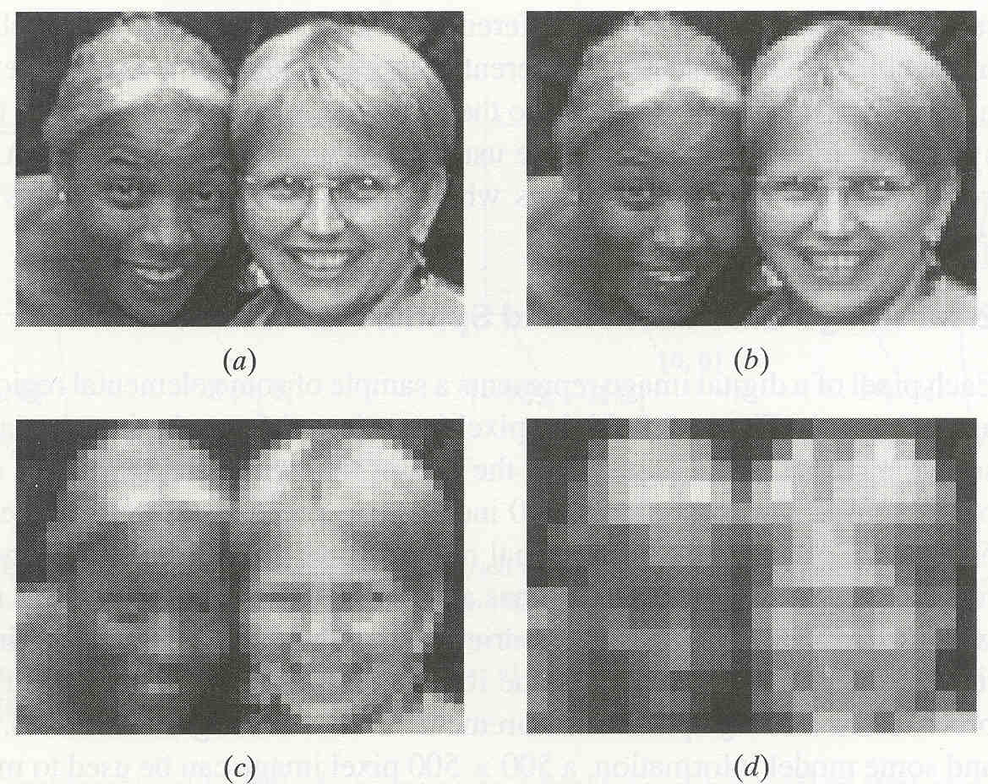
Resolution Examples
Resolution decreases by one half in cases at left
Human faces can be recognized at 64 x 64 pixels per face

Slide 14
Image Formats
Portable gray map (PGM) older form
GIF was early commercial version
JPEG (JPG) is modern version
Many others exist: header plus data
Do they handle color?
Do they provide for compression?
Are there good packages that use them
or at least convert between them?

Slide 15
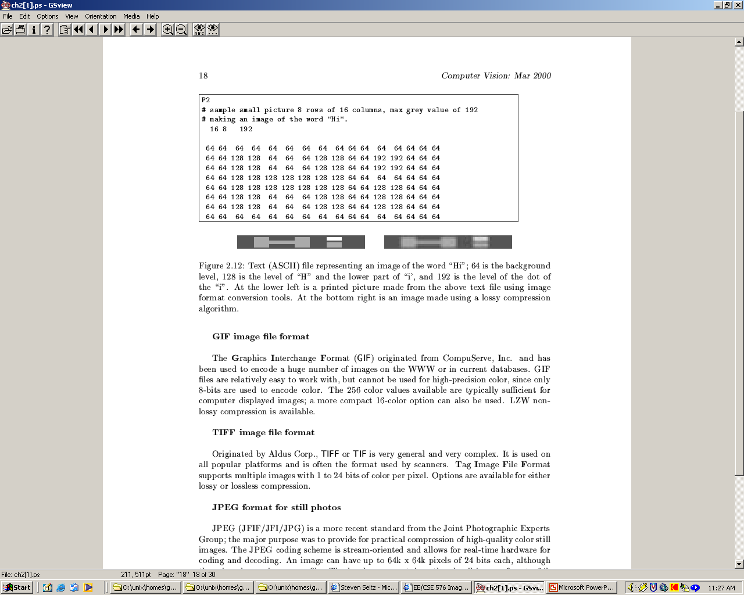
PGM image with ASCII info.
P2 means ASCII gray
Comments
W=16; H=8
192 is max intensity
Can be made with editor
Large images are usually not stored as ASCII

Slide 16
PBM/PGM/PPM Codes
P1: ascii binary (PBM)
P2: ascii grayscale (PGM)
P3: ascii color (PPM)
P4: byte binary (PBM)
P5: byte grayscale (PGM)
P6: byte color (PPM)

Slide 17
JPG current popular form
Public standard
Allows for image compression; often 10:1 or 30:1 are easily possible
8x8 intensity regions are fit with basis of cosines
Error in cosine fit coded as well
Parameters then compressed with Huffman coding
Common for most digital cameras

Slide 18
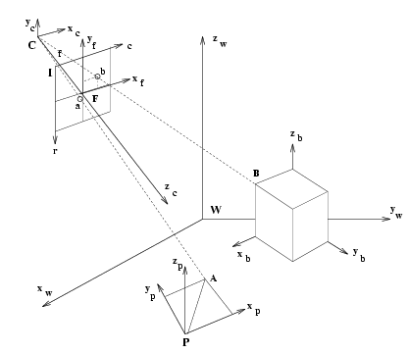
From 3D Scenes to 2D Images
Object
World
Camera
Real Image
Pixel Image

Slide 19
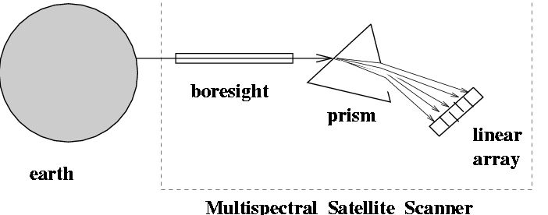
Other Types of Sensors:
Orbiting satellite scanner
View earth 1 pixel at a time (through a straw)
Prism produces multispectral pixel
Image row by scanning boresight
All rows by motion of satellite in orbit
Scanned area of earth is a parallelogram, not a rectangle

Slide 20
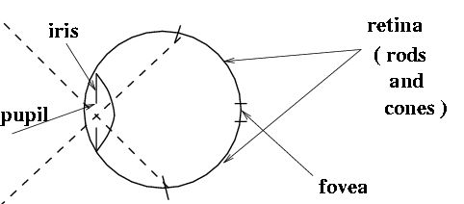
Human eye as a spherical camera
100M sensing elts in retina
Rods sense intensity
Cones sense color
Fovea has tightly packed elts, more cones
Periphery has more rods
Focal length is about 20mm
Pupil/iris controls light entry

Slide 21
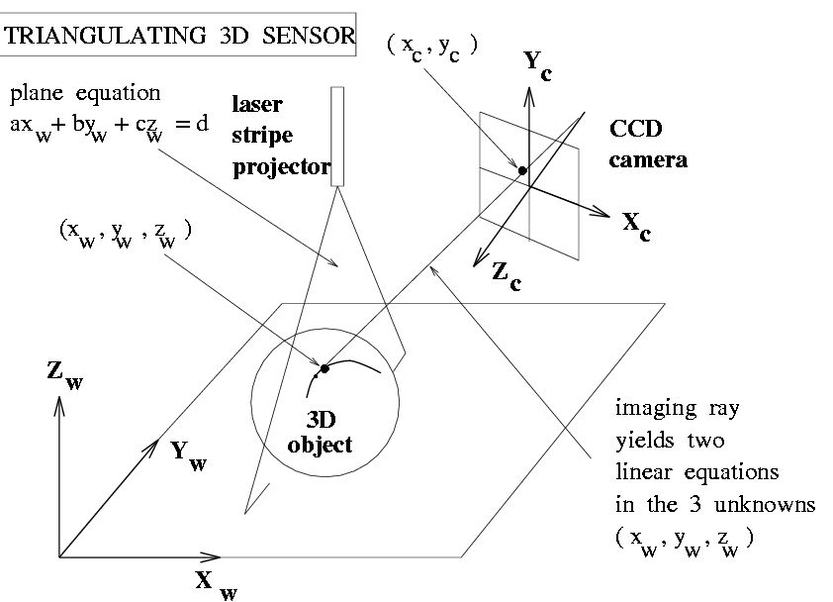
Surface data (2.5D) sensed by structured light sensor
Projector projects plane of light on object
Camera sees bright points along an imaging ray
Compute 3D surface point via line-plane intersection

Slide 22
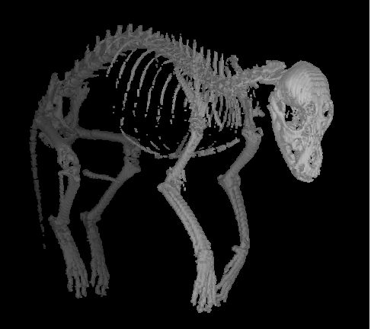
Magnetic Resonance Imaging
Sense density of certain chemistry
S slices x R rows x C columns
Volume element (voxel) about 2mm per side
At left is shaded image created by “volume rendering”

Slide 23
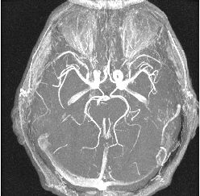
Single slice through human head
MRIs are computed structures, computed from many views.
At left is MRA (angiograph), which shows blood flow.
CAT scans are computed in much the same manner from X-ray transmission data.

Slide 24
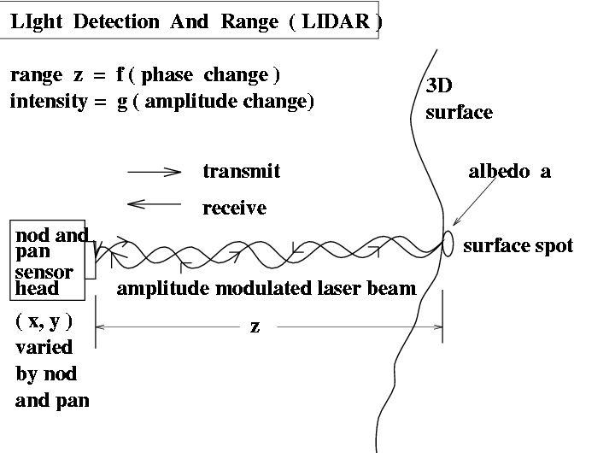
LIDAR also senses surfaces
Single sensing element scans scene
Laser light reflected off surface and returned
Phase shift codes distance
Brightness change codes albedo

Slide 25
Other variations
Microscopes, telescopes, endoscopes, …
X-rays: radiation passes through objects to sensor elements on the other side
Fibers can carry image around curves; in bodies, in machine tools
Pressure arrays create images (fingerprints, butts)
Sonar, stereo, focus, etc can be used for range sensing (see Chapters 12 and 13)

Slide 26
Where do we go next?
So we’ve got an image, say a single gray-tone image.
What can we do with it?
The simplest types of analysis is binary image analysis.
Convert the gray-tone image to a binary image
(0s and 1s) and perform analysis on the binary image,
with possible reference back to the original gray tones
in a region.

