Slide 1
Binary Image Analysis
Binary image analysis
consists of a set of image analysis operations
that are used to produce or process binary
images, usually images of 0’s and 1’s.
0 represents the background
1 represents the foreground
00010010001000
00011110001000
00010010001000

Slide 2
Binary Image Analysis
is used in a number of practical applications
part inspection
riveting
fish counting
document processing

Slide 3
What kinds of operations?
Separate objects from background
and from one another
Aggregate pixels for each object
Compute features for each object

Slide 4

Example: red blood cell image
Many blood cells are separate objects
Many touch – bad!
Salt and pepper noise from thresholding
How useable is this data?

Slide 5
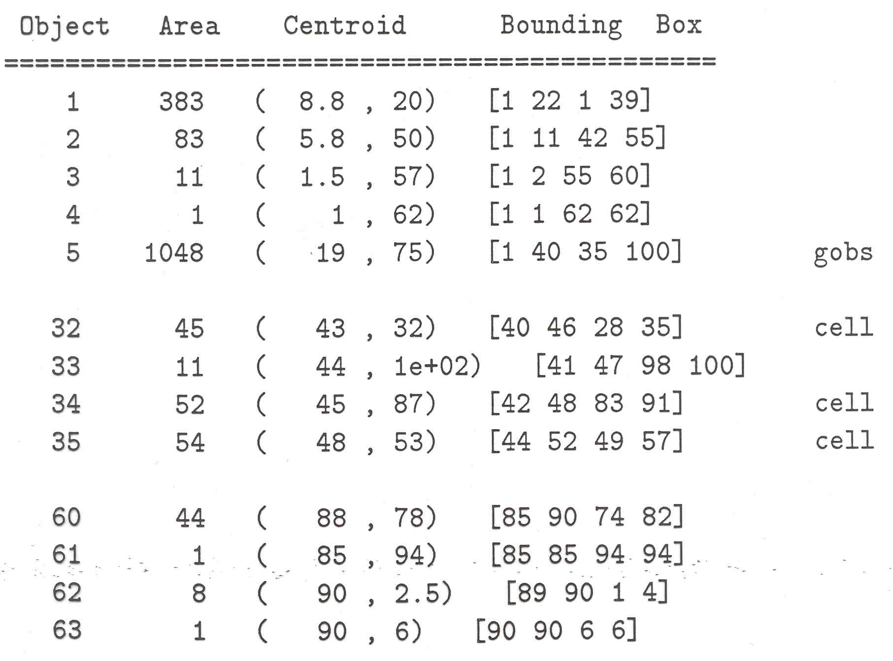
Results of analysis
63 separate objects detected
Single cells have area about 50
Noise spots
Gobs of cells

Slide 6
Useful Operations
Thresholding a gray-tone image
Determining good thresholds
Connected components analysis
Binary mathematical morphology
All sorts of feature extractors
(area, centroid, circularity, …)

Slide 7
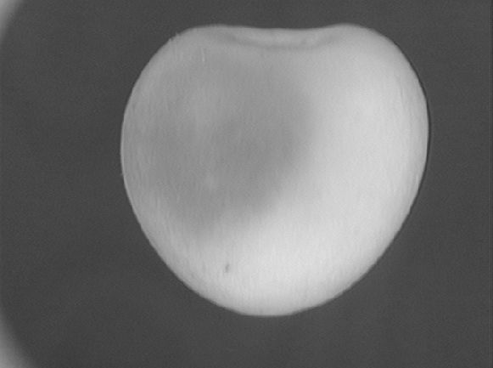
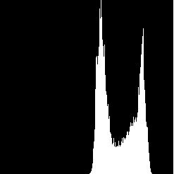
Thresholding
Background is black
Healthy cherry is bright
Bruise is medium dark
Histogram shows two cherry regions (black background has been removed)
pixel
counts
0
gray-tone values
256

Slide 8
Histogram-Directed Thresholding
How can we use a histogram to separate an
image into 2 (or several) different regions?
Is there a single clear threshold? 2? 3?

Slide 9
Automatic Thresholding: Otsu’s Method
Assumption: the histogram is bimodal
Grp 1 Grp 2
t
Method: find the threshold t that minimizes
the weighted sum of within-group variances
for the two groups that result from separating
the gray tones at value t.
See text (at end of Chapter 3) for the recurrence relations;
in practice, this operator works very well for true bimodal
distributions and not too badly for others.

Slide 10
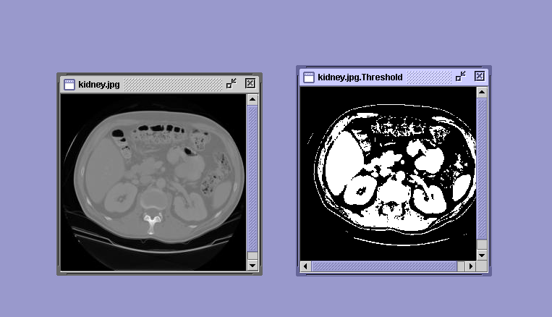
Thresholding Example

Slide 11
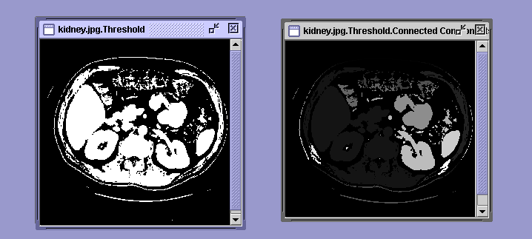
Connected Components Labeling
Once you have a binary image, you can identify and
then analyze each connected set of pixels.
The connected components operation takes in a binary image
and produces a labeled image in which each pixel has the
integer label of either the background (0) or a component.

Slide 12
Methods for CC Analysis
Recursive Tracking (almost never used)
Parallel Growing (needs parallel hardware)
Row-by-Row (most common)
Classical Algorithm (see text)
Efficient Run-Length Algorithm
(developed for speed in real
industrial applications)

Slide 13
Equivalent Labels
Original Binary Image
0 0 0 1 1 1 0 0 0 0 1 1 1 1 0 0 0 0 1
0 0 0 1 1 1 1 0 0 0 1 1 1 1 0 0 0 1 1
0 0 0 1 1 1 1 1 0 0 1 1 1 1 0 0 1 1 1
0 0 0 1 1 1 1 1 1 0 1 1 1 1 0 0 1 1 1
0 0 0 1 1 1 1 1 1 1 1 1 1 1 0 0 1 1 1
0 0 0 1 1 1 1 1 1 1 1 1 1 1 0 0 1 1 1
0 0 0 1 1 1 1 1 1 1 1 1 1 1 1 1 1 1 1
0 0 0 1 1 1 1 1 1 1 1 1 1 1 1 1 1 1 1
0 0 0 1 1 1 1 1 1 0 0 0 0 0 1 1 1 1 1

Slide 14
Equivalent Labels
The Labeling Process
0 0 0 1 1 1 0 0 0 0 2 2 2 2 0 0 0 0 3
0 0 0 1 1 1 1 0 0 0 2 2 2 2 0 0 0 3 3
0 0 0 1 1 1 1 1 0 0 2 2 2 2 0 0 3 3 3
0 0 0 1 1 1 1 1 1 0 2 2 2 2 0 0 3 3 3
0 0 0 1 1 1 1 1 1 1 1 1 1 1 0 0 3 3 3
0 0 0 1 1 1 1 1 1 1 1 1 1 1 0 0 3 3 3
0 0 0 1 1 1 1 1 1 1 1 1 1 1 1 1 1 1 1
0 0 0 1 1 1 1 1 1 1 1 1 1 1 1 1 1 1 1
0 0 0 1 1 1 1 1 1 0 0 0 0 0 1 1 1 1 1
1 ≡ 2
1 ≡ 3

Slide 15
Run-Length Data Structure
0 1 2 3 4
0
1
2
3
4
1 1 1 1
1 1 1
1 1 1 1
1 1 1 1
row scol ecol label
Binary
Image
0
1
2
3
4
5
6
7
U N U S E D 0
0 0 1 0
0 3 4 0
1 0 1 0
1 4 4 0
2 0 2 0
2 4 4 0
4 1 4 0
Rstart Rend
0
1
2
3
4
2
4
6
0 0
7 7
Row Index
Runs

Slide 16
Run-Length Algorithm
Procedure run_length_classical
{
initialize Run-Length and Union-Find data structures
count <- 0
/* Pass 1 (by rows) */
for each current row and its previous row
{
move pointer P along the runs of current row
move pointer Q along the runs of previous row

Slide 17
Case 1: No Overlap
Q
Q
|/////|
|/////| |////|
|///| |///|
|/////|
P
P
/* new label */
count <- count + 1
label(P) <- count
P <- P + 1
/* check Q’s next run */
Q <- Q + 1

Slide 18
Case 2: Overlap
Subcase 1:
P’s run has no label yet
Subcase 2:
P’s run has a label that is
different from Q’s run
Q
Q
|///////| |/////|
|/////////////|
|///////| |/////|
|/////////////|
P
P
label(P) <- label(Q)
move pointer(s)
union(label(P),label(Q))
move pointer(s)
}

Slide 19
Pass 2 (by runs)
/* Relabel each run with the name of the
equivalence class of its label */
For each run M
{
label(M) <- find(label(M))
}
}
where union and find refer to the operations of the
Union-Find data structure, which keeps track of sets
of equivalent labels.

Slide 20
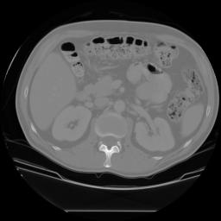
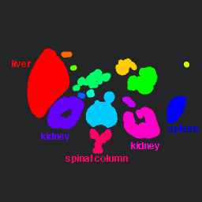


Labeling shown as Pseudo-Color
connected
components
of 1’s from
thresholded
image
connected
components
of cluster
labels

Slide 21
Mathematical Morphology
Binary mathematical morphology consists of two
basic operations
dilation and erosion
and several composite relations
closing and opening
conditional dilation
. . .

Slide 22
Dilation
Dilation expands the connected sets of 1s of a binary image.
It can be used for
1. growing features
2. filling holes and gaps

Slide 23
Erosion
Erosion shrinks the connected sets of 1s of a binary image.
It can be used for
1. shrinking features
2. Removing bridges, branches and small protrusions

Slide 24
Structuring Elements
A structuring element is a shape mask used in
the basic morphological operations.
They can be any shape and size that is
digitally representable, and each has an origin.
box
hexagon
disk
something
box(length,width) disk(diameter)

Slide 25
Dilation with Structuring Elements
The arguments to dilation and erosion are
a binary image B
a structuring element S
dilate(B,S) takes binary image B, places the origin
of structuring element S over each 1-pixel, and ORs
the structuring element S into the output image at
the corresponding position.
0 0 0 0
0 1 1 0
0 0 0 0
dilate
0 1 1 0
0 1 1 1
0 0 0 0
1
1 1
S
B
origin
B ⊕ S

Slide 26
Erosion with Structuring Elements
erode(B,S) takes a binary image B, places the origin
of structuring element S over every pixel position, and
ORs a binary 1 into that position of the output image only if
every position of S (with a 1) covers a 1 in B.
origin
0 0 1 1 0
0 0 1 1 0
0 0 1 1 0
1 1 1 1 1
0 0 0 0 0
0 0 1 1 0
0 0 1 1 0
0 0 0 0 0
1
1
1
erode
B
S
B S

Slide 27
Example 1 to Try
0 0 1 0 0 1 0 0
0 0 1 1 1 1 1 0
1 1 1 1 1 1 0 0
1 1 1 1 1 1 1 1
0 0 1 1 1 1 0 0
0 0 1 1 1 1 0 0
0 0 1 1 1 1 0 0
S
B
1 1 1
1 1 1
1 1 1
erode
dilate with same
structuring element

Slide 28
Example 2 to Try
B
0 0 0 0 0 0 0 0 0 0 1 0 0 0 0 0 0 0 0 0 0
0 0 0 0 0 0 0 0 0 1 1 1 0 0 0 0 0 0 0 0 0
0 0 0 0 0 0 0 0 1 1 1 1 1 0 0 0 0 0 0 0 0
0 0 0 0 0 0 0 1 1 1 1 1 1 1 0 0 0 0 0 0 0
0 0 0 0 0 0 1 1 1 1 1 1 1 1 1 0 0 0 0 0 0
0 0 0 0 0 1 1 1 1 1 1 1 1 1 1 1 0 0 0 0 0
0 0 0 0 1 1 1 1 1 1 1 1 1 1 1 1 1 0 0 0 0
0 0 0 1 1 1 1 1 1 1 1 1 1 1 1 1 1 1 0 0 0
0 0 1 1 1 1 1 1 1 1 1 1 1 1 1 1 1 1 1 0 0
0 1 1 1 1 1 1 1 1 1 1 1 1 1 1 1 1 1 1 1 0
1 1 1 1 1 1 1 1 1 1 1 1 1 1 1 1 1 1 1 1 1
S
0 1 1 1 0
1 1 1 1 1
1 1 1 1 1
1 1 1 1 1
0 1 1 1 0
First erode and then dilate with the same S.

Slide 29
Opening and Closing
Closing is the compound operation of dilation followed
by erosion (with the same structuring element)
Opening is the compound operation of erosion followed
by dilation (with the same structuring element)

Slide 30
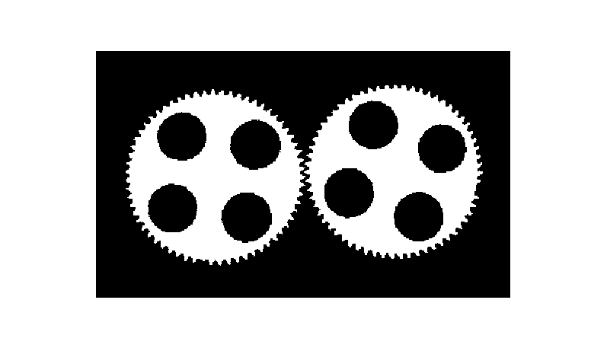
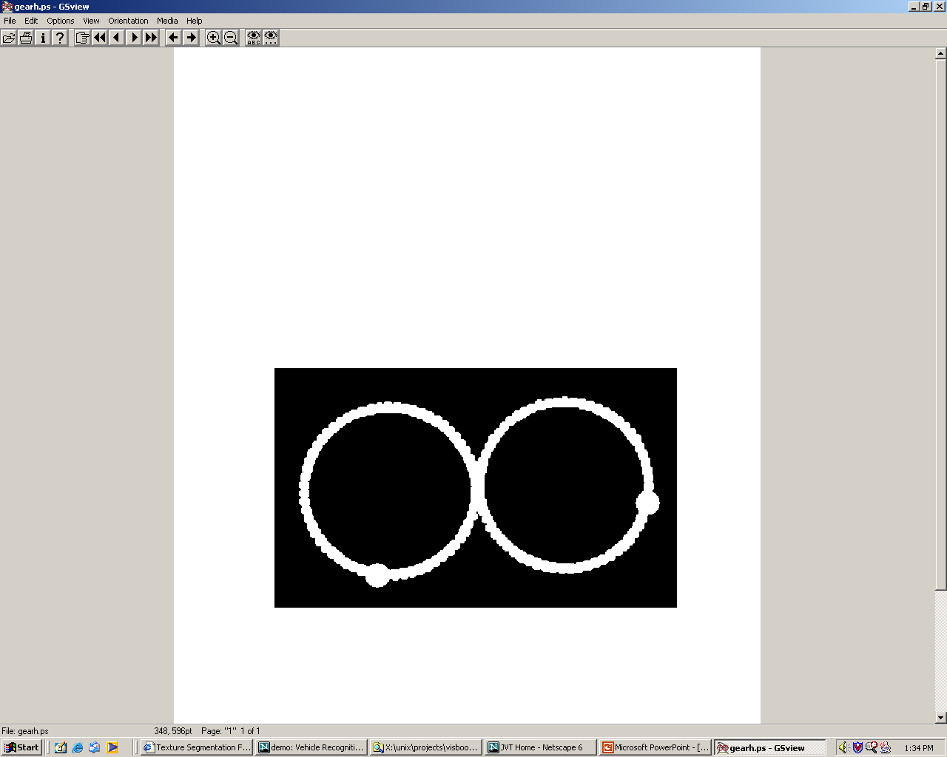
Gear Tooth Inspection
original
binary
image
How did
they do it?
detected
defects

Slide 31
Region Properties
Properties of the regions can be used to recognize objects.
geometric properties (Ch 3)
gray-tone properties
color properties
texture properties
shape properties (a few in Ch 3)
motion properties
relationship properties (1 in Ch 3)

Slide 32
Geometric and Shape Properties
area
centroid
perimeter
perimeter length
circularity
elongation
mean and standard deviation of radial distance
bounding box
extremal axis length from bounding box
second order moments (row, column, mixed)
lengths and orientations of axes of best-fit ellipse
Which are statistical? Which are structural?

Slide 33
Region Adjacency Graph
A region adjacency graph (RAG) is a graph in which
each node represents a region of the image and an edge
connects two nodes if the regions are adjacent.
This is jumping ahead a little bit.
We’ll consider this further for structural image analysis.

