Slide 1

Does Charlotte have an affordable housing
problem?
Andrew Tobin,
Hannah Cranford,
Zach Cohen,
Theresa Myers

Slide 2
Motivation & Introduction
Affordability in the Charlotte area affects everyone here!
Wanted to see current housing and rental statistics.
Wanted to know more about income data.
Wanted to understand poverty and homelessness numbers as well as recent trends.
AND OFCOURSE, what relationship do all of these thing have if any.

Slide 3
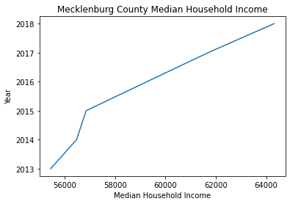
Mecklenburg County Median Household Income
g
General Income Findings:
2013 Median Household Income: $55,444
2018 Median Household Income: $64,312
5 Year Period Difference: Increase of $8,868 or approximately 16%
General Inflation Findings:
Average yearly inflation increase: 1.52%
Total period inflation increase: 7.84%

Slide 4
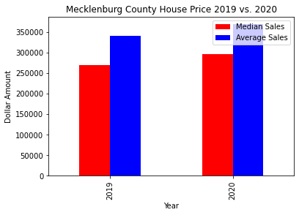

Mecklenburg County Average and Median House Values
g
General Findings:
2019 Average Sales Price: $340,669
2019 Median Sales Price: $270,000
2020 Average Sales Price: $369,055
2020 Median Sales Price: $295,900
YOY Differences:
Average Sales Price: $28,386 or
approximately 8.5% increase
Median Sales Price: $25,900 or
approximately 9.6% increase

Slide 5
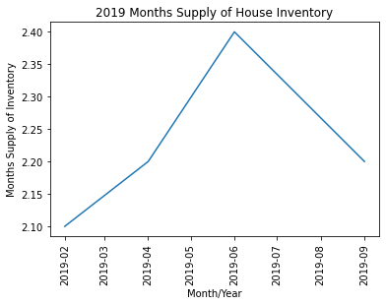
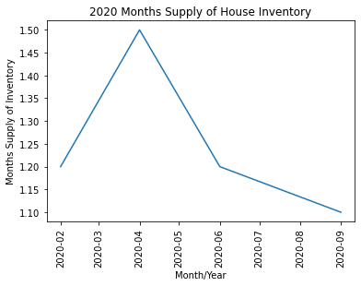
Mecklenburg County Housing Availability
g

Slide 6
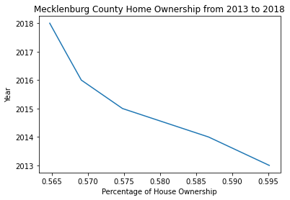
Mecklenburg County Home Ownership
g

Slide 7
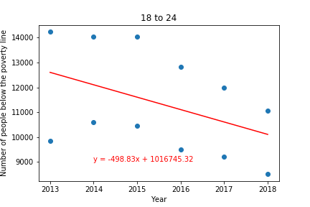
Poverty in Mecklenburg County
Data from datausa.io
Had to take out some age groups during the cleaning process
Data points represent all males or females under the poverty line for the given year

Slide 8
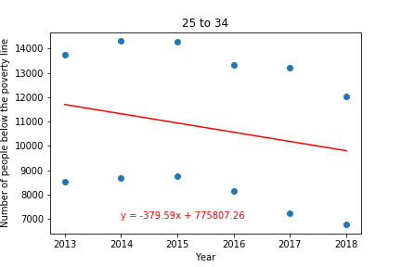
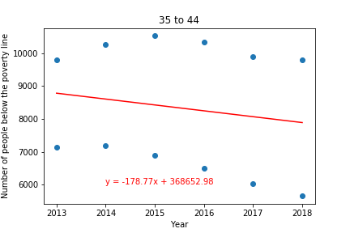
Poverty in Mecklenburg County

Slide 9
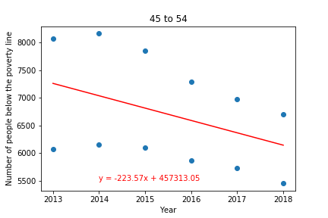
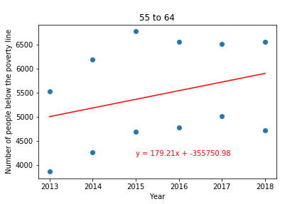
Poverty in Mecklenburg County

Slide 10
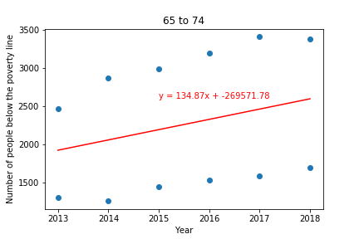
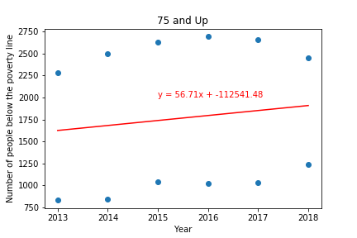
Poverty in Mecklenburg County

Slide 11
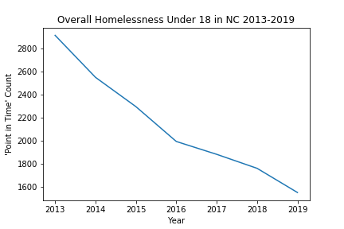
Homelessness in North Carolina
Under 18 years of age

Slide 12
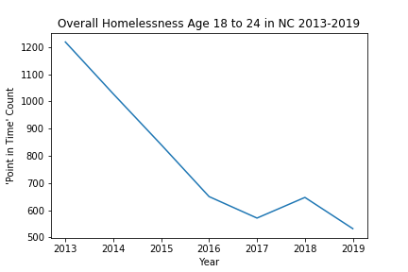
Homelessness & Poverty in NC
Individuals 18 to 24
Total Poverty -

Slide 13
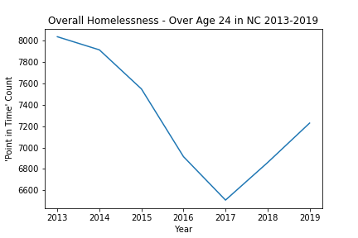
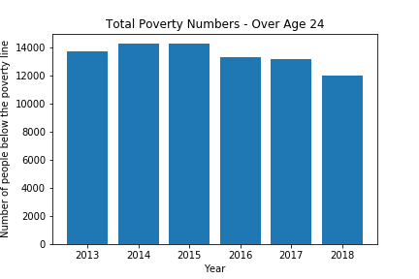
Homelessness & Poverty in NC Individuals over 24

Slide 14
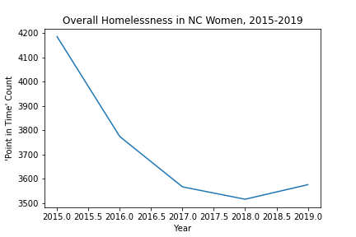
Homelessness in North Carolina
In Women 2015 - 2019

Slide 15
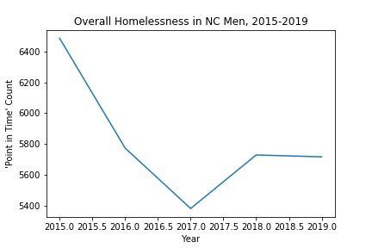
Homelessness in North Carolina
In Men (2015 - 2019)

Slide 16
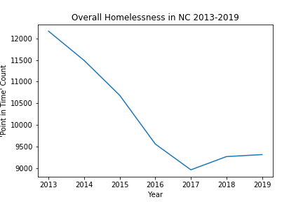
Homelessness Overall -
North Carolina

Slide 17
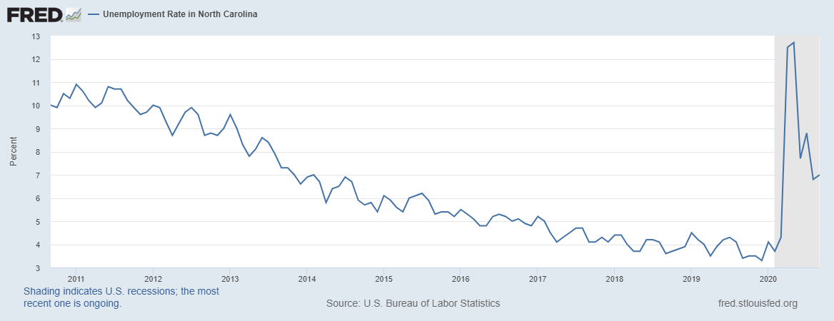
Unemployment Rate in North Carolina
2011 - 2019

Slide 18
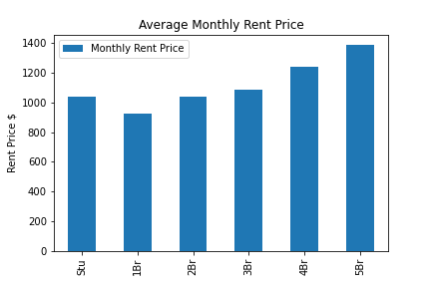
Rental Prices in Mecklenburg County
Average price, by Month
Studio: $1,040
1 Bedroom: $926
2 Bedroom: $1,039
3 Bedroom: $1,085
4 Bedroom: $1,238
5 Bedroom: $1,388
Overall, Monthly Prices increase as Bedrooms increase

Slide 19
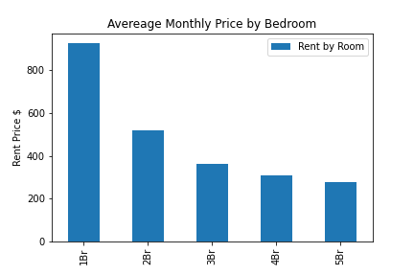
Rental Prices in Mecklenburg County
Average price per Month by Room
Studio: $1,040
1 Bedroom: $926
2 Bedroom: $519
3 Bedroom: $362
4 Bedroom: $310
5 Bedroom: $278
Overall, Monthly Prices decrease as Bedrooms increase

Slide 20
Conclusion
The price of home ownership has increased WHILE home ownership itself has decreased.
Median Income in comparison to average home sales price would lead one to think that a majority of people cannot afford charlotte housing.
The homelessness data on the other hand, shows a sharp decline from 2013 to 2017. One could assume, while home ownership may not be attainable, rental pricing is.
Based on our data, poverty numbers for those 55 and older have seen an increase from 2013-2018 while poverty numbers for those 54 and younger have decreased. Ultimately, it appears homelessness and poverty have decreased based on our data of age subsets.
Based on overall average income, Mecklenburg County has affordable rental properties at a high level

Slide 21

Thanks!
Are there any questions?

