Slide 1
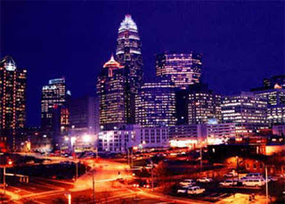
Is Charlotte Affordable?
Andrew Tobin, Hannah Cranford, Zach Cohen, Theresa Myers

