Slide 1


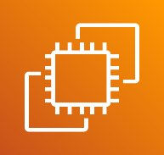









AWS Cloud
Amazon Virtual Private Cloud (Amazon VPC)
Region Seoul
Amazon Elastic Compute Cloud (Amazon EC2)
VPC
Private subnet
Data(was)
Private subnet
inside
Public subnet
homepage
Private subnet
DB

