Slide 1

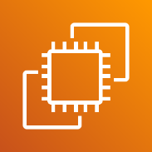
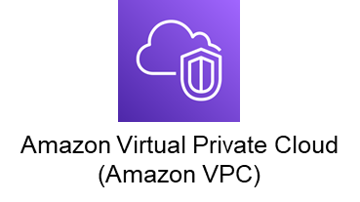

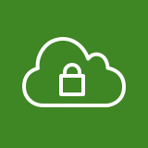







AWS Cloud
Region Seoul
Amazon Elastic Compute Cloud (Amazon EC2)
VPC Web
10.0.0.0/24
VPC WAS
10.0.1.0/24
Public subnet
Private subnet

