Slide 1

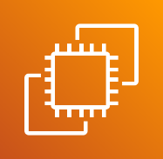


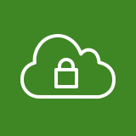


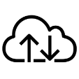




AWS Cloud
Region Seoul
Amazon Elastic Compute Cloud (Amazon EC2)
Amazon Virtual Private Cloud (Amazon VPC)
VPC
Private subnet
API
10.0.2.0/24
Private subnet
DB Cluster
10.0.0.0/24
Public subnet
Web
10.0.4.0/24
Private subnet
DB
10.0.1.0/24
Private subnet
WAS
10.0.3.0/24

