Slide 1




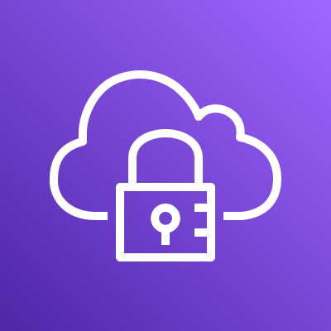






























AWS Cloud
Region
VPC
Private subnet
WAS
Private subnet
API
Public subnet
Web1
Auto Scaling group
Auto Scaling group
Public subnet
Web2
Security group
Security group
Private subnet
Web
Auto Scaling group
Security group
Private subnet
Baston
Private subnet
DB1
Private subnet
DB2
Private subnet
DB3
Security group
Security group
Security group
Security group
Availability Zone
Availability Zone

