Slide 1



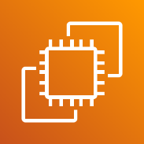


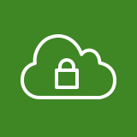










AWS Cloud
Region Seoul
VPC Web
10.0.0.0/23
VPC WAS
10.0.2.0/24
VPC DB
10.0.4.0/23
Security group
Security group
Public subnet
10.0.0.0/24
Security group
Private subnet
Private subnet
10.0.4.0/24
Auto Scaling group
Auto Scaling group
Private subnet
10.0.5.0/24
Public subnet
10.0.1.0/24

