Slide 1
Keywords Search on Relational Database
Project No: #32
Reporter: Jiahui Zhao
Supervisor: Dr. Jerry Liu

Slide 2
Background
Relational databases are used more and more, not well on info discovery
Keywords search is the most popular information discovery method
Such as, Google, Facebook
Notes:
With the amount of relational databases are used in all walks of life, a huge amount of information is stored in relational databases, but information discovery on relational databases is not well supported. Even though the major RDBMSs have provided full-text search capabilities, the problem is that they still require users to have knowledge of the database schemas and use a structured query language to search information.
Keywords search is the most popular information discovery method now, such as people using keywords search on Google, Facebook. Because of using keywords search the user does not need to know either a query language or the underlying structure of the data.

Slide 3
Motivation
Searching methods on full-text of relational database in market now
Oracle Text on Oracle: need to write SQL query
Elastic-Search on H-Base: have its own language, and need to write its own query
Only some professional person can do the searching
This project is a direct attempt of keywords search on relational database, built on H-Base which is preferred storage system and without using Elastic Search
Do not need to write query, just input some keywords
Do not need to know the schema of relational database
Can be used to do the searching for everyone

Slide 4
Requests
Request Name | Request No. | Request Date | Current Status
Multiple keywords search with ‘and’ relation | 2.1 | 06/09/2016 | Completed at every version
Multiple keywords search with ‘or’ relation | 2.2 | 06/09/2016 | Completed at every version
Result in table | 4.1 | 18/09/2016 | Completed at version 1
Configuration file | 10.1 | 10/10/2016 | Completed at version 2 & 3
Export result into file | 10.2 | 10/10/2016 | Completed at version 3
ID column number auto catch | 11.1 | 17/10/2016 | Completed at version 3

Slide 5
Solution
Keywords Search Engine (KSE) : multiple keywords with relations search
100% satisfy the requests from the client
Do not need to know the schema of database
Do not need to have query skills
Reduce searching time cost
Reduce searching engine cost

Slide 6
Scope
Limited to search on text of relational database such as number, dates, string
Relational database should has index column by itself.
Specify the index column name in configure file.
Relational database needs to have trigger to recording any changes if using the auto update function.

Slide 7
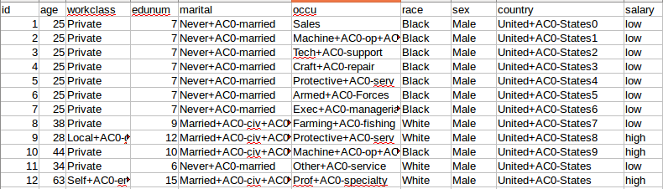
Index
KSE hash each cell into Key-Value pairs of H-Base as key
The key column is the index of H-Base
The ID as value stored in column name
The column store a empty string, no timestamp conflict
Notes:
The main request of my client is

Slide 8
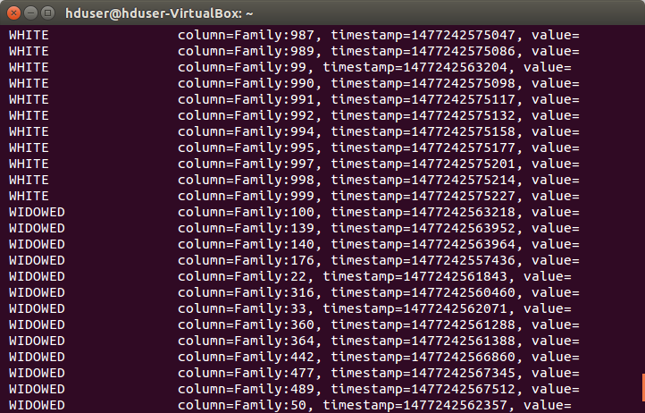
Index example
Notes:
The main request of my client is

Slide 9
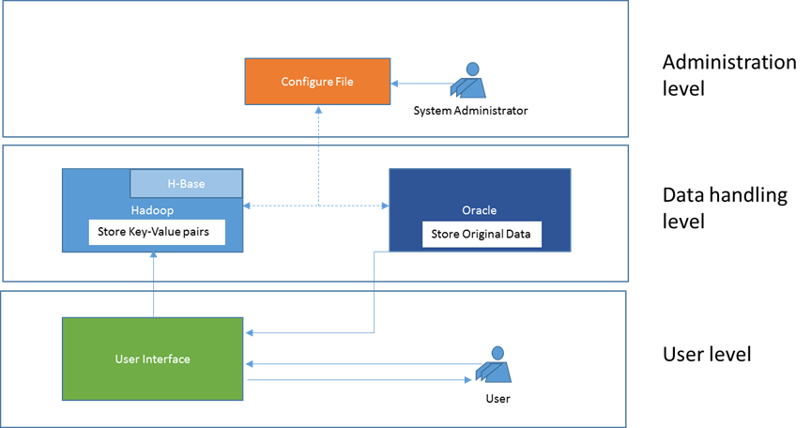
Construction
Notes:
The user level is a visual level which has an interface to users to input the keywords, display result and other operation buttons such as menu button, navigation buttons and export button.
The data handling level is background processing level which search the keywords from H-Base and SQL query generator to search with returned ID on relational database.
The administration level is an assistance level, this level has an external configure file which has the information to support the KSE initial and update H-Base

Slide 10
Challenge
Setup Hadoop and H-Base environment
Reinstall Linux operating system more than 10 times
Paged result and navigation for easy reading
Reset the result when reselect row number per page
Last page no empty cell if not full
Highlight the keywords in result

Slide 11
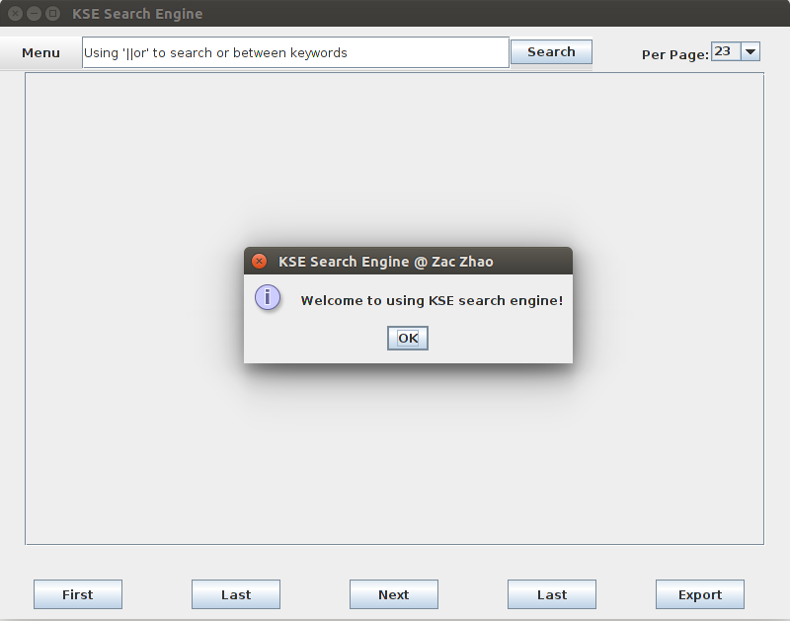

KSE

Slide 12
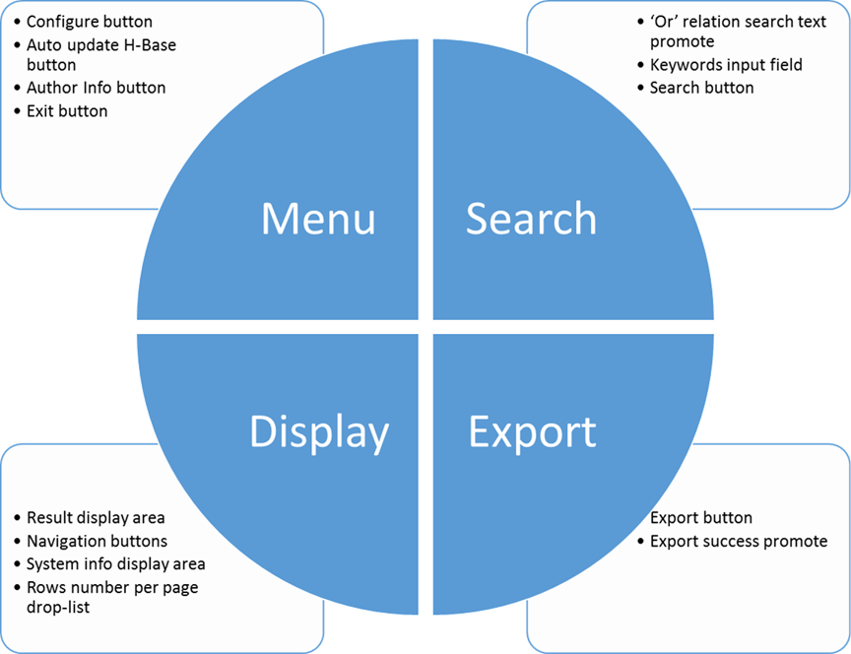
Functions and Components

Slide 13
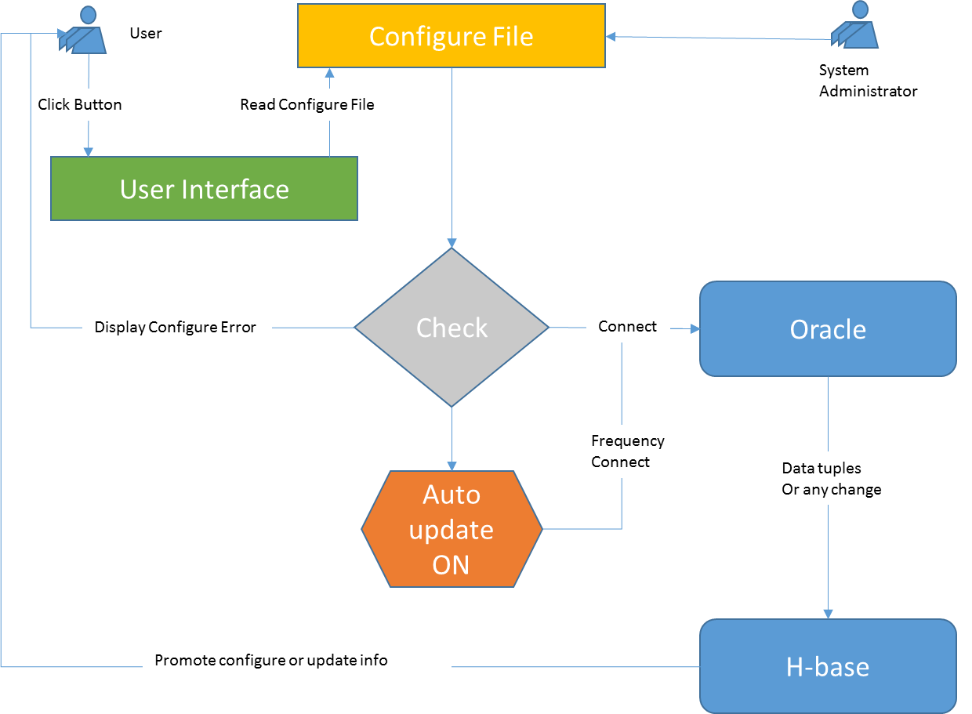
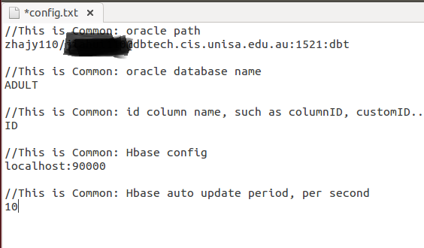
Configure File and Auto Update

Slide 14
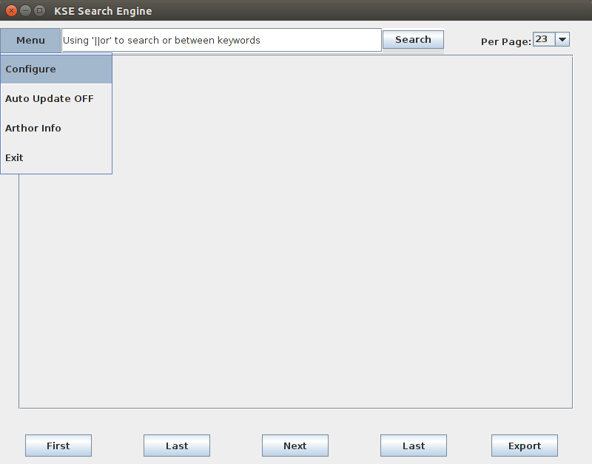
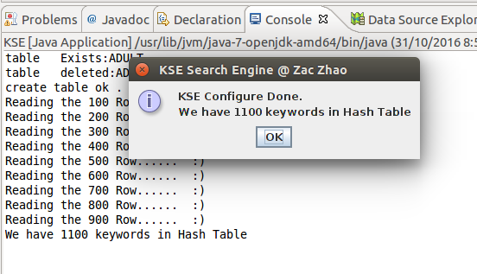
Configure

Slide 15
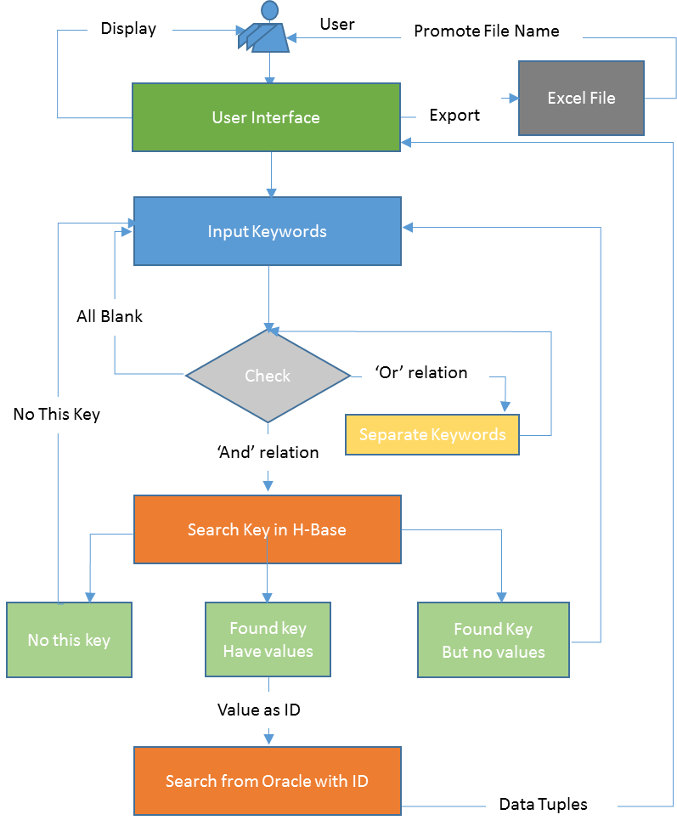
Keywords Search

Slide 16
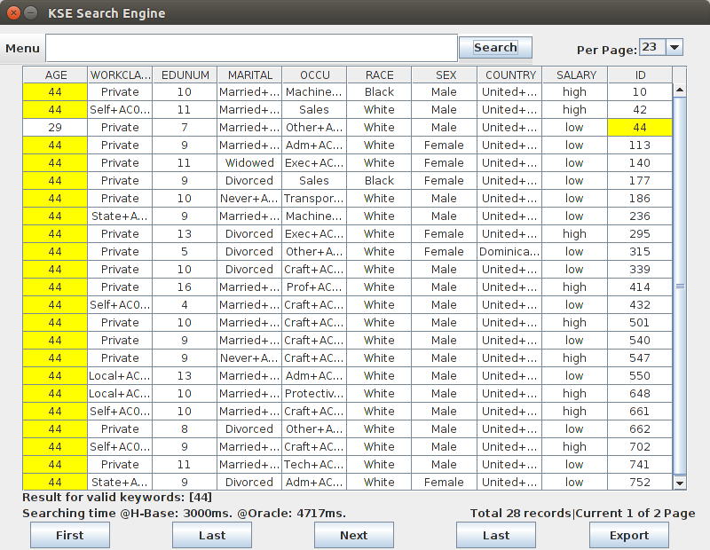
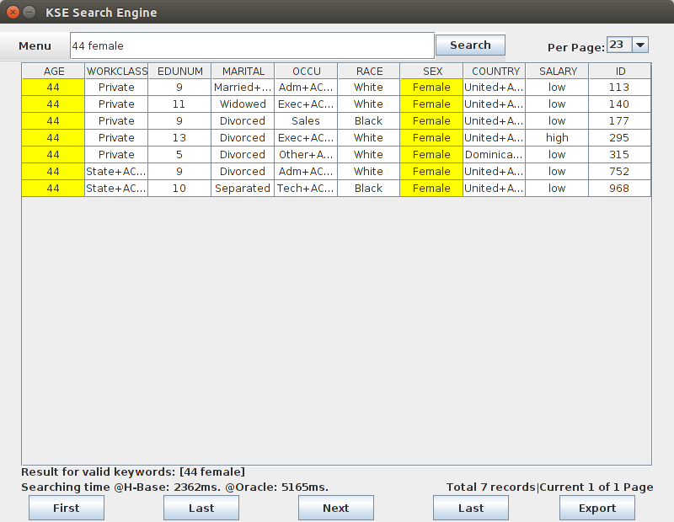
Search single, with ‘AND’ relation

Slide 17
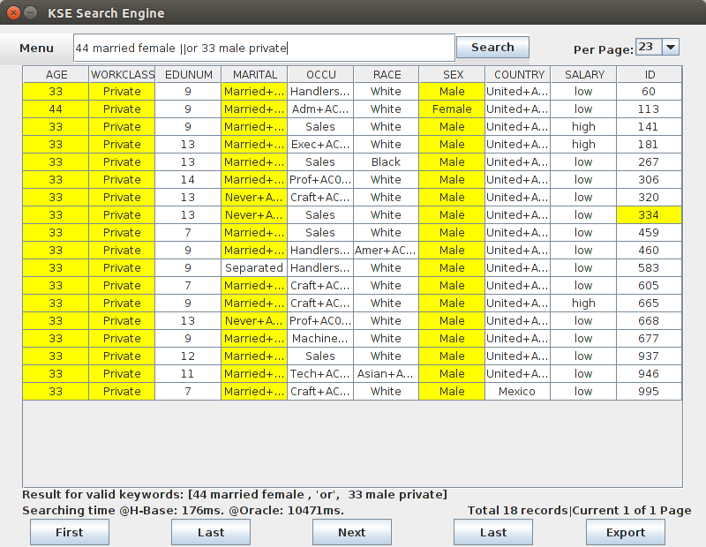
Search ‘AND’ + ‘OR’

Slide 18
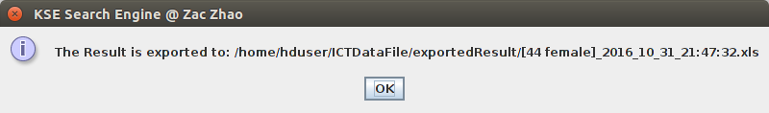

Export

Slide 19
Demonstration and Questions
KSE is open-source project,
Everyone can using the code or improve the function as they need.
Any questions can send email to :
zhajy110@mymail.unisa.edu.au

Slide 20

End
Notes:
Although there was some challenge and difficulties when I implemented the KSE, I learned a lot of new skills and got some real project management experiences from this. Thanks my academic supervisor Dr. Liu , and the ITMS project team let me have this opportunity. I really enjoy it. Thanks everyone to attend my presentation.

